Slide 1


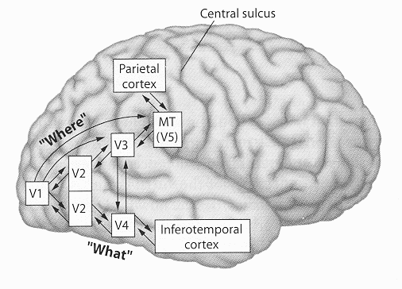
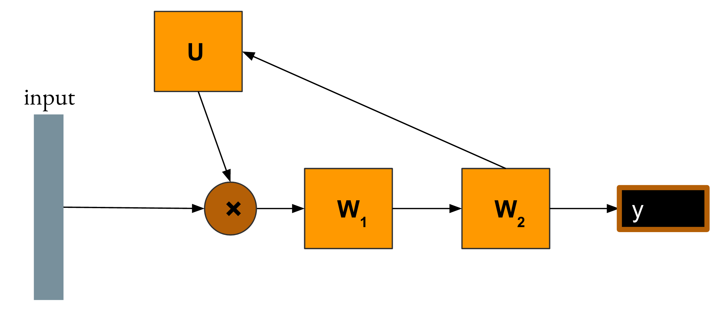
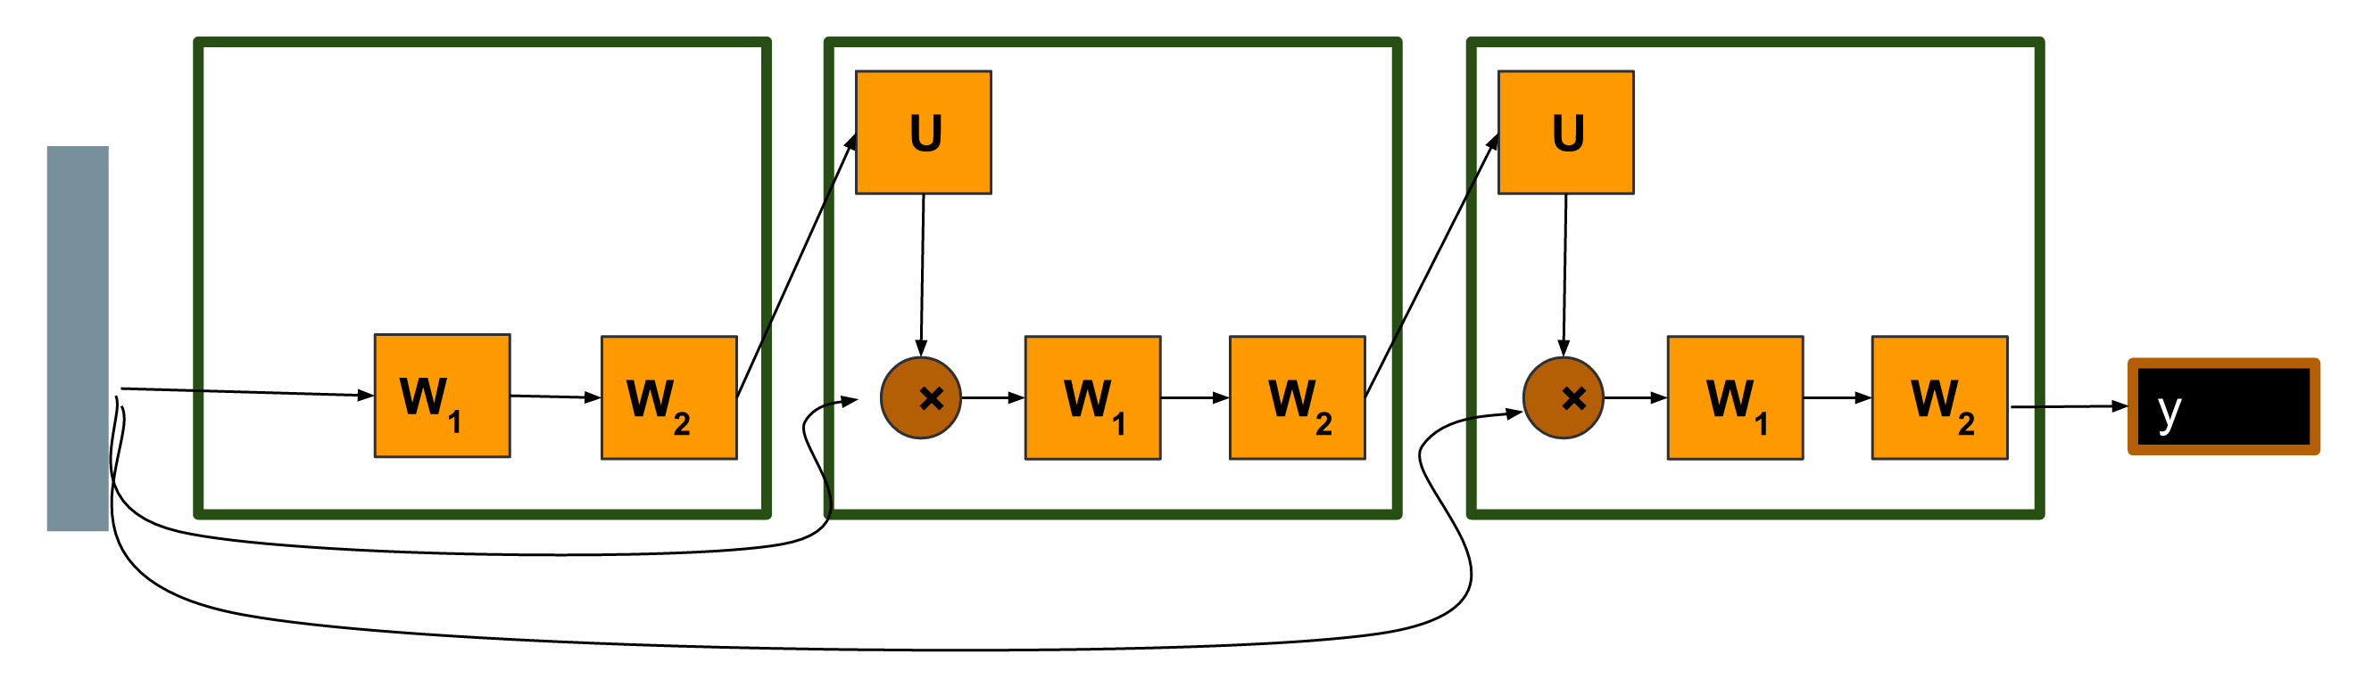
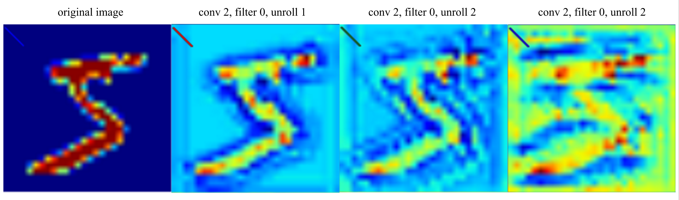
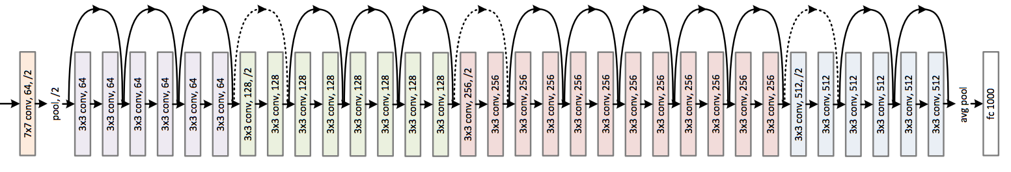

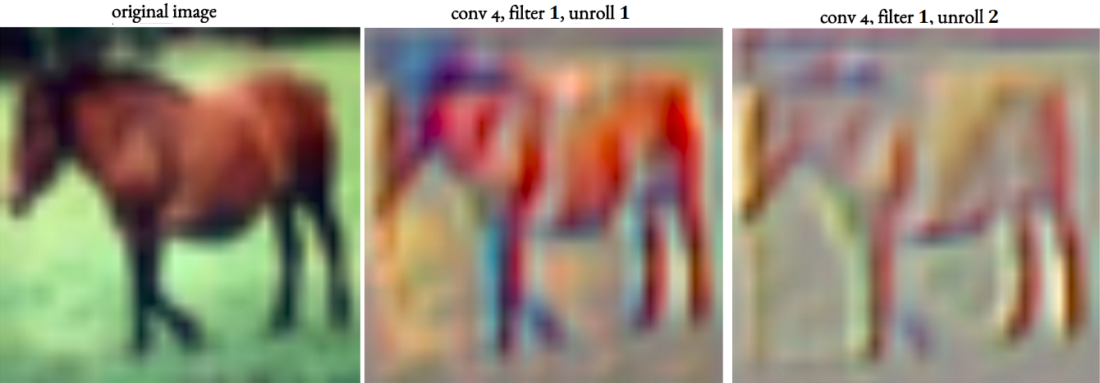
Loopy Neural Nets
- Imitating Feedback Loops In The Human Brain -
Isaac Caswell, Lisa Wang, Chuanqi Shen
Motivation
Biomimicry: Artificial neural networks are directed acyclic graphs (DAGs), but the network of neurons in our brains, in particular the two main visual object recognition systems (“what” and “where” pathways), contain many feedback loops. [1] We propose loopy neural networks (LNN) as a more faithful mimicry of actual neural net.
Practical: We are interested in exploring whether LNNs with fewer layers can perform as well, if not better than, deep networks. If true, then LNNs can become a more compact alternative when training neural net models.
Loopy Neural Net Architecture
We propose a new model of loopy neural networks that mimics the cyclic structures in the human brain by augmenting conventional neural networks with "loops" that allow information from deeper layers to be fed to the earlier layers. The loops can also contain parameters themselves, which we will refer to as “loop layers.”
Results on CIFAR-10
Introducing unrolls results in significantly better accuracy, implying that LNNs are more expressive models. Contrary to our expectation, the deep model performed much worse than the loopy model. This could be due to vanishing gradients.
Semantics: the output of U is a layer that weights the importance of each input feature, given that we know what the higher level features produced by W1 are.
U allows us to learn the relation between these higher and lower level features.
Example LNN with 1 loop
Visualizations
To explore how loops influence the learning process of the networks, we used guided backpropagation to visualize the filters at different stages of unrolling.
MNIST: Increasing the number of unrolls resulted in more non-linear reactions, a behaviour characteristic of deep layers, from the shallow layers of LNN.
CIFAR-10: Unrolls allowed shallower layers to find features (a characteristic of deep layers) in the image.
Related Existing Architectures
RNNs: Unrolling of loopy net similar to unrolling RNN. However, input only fed into first layer for loopy net, not at different time steps.
ResNet: Unrolled addition loops can be interpreted as skip connections.
Attention Networks: digest input, loop layer tells you where to attend, digest again. [EDIT]
Recurrent CNNs for Scene Labeling: Apply CNN multiple times to refine labels recursively. [CITE]
Example LNN unrolled 3 times
Models
1. Model Vanilla (5 convolutional layers, no loops):
input → {conv} X 5 → fc
2. Model Loopy (Model Vanilla with 1 sum loop around all 5 convolutional layers and unrolled 5 times):
input → {conv} X 5 → fc
3. Model Deep (25 convolutional layers and no loops, imitating the depth of the unrolled Model Loopy):
input → {conv} X 25 → fc
[1] M. A. Goodale and A. D. Milner. Separate visual pathways for perception and action. Trends in neurosciences, 15(1):20–25, 1992.
[2] Pinheiro and Collobert. Recurrent Convolutional Neural Networks for Scene Labeling, ICML 2014.

