Slide 1


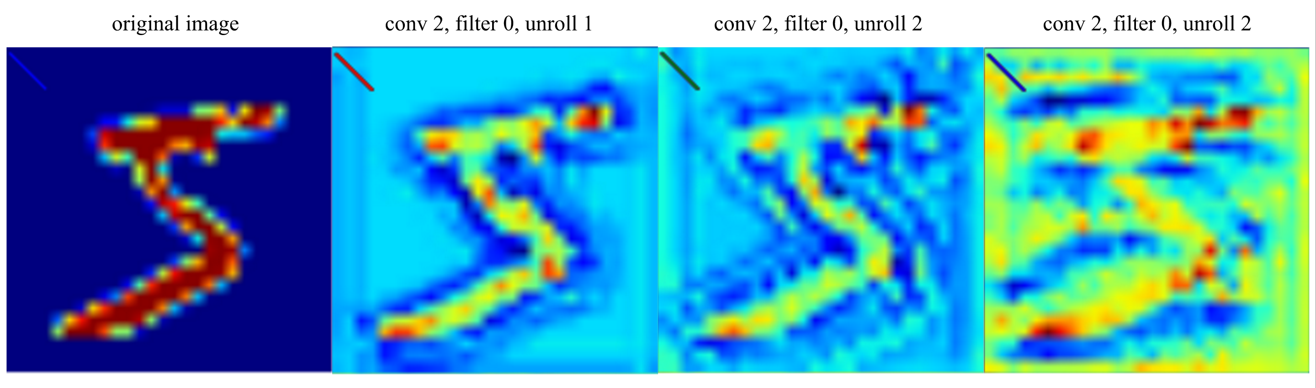
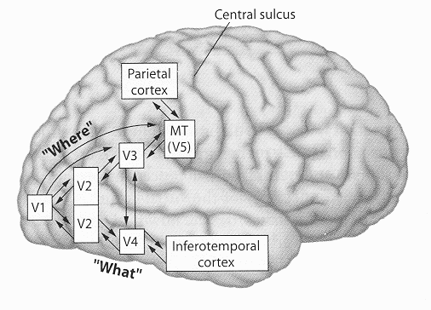
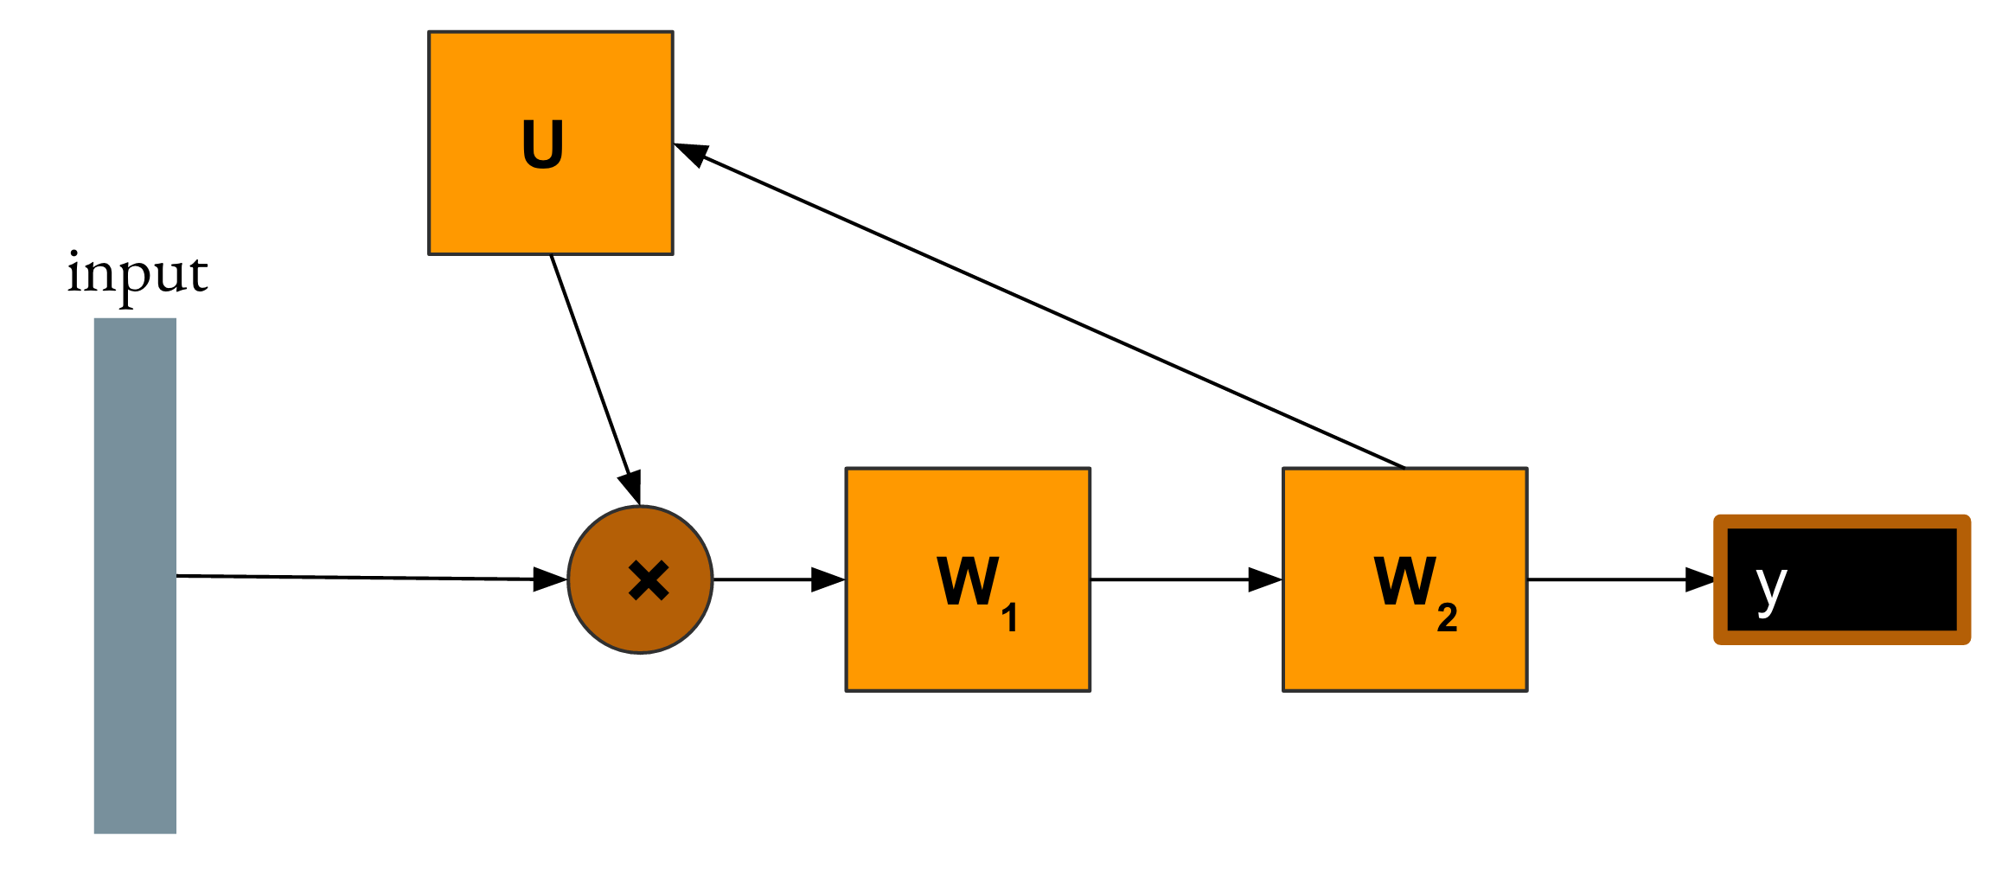
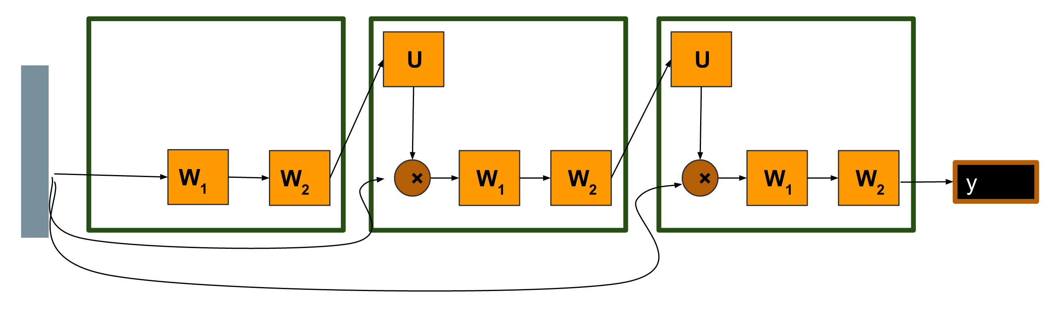

Loopy Neural Nets
- Imitating Feedback Loops In The Human Brain -
Isaac Caswell, Lisa Wang, Chuanqi Shen
{icaswell, lisa1010, shencq}@stanford.edu
Motivation
Biomimicry: Artificial neural networks are directed acyclic graphs (DAGs), but the network of neurons in our brains including the two main visual object recognition systems (“what” and “where” pathways) contain many feedback loops. [CITE]
Practical: We are interested in exploring whether we can simulate deeper networks using fewer layers by looping through layers multiple times. This has the potential of saving memory and accelerating the training process since we would use fewer parameters.
Loopy Neural Net Architecture
We propose a new model of loopy neural networks that mimics the cyclic structures in the human brain by augmenting conventional neural networks with "loops" that allow information from deeper layers to be fed to the earlier layers. The loops can also contain parameters themselves, which we will refer to as “loop layers.”
Visualizations
To explore how loops influence the learning process of the networks, we used guided backpropagation to visualize the filters at different stages of unrolling.
Related Existing Architectures
RNNs: Unrolling of loopy net similar to unrolling RNN. However, input only fed into first layer for loopy net, not at different time steps.
ResNet: Unrolled addition loops can be interpreted as skip connections.
Attention Networks: digest input, loop layer tells you where to attend, digest again. [EDIT]
Recurrent CNNs for Scene Labeling: Apply CNN multiple times to refine labels recursively. [CITE]
Results
We ran our models on two standard computer vision data sets; MNIST and CIFAR-10.
Acknowledgements
We thank
References
Biomimicry: Artificial

