Slide 1
Test Strategy Initial Draft
Registration

Slide 2
Topics
Testing Scope
Agile Testing Guiding Principles
Test Pipeline
Quality Gates
Entrance and Exit Criteria
Defect Management
Test Data Strategy
Risks and Mitigation
Testing Roadmap
Testing Types
Reference

Slide 3

Testing Scope
Registration
Vehicle Management
Subscription
Account Management
Payment Processing

Slide 4
Agile Testing Guiding Principles
Principle | Description
Shared Responsibility | Everyone in the team is responsible for testing and quality assurance.
Test Automation | Tests (End-to-end, API, Database, functional, integration, regression, performance) will be automated. Manual testing will only be used for exploratory type testing and non automatable scenarios.
Test Management | Feature files, automation code, documents and data will be treated with the same importance as production code.

Slide 5
Testing Types
Types of Testing | Definition | Environment | Ownership | Tool/ Language
User Acceptance Testing | Acceptance Testing is a level of software testing where a system is tested for acceptability. The purpose of this test is to evaluate the system's compliance with the business requirements, assess whether it is acceptable for delivery and evaluate user experience. | Stage | Focus Group/ Stakeholder | Manual
Unit Testing | Unit Testing is a level of software testing where individual units/ components of a software are tested. The purpose is to validate that each unit of the software performs as designed. | Dev/QA/Stage | Dev | JUnit
Smoke Testing | Smoke tests are basic tests that check basic functionality of the application. They are meant to be quick to execute, and their goal is to give you the assurance that the major features of your system are working as expected. | Dev/QA/Stage | Dev | Curl
Security Testing | A code security test analyzes how code is written and how it interacts with other objects in an environment to identify weaknesses or flaws that would allow an attacker to gain unauthorized access to systems, databases, or account privileges they should not have. | Stage | QA | Veracode

Slide 6
Testing Types
Types of Testing | Definition | Environment | Ownership | Tool/ Language
Performance Testing | Performance tests check the behaviors of the system when it is under significant load. These tests are non-functional and can have the various form to understand the reliability, stability, and availability of the platform. | Perf | QA | JMeter
Penetration Testing | A penetration test, also known as a pen test, is a simulated cyber attack against your computer system to check for exploitable vulnerabilities. Pen testing can involve the attempted breaching of any number of application systems, (e.g., application protocol interfaces (APIs), frontend/backend servers) to uncover vulnerabilities, such as unsanitized inputs that are susceptible to code injection attacks. | Stage | QA/ Infosec | Manual
NAR Testing | The Network Application Readiness (NAR) analysis is used to assess how the Wireless Area Network (WAN) could affect user response times for an application and to find out how an application might impact the WAN and the performance of other applications sharing the network. | Stage | QA/ WAN team | Manual - evaluate options for cloud applications
Integration Testing | Integration tests verify that different modules or services used by your application work well together. For example, it can be testing the interaction with the database or making sure that microservices work together as expected. | QA/ Stage | QA | Cucumber Java

Slide 7
Testing Types
Types of Testing | Definition | Environment | Ownership | Tool/ Language
Functional Testing | Functional testing is a type of testing which verifies that each function of the software application operates in conformance with the requirement specification. This testing mainly involves black box testing and it is not concerned about the source code of the application. | Dev/ QA | Dev | Cucumber Java
End-to-end Testing | End-to-End Testing is a methodology used to test whether the flow of an application is performing as designed from start to finish. The purpose of carrying out end-to-end tests is to identify system dependencies and to ensure that the right information is passed between various system components and systems. | QA/ Stage | QA | Cucumber Java
Contract Testing | A component test limits the scope of the exercised software to a portion of the system under test, manipulating the system through internal code interfaces and using test doubles to isolate the code under test from other components. Validation between provider and consumer to ensure that there is a proper interaction between both entities and the terms of the contract are fulfilled. | Dev | Dev | PACT

Slide 8

Testing Pipeline
Develop Feature
Deployment to Dev
Deployment to QA
Deployment to Perf
Deployment to Stage
Deployment to Prod
Build
UNIT testing
Junit
Smoke Testing
Connectivity
Smoke
Testing
Connectivity
Smoke Testing
Connectivity
Smoke Testing
Connectivity
Smoke Testing
Connectivity
LOCAL ENVIRONMENT
DEV ENVIRONMENT
QA ENVIRONMENT
PERF ENVIRONMENT
STAGE ENVIRONMENT
PRODUCTION
ACCEPTANCE +
INTEGRATION
Automation
REGRESSION
Automation
END TO END Testing
Automation/ Manual/ Simulators
Production Validation Automation/ Manual
Performance Testing
Automation
Approval to Deployment to PROD Environment
Automated deployment to Dev Environment
Automated deployment to QA Environment
Automated deployment to Stage Environment
Build
Docker Build & Deploy
Automated deployment to Perf Environment
SANITY TEST
API
REGRESSION
Automation
External Stake holder Acceptance
Manual
Disaster Recovery Testing
DevOps
END TO END Testing
Automation/ Manual/ Simulators
Pass
Pass
Pass
Pass
PEN Testing
InfoSec
Pass
Pass
Push
Image to artifactory
END TO END Testing
Automation/ Manual/ Simulators
SECURITY
Veracode
Go Live
Fail
Fail
Fail
Fail
NAR
Fail
Escaping Defect review and mitigation
Sprint DevOps cycle
Pre-Deployment window
Deployment

Slide 9
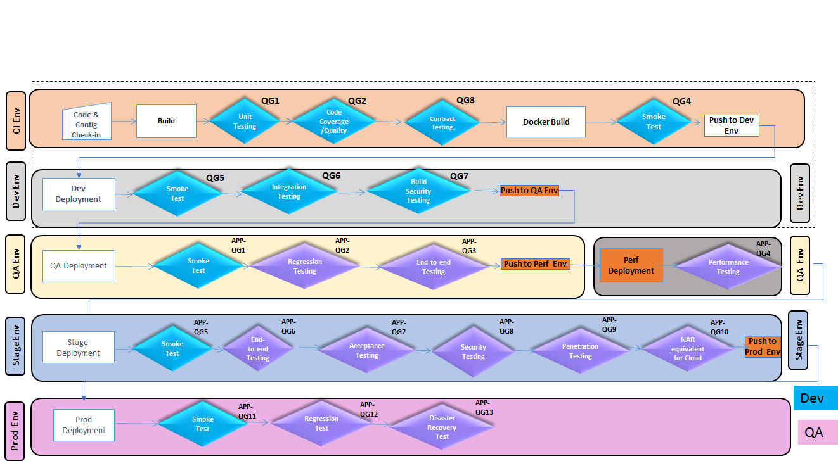
Quality Gates

Slide 10
Quality Gates
Quality Gate | Testing Type | Scope - What will be Tested? | Trigger | Environment | Data | Tools | Success/Exit Criteria | Frequency | Ownership | Comments
1 | Unit Testing | Testing the smallest piece of testable code (Typically Individual Methods within the Class) | CI/CD Pipeline (Semaphore) | Local | Mock Data | JUnit (Unit Testing Framework) |  | Code check-in | Scrum Team
2 | Code Coverage & Quality Analysis | Check for the Unit Test Coverage (Code Coverage) & Quality Analysis for Violations in the code | CI/CD Pipeline (Semaphore) | Dev | N/A | SonarQube | Code Coverage should be > 70% & code quality) | Code check-in | Scrum Team
3 | Sanity Testing | Test the new features are working successfully by doing a sanity test | CI/CD Pipeline (Semaphore) | Local/ Dev/QA/Stage/Prod | N/A | Rest Assured, Newman, Curl |  | Code deployed to new environemnt | Scrum Team | Sanity Test by hitting the /health rest end point to ensure proper startup of the MS via Docker Image
4 | Regression | Testing the impacted functionality and to make sure it did not break any other feature | CI/CD Pipeline (Semaphore) | Dev |  | BDD Cucumber JVM/ Java-REST Assured, Newman | Execution Rate = 100% Pass Rate > 90% | Dev to QA | Scrum Team
5 | Integration & End-to-end testing | Testing the feature as a whole (Including the external systems and interfaces like DB, System of Records, Middleware and/or other MS) | CI/CD Pipeline (Semaphore) | Dev |  | BDD Cucumber JVM/ Java-REST Assured, Newman | Execution Rate = 100% Pass Rate > 80% | Dev to QA | Scrum Team
6 | Regression | Testing the feature so that changes did not impact the functionality | CI/CD Pipeline (Semaphore) | QA |  | BDD Cucumber JVM | Execution Rate = 100% Pass Rate > 80% | Dev to QA | Team
7 | Security | Perform security scan of the code to test vulnerabilities |  | QA |  | Veracode | No issues,… | End of each sprint | Team
8 | End to end | Testing the end to end business flows from the UI and device |  | QA/ Stage |  | BDD Cucumber JVM/ Manual | Execution Rate = 100% Pass Rate > 80% | Dev to QA | Team
9 | Performance Testing | To compare the response time of the feature against the previous execution statistics, SLAs, Uptime verification, rendering time of API/ UI, System availability and other non functionality requirements |  | Perf |  | JMeter/ Blazemeter | SLAs? Response time | Every sprint | Team
10 | End to end | Testing the end to end business flows from the UI and device |  | Stage |  | BDD Cucumber JVM/ Manual | Execution Rate = 100% Pass Rate > 80% | QA to Stage | Team
11 | External Stake Holder Acceptance | Final stage in the testing process before the system is accepted for production use testing all the business requirements, flows |  | Stage | Mock | Manual | Accepted |  | External Stake holders
12 | NAR | Testing network connectivity |  | Stage |  | 3rd Party | No issues,… | Before code goes to production | WAN Team
13 | Pen Testing | Testing if there are any security vulnerabilities. |  | Stage |  | Veracode | No issues,… | Before code goes to production | Infosec
14 | Disaster Recover Testing |  |  | Production |  | Manual | No issues,… | Before code goes to production | Team with DevOps
15 | Production Validations |  |  | Production |  | BDD Cucumber JVM/ Manual |  |  | Team

Slide 11

Entrance and Exit Criteria
Entrance Criteria | Local | Dev | QA | Stage | Perf | Prod
Feature files reviewed and signed off
Code Complete
Stable Environment
Peer review done
Unit testing – all possible scenarios
Code coverage (sonar >70%)
Code quality
No known issues or defects
Connectivity with partner systems
Acceptance/ Integration Testing(>80% Pass)
Regression/End-to-end testing(>80% Pass)
External Stake Holder Acceptance
NAR
Pen Testing
Performance Testing
Disaster Recovery Testing
Exit Criteria
Test Execution complete and Pass rate is >80%
Defects are reviewed with PO/ team and no open issues
Test execution and defect status published in confluence and signed off

Slide 12
Defect Management
Defect Workflow
Defect Lifecycle
Developers
QA
Product Owner
Defect Triage calls will be scheduled by QA with stake holders as required

Slide 13
Test Data Strategy
Test Data | Process to obtain data | Timeline
Test VINs – 50 Lexus & 50 Toyota | TC will provide the VINs | Before integration testing commences
Email – SMTP Servers | Research options
IMEI | Research options for in-house tool

Slide 14
Risk and Mitigation
Risks | Mitigation
Delay in completing development and Unit testing will impact the subsequent testing phases. | Status and impediments will be discussed during daily stand up meetings.
Stable Dev/ QA/STAGE environment needs to be available during testing. | Testing timeline will be published to all the stakeholders in advance and this will be discussed during daily stand ups.
All defects need to be fixed in the same sprint in order to continue with the test execution and meet Sprint timelines. | This will be discussed and followed-up with the PO/ Scrum team during daily stand ups.

Slide 15
Reference
Testing Types:
https://confluence.sdlc.toyota.com/display/CTP/Testing+Types+-+Standards+for+Software+Delivery
API Testing:
https://confluence.sdlc.toyota.com/display/CTP/API+Automation+Testing+Tool+Comparison
UI Testing:
https://confluence.sdlc.toyota.com/display/CTP/Page+Object+Model+pattern+with+BDD+using+the+Java+Spring+Framework+Automation
Load and Performance Testing:
https://confluence.sdlc.toyota.com/pages/viewpage.action?pageId=107085901
Mobile Testing:
https://confluence.sdlc.toyota.com/pages/viewpage.action?pageId=111248765
Security Testing:
https://confluence.sdlc.toyota.com/display/CTP/Security+Testing+Tool+Comparison
Veracode:
https://confluence.sdlc.toyota.com/display/CTP/Guideline+-+IntelliJ+Plugin+from+Local+to+perform+Veracode+Scan
Penetration Testing:
https://confluence.sdlc.toyota.com/display/CTP/Penetration+Testing+-+How+To+Guidleine
NAR Testing:
https://confluence.sdlc.toyota.com/display/CTP/Network+Application+Readiness%28NAR%29+-+How+To+Guideline
Test Strategy:
https://confluence.sdlc.toyota.com/pages/viewpage.action?pageId=106340277

