Slide 1
Apica
Load Testing Tool

Slide 2
Agenda
What is Apica?
Load Testing & Synthetic Monitoring
Apica – Load Test architecture
Why Apica?
How it simplifies performance testing?
Overview of scripts and results
Questions

Slide 3
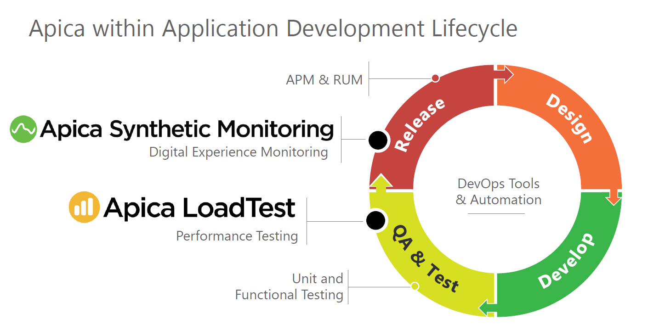
What is Apica?

Slide 4
Load Testing & Synthetic monitoring
Load Testing
Load testing is the process of putting simulated demand on software, system, application or website in a way that tests or demonstrates it's behavior under various conditions and measuring its response.
Synthetic monitoring
Monitoring that is done using a scripted recordings of transactions.
Transactions are then continuously monitored around the clock for performance, such as functionality, availability, response time.
Identify performance issues before they affect our customers.

Slide 5
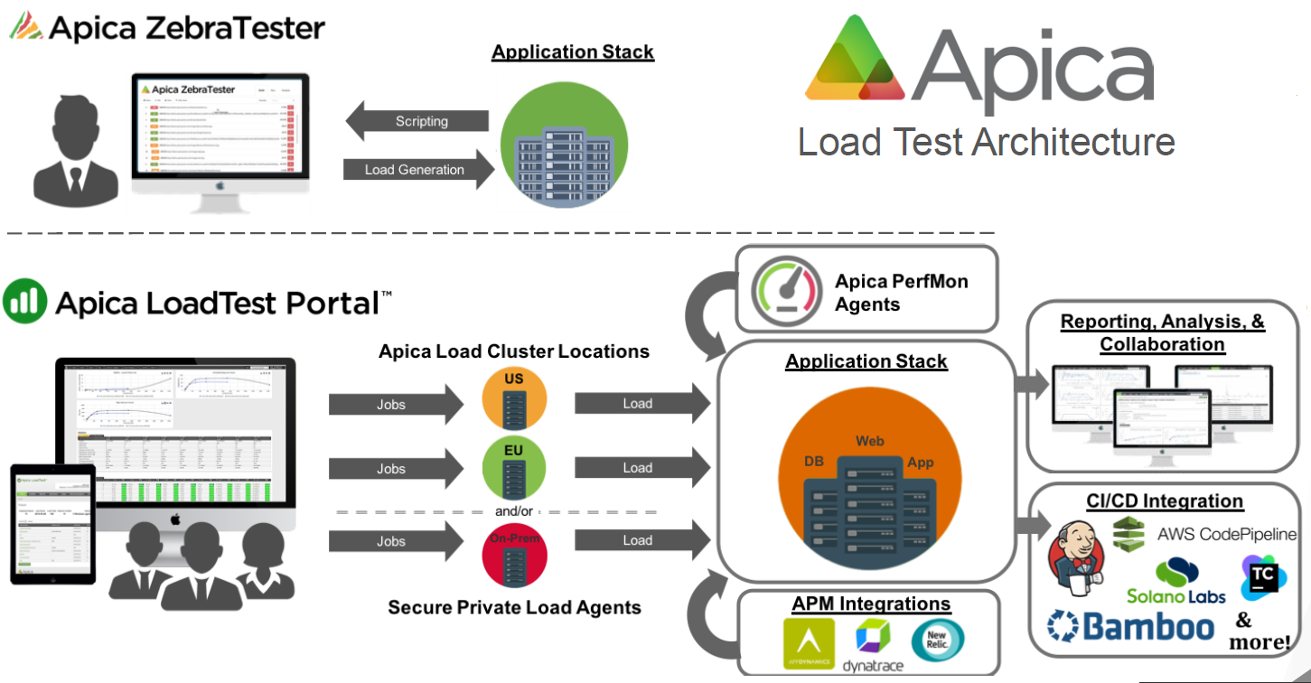
Apica Load Test Architecture
https://confluence.sdlc.toyota.com/display/CTP/Load+Testing+Tool+Comparison

Slide 6
Why Apica?
App Dynamic Integration
CI/CD integration
Connected Car technology support

Slide 7
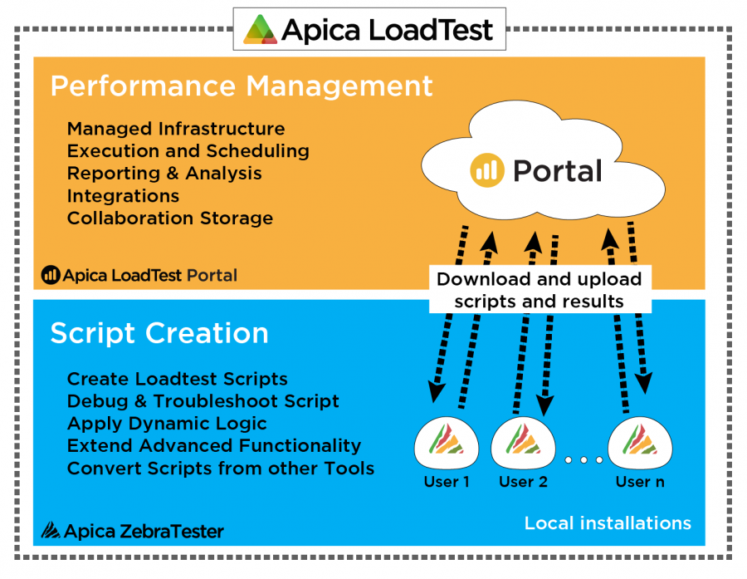
Apica Solution

Slide 8
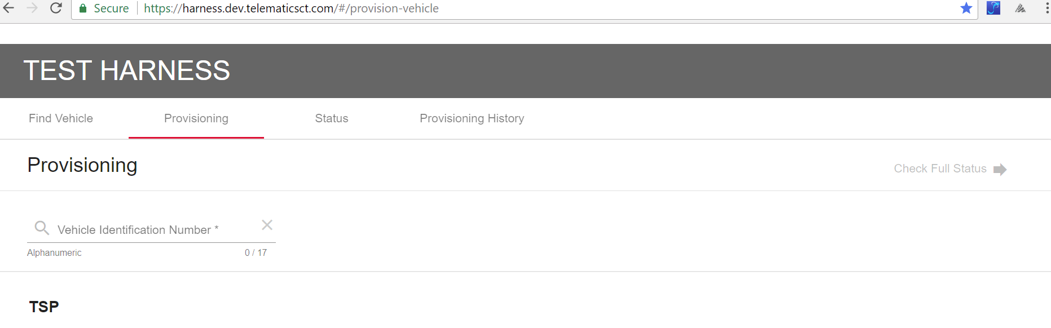
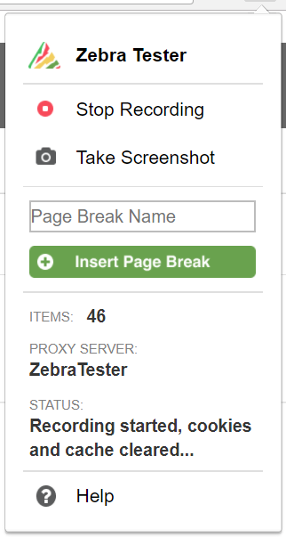
Scripting
Steps:
Create Load Test Scripts
Debug & Troubleshoot
Dynamic Logic
Advanced Functionality
Convert Scripts

Slide 9
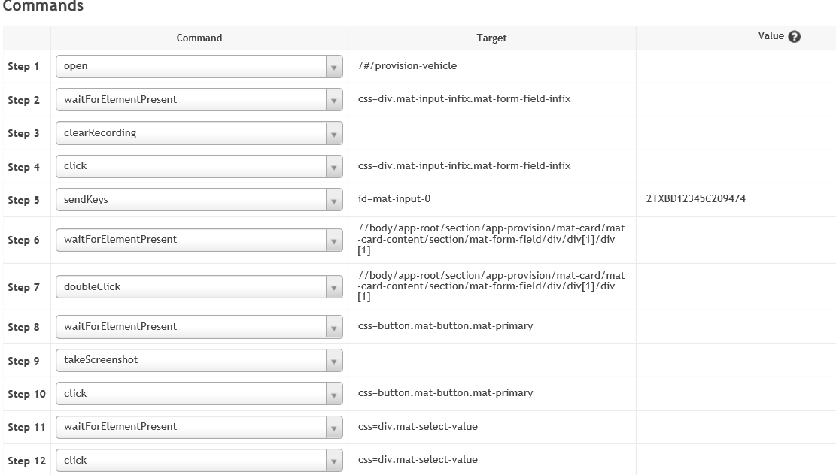
Modify
Modify load test scripts to reflect more realistic Load test simulations.
Defining the project, users.
Randomize parameters (Data, times, environment).

Slide 10
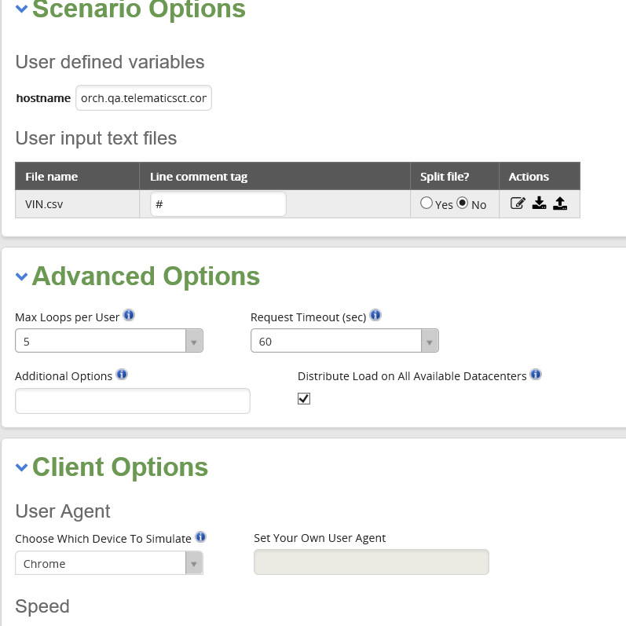
Execute
Virtual Users:
Start: 10
Increase by: 5
Maximum: 100
Test Goals:
Maximum response time<=20 seconds
Location:
Atlanta

Slide 11
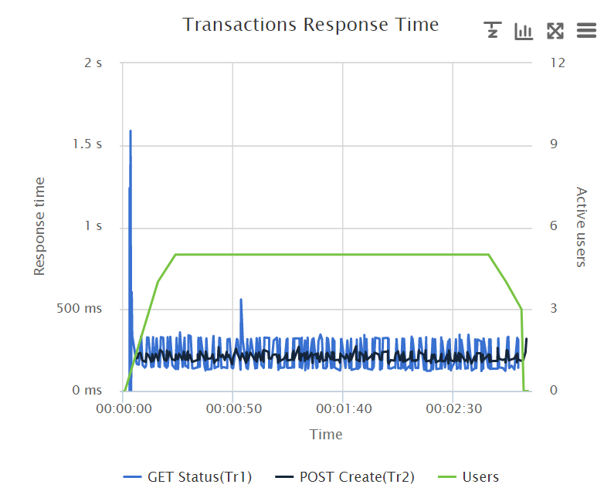
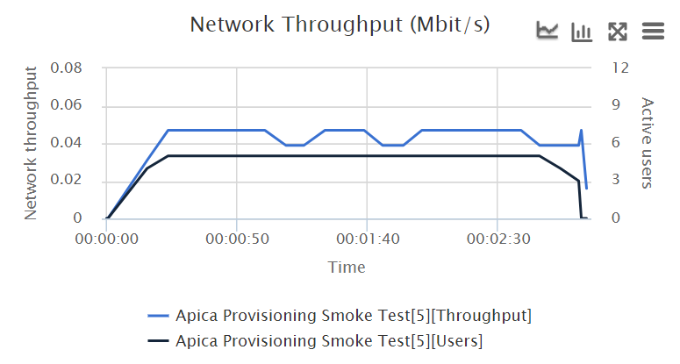
Analyze
Response time is defined as the delay between the point of request and the first response from the service
Throughput represents the number of requests/business transactions processed by the product in a specified time duration. and typically measured in bits per second (bps), as in megabits per second (Mbps) or gigabits per second (Gbps).

Slide 12
Questions?

