Slide 1

Project Phoenix
One App - Platform Consolidation

Slide 2

Agenda
Challenge
Proposal
SXM Ask

Slide 3
Challenges - 17CY Retrospect
\
Identity
Management
- Login failure
- verify account
- Reset PWD
Data Mismatch
- Vin not Found
- Missing Vin
- Multiple accounts
Multiple Apps
Service Provisioning
- Multiple Apps and Multiple versions
Vehicle Stuck in Pending
- Spec L & I failure
- Missing VINs
Slow Response
- Too long to load the screen
- Transactions take too long to complete
Complicated Process
- Too many Steps
- Not intuitive
- Disjointed experience
- Generic error Msg
Sub Par- Sub optimum user experience

Slide 4
17CY KAIZEN
Performance
Data Mismatch
Remote
Identity
In App Registration (primary)
Process Complexity
Separation of concern
Avoid data sync
Auto Discovery
Auto Authorization
SMS based account verification
Uniformed experience across all channels
UX Emotional attachment
3 Step Process
Bring remote services in house
Single Identity Provider (Azure)
Phone # as user id
SMS based Account verified
Phone base authorization
Single process for all generations
TMNA Master of Profile
TC/SXM Master of Subscription
OTP based PWD reset
Uniformed experience across 17CY & 17CY+
Intuitive experience
Microservices
Cloud 1st
Avoid multiple hops
In-Memory caches
Adopt Dev-ops
Tech Standardization
GUID is unique identifier
Web Channel will be integrate with LD/TO
Dealer Portal integrate with DD
SXM Agent portal Integrate with Orchestration layer
One Applications
One Portal
Orchestration Layer
Provisioning
Subscriptions & Products
Veh Management
Identity Management
Subscriptions
SVPP
Prov.
CVS
OCPR
IDaaS
SXM
TSC
CC
Azure

Slide 5
Discussion Points- (Ideas previously discussed)
SXM to provide APIs for subscription management. The ultimate goal is to consolidate the existing mobile (LER/TRC, LD/TO and T/LCapps) apps into a single App . There are also changes needed to LD and TO that will benefit from these APIs. We would also like to introduce In-App registration and payment processing.
The concept of a TARP portal will eventually change. We need to start discussing a scenario where the TARP portal is retired in the future. Mainly, what would that look like technically.
We would like to change the concept of data sync. The change would essentially sunset the current sync process.
We discussed APIs for our LD/TO admin tool in the past. We would like to finally activate those. We think some of this development may already be done so we want to confirm.
We think we need to make changes to payment processing as we sunset our current Peoplesoft/STARR platforms and move to SAP. We would like to brainstorm ideas for this.

Slide 6
Discussion Points
Process Flow Discussion Points
Enhance the Subscription API to include write
SXM agent portal to invoke CT orchestration layer for
Account Mngt
Subscription Mngt
Product List
Vin validation
Remote Authorization
Data Sync.
RDR – no change
Payment Processing in One App
F&A data Feeds
BI Feed
Bulk enrolment
PD integration

Slide 7
Discussion Points
Process Flow Discussion Points
Remote Vehicle List
Spec L and Spec I
Nickname and Timezone
Auth code generation and Validation (HS & HU)
B2C token validation
Retire Cust_ID
Email Notification Matrix
SSA
T&C

Slide 8
Subscription
Process Flow Discussion Points
Subscription API
Create
Update
Upgrade
Down grade
Cancel
Dealer Unlink
Wavier
Reversal

Slide 9
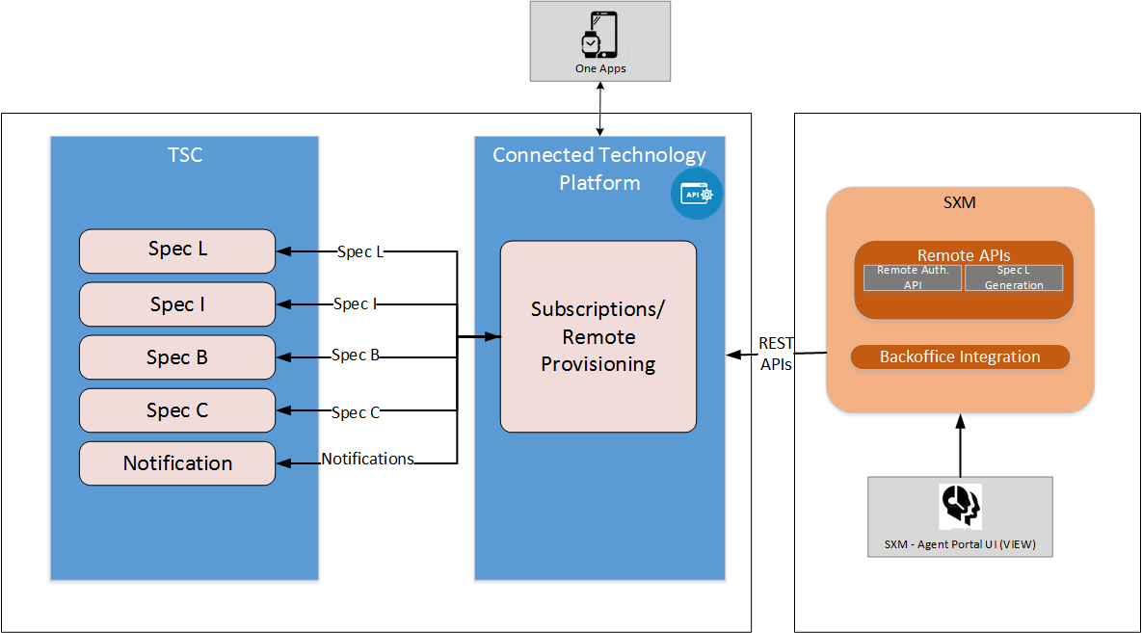
Remote services
Process Flow Discussion Points
Simplify the remote authorization process
By default PS will be the remote user
Agent Portal
Invoke CTP remote authorization API
Manual remote pairing by Agent

Slide 10
Data sync & Identity management
Process Flow Discussion Points
Retire Data Sync
Point to point API calls
Agent portal to invoke CTP profile & subscription management microservices
Other consuming client applications to call CTP microservices
DS event list
Retirement Merge-Purge
Move from Cust_Id to GUID
GUID will be the only identifier for customers
Cell/Mobile Phone number is mandatory

Slide 11
Notifications
Process Flow Discussion Points
Consolidated Notification Platform
Event based eco-system
SXM to raise events with context
CT will send notifications
Customer preferences
Communication Templates
Push notification, Email, SMS

Slide 12
Payment Processing
Process Flow Discussion Points
Need a set of APIs to support payment processing in the new App
or
Need an iframe for payment processing

Slide 13
Questions

