Slide 1
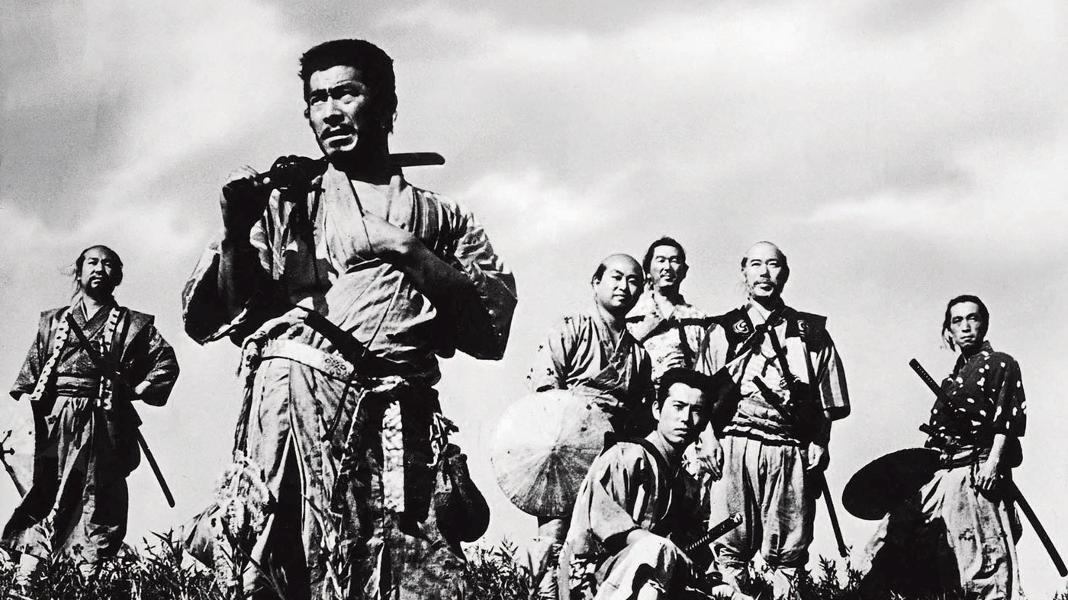
Connected Samurais Harada Method Overview

Slide 2
The Harada Method
The world’s best technique to develop people to their maximum creative capacity
Harada is rated as the number one consultant in Japan on Day-to­‐Day management

Slide 3


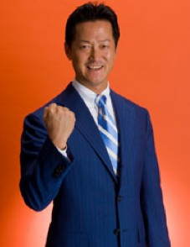

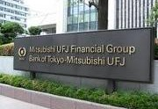
The Harada Method
Takashi Harada

Slide 4
The Harada Method
Takashi Harada!
Junior High School teacher – worst school in Osaka!
13 Students became number one!
School number one five years in a row!
Industry 55,000 people in 280 companies!

Slide 5
Principles of the Harada Method
Self‐Reliance
Goal­‐oriented
Develop people to their fullest potential
Everyone can be successful

Slide 6






Harada Method Steps to Self Reliance
Goal
Purpose
Analysis
Action
Routines

Slide 7
Harada Method takes a Sports Analogy
Pick an activity to excel at.
Pick your own goal that is aligned with your vision and your company’s success.
Develop your own time line.
Create the necessary measures to monitor your progress.
Determine the real purpose and beneﬁt to becoming a champion for yourself, your family and others.

Slide 8
The Harada Method
Analyze your past successes to determine their strengths and ensure that you can repeat them.
Analyze your past failures to determine the weaknesses and create ways to eliminate them.
Write down 64 tasks/actions needed to reach your goal.

Slide 9
The Harada Method
List 10 daily routines to establish new habits and break those past patterns that were limiting them.
Keep a daily diary to see that your tasks/actions were being done at the time scheduled.
Evaluate your daily performance to motivate yourself to stay on target.
Learn how to work with a coach to review and improve your daily progress.

Slide 10




What is a self-­reliant person?
Professional skills & knowledge
Achievements
Foundation
Public service spirits: Caring for others, Helping others grow, Sharing experiences.
Good character
Copyright (c) Harada Education Institute, Inc. All Rights Reserved.

Slide 11

A self-reliant person:
is open-minded about advice or criticism– like an empty glass on the table willingly waiting to be ﬁlled.

Slide 12
A self-reliant person:
is self-determined to achieve goals.
is a self believer about winning.
is a good habit creator.
is a reﬂective thinker.
is a strong believer in the importance of balancing one’s spirit, skill, physical strength and lifestyle as sources of human power.

Slide 13
The 3 principles to “rebuild” something e.g. company, team, or one’s life
Be punctual.
Be attentive to cleaning and organizing places.
Be courteous and respectful to others.

Slide 14



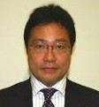




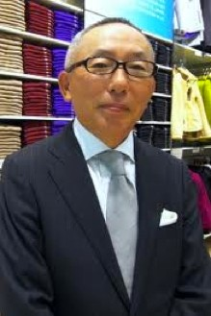
Uniqlo - What should the manager do?

Slide 15
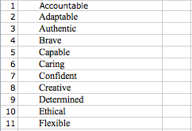
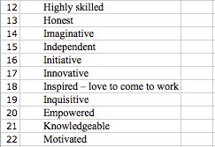
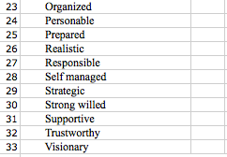
Self-Reliance

Slide 16









Harada’s Three distinctive tools for achieving success
Open Window 64
Harada’s long-term goal setting sheet
Harada’s routine check sheet
Harada’s diary

Slide 17
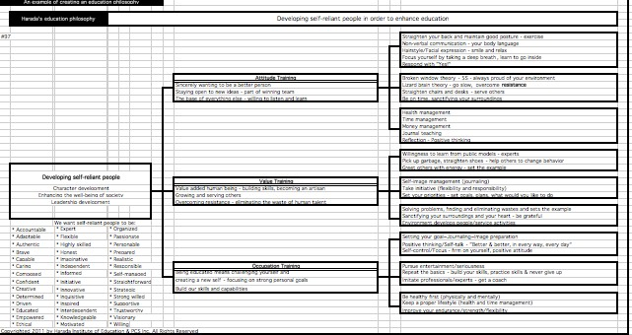
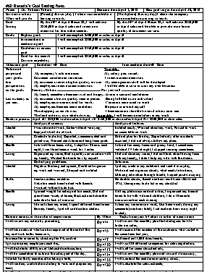
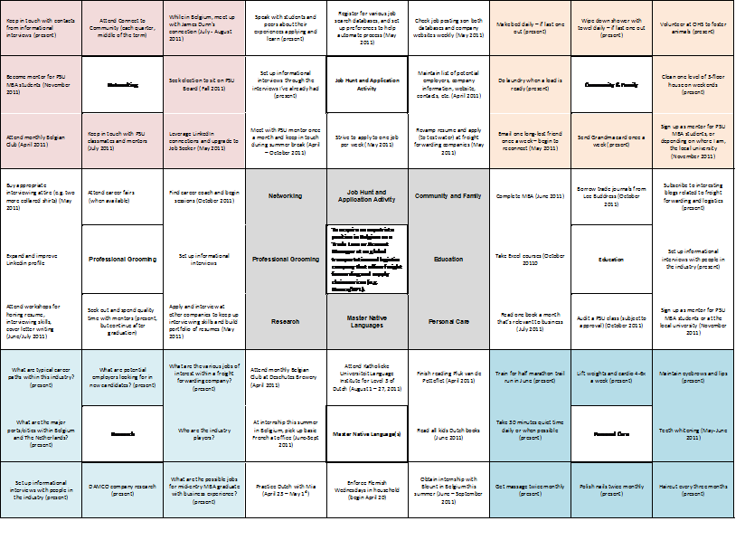
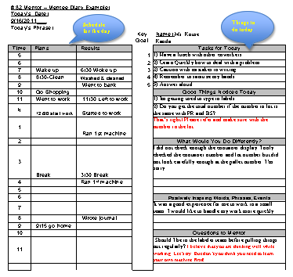
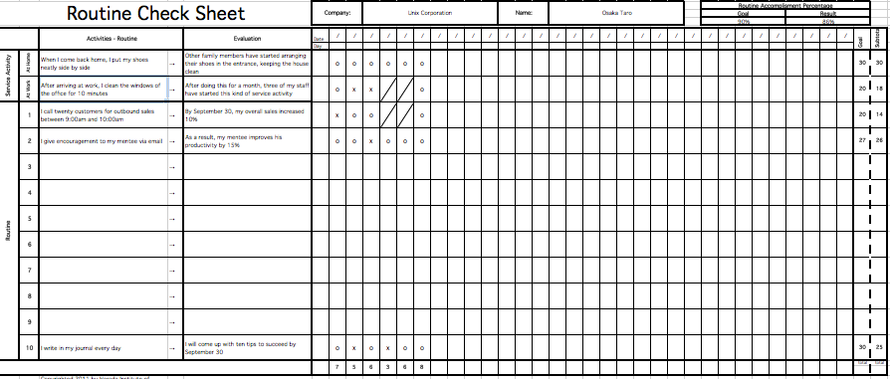
Harada Method Tools
Philosophy
Long-term Goal Form
64 Chart
Routine Check Sheet
Daily Diary
Copyright (c) Harada Education Institute, Inc. All Rights Reserved.

Slide 18
Deﬁnition of success
Success comes from setting the goals that one ﬁrmly believes one should try to achieve and executing the plan within a desired time frame.

Slide 19
Success lies in the acquisition of required skills
skills=achievable abilities through making the required eﬀort

Slide 20


















Harada’s 4 perspective on the values of having a goal
tangible
Tangible goal
for society and others
Tangible goal for myself
society & others
I
Intangible goal
for society and others
Intangible goal for myself
intangible

Slide 21




















Harada’s 4 perspective on the values of having a goal
tangible
increased customer satisfaction rate
increased company sales
higher salaries
bigger bonuses
skill improvement
society & others
myself
improved family life
improve customer relationships
revitalized local community
increased conﬁdence level
increased sense of satisfaction
increased sense of security
intangible

Slide 22
The keys to reinforcing your goal
Start writing with “I”.
Clarify the desired complete on date.
Choose a few goals from your “4 perspective” and relate them.
Write in a positive tone.
Use the present perfect tense to mean that you have already achieved the targeted goals, and you feel like as if it is happening NOW.
Make NO comparison with others.
Include expressions to thank others for opportunities.

Slide 23
Open Window 64 by Norman Bodek
Improve PowerPoint slides by 9/21 | Deliver keynotes | Practice Q&E with local companies | Emails to past attendees lists | Develop website | Promote Harada Workshop Aug 12- 31 | Perfect the keynote address | The Harada 5 day certification course Oct.1 | The 3-day course
Do videos Jan. 15 | Build Skills | Work on website | Create ann email promotional piece for workshops | Marketing | Promote books Sptember 10th | Produce webinar | Develop Courses | The two-day course
Improve presentation skills | Learn to use pages 8-15 | Learn Japanese Jan. 1 | Articls news letters once / week | Collect email Addresses | Get keynotes | Respect for people | Senior management presentation 9-27 | Q&E certification
Sduty all of Harada's material daily | Read Covey and other success writers | Prepare for daily diary publication Aug 15 | Build Skills | Marketing | Develop Courses | Exercise twice a day | Meditate twice a day | Improve my posture
Study innovation | Study and Reserch | Master System Oct. 15 | Study and Reserch | To be the Best Harada Method teacher in the West | Health and Mind | Set up a precise diet | Health and Mind | Shizeng twice a month(1st and 15th)
Study MAP | Intefrate Q&E kaizen to Harada Sept. 15 | Learn Adobe software | Community and Family | Spirit | Write | Carefully monitor my blood pressure | Drink 6 glasses of water a day | Sake off tension
Teach at PSU Sept. 27 | Teach Harada to other teachers Jan. 1 | Work at a local charity Dec. 15 | Meditate twice a day | Friday with Alfred | Imagine what is possible | Story book - Start Jan.1 | Write the Harada book -evryday - complete by 12/31 | The training manual-complete by October 1st
Do the dishes and keep house clean daily | Community and Family | Do 5s- remove books Sept. 1 | Stop wandering thoughts | Spirit | Summarize Ponlon, Kukai and Inamori | To major management media-every other week | Write | Write monthly newsletter 1st of month
Help students with their resumes and interviews at class | Speak to local groups | Noriko accounting 8- 14 | Observe -listen - Stop daily for a few minutes | Read spiritual works - daily | Inside when speaking - work on this | To senior leaders two per week | Daily dialy every day | CEO newsletter Nov. 1

Slide 24
Endorsements
“My experience with you was so great. As a lean practitioner, we strive for continuous improvement everyday in our business and client's businesses. The Harada method is the missing link between continuous improvement, yourself and your mentees. It's comprehensive system allows oneself to take an honest assessment of their life and strive for excellence as wells as fulfillment of dreams. Norman's approach is accessible and well suited to individuals of all learning styles. This is a course well worth the time and investment, with returns far beyond what one would have previously thought possible. Thank you Norman and Will for wonderful experience that has forever changed my approach to developing myself and truly defined my purpose in life.”
– Ryan Allen, Total Systems Development

Slide 25
Resources
http://www.pcspress.com/

Slide 26
Questions?

