Slide 1

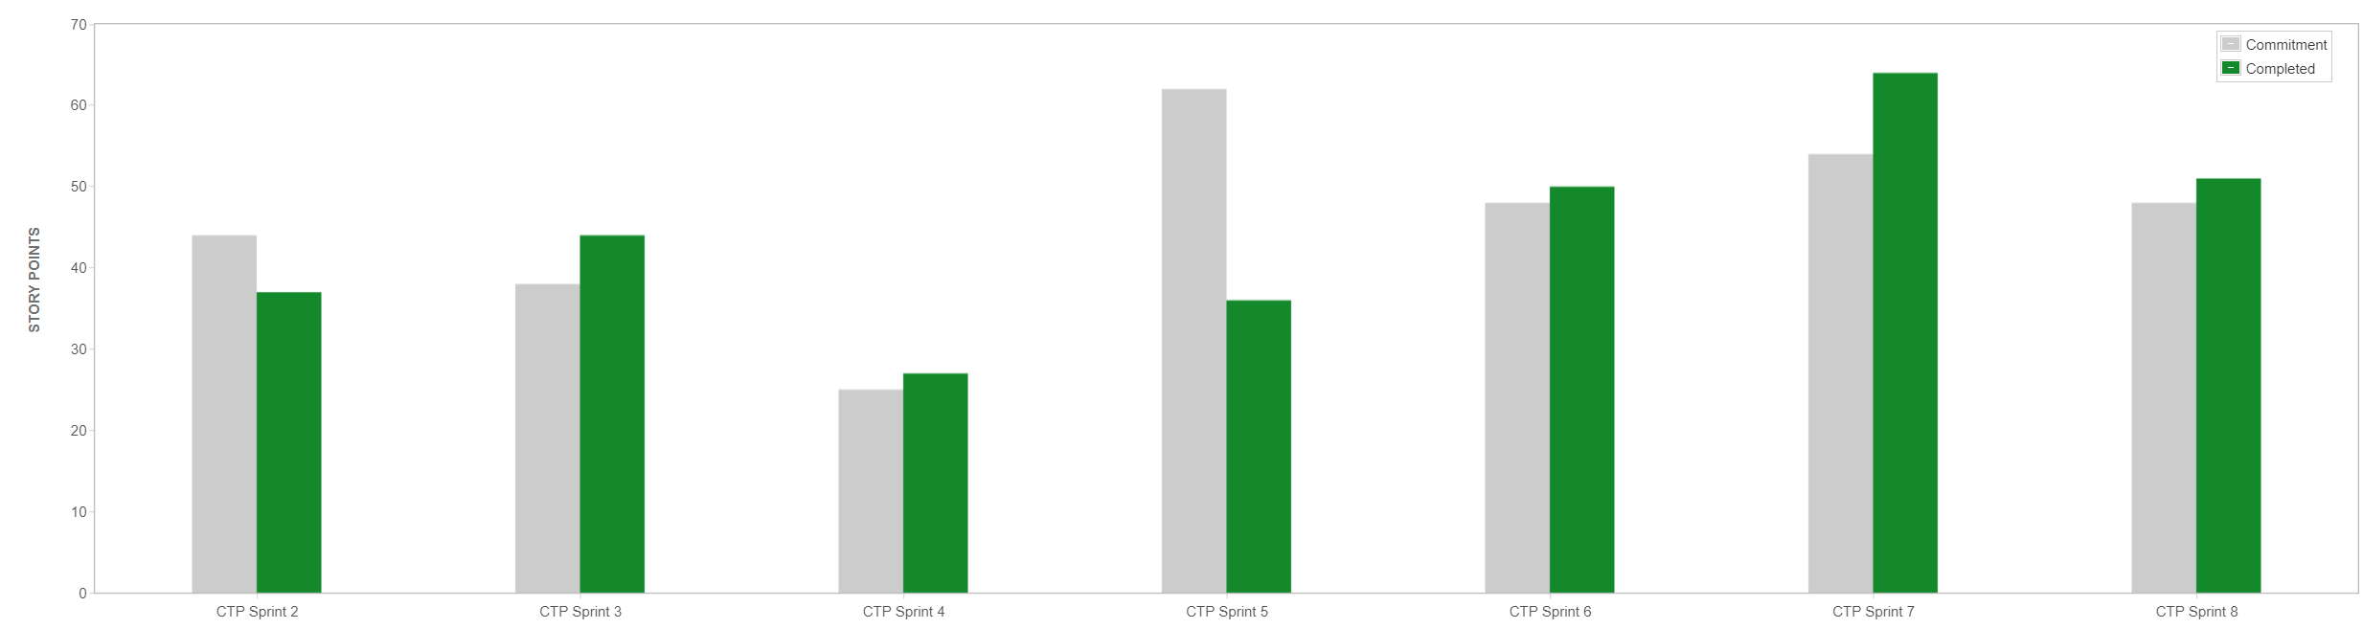
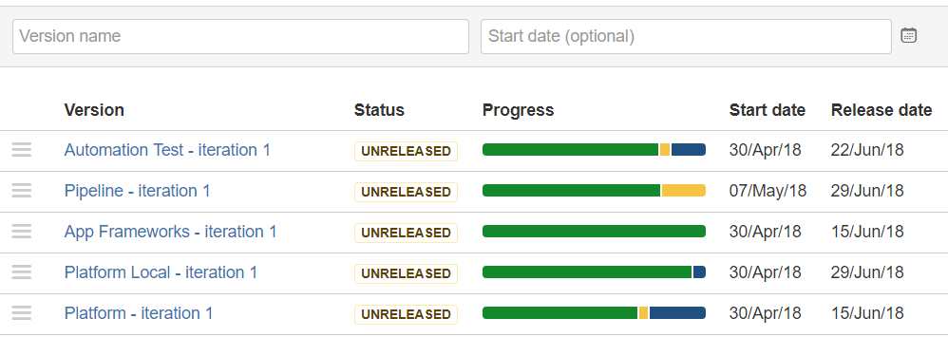


Progress Update: Connected Samurai (HXF)
Project Lead | Primary Contact | Status Date
Rock Mutchler | Lakshmi M | 06/12/18
TEAM Goal: Connected Technologies Platform - “Create awesome customer experience for connected technologies offered to Toyota and Lexus customer” - Primarily responsible for the Cross functional activities supporting CY 17 + App teams
Top achievements since last status report: (05/29/18)
Completed the Platform Infra increment – Route 53, ALB, API Gateway, NAT
Completed Demo to store secrets in SSM and Profile from Spring Config
Demo’ed and documented POC for using GOAD to perform LOAD tests
Completed Automated test execution on JMeter using Jenkins plugin
Completed Modular component to perform logging on AWS Infra using EKK
Completed XLR Set up of Tools – Completed Git hooks commit with Jenkins
Completed DevOps Support for Subscription Repos – 4 – (DEV/ QA/ STG)
Completed prototype for SNS Notification – Basic email notification on AWS
Completed PoC on AWS to Demo Component testing on Microservices
Completed evaluation of Existing Log utility for reuse for CTP
Planned Pipeline for Next Report:
Complete the MVP 1 for Platform – AWS with base infra
Complete all the associated components for handling for applications onboard
Complete PoC Perfecto for Mobile UI testing – Automation
Modularize code in TF for AWS Infra Components (run check)
Complete the CTP Pipeline configuration with Tools (Sonar, Jenkins, Artifactory) – Automated with Gate checks
Complete Integration of the AWS Platform with the CTP Pipeline
Complete CI CD Request for Subscription Collector Repo Request
Complete unbundling of CVS Microservices from CVS ORCH
Publish comparison for Mobile Automation testing Tools for CT
Quick references: Confluence/ Bit Bucket
https://confluence.sdlc.toyota.com/display/CTP/How+to+Guideline+-+GOAD+for+Automated+Load+Testing
https://confluence.sdlc.toyota.com/pages/viewpage.action?pageId=111252419
https://confluence.sdlc.toyota.com/pages/viewpage.action?pageId=111249454
https://confluence.sdlc.toyota.com/pages/viewpage.action?pageId=111255574
https://confluence.sdlc.toyota.com/pages/viewpage.action?pageId=111248729
https://bitbucket.sdlc.toyota.com/projects/CTP (Code !!!)
Issue/Risk | Description | Issue Owner | Criticality | Issue Date | Target Date | Status
Action 1 | Platform MVP – V1.0 | Connected Samurai | MED | 043018 | 061818 | In Progress – Ongoing efforts to have all the components per Roadmap aligned for Demo to Onboard application into AWS Pilot - *HIGH*
Action 2 | Pipeline MVP – V1.0 | Connected Samurai | HIGH | 052218 | 062218 | In Progress – Complete the Platform integration and Pipeline tools configured for CT Apps – Sonar, Jenkins & Artifactory - *HIGH*
Decision | CTP Onboarding – Pilot | Connected Samurai | HIGH | 062518 | 070218 | To Do – Target the First service/ application of registration – Subscription onboard to CTP – Pipeline & platform
Decision | Automation Team member | Connected Samurai | HIGH | 060818 | 061518 | One of the active Automation testing contributors for HXF will depart HXF/ CT on 061518 – Mutual Decision
Artifacts:
JIRA → https://jira.sdlc.toyota.com/secure/RapidBoard.jspa?rapidView=2552
Bitbucket → https://bitbucket.sdlc.toyota.com/projects/CTP
Confluence → https://confluence.sdlc.toyota.com/display/CTP/Connected+Technology+Platform+-+HOME

