Slide 1

Subscription
Customer Life Cycle Management (aka Registration)

Slide 2
Subscription Design – One Portal

Slide 3
Subscription Design – Integration view

Slide 4
Subscription Design – Service Model view

Slide 5

Cardinality
Discussion Points
CARDINALITY:
Customer <-> GUID : One to One
Customer <-> Vehicles : One to Many
Vehicle <-> Subscription : One to One
Subscription <-> Package : One to Many
Package <-> Products : One to Many
RELATIONSHIP:
One Customer, One Account (GUID)
GUID is only unique identifier for a Customer
One Vehicle can have only one Primary Subscriber
One Vehicle can have only one Remote User
Primary Subscriber is the remote user by default
No Secondary Subscribers
Primary Subscriber can delegate Remote access to any user

Slide 6
Products/Packages
Customer Life Cycle Management (aka Registration)

Slide 7
Service
Service:
Service is a feature offered by telematic to the customer. Service is the base element for all products and packages.
Service contains the following key Attribute:
Service Description
List of Flags for the service
List of Capabilities the service is offered for
From a provisioning perspective
Service is a set of flags.
Service translates to one or many flags on the DCM/HU.
Service is the key unit for provisioning.
We provision/deprovision a service on the Vehicle.
Example : ACN, SOS, SVL, Door Lock/unlock, Remote Start/Stop, VHR, & etc.

Slide 8
Products
Product:
Is a collection of Services(aka features). It can contains 1 to N Services.
The rate plan is tied to a product.
The Term is tied to a product.
In Zuora, the subscription is Tied to a product.
Product contains the following key Attribute:
Product Description
List of Services(s)
Rate plan
Charge Plan
Discount (if any)
Term (duration)
Example : Service Connect, Safety Connect or Remote

Slide 9
Package
Package :
Is a bundle of products. It can contains 1 to N products. We always Sell a Package to the customer.
The rate plan maybe tied to a package. (need to understand Zuora’s product structure)
Package contains the following key Attribute:
Package Description
List of product(s)
Optional : (depending on future needs)
Rate plan
Discount (if any)
Term (duration)
A package may have products with different terms (still being discussed)
An Al-A-Cart product is a package of one product.
AKA : Bundle
Open Questions
Bundling for Product catalog

Slide 10
Scenario : Package & Product Mapping for Zuora
Open Questions
Bundling for Product catalog

Slide 11
Subscription Design – Functional view
CTP
Customer Account
VIN association
Product and rate plan setup in Zuora (Manual)
Package to Zuora Product/rate plan mapping (TBD)
Remote User association
Remote Authorization
User data consents
Customer Communication – based on Zuora events
Customer Preferences
Send receipt , based on Zuora data (trigger)
Renewal reminders
Expiration notice
Payment method expiring alert
Wavier
Generate Contract
Contract to Zuora Sub. Mapping (TBD)
T&C management
Emergency Contact
Subscription History (TBD)
Change of Ownership events
Zuora
Create Subscription
Trial Subscription
Paid Subscription
Subscription Life cycle management
Manage term(duration)
Auto renew
Generate Triggers for life cycle event
Add products
Remove product
Payment Processing
Payment preferences
Collect payment
Trigger receipt event (Data)
Calculate tax (based on sold to address)
Auto renew payment processing
Save CC info
Save billing info

Slide 12
Scenario : trial eligibility
Discussion Points
Trials are tied to a VIN
Trial Duration are independent of the PS
Change of Ownership does not reset the Trial
Subscription created in Zuora are primarily tied to a customer with a custom field for a VIN
Open Questions
Does Zuora have the ability to track a subscription based on VIN only, independent of the customer ?

Slide 13
Scenario : New Subscription – trial Use Case
Use Case: | Detail:
Customer wants to subscribe for free trial package | Prerequisite: VIN 1 does not have any active subscription. VIN 1 is capable for Package 1. Customer 1 wants to subscribe for Package 1 for VIN 1 Package 1 contains: 1. Product Safety Services = 10 year free trial 2. Product Remote Services = 6 month free trial 3. Product Destination Assist = 3 month free trial Customer 1 is the primary and remote subscriber for VIN 1. For trial subscription customer does not need to provide a payment method. Trial can start from either subscription date or DOFU (from RDR)

Slide 14
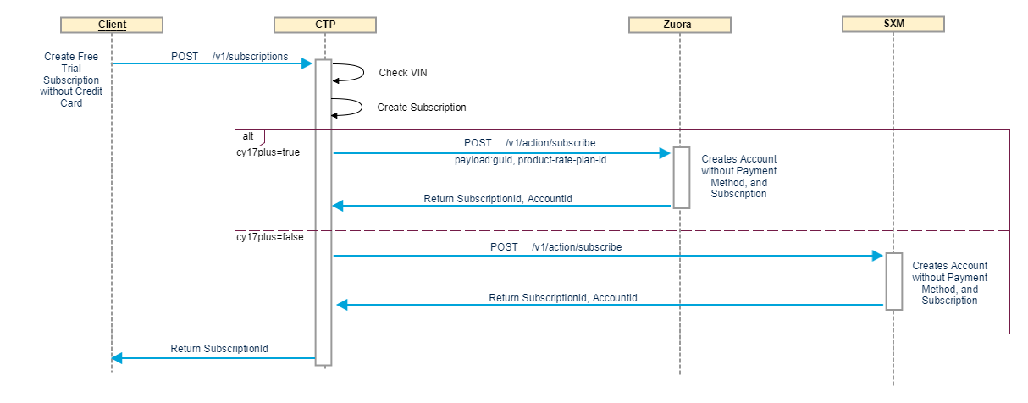
Scenario : New Subscription – trial
Discussion Points
Customer does not provide payment details
Subscription created in CTP
Customer account created in Zuora (if account does not exist)
Subscription created in Zuora and linked to customer account
Open Questions
Will Zuora charge us for 0$ subscriptions

Slide 15
Scenario : New Subscription – paid Use case # 1
Use Case: | Detail:
Customer wants to purchase paid Remote Service product after trial is over for Remote Service. | Prerequisite: Customer 1 has already subscribed for Trial Package Customer 1 wants to subscribe for Package 2 for VIN 1 Package 2 contains: 1. Product Remote Services = 1 year paid Customer 1 is the primary and remote subscriber for VIN 1. For paid subscription customer has provided a payment method. Paid subscription will start from current date.

Slide 16
Scenario : New Subscription – paid Use case # 2
Use Case: | Detail:
Customer wants to purchase a new package while trial is still going on. | Prerequisite: Customer 1 has already subscribed for Package 1, Trial Package Customer 1 wants to subscribe for Package 3 for VIN 1 Package 1 contains: 1. Product Safety Services = 10 year free trial 2. Product Remote Services = 6 month free trial 3. Product Destination Assist = 3 month free trial Package 3 contains: Product Remote Services = 1 year paid Product Destination Assist = 1 year paid Customer 1 is the primary and remote subscriber for VIN 1. For paid subscription customer has provided a payment method. Paid subscription will start after trial is over.

Slide 17
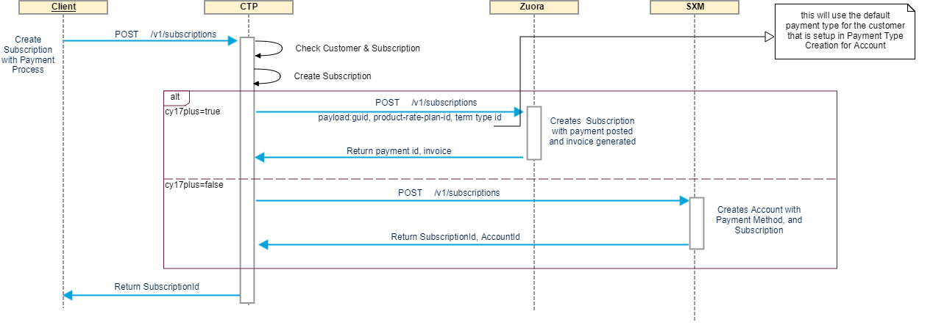
Scenario : New Subscription – paid
Discussion Points
Customer provides payment details which are stored in Zuora
Subscription created in CTP
Customer account created in Zuora (if account does not exist)
Subscription created in Zuora and linked to customer account
Open Questions
Need more clarity on subscription workflow for check based payments

Slide 18
Scenario : upgrade Subscription - Use case
Use Case: | Detail:
Customer wants to subscribe to additional product to his existing subscription. | Prerequisite: Customer 1 has already subscribed for Package 3 Customer 1 wants to subscribe to Package 4 for VIN 1 Package 3 contains: Product Remote Services = 1 year paid Product Destination Assist = 1 year paid Package 4 contains: 1. Product Service Connect = 1 year paid Customer 1 is the primary and remote subscriber for VIN 1. For paid subscription customer has provided a payment method. Package 4 will start from current start date. How will the end dates align for package 3 and 4?

Slide 19
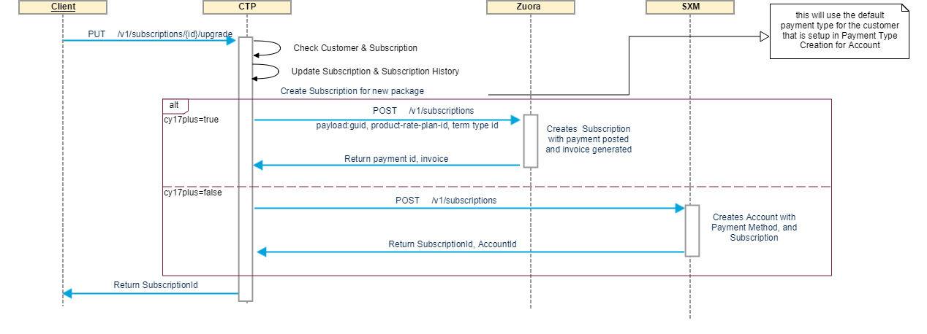
Scenario : upgrade Subscription
Discussion Points
Customer adds new package(s) to an existing subscription
CTP creates subscription in Zuora for new product and linked to customer account
Subscription in CTP updated to reflect addition new package
Open Questions
How do we handle opt-ins or opt-outs?

Slide 20
Scenario : Downgrade Subscription – use case
Use Case: | Detail:
Customer wants to cancel a product from existing subscription. | Prerequisite: Customer 1 has already subscribed for Package 3 Customer 1 wants to cancel Destination Assist 1 year paid from Package 3 for VIN 1 Package 3 contains: Product Remote Services = 1 year paid Product Destination Assist = 1 year paid After downgrade Package 3 contains: Product Remote Services = 1 year paid Customer 1 is the primary and remote subscriber for VIN 1. For paid subscription customer has provided a payment method.

Slide 21
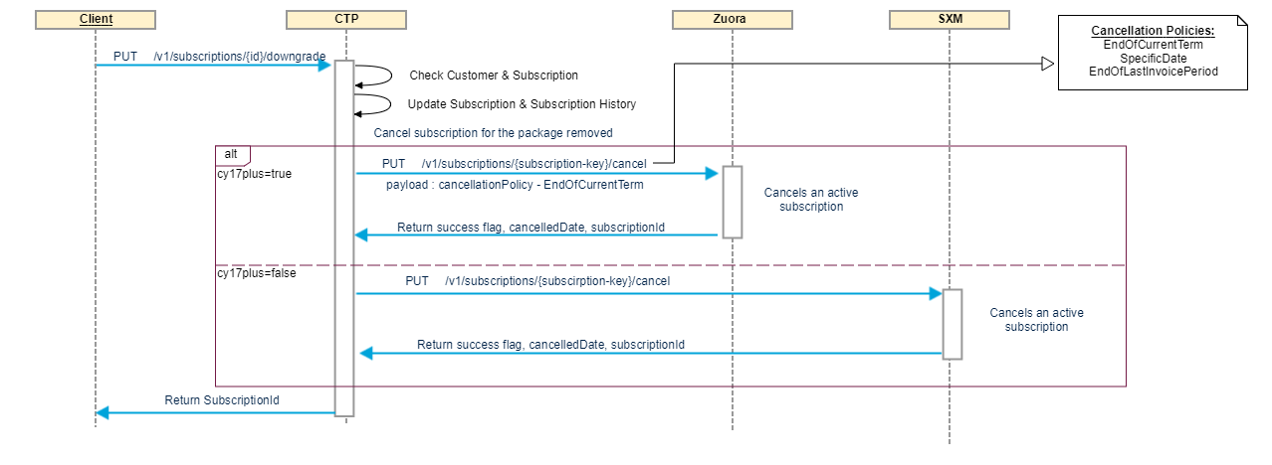
Scenario : Downgrade Subscription
Discussion Points
Customer removes package(s) from existing subscription
CTP cancels subscription for that package from Zuora
Zuora calculates and triggers refund
Subscription in CTP updated to remove the specified package
Open Questions

Slide 22
Scenario : renew Subscription (Manual) – use case
Use Case: | Detail:
Customer wants to renew existing subscription. | Prerequisite: Customer 1 has already subscribed to Package 3 Customer 1 wants to renew Package 3 for VIN 1 Package 3 contains: Product Remote Services = 1 year paid, ending today Product Destination Assist = 1 year paid, ending today After renewal Package 3 contains: Product Remote Services = 1 year paid, ending 1 year from today Product Destination Assist = 1 year paid, ending 1 year from today Customer 1 is the primary and remote subscriber for VIN 1. For paid subscription customer has provided a payment method.

Slide 23
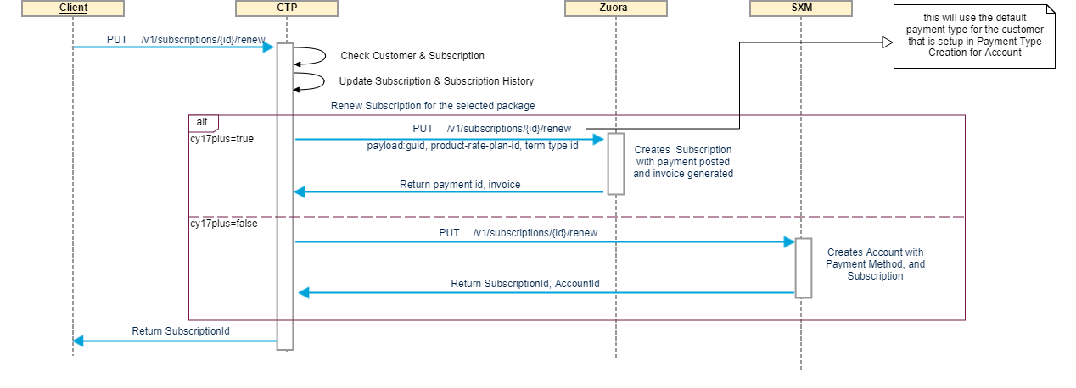
Scenario : renew Subscription (Manual)
Discussion Points
Customer renews existing subscription
Subscription renewed in Zuora
Zuora realizes renewal payment and notifies CTP
Subscription updated in CTP
Open Questions

Slide 24
Scenario : renew Subscription (Auto) – use case
Use Case: | Detail:
Based on auto renew process, Zoura triggers an auto renewal for Customer on his billing date. | Prerequisite: Customer 1 has already subscribed to Package 3 Zoura triggers auto renew for Package 3 for VIN 1 Package 3 contains: Product Remote Services = 1 year paid, ending today Product Destination Assist = 1 year paid, ending today After renewal Package 3 contains: Product Remote Services = 1 year paid, ending 1 year from today Product Destination Assist = 1 year paid, ending 1 year from today Customer 1 is the primary and remote subscriber for VIN 1. For paid subscription customer has provided a payment method.

Slide 25
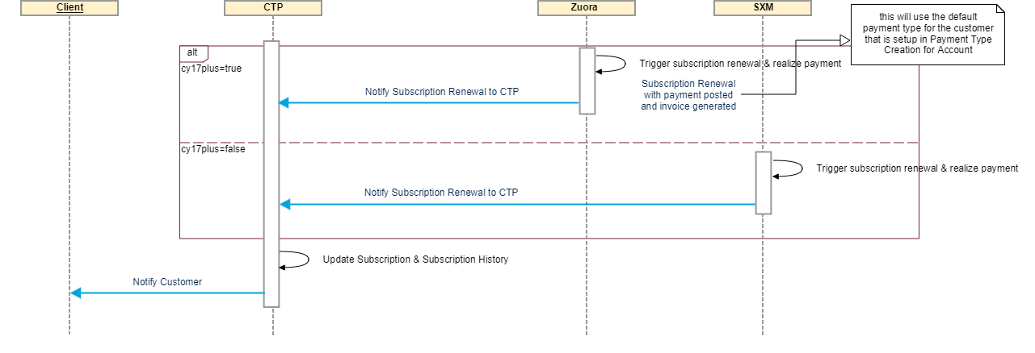
Scenario : renew Subscription (Auto)
Discussion Points
Zuora realizes the payment as per renewal product rate plan
Zuora triggers notification to CTP for renewed subscription and account
CTP updates its own subscription details
Open Questions
How to manage negative scenario where trial product plan renews to a paid plan and payment details are not present in Zuora?

Slide 26
Scenario : Cancel Subscription – use case 1
Use Case: | Detail:
Customer wants to cancel trial subscription. | Prerequisite: Customer 1 has already subscribed to Package 1 Customer wants to cancel his subscription for Package 1 Trial Package 1 contains: 1. Product Safety Services = 10 year free trial 2. Product Remote Services = 6 month free trial 3. Product Destination Assist = 3 month free trial Customer 1 is the primary and remote subscriber for VIN 1. After cancelation, all products under package 1 are cancelled.

Slide 27
Scenario : Cancel Subscription – use case 2
Use Case: | Detail:
Customer wants to cancel paid subscription. | Prerequisite: Customer 1 has already subscribed to Package 3 Customer wants to cancel his subscription for Package 3 paid. Package 3 contains: Product Remote Services = 1 year paid Product Destination Assist = 1 year paid Customer 1 is the primary and remote subscriber for VIN 1. After cancelation, all products under package 3 are cancelled and customer is issued a refund, if any.

Slide 28
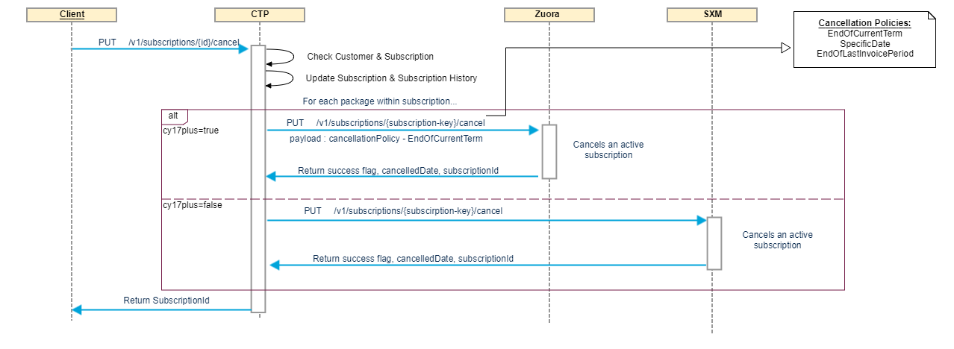
Scenario : Cancel Subscription
Discussion Points
Customer calls in and cancels existing subscription
CTP cancels all active subscriptions for that vehicle in Zuora
Zuora calculates and triggers refund
Subscription cancelled in CTP
Open Questions

Slide 29
Scenario : Wavier
Use Case: | Detail:
Customer wants to waive all services before even subscribing to any packages. | Prerequisite: VIN 1 does not have any active subscription. VIN 1 is capable for Package 1. Customer wants to waive before subscribing to any packages. Customer 1 is the primary and remote subscriber for VIN 1. After waiver, trial time needs to be tracked based on DOFU for VIN 1. Contract is still created with waiver information. If customer wants to subscribe again then a new subscription will be created.

Slide 30
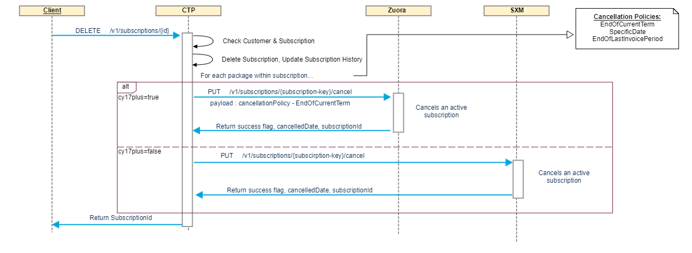
Scenario : Wavier
Discussion Points
Customer waives off subscription explicitly or through vehicle sold event
CTP cancels all active subscriptions for that vehicle in Zuora
Zuora calculates and triggers refund
Subscription cancelled in CTP
Open Questions
Can Zuora process single refund transaction for all subscriptions linked to that customer account?

Slide 31
Scenario : Goodwill
Use Case: | Detail:
Customer is given a goodwill package. | Prerequisite: Customer has already subscribed to Package 1. Customer 1 is not happy with the service, Agent gives customer 3 month goodwill package for VIN 1 Package 1 contains: 1. Product Safety Services = 10 year free trial 2. Product Remote Services = 6 month free trial 3. Product Destination Assist = 3 month free trial Goodwill Package: Goodwill package for Remote and Destination Assist products = 3 months Goodwill package should start after trial for Remote Services and Destination Assist is over.

Slide 32
Scenario : Second Customer purchase vehicle with trial time still remaining
Use Case: | Detail:
2nd Customer purchases VIN 1 with trial time still remaining on Package 1. | Prerequisite: Customer 2 has purchased VIN1. Customer 2 wants to sign up for Package 1 on VIN 1 Package 1 contains: 1. Product Safety Services = 9 year 10 month free trial 2. Product Remote Services = 4 month free trial 3. Product Destination Assist = 1 month free trial

Slide 33
Scenario : Driveoff Use case
Use Case: | Detail:
Customer purchases VIN 1 and did not subscribe to any product and did not waive either. | Prerequisite: VIN 1 does not have any active subscription. VIN 1 is capable for Package 1. Customer 1 drives off from dealer lot after purchasing VIN 1 Trial can start from either subscription date or DOFU (from RDR)

Slide 34
Scenario : Customer owns a multi vehicle subscription - Use case
Use Case: | Detail:
Customer purchases VIN 2 and already has an existing subscription on VIN 1. | Prerequisite: VIN 2 does not have any active subscription. VIN 2 is capable for Package 1. Customer 1 wants to subscribe for Package 1 for VIN 2 VIN 1, Package 1 contains: 1. Product Safety Services = 10 year free trial 2. Product Remote Services = 6 month free trial 3. Product Destination Assist = 3 month free trial VIN 2, Package 1 contains: 1. Product Safety Services = 10 year free trial 2. Product Remote Services = 6 month free trial 3. Product Destination Assist = 3 month free trial Customer 1 is the primary and remote subscriber for VIN 1. Customer 1 is the primary and remote subscriber for VIN 2. For trial subscription customer does not need to provide a payment method. Trial can start from either subscription date or DOFU (from RDR)

Slide 35
Open questions
# | Questions | Zuora Response
 | Can Zuora be a VIN based subscription
 | Do we put Trial subscriptions in Zuora ? Will Zuora charge TMNA for $0 subscriptions
 | Customer info will reside in TMNA
 | Which Address does Zuora uses to calculate the TAX
 | When a customer changes the address do we recalculate the tax | Yes, guid can be the account number
 | Can it support bundling multiple subscriptions into one | NO, but there is a workaround
 | Can it support white labelled or custom branded customer view ? | NA
 | Can we do single credit card charge for multiple subscriptions in Zuora (for the same Customer) ? | Yes
 | Is there tax calculation API and if yes, what are pre-requisites to use it ? | Yes
 | Subscription Order History management: does it remove the entries of the customer subscriptions upon cancellation?
 | What are ZUORA's availability and response time SLA for APIs
 | Discount on package with multiple subscriptions?
 | For a monthly subscription, is the end date going to be changing ?

Slide 36
Open questions
# | Questions | Zuora Response
 | Can Zuora Providing Bundling in Product catalog
 | Can Zuora create an account given TMS GUID as the identifier
 | what does EVERGREEN termType mean ?
 | How to setup monthly payments ?
 | Currency and Payment Type associated to customer account ?
 | Can Bill cycle and currency tied to subscription ?
 | What is the Business Account Type (Fleet purpose) support in Zuora
 | Can the BillCycleType tied to rateplan or product ?
 | Is Discount values showed in invoice if discount is applied?
 | How much customization is allowed in Invoice template
 | Whats the difference between ContractEffectiveDate vs CustomerAcceptanceDatechanging the ContractEffectiveDate or CustomerAcceptance Date

Slide 37
Questions

