Slide 1
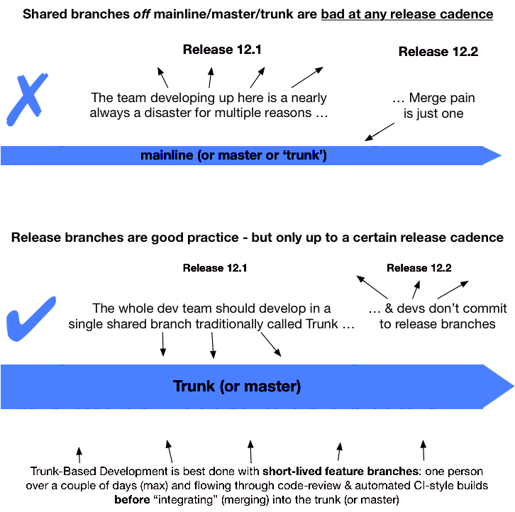
Trunk Based Development
Overview of the gains, and how we continuously improve and continuously integrate, and not work in our own boxes.

Slide 2
What About Long Running Features?
modularity through design not through VCS
add an abstraction over any code you are going to change in a feature
new features are added through Adapters and Interfaces
production code keeps old implementations while feature code is incomplete
development code uses the new implementations
when the feature is ready, the new implementations are rolled out

Slide 3
Feature - Toggles
Features are hidden until ready
Hide features at the entry points
Easy to configure
Easy to Implement with small change
Can be tailored to specific groups
Allows for easy A / B testing.

Slide 4
Feature Toggle Links
Old Links - Not a new untested Process
- so many more links -
http://paulhammant.com/2013/04/05/what-is-trunk-based-development
http://paulhammant.com/blog/branch_by_abstraction.html
http://paulhammant.com/2011/05/13/avoid-big-bang-for-branch-by-abstraction/
http://continuousdelivery.com/2011/05/make-large-scale-changes-incrementally-with-branch-by-abstraction/branch-by-abstraction/
http://c2.com/cgi/wiki?BranchByAbstraction
http://martinfowler.com/bliki/FeatureToggle.html
http://martinfowler.com/bliki/BranchByAbstraction.html
http://www.stephen-smith.co.uk/application-pattern-verify-branch-by-abstraction/
http://dev.jimdo.com/2013/05/03/software-migration-strategies/
http://java.dzone.com/articles/application-pattern-verifyhttp://java.dzone.com/articles/application-pattern-verify
http://www.whitewashing.de/2013/12/05/feature_flags_and_doctrine_entities.html
http://abhishek-tiwari.com/post/decoupling-deployment-and-release-feature-toggles

Slide 5

“Google arranges for 95% (25,000) of its software developers to share one trunk in “Why Google Stores Billions of Lines of Code in a Single Repository””
https://youtu.be/W71BTkUbdqE
Rachel Potvin
Josh Levenberg

