Slide 1

Integration Test Plan, schedule forecast

Slide 2

Topics …
End-to-End Integration Automation Approach
Integration of Features initiated from/delivered via One Portal
Integration of Features initiated from/delivered via One App – CY17+
Integration of Features initiated from/delivered via One App – CY17 SXM
Integration of Vehicle Feeds processing with up/down stream systems
Inter-dependent components mapping and supporting teams

Slide 3
Integration Automation Approach
CTP-Test Automation Framework provides, end-to-end evaluation and coverage through:
Automation of Feature scenarios that span across multiple components/applications within connected eco-system
Scripts are designed to validate Service health checks, Code quality, Security, UI, API responses, database updates
Scripts will evaluate integration aspects - both within CT Registration Apps as well as with external systems
Jenkins jobs are created for the automated tests to run in Dev, QA, Staging environments
Jenkins jobs are configured as tasks within the XLR Pipeline template for Dev, QA, Staging environments
As part of CI/CD, as and when the code is committed to the release branch, XLR pipeline would orchestrate the execution of the Jenkins jobs which will run the battery of automated scripts, to ensure Connected Services for the customers.
Failures within XLR tasks execution would be notified via slack channel to respective application groups for intervention.
Test summary results would show execution metrics and issues - denoting where in the chain an issue has occurred.
Sample Scenarios:
Customer Facing: Account creation via OnePortal by Dealer -> Show Vehicle Details -> Product Selection -> Opting for Data Consents -> Subscription -> Vehicle Association to Customer-> Service Provisioning -> Perform Remote Service
Enabling Feeds: TSC sends ADF to CTP -> CTP stores in CVS -> NVS (EIG) requests ADF from CTP -> CTP sends ADF to NVS -> NVS enriches ADF -> NVS sends enriched ADF to CTP -> CTP updates in CVS -> CTP sends enriched FDF to TSC , TSP

Slide 4
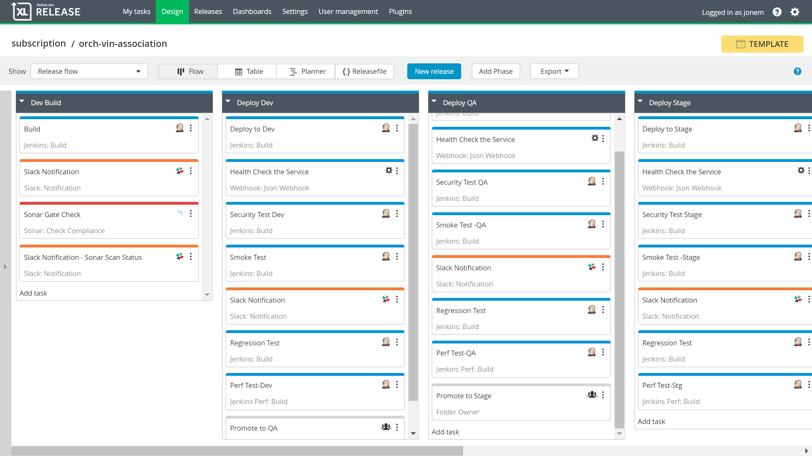
Integration Automation of services
CI/CD pipeline with Smoke, Regression, Security checks and Quality Gates

Slide 5
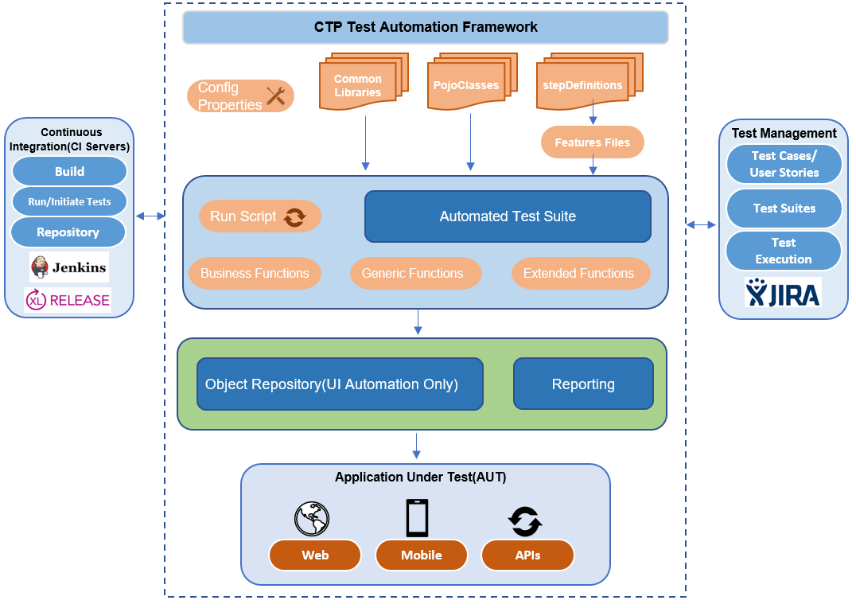
Integration Automation framework
Enhancements in progress …

Slide 6
one portal Driven
Activity | Cycle 1 (First Pass) |  |  |  |  | Cycle 2 ( Fix Validation)
 | Oct 1-5 | Oct 8-12 | Oct 15-19 | Oct 22-26 | Oct 29-Nov 2 | Nov 5-9 | Nov 12-16 | Nov 19-23 | Nov 26-30
Initiation | One Portal | One Portal | One Portal | One Portal | One Portal | One Portal | One Portal | One Portal | One Portal
Features under Test | Account: Search Customer-by Email, Search Customer-by Mobile, Create Account, Add Address, Update Name, Update Address Portal Variants: Toyota/Lexus - US-en, CA-en, CA-fr | Vehicle, Products: Search Vehicle, Add Vehicle, Add Second Vehicle, Show Vehicle List, Show Vehicle Details, Show Vehicle Image, Show Capabilities, Show Products, Zuora Rate Plan, Subscription Status, Vehicle Association | Subscription: Trial Subscription, Agree Data Consents, Privacy Policy, T&C Manage Subscription, Waive Subscription, Remove Vehicle, Unlink Vehicle from another Customer, Add Remote User | Based on Trial Subscription, Data Consents Agreements, Waiver Service Provision: (Spec-L, Spec-I) for Remote Services, Service Connect, HU Flags, RVT, Vehicle Probe Plus Flags update in DCM/HU | Service Provision: Denso DCM, Toyota HU Service Provision: LGE DCM, Lexus HU | Retest Fixes | Retest Fixes | Retest Fixes | Retest Fixes
Inter-Dependent Components & Supporting Teams | Account, Azure | Account, Vehicle, Products, Subscription, Zuora | Account, Vehicle, Products, Subscription, Zuora | Subscription, Provisioning, TSP, TSC, GCP, DCM, HU, SET | Subscription, Provisioning, TSP, TSC, GCP, DCM, HU, SET | As required | As required | As required | As required

Slide 7
One app driven - Cy17+
Activity | Cycle 1 (First Pass)
 | Week 1 | Week 2 | Week 3 | Week 4 | Week 5 | Week 6 | Week 7 | Week 8 | Week 9
Initiation | OneApp | OneApp | OneApp | OneApp | OneApp | OneApp | OneApp | OneApp | OneApp
Features under Test | Account: Create Account (Email, Mobile) Sign-up with Social Media (Google, Facebook) Activate Account Login with Email/ Mobile, Password Social Media Login Update Name, Email, Phone, Address OneApp Variants: Toyota/Lexus – iOS, Android | Vehicle, Products: Add Vehicle, Add Nick Name, Add Second Vehicle, Show Vehicle List, Show Vehicle Details, Show Vehicle Image, Show Capabilities, Show Products, Rate Plan, Subscription Status | Subscription: Trial Subscription, Agree Data Consents, Privacy Policy, T&C Manage Subscription, Waive Subscription, Cancel Subscription, Remove Vehicle, Add Remote User Vehicle Service Provision (Spec-L, Spec-I) for Remote Services | Remote Services: Generate Auth Code Validate Auth Code Engine Start/Stop, Door Lock/Unlock, Vehicle Locator, Push Notification Vehicle Status: Setup Alerts, Vehicle Status Alerts Push Notification Dealer Info: Dealer List Dealer Location Dealer Contact Info | Set Preferred Dealer Service Connect: VHR, MIL-On, MIL-On Alerts Dealer Contact Push Notification Schedule Service Appointment: Find Dealer, Find Slots, Schedule, Update, Cancel | Campaigns: Recall Campaign, Service Campaign Voice ORB: QRG/FAQs, Appointment, Service Connect, Warranty, Recall, Remote Services | Guest Driver Profile Settings: Curfew Speed Area Total Miles Total Time Trigger Violations: Curfew Speed Area Total Miles Total Time Push Notification | Telemetry Data: Odometer Fuel Gauge Tire Pressure Trip Summary: Total Mile Total Time Time Stamp Driver Score Route Map Harsh Icons Driver Score: Instance of, - Harsh Acceleration - Harsh Breaking - Harsh Cornering | Usage Based Insurance: First Opt-In Show Insurance Offerings Second Opt-In Show Quotes Service Offerings: Offering details Coupon images
Inter-Dependent Components & Supporting Teams | CTP-Orch, ForgeRock | CTP-Orch, Account, Vehicle, Vehicle Association, Products, Subscription, Zuora | CTP-Orch, Account, Vehicle, Products, Subscription, Zuora, Provisioning, TSC, GCP, DCM, HU, SET | CTP-Orch, Subscription, TSC (17+) (Spec-B, Spec-C) Remote Service, DIS | CTP-Orch, Vehicle Association, BRRI/Data Hub, Dealer-FX | CTP-Orch, EIG, PQSS | CTP-Orch, TSC (17+) (Spec-B, Spec-C) Remote Service | CTP-Orch, TBDC (TC) | CTP-Orch, TIMS, Customer Central, TOOMS

Slide 8
One app driven - CY17 sxm
Activity | Cycle 1 (First Pass)
 | Week 1 | Week 2 | Week 3 | Week 4 | Week 5 | Week 6 | Week 7 | Week 8 | Week 9
Initiation | OneApp | OneApp | OneApp | OneApp | OneApp | OneApp | OneApp | OneApp | OneApp
Features under Test | Account: Create Account (Email, Mobile) Sign-up with Social Media (Google, Facebook) Activate Account Login with Email/ Mobile, Password Social Media Login Update Name, Email, Phone, Address OneApp Variants: Toyota/Lexus – iOS, Android | Vehicle, Products: Add Vehicle, Add Nick Name, Add Second Vehicle, Show Vehicle List, Show Vehicle Details, Show Vehicle Image, Show Capabilities, Show Products, Rate Plan, Subscription Status | Subscription: Trial Subscription, Agree Data Consents, Privacy Policy, T&C Manage Subscription, Waive Subscription, Cancel Subscription, Remove Vehicle, Add Remote User Vehicle Service Provision (Spec-L, Spec-I) for Remote Services | Remote Services: Generate Auth Code Validate Auth Code Engine Start/Stop, Door Lock/Unlock, Vehicle Locator, Push Notification Vehicle Status: Setup Alerts, Vehicle Status Alerts Push Notification Dealer Info: Dealer List Dealer Location Dealer Contact Info | Set Preferred Dealer Service Connect: VHR, MIL-On, MIL-On Alerts Dealer Contact Push Notification Schedule Service Appointment: Find Dealer, Find Slots, Schedule, Update, Cancel | Campaigns: Recall Campaign, Service Campaign Voice ORB: QRG/FAQs, Appointment, Service Connect, Warranty, Recall, Remote Services | Guest Driver Profile Settings: Curfew Speed Area Total Miles Total Time Trigger Violations: Curfew Speed Area Total Miles Total Time Push Notification | Telemetry Data: Odometer Fuel Gauge Tire Pressure Trip Summary: Total Mile Total Time Time Stamp Driver Score Route Map Harsh Icons Driver Score: Instance of, - Harsh Acceleration - Harsh Breaking - Harsh Cornering | Usage Based Insurance: First Opt-In Show Insurance Offerings Second Opt-In Show Quotes Service Offerings: Offering details Coupon images
Inter-Dependent Components & Supporting Teams | CTP-Orch, ForgeRock, SXM | CTP-Orch, ForgeRock, SXM, Vehicle, VIS | CTP-Orch, SXM, TSC, GCP, DCM, HU, SET | CTP-Orch, SXM, TSC (17) (Spec-B, Spec-C) Remote Service, DIS | CTP-Orch. DCS1.0, BRRI/Data Hub, Dealer-FX | CTP-Orch, EIG, PQSS | CTP-Orch, SXM, TSC (17) (Spec-B, Spec-C) Remote Service | CTP-Orch, TBDC (TC) | CTP-Orch, TIMS, Customer Central, TOOMS

Slide 9
Vehicle Feeds
Activity | Cycle 1 (First Pass) |  |  |  |  |  |  | Cycle 2 ( Fix Validation)
 | Oct 1-5 | Oct 8-12 | Oct 15-19 | Oct 22-26 | Oct 29-Nov 2 | Nov 5-9 | Nov 12-16 | Nov 19-23 | Nov 26-30
Feeds pertain to |  | TMNA, TdPR, SXM | TCI, SXM | Servco, SXM | Downstream Systems | TMNA, TdPR | TCI, Servco
Feeds / Features under Test | ------------------- | ADF, Enriched FDF: 17+ Process ADF 17+ Return ADF Process Enriched FDF (Tele) Process Enriched FDF (Non-Tele) SXM Feeds: FDF (Only 17, Legacy) RDR (Only 17, Legacy) | ADF, Enriched FDF: 17+ Process ADF 17+ Return ADF Process Enriched FDF (Tele) Process Enriched FDF (Non-Tele) SXM Feeds: FDF (Only 17, Legacy) RDR (Only 17, Legacy) | ADF, Enriched FDF: 17+ Process ADF 17+ Return ADF Process Enriched FDF (Tele) Process Enriched FDF (Non-Tele) SXM Feeds: FDF (Only 17, Legacy) RDR (Only 17, Legacy) | Notify Change V2 (ASI, HW Type) VIS Information (ASI, HW Type) | 17+ DCM Replacement | 17 DCM Replacement Legacy DCM Replacement | Retest Fixes | Retest Fixes
Inter-Dependent Components & Supporting Teams |  | CVS, NVS, EIG, VRoR, VDW, DSS, Datahub, TSP, TSC FTH, EIG, SXM | CVS, TCI, EIG, VRoR, VDW, DSS, Datahub, TSP, TSC | CVS, Servco, EIG, VRoR, VDW, DSS, Datahub, TSP, TSC | CVS, VIS, VRoR to 1DD/RTI, VRoR to TdPR, ETA, SET, GST,C360, CPD/EFC, SET, GST, DPMS, PQSS, T3/SLP | CVS, NVS, EIG, VRoR, VDW, DSS, PQSS, TSP, TSC, GCP, DCM, HU, SET | CVS, NVS, TCI, Servco, EIG, VRoR, VDW, DSS, PQSS, TSP, TSC, GCP, DCM, HU, SET | As required | As required

