Slide 1

IQ Innovation Contest Finalist
May 18, 2008
<PROJECT TITLE>
<Product definition “sub-title” – 10 word limit>
<entrant’s name>
<entrant’s email address>
<team/group name, if any>
Faculty Sponsor/Advisor: <faculty name>
Innovation Quest – Learn by Doing…Give Back by Creating…

Slide 2
Product Description
<Answer
“What is the ultimate product or service?”>
<Feel free to use pictures, screen-shots, very short videos>
<Keep it concise and to the point>
  <Keep it to a 1-slide description>
  <3-4 bullets max. is ideal; hence, this slide is already too busy ☹>
  <Remember: All slides within 15 minutes>

Slide 3
Product Application
<Answer: “How will the product be used?”
“Who is the user; what is the benefit received by that user?”>
<This describes the product in action>
<What does the price of the product need to be?>
<Again, feel free to use pictures, screen-shots, other graphics>

Slide 4
Key Innovation
<Answer:
“What is the key new innovation?”>
<This is what makes your product unique from what anybody else has offerred.*>
<What is the key benefit that your innovation provides compared to current solutions?>
<*Be sure you’ve performed at least a Google search on your innovation so you know what similar products already exist, then describe what’s unique and valuable.>

Slide 5
Product Validation
<How will you validate/prove the product and its innovative uniqueness?>
<What shows that the product is of benefit to the targeted user?>

Slide 6
Project Logistics
<Schedule: Major development and other operational milestones>
<Estimated product development costs with timing>
<And “What is the product price to the user; what is the cost to produce the product/service?”>
<Equipment/special requirements>

Slide 7
Resources and Staffing
<Who will do what and when will they do it?>
<Do you need additional team members, mentoring, or other help?>
<What other resources will you need?>

Slide 8
The Market
<Market Factors: >
  <Who are the product's users?>
  <What is the product's demographic audience and what are the key buyer “needs” and “must-have" features?>
<What is the direct and indirect competition to this product? How does your product successfully compete>

Slide 9
Market Opportunity
<How big will the overall market be for this product over time (the market you’ll be competing for against the competition – units and dollars)?>
<What are your potential sales, realistically, over time (units and dollars, over time)?>
<What is the best sales approach? How do you reach the customer?>
<How does your product successfully beat the competition?>

Slide 10
Go-to-Market and
Business Development
<What is your Go-to-Market strategy?>
  <Initial early adopter sales>
  <Distribution and channel sales>
<Who did you test market to and what was the feedback>
  <What volume of orders did they say they’d take?>
  <Will they commit to an advanced Letter-of-Intent to purchase?>
  <Will they commit to an advanced Purchase Order?>
5/18/08
IQ 2008 Contest Finalist
© 2008 <author> & Innovation Q

Slide 11
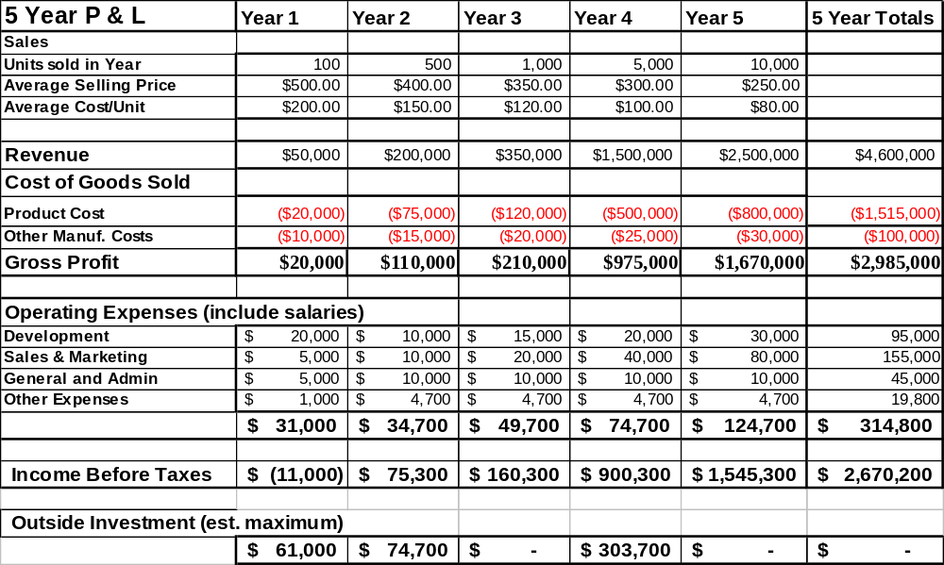
ROI: Return on Investement
<How much will it cost to develop, build, and sell?>
<How much revenue and profit will result?>
<Here’s a sample 5-year Profit & Loss statement and a simple statement of outside investment to cover the initial losses and production expansion. This exact format is not required:>

Slide 12
Conclusions
<Conclusion and Future Plans: If the immediate project is successful what's next: business plan, venture funding, licensing, sell invention, other?>

Slide 13
IQ Finalists – April 28, 2007
Inspiring and Fostering
Innovation for Our Future
Learn by Doing…Give Back by Creating…

