Slide 1
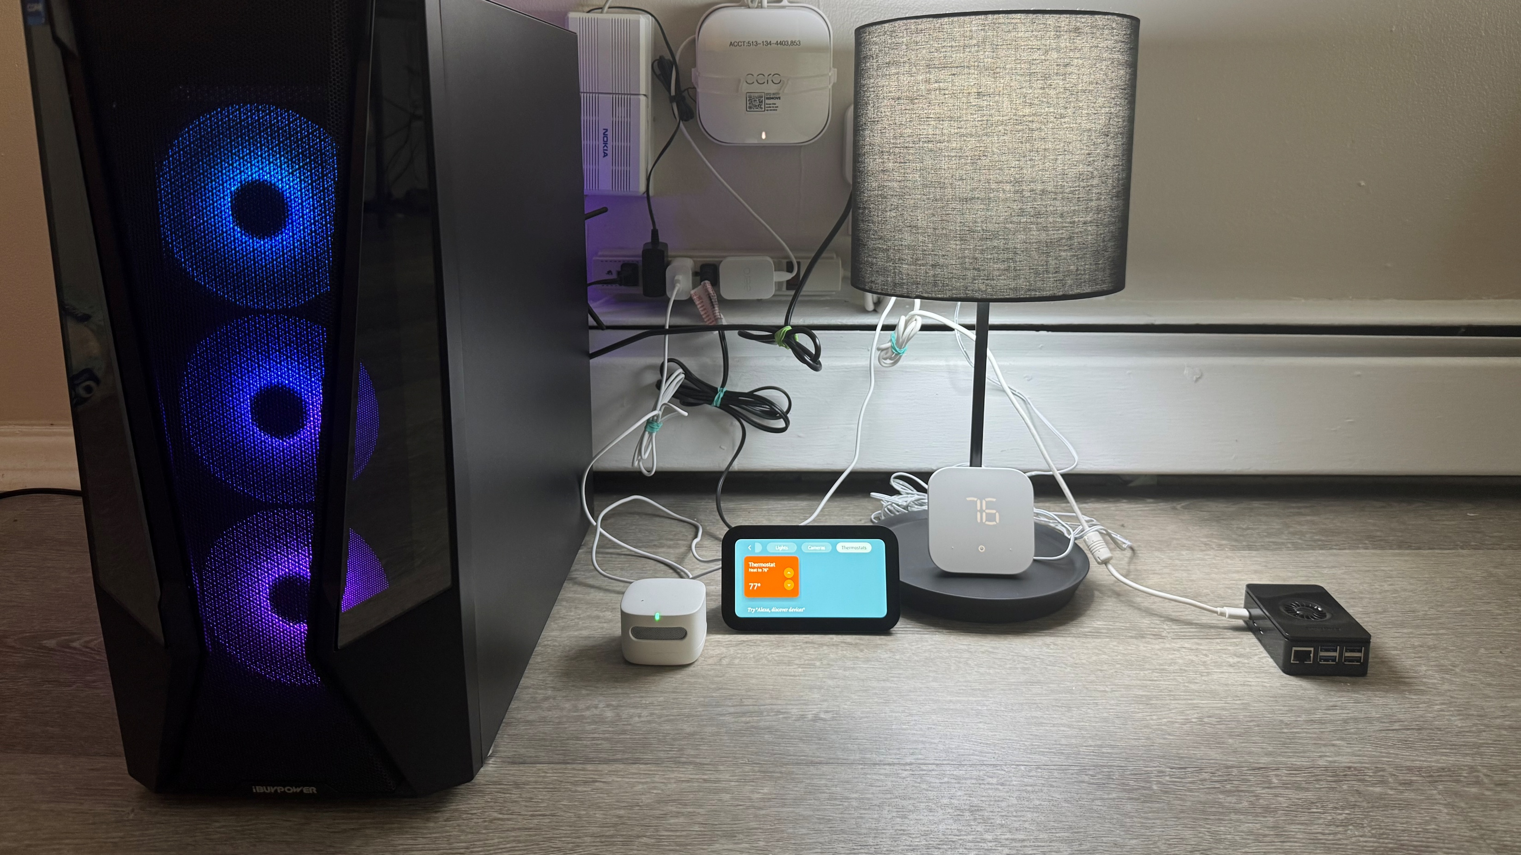
Access Point
IP: 192.168.4.35
Occupancy Sensor
IP: 192.168.4.27
Server
IP: 192.168.4.21
Smart Thermostat
IP: 192.168.4.20
IAQ Sensor
IP: 192.168.4.17
Amazon Alexa IP: 192.168.4.22
Attacker Device
IP: 192.168.4.34

