Slide 1
Hash Functions
LOCAL DEPTH
2
4*
12*
32*
16*
Bucket A
GLOBAL DEPTH
2
2
00
1*
5*
21*
13*
Bucket B
01
10
2
10*
Bucket C
11
DIRECTORY
2
15*
7*
19*
Bucket D
DATA PAGES
Hash function = last 2 bits in its binary representation

Slide 2
Finding Similar Items

Slide 3
Acknowledgements
Slides provided by:
L. Leskovec, A. Rajaraman, J. Ullman
Themis Palpanas, George Papadakis, Ekaterini Ioannou
Avigdor Gal
Yannis Velegrakis
Copyright remains with the respective authors.

Slide 4
Connection to Previous Lecture
Entity Identification is based on similarity
i.e., finding similar items
For small number of entities of relativelly small size things are manageable.
What if we have too many entities ?
What if the entities are too large?
Too many comparisons (Time)
Too large memory requirements (Space)
Approach: See entities as a set
Finding similar items reduced to finding similar sets

Slide 5
Problem Statement
Given:
A set of high dimensional data points
And some distance function
Which quantifies the “distance” between data points
Goal:
Find all pairs of data points that are within some distance threshold

Slide 6
Many data−mining problems can be expressed as finding “similar” sets:
Entity resolution.
Pages with similar words
For classification by topic
For plagiarism
For repetition avoidance
NetFlix users with similar tastes in movies
For recommendation systems.
Dual: movies with similar sets of fans.
For movie classification

Slide 7
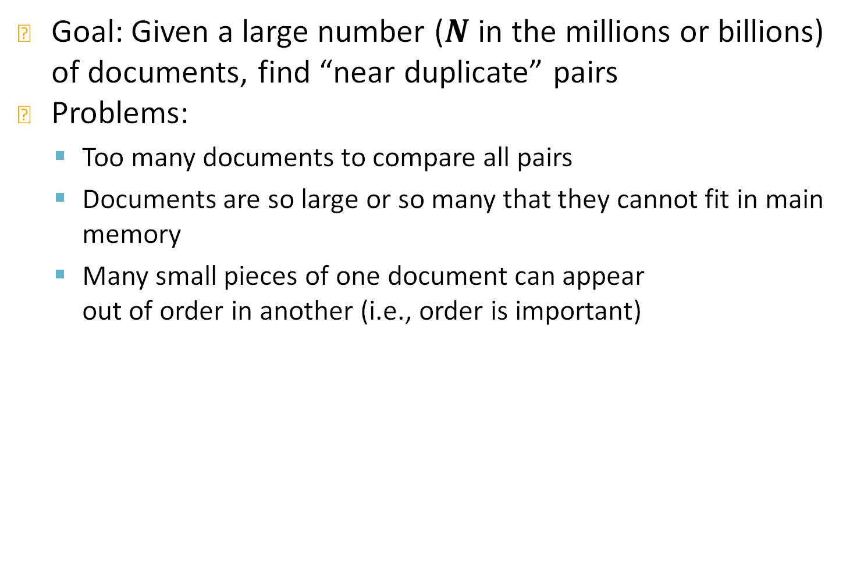
Focus on Finding Similar Documents
Goal: Given a large number ($N$ in the millions or billions) of documents, find “near duplicate” pairs
Problems:
Too many documents to compare all pairs
Documents are so large or so many that they cannot fit in main memory
Many small pieces of one document can appear out of order in another (i.e., order is important)

Slide 8
Converting Documents to Sets
Set of “words” (or “important words”) not effective
Shingling
Generating a set of strings of length k that appear in the document
A k −shingle (or k −gram) for a document is a sequence of k characters or k works or any other token
Example: k=2; doc = abcab. Doc2=abfef
Set of 2−shingles= {ab, bc, ca}. 2-shingles2={ab bf fe ef}
[ab bc ca bf fe ef]
D1: [1,1,1,0,0,0]. D2: [1,0, 0, 1,1,,1]
A doc is represented by its set of k−shingles
Each document is an 0/1 Vector in the space of shingles
Sparse Vectors

Slide 9
Converting Documents to Sets
Documents that are intuitively similar will have many shingles in common
Changing a word only affects k−shingles within distance k from the word.
Reordering paragraphs only affects the 2k shingles that cross paragraph boundaries.
Example: k=3, “The dog which chased the cat” versus “The dog that chased the cat”.
Only 3−shingles replaced are:
g_w, _wh, whi, hic, ich, ch_, and h_c

Slide 10
Challenges in using shingles
Selecting the right k
K=5 is ok for short documents
K=10 is better for long documents
Selecting the right token
Hashing Shingles
Represent a doc by its tokens, that is, the set of hash values of its k−shingles.
Two documents could (rarely) appear to have shingles in common, when in fact only the hash−values were shared.
Example: k=2; document D₁= abcab Set of 2-shingles: S(D₁) = {ab, bc, ca} Hash the singles: h(D₁) = {1, 5, 7}

Slide 11
Computing Similarities between Document Representations as Sets

Slide 12
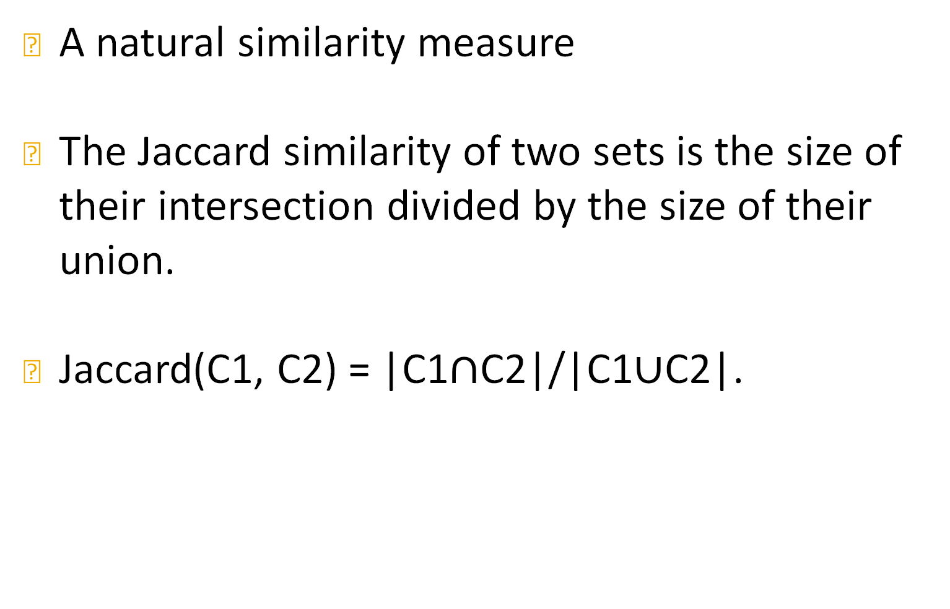
Jaccard Similarity
A natural similarity measure
The Jaccard similarity of two sets is the size of their intersection divided by the size of their union.
Jaccard(C1, C2) = |C1$∩$C2|/|C1$∪$C2|.

Slide 13
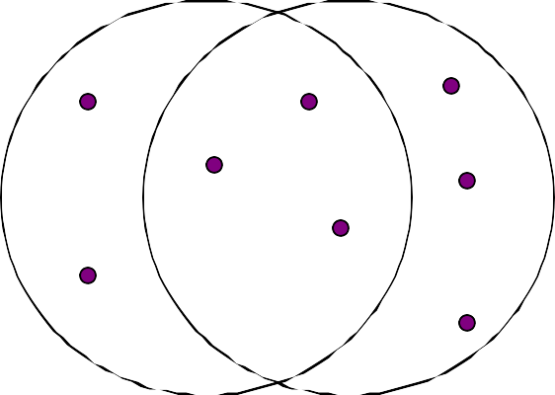
Example: Jaccard Similarity
3 in intersection.
8 in union. Jaccard similarity
= 3/8

Slide 14
Encoding Sets as Bit Vectors
Many similarity problems can be formalized as finding subsets that have significant intersection
Encode sets using 0/1 (bit, boolean) vectors
One dimension per element in the universal set
Interpret set intersection as bitwise AND, and set union as bitwise OR
Example: C₁ = 10111; C₂ = 10011
Size of intersection = 3; size of union = 4,
Jaccard similarity (not distance) = 3/4
Distance: d(C₁,C₂) = 1 – (Jaccard similarity) = 1/4

Slide 15
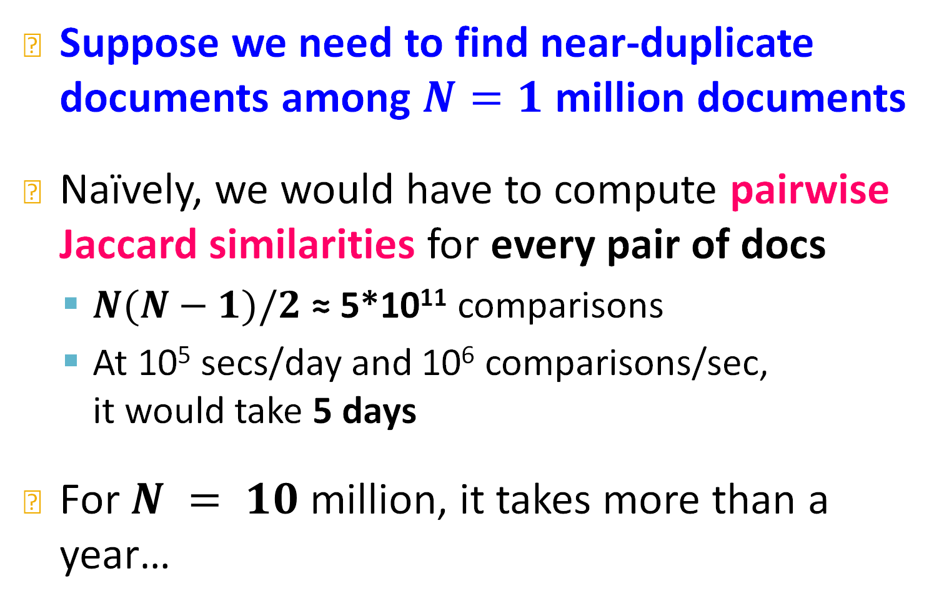
The challenge
Suppose we need to find near-duplicate documents among $N=1$ million documents
Naïvely, we would have to compute pairwise Jaccard similarities for every pair of docs
$N(N−1)/2$ ≈ 5*10¹¹ comparisons
At 10⁵ secs/day and 10⁶ comparisons/sec, it would take 5 days
For $N = 10$ million, it takes more than a year…

Slide 16
The solution
Construct signatures of the items we compare and compare the signatures instead
Signatures being much smaller of course
Minhashing : convert large sets to short signatures, while preserving similarity.
[X, Y] X = 0 or 1, Y=0 or 1
[0,1] D1. [1,1]. D2

Slide 17
Rows = elements of the universal set.
Example: the set of all k−shingles.
Columns = sets.
1 in row e and column S if and only if e is a member of S.
Column similarity is the Jaccard similarity of the sets of their rows with 1.
Typical matrix is sparse.

Slide 18
C₁ | C₂
0 | 1
1 | 0
1 | 1
0 | 0
1 | 1
0 | 1
*
*
* *
Sim(C₁, C₂) =
2/5 = 0.4
* *
*

Slide 19

Given columns C₁ and C₂, rows may be classified as:
 | C₁ | C₂
a | 1 | 1
b | 1 | 0
c | 0 | 1
d | 0 | 0
Also, a = # rows of type a , etc.
Note Sim(C₁, C₂) = a/(a +b +c ).

Slide 20

Imagine the rows permuted randomly.
Define minhash function h(C) = the number of the first (in the permuted order) row in which column C has 1.
Use several (e.g., 100) independent hash functions to create a signature for each column.
The signatures can be displayed in another matrix – the signature matrix – whose columns represent the sets and the rows represent the minhash values, in order for that column.

Slide 21
Min-Hashing Example
2nd element of the permutation is the first to map to a 1
Permutation π
Input matrix (Shingles x Documents)
Signature matrix M
2
4
3
4
7
2
6
1
5
1
0
1
0
2
1
2
1
3
2
1
0
0
1
2
1
4
1
7
1
0
1
0
1
1
2
1
2
6
3
0
1
0
1
1
6
0
1
0
1
4th element of the permutation is the first to map to a 1
5
7
1
0
1
0
4
5
1
0
1
0

Slide 22






Input matrix
Signature matrix M
1
3
7
6
2
5
4
4 |  | 3
2 |  | 4
1 |  | 7
3 |  | 6
6 |  | 1
7 |  | 2
5 |  | 5
1 | 0 | 1 | 0
1 | 0 | 0 | 1
0 | 1 | 0 | 1
0 | 1 | 0 | 1
0 | 1 | 0 | 1
1 | 0 | 1 | 0
1 | 0 | 1 | 0
2 | 1 | 2 | 1
2 | 1 | 4 | 1
1 | 2 | 1 | 2

Slide 23

The probability (over all permutations of the rows) that h(C₁) = h(C₂) is the same as Sim(C₁, C₂).
Both are a /(a +b +c )!
Why?
Look down the permuted columns C₁ and C₂ until we see a 1.
If it’s a type−a row, then h(C₁) = h(C₂). If a type−b or type−c row, then not.

Slide 24
The similarity of signatures is the fraction of the minhash functions in which they agree.
Thinking of signatures as columns of integers, the similarity of signatures is the fraction of rows in which they agree.
Thus, the expected similarity of two signatures equals the Jaccard similarity of the columns or sets that the signatures represent.
And the longer the signatures, the smaller will be the expected error.

Slide 25



Input matrix
Signature matrix M
1
3
7
6
2
4 |  | 3
2 |  | 4
1 |  | 7
3 |  | 6
6 |  | 1
7 |  | 2
5 |  | 5
1 | 0 | 1 | 0
1 | 0 | 0 | 1
0 | 1 | 0 | 1
0 | 1 | 0 | 1
0 | 1 | 0 | 1
1 | 0 | 1 | 0
1 | 0 | 1 | 0
2 | 1 | 2 | 1
2 | 1 | 4 | 1
1 | 2 | 1 | 2
5
1-3 2-4 1-2
Col/Col 0.75
Sig/Sig 0.67
0.75 0
1.00 0
4

Slide 26
Suppose 1 billion rows.
Hard to pick a random permutation of 1…billion.
Representing a random permutation requires 1 billion entries.
Accessing rows in permuted order leads to thrashing.
20

Slide 27
Implementation Trick
Permuting rows even once is prohibitive
Row hashing!
Pick K = 100 hash functions k_{i}
Ordering under k_{i} gives a random row permutation!
One-pass implementation
For each column C and hash-func. k_{i} keep a “slot” for the min-hash value
Initialize all sig(C)[i] = ∞
Scan rows looking for 1s
Suppose row j has 1 in column C
Then for each k_{i} :
If k_{i}(j) < sig(C)[i], then sig(C)[i] ← k_{i}(j)

Slide 28

for each row r do begin
for each hash function h_{i} do
compute h_{i} (r);
for each column c
if the document c has 1 in row r
for each hash function h_{i} do
if h_{i} (r) is smaller than M(i, c) then
M(i, c) := h_{i} (r);
end;

Slide 29

Sig1
Sig2
h(1) = 1 | 1 | ∞
g(1) = 3 | 3 | ∞
Row | C1 | C2
1 | 1 | 0
2 | 0 | 1
3 | 1 | 1
4 | 1 | 0
5 | 0 | 1
h(x) = x mod 5
g(x) = (2x+1) mod 5

Slide 30
Sig1
Sig2
h(1) = 1 | 1 | ∞
g(1) = 3 | 3 | ∞
h(2) = 2 | 1 | 2
g(2) = 0 | 3 | 0
Row | C1 | C2
1 | 1 | 0
2 | 0 | 1
3 | 1 | 1
4 | 1 | 0
5 | 0 | 1
h(x) = x mod 5
g(x) = (2x+1) mod 5

Slide 31
Sig1
Sig2
h(1) = 1 | 1 | ∞
g(1) = 3 | 3 | ∞
h(2) = 2 | 1 | 2
g(2) = 0 | 3 | 0
h(3) = 3 | 1 | 2
g(3) = 2 | 2 | 0
Row | C1 | C2
1 | 1 | 0
2 | 0 | 1
3 | 1 | 1
4 | 1 | 0
5 | 0 | 1
h(x) = x mod 5
g(x) = (2x+1) mod 5

Slide 32
Sig1
Sig2
h(1) = 1 | 1 | ∞
g(1) = 3 | 3 | ∞
h(2) = 2 | 1 | 2
g(2) = 0 | 3 | 0
h(3) = 3 | 1 | 2
g(3) = 2 | 2 | 0
h(4) = 4 | 1 | 2
g(4) = 4 | 2 | 0
Row | C1 | C2
1 | 1 | 0
2 | 0 | 1
3 | 1 | 1
4 | 1 | 0
5 | 0 | 1
h(x) = x mod 5
g(x) = (2x+1) mod 5

Slide 33
Sig1
Sig2
h(1) = 1 | 1 | ∞
g(1) = 3 | 3 | ∞
h(2) = 2 | 1 | 2
g(2) = 0 | 3 | 0
h(3) = 3 | 1 | 2
g(3) = 2 | 2 | 0
h(4) = 4 | 1 | 2
g(4) = 4 | 2 | 0
h(5) = 0 | 1 | 0
g(5) = 1 | 2 | 0
Row | C1 | C2
1 | 1 | 0
2 | 0 | 1
3 | 1 | 1
4 | 1 | 0
5 | 0 | 1
h(x) = x mod 5
g(x) = (2x+1) mod 5

Slide 34

Often, data is given by column, not row.
Example: columns = documents, rows = shingles.
If so, sort matrix once so it is by row.

Slide 35
Focusing on Similar MinHash Signatures
Locality−sensitive hashing : focus on pairs of signatures likely to be similar.

Slide 36
General idea: Generate from the collection of all elements (signatures in our example) a small list of candidate pairs: pairs of elements whose similarity must be evaluated.
For signature matrices: Hash columns to many buckets, and make elements of the same bucket candidate pairs.

Slide 37

Pick a similarity threshold t, a fraction < 1.
We want a pair of columns c and d of the signature matrix M to be a candidate pair if and only if their signatures agree in at least fraction t of the rows.
I.e., M(i, c) = M(i, d) for at least fraction t
values of i.

Slide 38
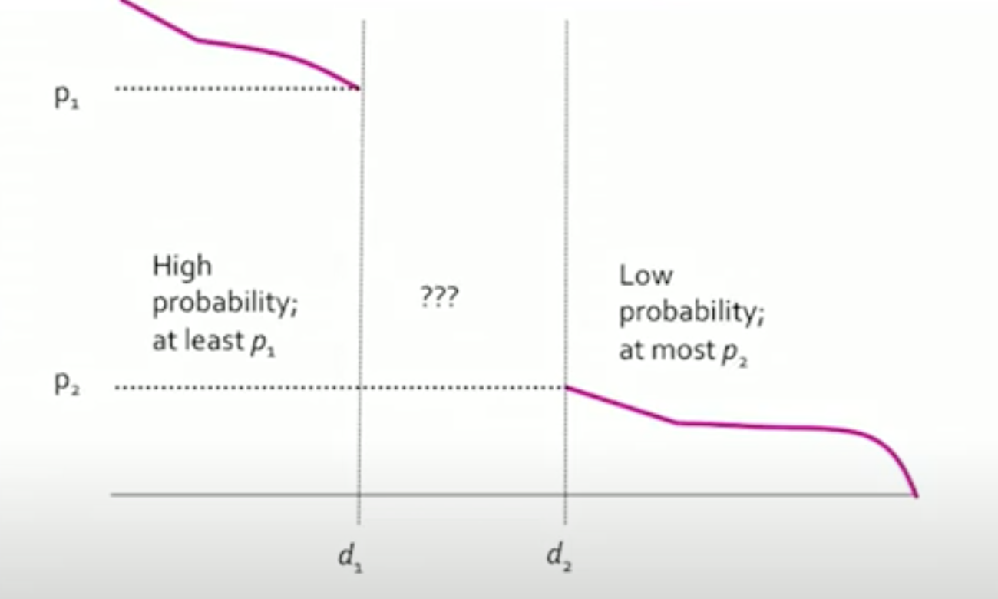
Assumptions for LSH
Consider a space S of points with distance measure d
Hash functions to be (d1,d2,p1,p2)-sensitive if for any two points x and y:
If d(x,y)<=d₁ then h(x)=h(y)>=p₁, ∀h
If (d,y)≥d₂, then h(x)=h(y)≤p₂, ∀h
For Jaccard distance & minhash:
Prob[h(x)=h(y)] = 1 – d(x,y)

Slide 39
Big idea: hash columns of signature matrix M
several times.
Arrange that (only) similar columns are likely to hash to the same bucket.
Candidate pairs are those that hash at least once to the same bucket.

Slide 40

r rows per band
b bands
One signature
Matrix M

Slide 41
Divide matrix M into b bands of r rows.
For each band, hash its portion of each column to a hash table with k buckets.
Make k as large as possible.
Candidate column pairs are those that hash to the same bucket for S 1 band.
Tune b and r to catch most similar pairs, but few nonsimilar pairs.
30

Slide 42


Buckets
Columns 2 and 6
are probably identical in this band.
Columns 6 and 7 are surely different.
r rows
b bands
Matrix M
9/29/2014

Slide 43




Candidate pairs : those pairs
of signatures that we need to test for similarity.
Docu- ment
Locality- sensitive Hashing
The set of strings
of length k that appear in the doc- ument
Signatures : short integer vectors that represent the sets, and reflect their similarity

Slide 44
Methods for High Degree of Similarity
LSH is good for relativelly low similarities
Finding Identical Items
Hash on the first few letters
Hash the whole document
Hash fixed positions only
Representing Sets as Strings
Length based Filtering
Sort strings on length and compare only with what follows.
Prefix Indexing

Slide 45
LSH idea in entity Linking: Blocking
Represent each entity by one or more signatures called blocking keys
Focus on string values
Place into blocks all entities having the same or similar blocking key
Two matching profiles can be detected as long as they co-occur in at least one block
Trade-off between recall and precision!
Generation 1: Tackling Veracity
Notes:
To leverage Big Data, we need to perform ER.
ER is a core task for many applications, like Linked Data.

Slide 46
Modern Entity Linking
Schema Alignment
Blocking
Matching
Clustering
Requires 4 steps
Notes:
which are introduced during manual data entry, or by the limitations of the automatic extraction techniques

Slide 47
Step 1: Schema Alignment / Matching
Scope: Remove heterogeneity in names
Record Linkage
Goal:
Create mappings between equivalent attributes of the two schemata, e.g., profession ≡ job
Types of Solutions: Schema Matching Methods
Structure-based
Instance-based
Usage-based
Hybrid
Generation 1: Tackling Veracity

Slide 48
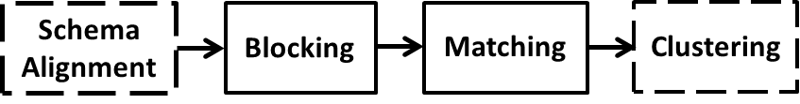
Step 2: Blocking
Scope:
Both Deduplication and Record Linkage
Goal:
ER is an inherently quadratic problem, O(n²): every entity has to be compared with all others
Blocking groups similar entities into blocks
Comparisons are executed only inside each block
Complexity is now quadratic to the size of the block (much smaller than dataset size!)
The Minhash/LSH Principle

Slide 49
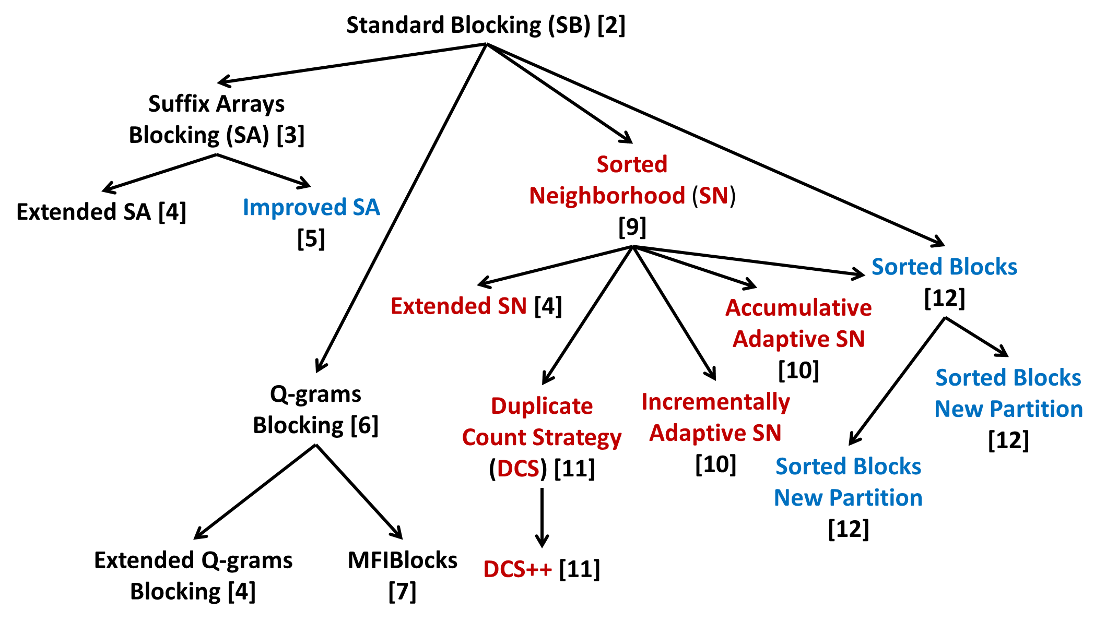
Genealogy Tree of Non-learning Blocking Methods
Only to give an idea of the
many methods that exist

Slide 50
Step 3: Matching
Estimates the similarity of candidate matches.
Input
A set of blocks
Every distinct comparison in any block is a candidate match
Output
Similarity Graph
Nodes → entities
Edges → candidate matches
Edge weights → matching likelihood (based on similarity score)
We have already seen this

Slide 51


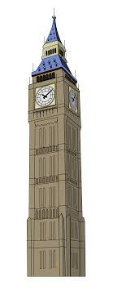
Step 4: Clustering
Partitions the matched pairs into equivalence clusters
i.e., groups of entity profiles describing the same
real-world object
Input
Similarity Graph:
Nodes → entities
Edges → candidate matches
Edge weights → matching likelihood (based on similarity score)
Output
Equivalence Clusters
Part of the Data Mining Course

Slide 52
THANK YOU

Slide 53
Computational cost
Brute-force approach
Input:
Entity Collection E
Blocking
Duplicate Pairs
|E| entities
E.g.: For a dataset with 100,000 entities:
~10¹⁰ comparisons,
If 0.05 msec each → >100 hours in total
|E| entities
Generation 1: Tackling Veracity
Notes:
We can illustrate the relative cost of the main approaches through a diagram.
In the ideal case, the green circle coincides with the red one.
Blocking covers the largest part of duplicate pairs, but not all of them.
It also incorporates comparisons between non-matching entities.
The closer the green circle is to the red one, the better the blocking method is.

Slide 54
General Principles of Blocking
Represent each entity by one or more signatures called blocking keys
Focus on string values
Place into blocks all entities having the same or similar blocking key
Two matching profiles can be detected as long as they co-occur in at least one block
Trade-off between recall and precision!
Generation 1: Tackling Veracity
Notes:
To leverage Big Data, we need to perform ER.
ER is a core task for many applications, like Linked Data.

Slide 55
Genealogy Tree of Non-learning Blocking Methods [1]
Only to get an idea of the
plurality of methods
Generation 1: Tackling Veracity

Slide 56
Step 3: Matching
Estimates the similarity of candidate matches.
Input
A set of blocks
Every distinct comparison in any block is a candidate match
Output
Similarity Graph
Nodes → entities
Edges → candidate matches
Edge weights → matching likelihood (based on similarity score)
We have already seen this
Papadakis, Ioannou, Palpanas
Generation 1: Tackling Veracity

Slide 57
Step 4: Clustering
Partitions the matched pairs into equivalence clusters
i.e., groups of entity profiles describing the same
real-world object
Input
Similarity Graph:
Nodes → entities
Edges → candidate matches
Edge weights → matching likelihood (based on similarity score)
Output
Equivalence Clusters
Part of the Data Mining Course
Papadakis, Ioannou, Palpanas
Generation 1: Tackling Veracity

Slide 58
Generation 2: Tackling Volume and Veracity
Schema Alignment
Blocking
Matching
Clustering
Same workflow as Generation 1
Scope:
(tens of) millions of structured entity profiles
Goals:
High accuracy despite noise
High time efficiency despite the size of data
Assumptions:
Known schema → custom, schema-based solutions
Notes:
which are introduced during manual data entry, or by the limitations of the automatic extraction techniques

Slide 59
Solution: Parallelization
Two types:
Multi-core parallelization
Single system → shared memory
Distribute processing among available CPUs
Massive parallelization
Cluster of independent systems
Map-Reduce paradigm [1]
Data partitioned across the nodes of a cluster
Fault-tolerant, optimized execution
Map Phase: transforms a data partition into (key, value) pairs
Reduce Phase: processes pairs with the same key
Generation 2: Tackling Volume & Veracity

Slide 60
Any Questions?

