Slide 1
ICDEV™ AI Academy & GameDay Innovation Lab Training Program
ICDEV™ · A System That Builds Systems
Lab standing up from scratch. Goal: train 100 people in cohorts of 20. Internet-connected. VPN to IC

Slide 2
Program Overview
▸ Goal: Train up to 100 people (technical + non-technical) in an ICDEV Innovation Lab
▸ Cohort size: 20 students per session — 5 cohorts to reach 100
▸ Curriculum: ICDEV AI Academy (16 guided missions) + GameDay TTX scenarios
▸ Location: Innovation Lab (ICDEV server) connected via VPN to ICE Training Room (20 PCs)
▸ Everything built from scratch — server, network, VPN, user management
ICDEV™ · A System That Builds Systems
2
Notes:
This deck covers the full plan: infrastructure, phases, timeline, and training delivery model.

Slide 3
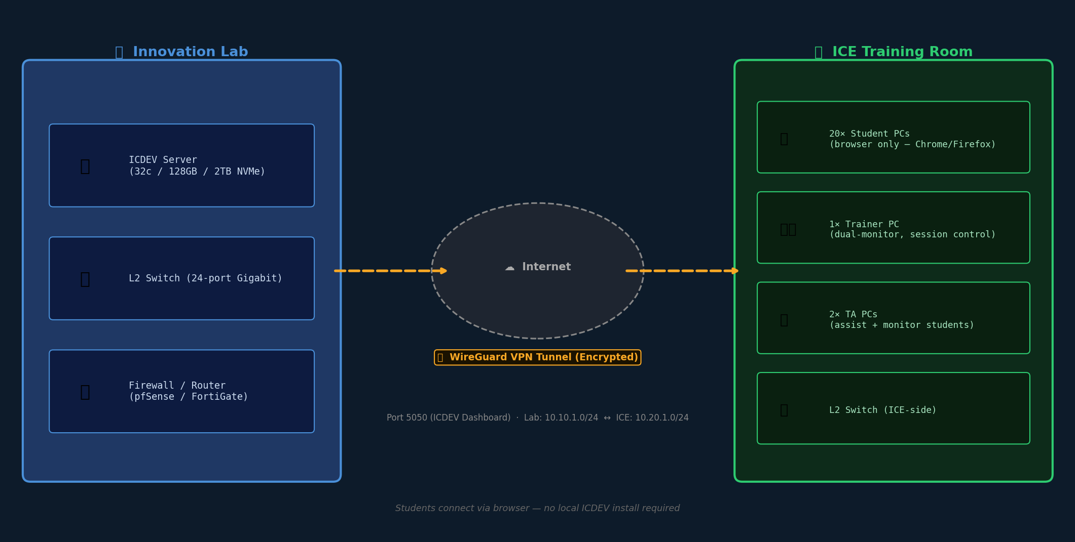
Lab ↔ ICE Training Room Architecture
▸ Innovation Lab: ICDEV server + L2 switch + firewall/router
▸ ICE Training Room: 20 student PCs + 1 trainer + 2 TA PCs (23 total seats)
▸ Connectivity: WireGuard VPN tunnel over internet (encrypted)
▸ Students access ICDEV dashboard via browser — no local installs required
▸ Lab and ICE are separate physical locations connected by internet + VPN
ICDEV™ · A System That Builds Systems
3
Notes:
Two-location model: all compute stays in the Lab, students connect from ICE over VPN.

Slide 4
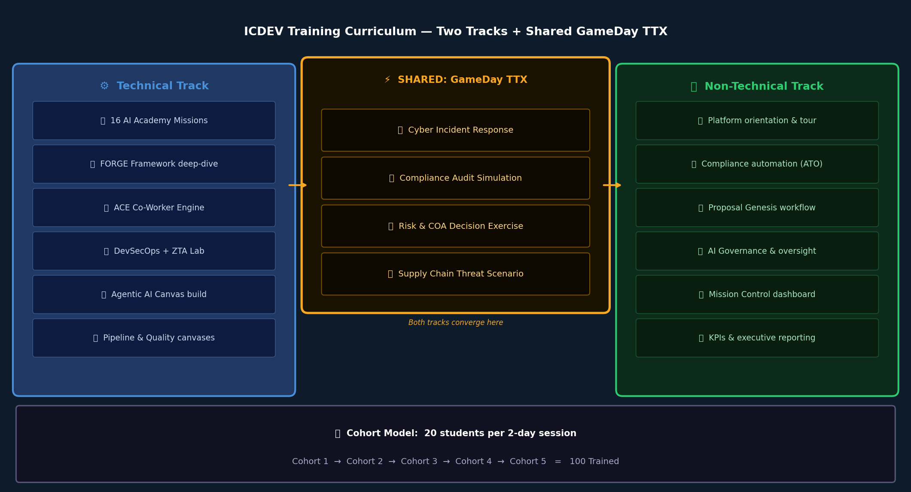
Training Curriculum: Two Tracks
▸ Technical Track: 16 AI Academy missions — FORGE, ACE co-workers, DevSecOps, Agentic AI canvas
▸ Non-Technical Track: Platform tour, compliance automation, Proposal Genesis, AI governance
▸ Shared: GameDay TTX — cyber incident, compliance audit, risk simulation scenarios
▸ Hands-on: every student gets a personal ICDEV account and live sandbox environment
▸ Duration: 2-day intensive per cohort (Day 1 = Academy, Day 2 = GameDay)
ICDEV™ · A System That Builds Systems
4
Notes:
Both tracks converge at GameDay for shared TTX practice. Personalized accounts persist across sessions.

Slide 5
Phase 1 — Foundation & Design | Months 1–2
▸ ❆ Requirements finalization: classification level, user count, compliance baseline
▸ ❆ Network design: IP schema, VLAN layout, firewall rule set, VPN topology
▸ ❆ Server procurement: spec and order ICDEV host server (see Slide 12 for specs)
▸ ❆ ICE coordination: confirm 20 PC availability, reserve training room calendar
▸ ❆ Deliverable: Approved Lab Design Document + Bill of Materials
ICDEV™ · A System That Builds Systems
5
Notes:
Phase 1 is all planning and procurement. No physical build yet. Key risk: ICE room availability.

Slide 6
Phase 2 — Server & Lab Build | Months 2–3
▸ ❆ Rack server, L2 switch, firewall/router delivered and racked in Lab
▸ ❆ OS install: Ubuntu 22.04 LTS or RHEL 9 — hardened per DISA STIG baseline
▸ ❆ PostgreSQL 16 + Python 3.11 environment installed and validated
▸ ❆ ICDEV cloned, .env configured (API keys, DB URI, ICDEV_STORAGE_BACKEND=postgresql)
▸ ❆ Deliverable: ICDEV dashboard accessible at http://lab-server:5050 — internal only
ICDEV™ · A System That Builds Systems
6
Notes:
Server spec: 32-core CPU, 128GB RAM, 2TB NVMe SSD minimum for 20 concurrent users.

Slide 7
Phase 3 — VPN & ICE Connectivity | Months 3–4
▸ ❆ WireGuard VPN configured: Lab firewall = server peer, ICE router = client peer
▸ ❆ Encrypted tunnel: Lab subnet (10.10.1.0/24) ↔ ICE subnet (10.20.1.0/24)
▸ ❆ Firewall rules: allow port 5050 (ICDEV dashboard) + 5432 (PG, internal only)
▸ ❆ ICE PC browser test: all 23 seats reach ICDEV at http://10.10.1.10:5050
▸ ❆ Deliverable: VPN health check report + bandwidth test (target ≥ 10 Mbps/user)
ICDEV™ · A System That Builds Systems
7
Notes:
WireGuard chosen for simplicity, performance, and auditability. Fallback: OpenVPN or IPsec.

Slide 8
Phase 4 — ICDEV Config & Training Content | Months 4–5
▸ ❆ LLM routing configured: Anthropic API key set, claude-sonnet-4-6 as default model
▸ ❆ AI Academy: 16 mission packs loaded, technical + non-technical tracks configured
▸ ❆ GameDay TTX: cyber incident, compliance audit, and risk simulation scenarios seeded
▸ ❆ ICDEV canvases enabled: Agentic AI, Security, Network, Pipeline, Quality, Boundary
▸ ❆ Deliverable: Trainer runbook + student quickstart guide published
ICDEV™ · A System That Builds Systems
8
Notes:
LLM costs are metered per session — budget ~$2-5 per student per day for API calls.

Slide 9
Phase 5 — User Management & Pilot Cohort | Months 5–6
▸ ❆ User provisioning: 20 student accounts + trainer + 2 TA accounts per cohort
▸ ❆ RBAC: student role (sandbox only), trainer role (read-all + session control), TA role
▸ ❆ Cohort reset script: wipes sandbox data between cohorts, preserves platform config
▸ ❆ Pilot run: first 20-person cohort — collect feedback, measure completion, fix gaps
▸ ❆ Deliverable: After-action report + tuned runbook ready for Cohort 2
ICDEV™ · A System That Builds Systems
9
Notes:
Pilot cohort should include a mix of technical and non-technical students to stress-test both tracks.

Slide 10
Phase 6 — Scale to 100 Students | Months 6–9
▸ ❆ Run 4 additional cohorts of 20 (Cohorts 2–5) — one every 3–4 weeks
▸ ❆ Server capacity: validate CPU/RAM under 20 concurrent users; add RAM if needed
▸ ❆ Optionally add a second ICDEV instance for parallel cohort capacity
▸ ❆ Continuous improvement: Genesis weekly reflex + lesson-learned engine active
▸ ❆ Deliverable: 100 trained students — certificates issued, skills tracked in ICDEV
ICDEV™ · A System That Builds Systems
10
Notes:
After Cohort 3, run a lessons-learned session and tune the curriculum before the final two cohorts.

Slide 11
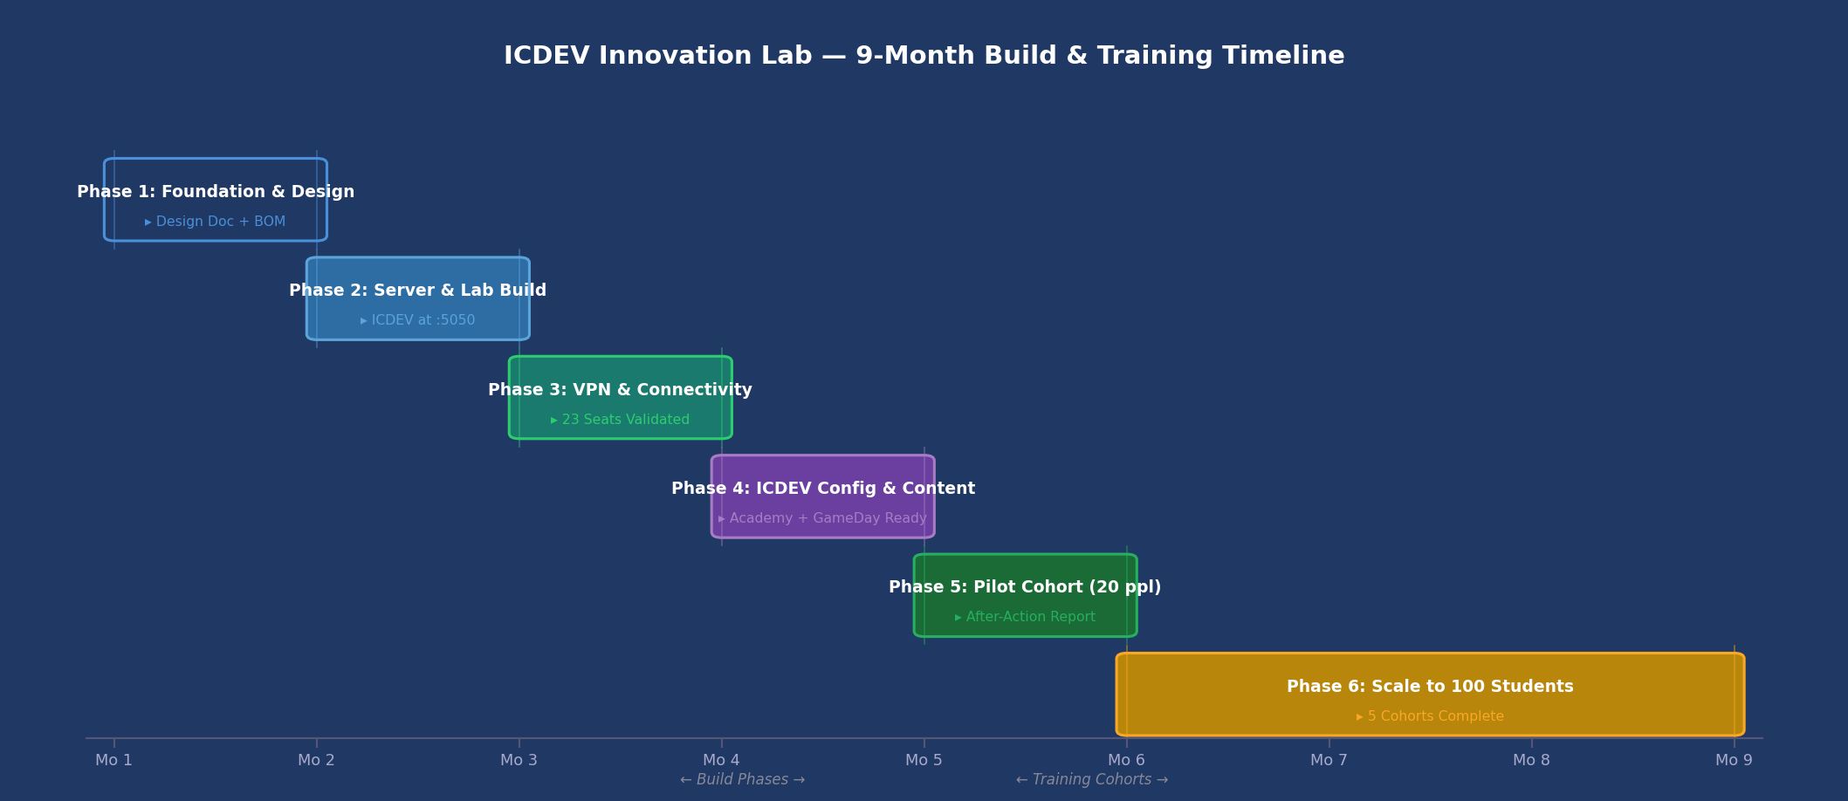
9-Month Build & Training Timeline
▸ Months 1–2: Foundation — design, procurement, ICE coordination
▸ Months 2–3: Lab Build — server, OS, ICDEV install
▸ Months 3–4: VPN — encrypted tunnel Lab ↔ ICE, 23-seat validation
▸ Months 4–6: Config + Pilot — LLM, Academy, GameDay, first cohort
▸ Months 6–9: Scale — 4 additional cohorts → 100 students trained
ICDEV™ · A System That Builds Systems
11
Notes:
Timeline is aggressive but achievable if procurement starts in Month 1.

Slide 12
ICDEV Server Specifications (20 Concurrent Users)
▸ CPU: 32-core / 64-thread (AMD EPYC or Intel Xeon) — LLM inference + 20 sessions
▸ RAM: 128 GB DDR5 — PostgreSQL buffer pool (32 GB) + per-session overhead
▸ Storage: 2 TB NVMe SSD primary (OS + ICDEV + PG) + 4 TB HDD archive
▸ NIC: 2× 10 GbE (one to switch, one to firewall/uplink) — bonded for redundancy
▸ OS: Ubuntu 22.04 LTS (preferred) or RHEL 9 — DISA STIG hardened at build time
ICDEV™ · A System That Builds Systems
12
Notes:
If budget is constrained, 16-core / 64 GB is the minimum viable config for 20 concurrent users.

Slide 13
Innovation Lab Network Equipment
▸ Firewall/Router: pfSense or Fortinet FortiGate — WireGuard VPN, stateful firewall, IDS
▸ L2 Switch: 24-port managed gigabit (Cisco SG350 or equivalent) — VLANs for server/mgmt
▸ UPS: 1500VA rack-mount — protects server + network gear from power events
▸ Cabling: Cat6A patch cables, rack PDU, 6U wall-mount or floor rack
▸ Internet uplink: ≥ 200 Mbps symmetric — supports 20 concurrent VPN + LLM API sessions
ICDEV™ · A System That Builds Systems
13
Notes:
Lab VLAN design: VLAN 10 = server, VLAN 20 = management, VLAN 30 = VPN termination.

Slide 14
ICE Training Room — 23-Seat Configuration
▸ 20× Student PCs: browser only (Chrome/Firefox) — no ICDEV local install required
▸ 1× Trainer PC: dual-monitor recommended — one for ICDEV session control, one for display
▸ 2× TA PCs: monitor + assist student sessions via ICDEV trainer role
▸ Display: projector or large display (75"+) for instructor screen share
▸ ICE network: WireGuard VPN client pre-configured on all 23 PCs — ICDEV via browser
ICDEV™ · A System That Builds Systems
14
Notes:
Students need no technical setup — just open a browser. Trainer controls session pacing via ICDEV dashboard.

Slide 15
User Management — Per-Cohort Account Model
▸ Account naming: student01–student20 (reused per cohort after sandbox reset)
▸ Roles: student (sandbox only), trainer (read-all + HITL approval), ta (view + assist)
▸ Sandbox isolation: each student gets a dedicated tenant namespace — no cross-contamination
▸ Cohort reset: Python script wipes sandbox tables, resets passwords, seeds fresh Academy state
▸ Auth: local ICDEV accounts (Phase 1); optional LDAP/AD integration in Phase 6 scale-up
ICDEV™ · A System That Builds Systems
15
Notes:
Keep accounts simple for the pilot. LDAP integration adds complexity — defer to Phase 6 if needed.

Slide 16
Training Day Runbook
▸ T-1 day: Run cohort reset script, validate all 23 seats reach ICDEV, brief trainer
▸ Day 1 AM: Platform orientation (1h) → AI Academy missions 1–8 (3h) → Lunch
▸ Day 1 PM: Academy missions 9–16 (3h) → Canvas hands-on workshop (2h)
▸ Day 2 AM: GameDay briefing (1h) → Cyber incident TTX (2h) → Compliance audit TTX (2h)
▸ Day 2 PM: Risk simulation TTX (2h) → After-action review (1h) → Certificates
ICDEV™ · A System That Builds Systems
16
Notes:
Two-day intensive. Non-technical students skip missions 12-16 and do an extended GameDay PM instead.

Slide 17
Key Risks & Mitigations
▸ Risk: VPN latency > 100ms sluggish dashboard → CDN-optimized static assets + local JS caching
▸ Risk: Server overload with 20 concurrent LLM sessions → per-role cost caps + queue throttling
▸ Risk: ICE PCs block browser ports → coordinate with ICE IT 30 days before pilot for whitelist
▸ Risk: Anthropic API outage during training → Ollama local LLM fallback in llm_config.yaml
▸ Risk: Cohort reset script fails → tested reset procedure + documented manual rollback
ICDEV™ · A System That Builds Systems
17
Notes:
The Ollama fallback is the most important mitigation — configure in Phase 4 even if you don't plan to use it.

Slide 18
Success Metrics — How We Know It’s Working
▸ Academy completion rate: ≥ 90% of students complete all 16 missions per cohort
▸ GameDay TTX scores: ≥ 80% average on cyber, compliance, and risk scenarios
▸ Lab uptime: ≥ 99.5% during scheduled training windows (monitored via ICDEV /monitoring)
▸ Cohort throughput: 5 cohorts of 20 completed within 9 months = 100 students trained
▸ Post-training survey: ≥ 4.0/5.0 average on platform usefulness and instructor quality
ICDEV™ · A System That Builds Systems
18
Notes:
Track these in ICDEV's built-in analytics dashboard — no external BI tool needed.

Slide 19
Next Steps
Approve Lab Design Document — kick off server procurement (Month 1)
Coordinate with ICE IT — reserve training room + whitelist VPN ports
Assign Lab Admin — person responsible for ICDEV server and cohort resets
ICDEV™ · A System That Builds Systems
19
Notes:
Critical path: server procurement takes 4–6 weeks. Start that in Week 1.

