Slide 1
ICDEV™: The System That Builds Systems
ICDEV™ · A System That Builds Systems
Open with the framing: ICDEV is not a single tool. It is a system that builds systems — software, co

Slide 2
Agenda: Three Acts
▸ 1. Why government software delivery is broken — the four forces driving the pain
▸ 2. What ICDEV™ does about it — the platform, the agents, the reflexes
▸ 3. Three use cases that change the math — Proposals, ATO, Program Management
ICDEV™ · A System That Builds Systems
2
Notes:
Three short acts. We'll spend the most time in Act 3, the use cases.

Slide 3
Government Software Delivery Is Broken
▸ 2x — Federal IT projects run two times over budget on average
▸ 33% — Average schedule slip on large federal IT programs
▸ 12–18 months — Typical ATO (Authority To Operate) timeline before a system can go live
▸ 70% — Share of large federal IT programs that fail to meet original goals
ICDEV™ · A System That Builds Systems
3
Notes:
Source: GAO high-risk list. These numbers are consistent across the last decade. Even the best federal program offices live with this. The question is not whether to fix it — it's how.

Slide 4
Four Forces Driving the Pain
▸ Compliance Tax — ATO, FedRAMP, CMMC, STIGs, SBOM live in siloed tools
▸ Capture Tax — 200-page proposals assembled manually under deadline pressure
▸ Program Tax — EVM, CPARS, CDRLs still tracked on spreadsheets
▸ Security Tax — zero-trust and SBOM treated as checkboxes, not engineering
ICDEV™ · A System That Builds Systems
4
Notes:
Every one of these forces is real and necessary. The problem is not that the work exists — the problem is that it lives in 12 different tools, owned by 12 different teams, and never comes together until the audit. ICDEV's bet is that all four of these are actually the same work viewed from four angles.

Slide 5
Enter ICDEV™ — The System That Builds Systems
▸ 20+ design canvases for AI-assisted design across every engineering domain
▸ 15 AI agents on a coordinated A2A (agent-to-agent) protocol
▸ 31 always-on reflexes that keep the system healthy while you sleep
▸ From RFP to runtime on one stack — no glue code, no integration tax
ICDEV™ · A System That Builds Systems
5
Notes:
Slow down here. ICDEV is not a single product. It is a system of systems. Twenty design canvases for engineers. Fifteen agents that talk to each other. Thirty-one reflexes running 24/7 in the background. And all of it on one stack.

Slide 6
The ICDEV Ecosystem — Six Capability Domains
▸ Design Canvases — Network, Security, Infrastructure, Agentic AI, Documents
▸ Compliance & ATO — FedRAMP, CMMC, NIST, cATO, crosswalk engine
▸ GovCon Intelligence — SAM.gov capture, proposals, CPMP post-award
▸ Agentic AI Platform — 15 agents, ANVIL 5-phase build, Genesis reflexes
▸ Security & ZTA — NSA ZIG (7 pillars), zero-trust, OWASP Agentic
ICDEV™ · A System That Builds Systems
6
Notes:
Six domains, one platform. Every canvas, every agent, every reflex is wired into the same data layer. That's the difference between a tool and a system.

Slide 7
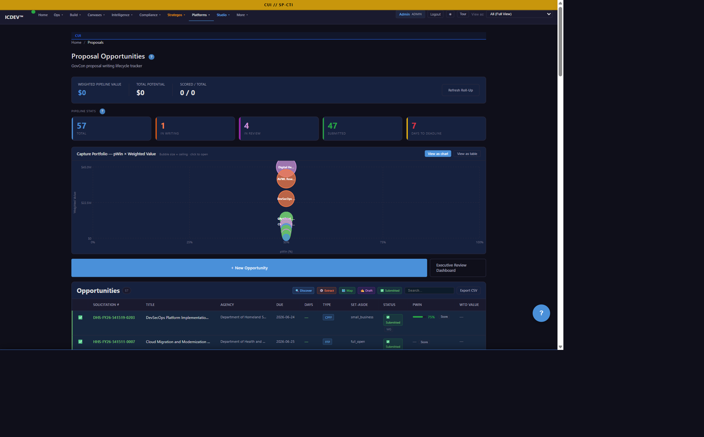
Use Case 1 — Proposals: 14 Days to 5 Days
▸ Challenge: A 200-page RFP arrives. You have 14 days. The team spends week 1 reading, week 2 writing, week 3 polishing — and you're already late.
▸ Solution: GovCon canvas scans SAM.gov, mines requirements, scores bid/no-bid, drafts sections, auto-populates compliance matrices.
▸ Outcome: 14 days → 5 days. Bid cycle cut by 60%. Win-rate lift on compliant submissions.
ICDEV™ · A System That Builds Systems
7
Notes:
This is the use case capture managers feel first. The GovCon canvas does the reading, the drafting, and the compliance-mapping in parallel. Your team reviews and decides — not types.

Slide 8
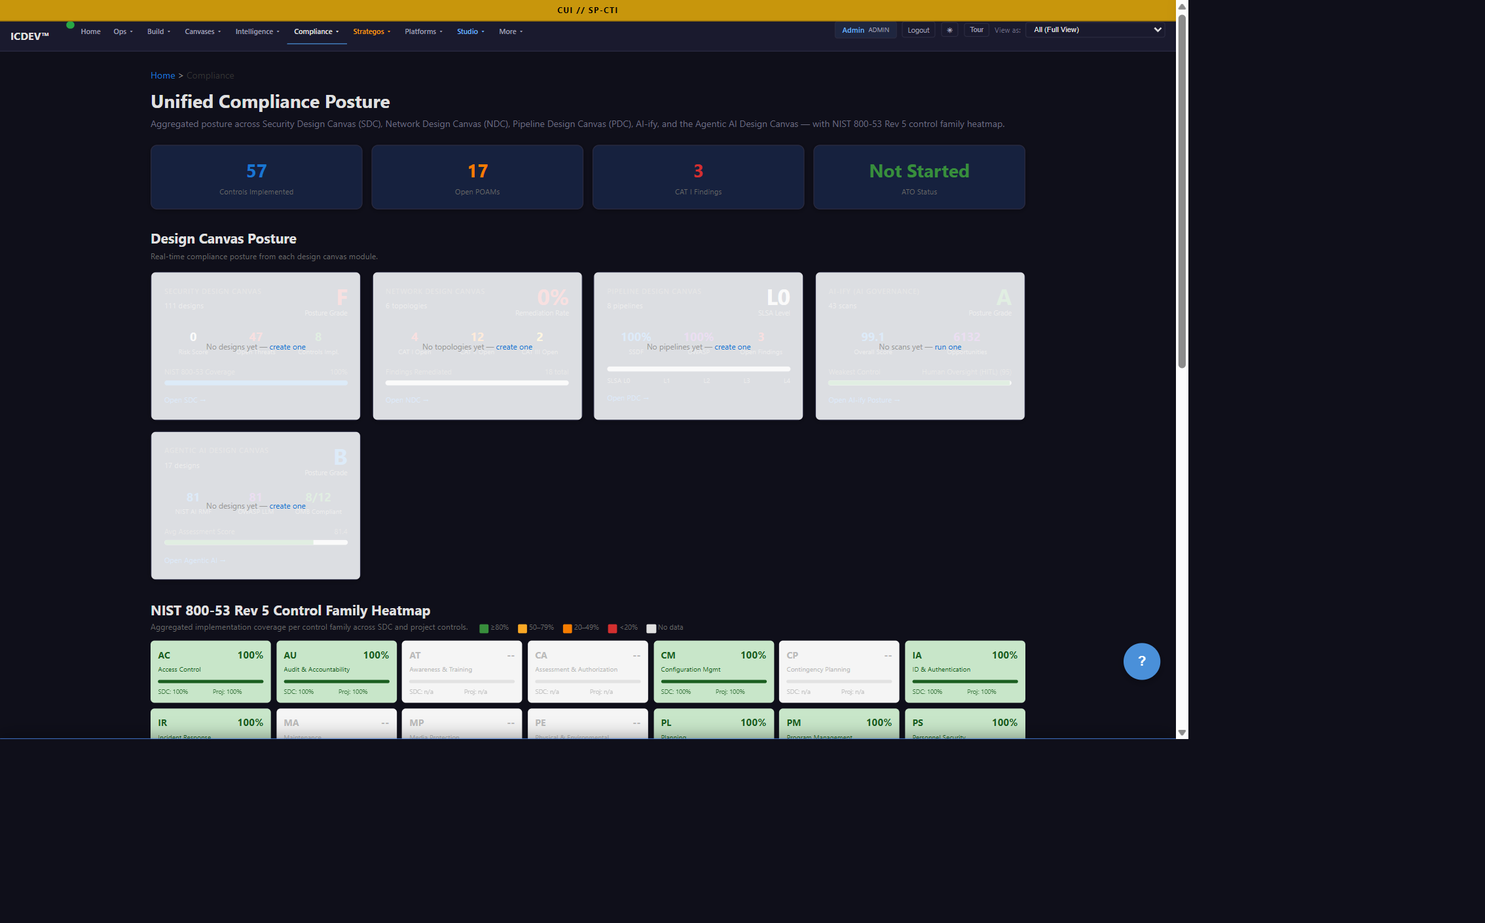
Use Case 2 — ATO: 18 Months to 60 Days
▸ Challenge: A new system needs an ATO. You need SSP, POAM, STIG results, SBOM, FIPS 199 categorization. Each lives in a different tool, owned by a different team.
▸ Solution: Compliance canvas generates SSP from controls catalog, runs NIST 800-53 → FedRAMP/CMMC crosswalk, pulls live STIG/SBOM evidence, populates POAM, ships a complete package. cATO continuous monitoring every 6 hours.
▸ Outcome: 18 months → 60 days for initial ATO. Compliance posture visible in real time.
ICDEV™ · A System That Builds Systems
8
Notes:
This is the use case ISSOs and AOs feel first. The compliance canvas turns SSP generation from a 90-day manual slog into a same-day pull. And once the ATO is granted, cATO monitoring keeps it that way — every six hours.

Slide 9
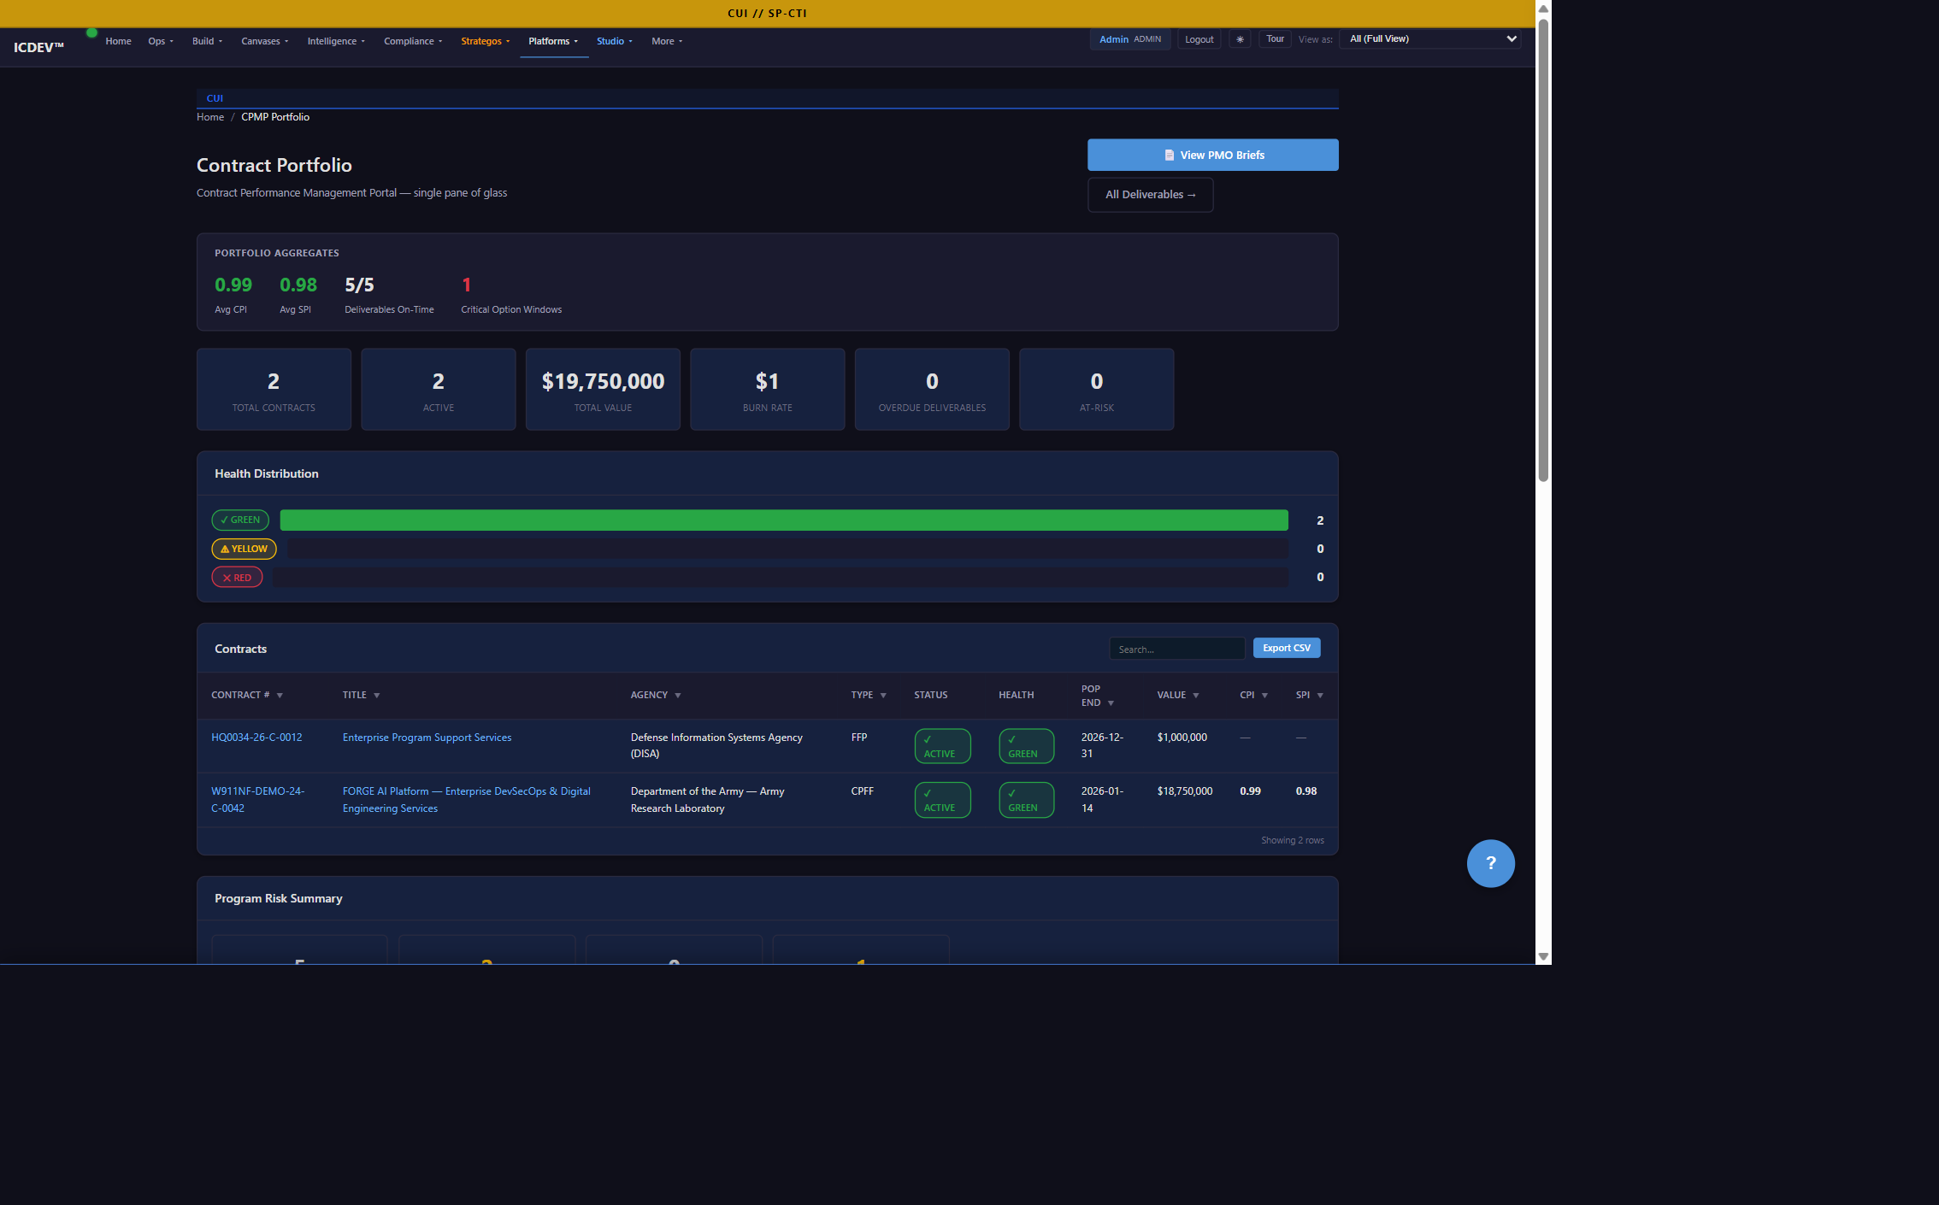
Use Case 3 — Program Management: Spreadsheets to Live Contract
▸ Challenge: A $40M contract has 12 CLINs (Contract Line Items), 47 deliverables, and a COR (Contracting Officer's Representative) who wants EVM (Earned Value Management) and CPARS (Contractor Performance Assessment Reporting System) on demand.
▸ Solution: CPMP canvas tracks EVM, predicts CPARS scores, auto-detects negative events, generates CDRLs (Contract Data Requirements List), surfaces contract health in real time.
▸ Outcome: No more end-of-month surprises. CORs get answers in 30 seconds, not 3 days.
ICDEV™ · A System That Builds Systems
9
Notes:
This is the use case PMs feel first. The CPMP canvas turns the contract from a static document into a live dashboard. EVM auto-updates. CPARS auto-predicts. CDRLs auto-generate. CORs get answers in 30 seconds, not 3 days.

Slide 10
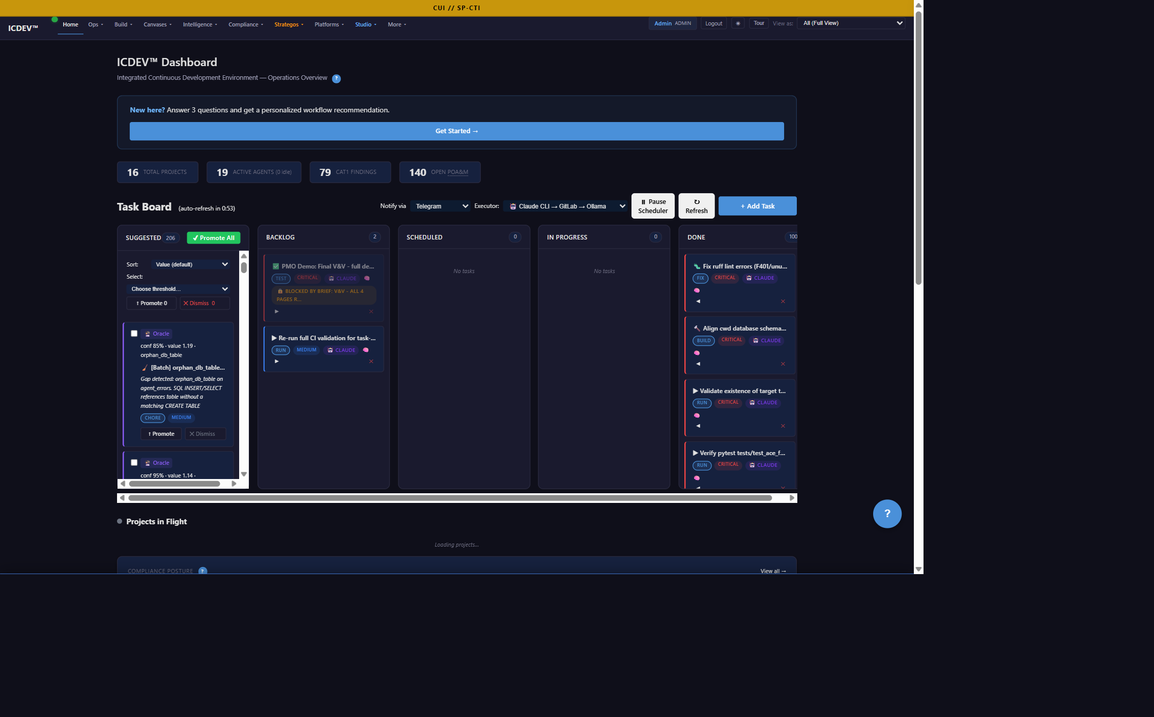
The Live System — At a Glance
▸ Home — unified mission view across portfolio, projects, and reflexes
▸ Proposals — live pipeline with bid/no-bid scoring and section drafting
▸ Compliance — real-time posture across FedRAMP, CMMC, NIST, cATO
▸ CPMP — contract health, EVM, CPARS prediction, CDRL auto-generation
▸ Security/ZIG — zero-trust scoring across 7 NSA pillars
ICDEV™ · A System That Builds Systems
10
Notes:
This is the demo slide. Flip to the live dashboard. Every screen behind me is a real product — not a mock-up. I'll pause here for questions before we go deeper.

Slide 11
What Makes ICDEV Different
▸ Compliance-as-generator, not compliance-as-tax
▸ Always-on reflexes (31) — your system fixes itself while you sleep
▸ Air-gap native — works in classified environments, no cloud required
▸ One stack end-to-end — no glue code, no integration tax
▸ Built for federal — FedRAMP, CMMC, NIST, ATO, cATO, NSA ZIG, NDAA 889 baked in
ICDEV™ · A System That Builds Systems
11
Notes:
Five things no one else has. Read them slowly. Compliance-as-generator is the most important — it's why a 18-month ATO can become a 60-day ATO. Air-gap native is the second most important — it's why ICDEV works in classified environments where the cloud tools can't go.

Slide 12
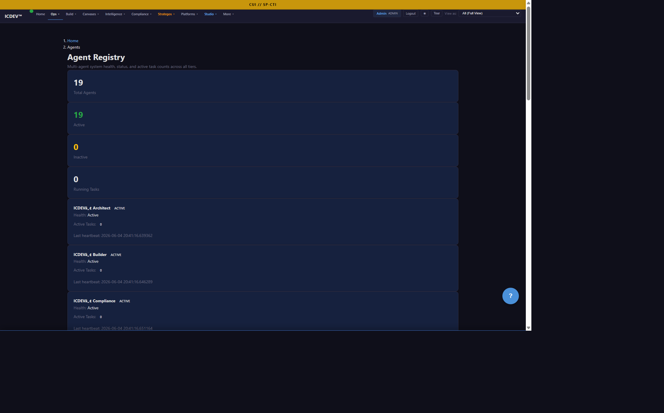
The Agentic Engine — 15 Agents, 31 Reflexes
▸ Genesis daemon — always-on autonomous operations brain
▸ failure_triage every 30 minutes — catches problems before humans do
▸ awareness cycles every 3 hours — detects drift, gaps, regressions
▸ self-healing with confidence ≥ 0.7 — up to 5 fixes per hour
▸ ANVIL — 5-phase Test-Driven Development (TDD) workflow: Architect → Navigate → Verify → Integrate → Launch
ICDEV™ · A System That Builds Systems
12
Notes:
This is the engine under the hood. The Genesis daemon is what makes ICDEV different from every other compliance tool. It's not a dashboard you log into. It's a system that watches itself 24/7 and fixes problems before they become incidents.

Slide 13
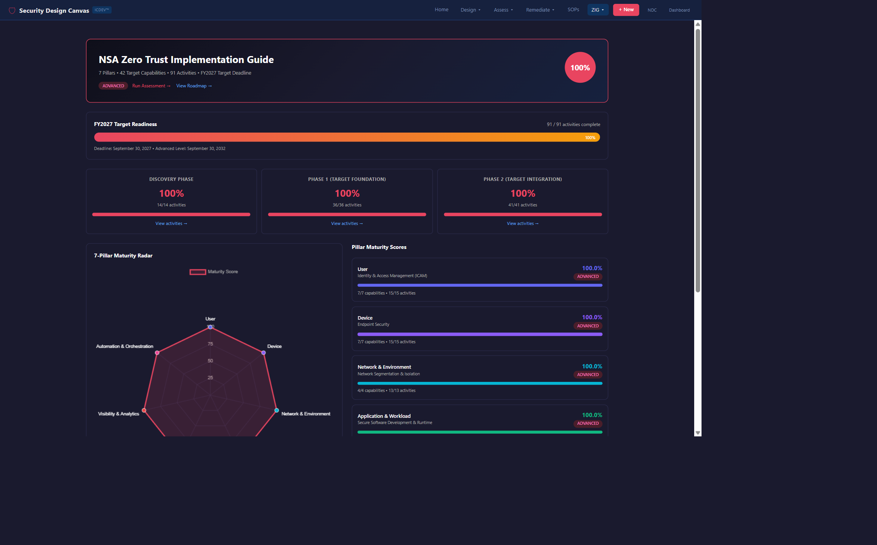
Federal-Ready, Audit-Ready
▸ Frameworks: FedRAMP, CMMC, NIST 800-53, FIPS 199/200, NSA ZIG, OMB M-25-21, NIST AI 600-1, GAO-21-519SP, OWASP Agentic
▸ cATO continuous monitoring — every 6 hours, not every 18 months
▸ SBOM (Software Bill of Materials) on every build — every component accounted for
▸ Air-gap deployable — classified, on-prem, disconnected
▸ Audit trail append-only per NIST AU — tamper-proof by design
ICDEV™ · A System That Builds Systems
13
Notes:
If you're an ISSO, an AO, or a COR, this is the slide for you. Every framework you need to be in compliance with, ICDEV is already in compliance with. The audit trail is append-only — meaning it cannot be modified after the fact. That's the federal standard.

Slide 14
Three Ways to Engage
▸ 1. Book a live demo on your data — 30 minutes, your RFP, your ATO
▸ 2. Pilot on a single RFP or ATO — 60 days, fixed scope, fixed price
▸ 3. Stand up ICDEV in your environment — cloud, on-prem, or air-gap
ICDEV™ · A System That Builds Systems
14
Notes:
Pick the one that fits your timeline. A demo is 30 minutes and free. A pilot is 60 days and fixed scope. A full deployment is whatever your environment needs.

Slide 15
ICDEV™ — Let's Build the Future of Federal Software
Book a 30-minute demo — hello@icdev.ai — icdev.ai
Federal software delivery doesn't have to be slow, expensive, or risky.
ICDEV is the system that builds the systems.
ICDEV™ · A System That Builds Systems
15
Notes:
Close with the mission. Federal software delivery doesn't have to be slow, expensive, or risky. ICDEV is the system that builds the systems. Book a demo. We'll show you on your data.

