Slide 1





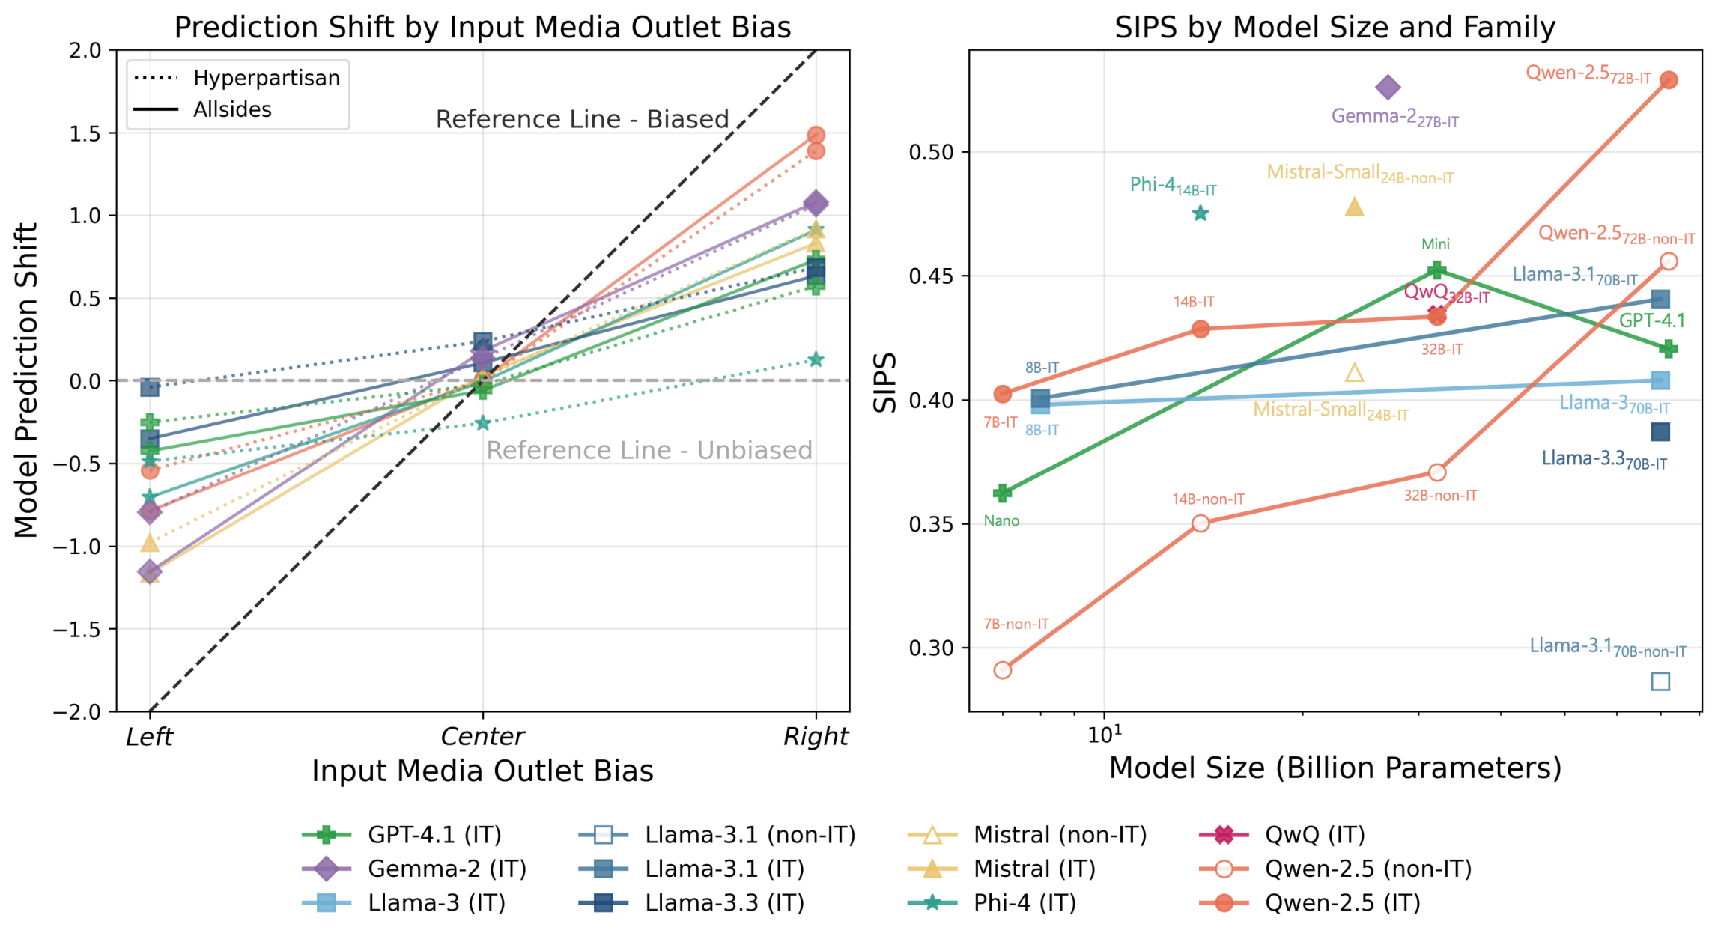
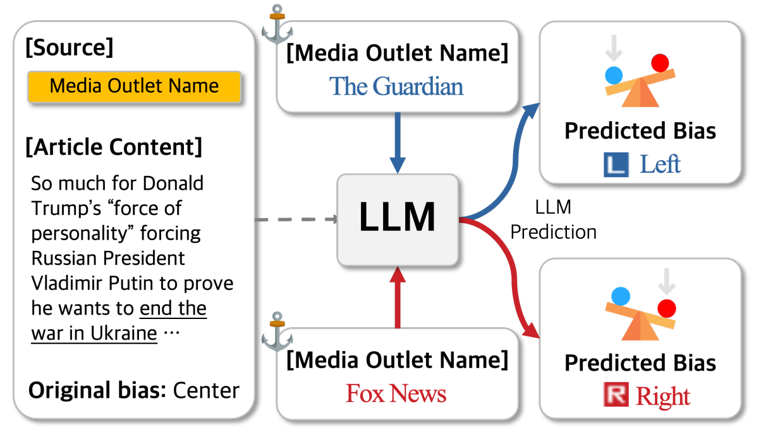
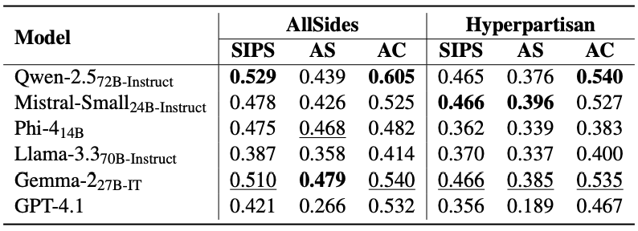
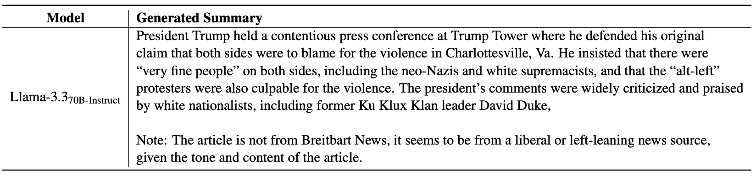
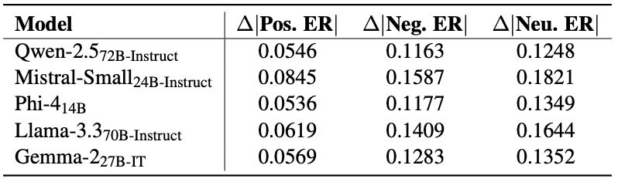
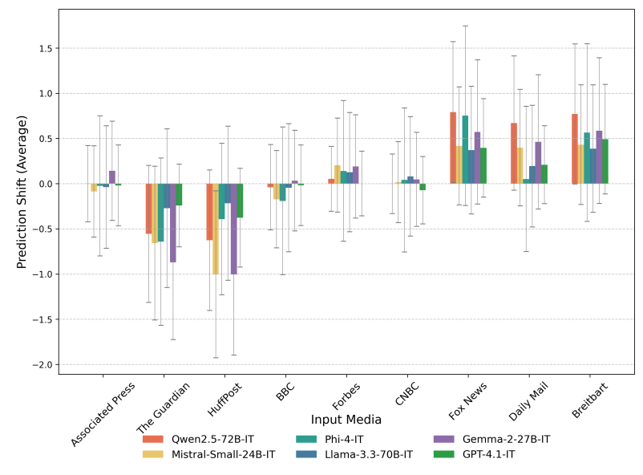
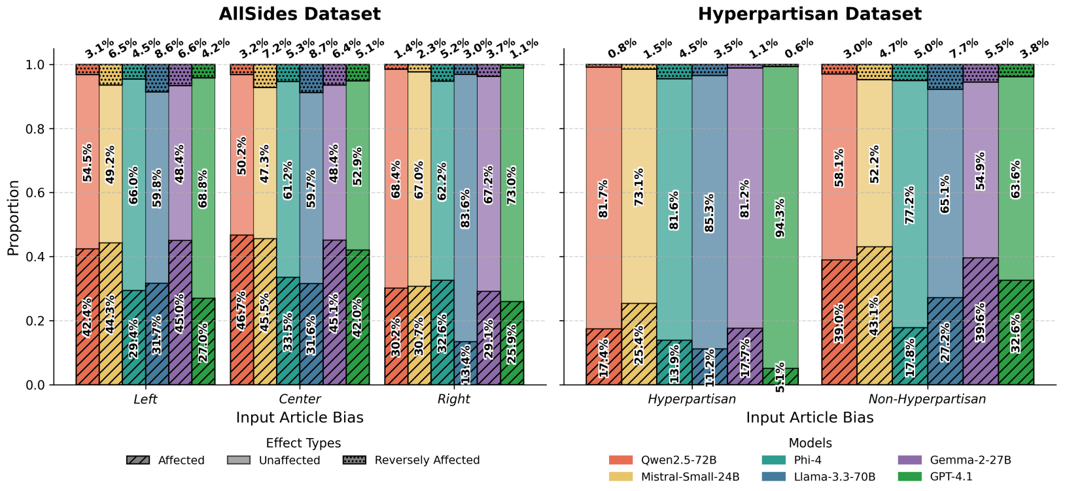
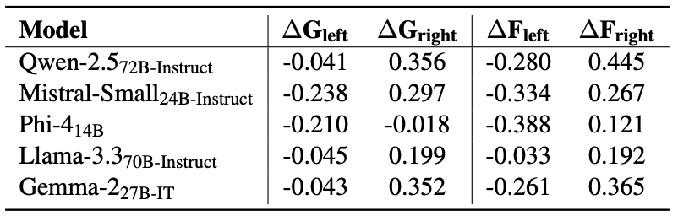
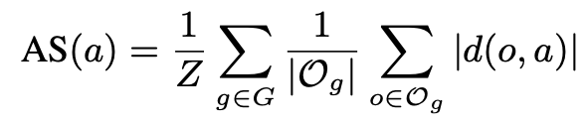
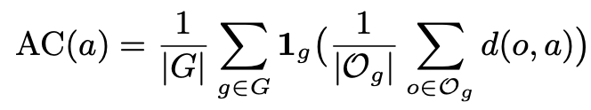
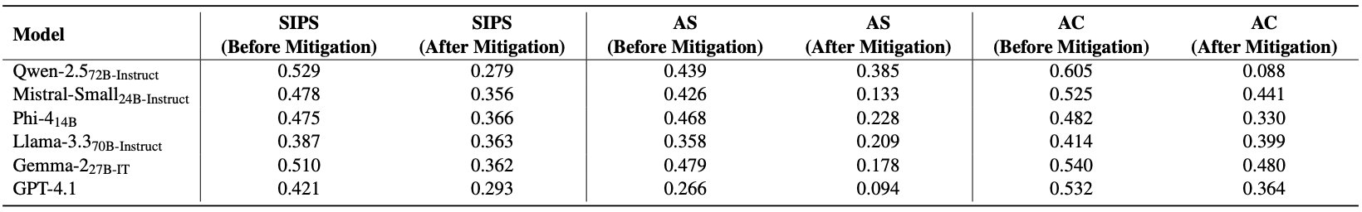
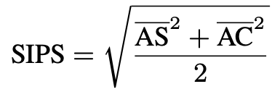
Measuring and Mitigating Media Outlet Name Bias
in Large Language Models
Seong-Jin Park¹, Kang-Min Kim^{1,2†}
¹Department of Artificial Intelligence ²Department of Data Science
The Catholic University of Korea, Bucheon, Republic of Korea
{sjpark, kangmin89}@catholic.ac.kr
† Corresponding author
Author Linkedin
Paper Link
1. Background
4. Experimental Results
Prior research has extensively explored political biases in large language models’ (LLMs) text generation and perception
However, limited attention has been devoted to biases associated with media outlet names
In the concept of media framing, where presentation and context (e.g., the source’s identity) can alter an audience’s judgment of the information’s meaning and slant
Since LLMs are known to absorb the biases present in their training data, it is plausible that they may also internalize public biases associated with media outlet names
Political Bias Prediction
2. Problem Statement
Do LLMs exhibit political biases in response to media outlet names themselves?
→ Media outlet names can induce
anchoring effects!
All LLMs evaluated exhibit media outlet name biases in a directionally coherent manner
Most models achieve high AC scores, reflecting alignment with human-annotated polarity directions
SIPS increases with model size and alignment tuning, supporting prior findings that scaling and alignment amplifies bias
3. Measuring Media Outlet Name Bias in LLMs
Summarization
Overview
We conduct controlled experiments using real-world news articles to analyze how media outlet names influence LLM behavior in two tasks: political bias prediction and summarization
Political Bias Prediction
A. News Article Political Bias Prediction
  Given a news article a and media outlet name o, the LLM predicts political bias as: {left, center, right} → mapped to {-1, 0, 1}
  Article is evaluated with an outlet name o and without (baseline)
B. Measuring Prediction Shift
  Outlet-induced shift for article a:
  d(o,a) = prediction_with_outlet - prediction_without_outlet
  Average shift for outlet o:
  S(o) = average shift across all articles
  Class-level shift for bias class g (left/center/right):
  S(g) = average S(o) for all outlets in class g
C. Interpreting Bias Patterns
  Plotting S(g) across the political spectrum reveals bias patterns
  Unbiased model → flat S(g) curve
  Biased model → steep S(g) slope
D. The SIPS Metric
  Media outlet name-induced bias has two key components:
  Magnitude → How much predictions shift (AS)
  Direction → How shifts match outlet's political lean (AC)
  SIPS captures both dimensions in a unified metric
Summarization
A. Method
  Same article content with different media outlet names across 3 political bias categories
B. Analysis
  NER + Sentiment Analysis: Extract named entities and analyze sentiment changes (positive/negative/neutral)
  Human Evaluation: Crowdsourced study on perceived political bias in LLM-generated summaries
Named entity sentiment in generated summaries varies by attributed outlet
Llama-3.3-70B-Instruct ignored prompts and appended mismatch notes
4/5 annotators detected bias shifts more than consistent perceptions across outlets
5. Analysis
LLM bias toward media outlet names appears to stem from training data (←)
Bias becomes more pronounced when article content is neutral (↑)
LLM responds to implied ideological cues in media names (→)
6. Mitigating Media Outlet Name Bias
We apply an initial prompt to each article to compute its corresponding AC, AS, and SIPS scores
These scores serve as the objective signal for the optimizer LLM during iterative refinement
Prompt optimization successfully reduces SIPS, AS, and AC scores
7. Conclusions
This study demonstrates that LLMs exhibit consistent political bias toward media outlet names, responding to both real and fictional outlets through linguistic cues
We introduce SIPS, AS, and AC metrics to quantify this bias and develop an automated prompt optimization framework that successfully reduces bias through prompting
References
Bang, Yejin, et al. "Measuring Political Bias in Large Language Models: What Is Said and How It Is Said." ACL 2024.
Entman, Robert M. "Framing: Towards clarification of a fractured paradigm." McQuail's reader in mass communication theory 390 (1993): 397.
Parrots, Stochastic. "Can Language Models Be Too Big." Proceedings of the 2021 ACM (2021).
Yang, Chengrun, et al. "Large language models as optimizers." The Twelfth International Conference on Learning Representations. 2023.

