Slide 1

基于对象编程风格
第九章

Slide 2
boost bind/function
boost bind/function库的出现，替代了stl中的mem_fun,ptr_fun,bind1st,bin2nd等函数

Slide 3
boost bind/function
#include <iostream>
#include <boost/function.hpp>
#include <boost/bind.hpp>
using namespace std;
class Foo
{
public:
void memberFunc(double d, int i, int j)
{
cout << d << endl;//打印0.5
cout << i << endl;//打印100
cout << j << endl;//打印10
}
};
int main()
{
Foo foo;
boost::function<void (int)> fp = boost::bind(&Foo::memberFunc, &foo, 0.5, _1, 10);
fp(100);
return 0;
}

Slide 4
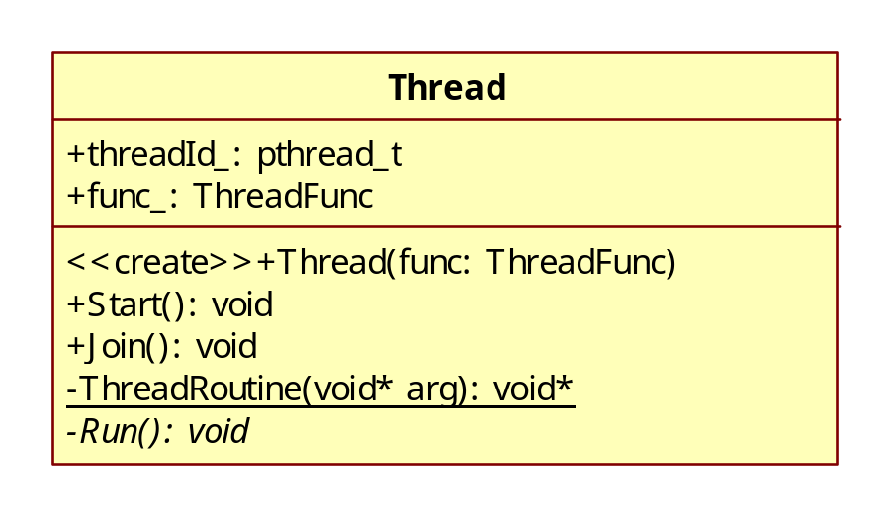
Thread类图
typedef boost::function<void ()> ThreadFunc;

