Slide 1

muduo_base库源码分析
第十二章

Slide 2
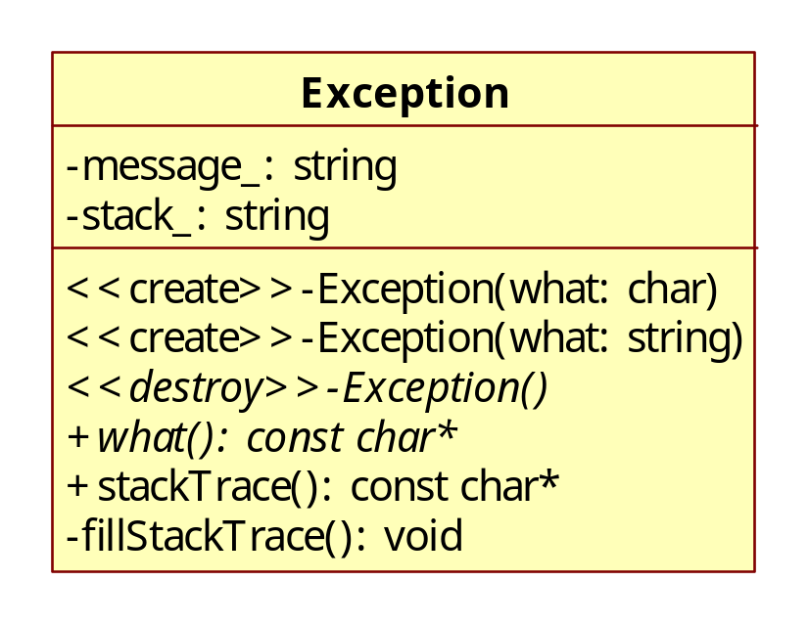
本章目标
Exception类实现
  backtrace，栈回溯，保存各个栈帧的地址
  backtrace_symbols，根据地址，转成相应的函数符号
  abi::__cxa_demangle

Slide 3
abi::__cxa_demangle
string Exception::demangle(const char* symbol)
{
size_t size;
int status;
char temp[128];
char* demangled;
//first, try to demangle a c++ name
if (1 == sscanf(symbol, "%*[^(]%*[^_]%127[^)+]", temp)) {
if (NULL != (demangled = abi::__cxa_demangle(temp, NULL, &size, &status))) {
string result(demangled);
free(demangled);
return result;
}
}
//if that didn't work, try to get a regular c symbol
if (1 == sscanf(symbol, "%127s", temp)) {
return temp;
}
//if all else fails, just return the symbol
return symbol;
}

