Slide 1
TDC Review
5/27/2020
Noeloikeau Charlot

Slide 2
Goal
Measure ultrafast systems using an FPGA
Approach: exploit carries (dedicated, ultrafast pathways) used for addition operation in logic
Pass a signal down a carry chain, “adding” constants and registering signal each time it passes over carry
After some time, read out the stored timeseries of the signal

Slide 3
Carry-Chain Overview
Naïve implementation
Addition
Quartus megafunction
Problems with inhomogeneity
Advanced implementation
Controlled placement
FPGA-specific logic primitives & gate control
Problems with synthesis of LUT mask, current sources

Slide 4
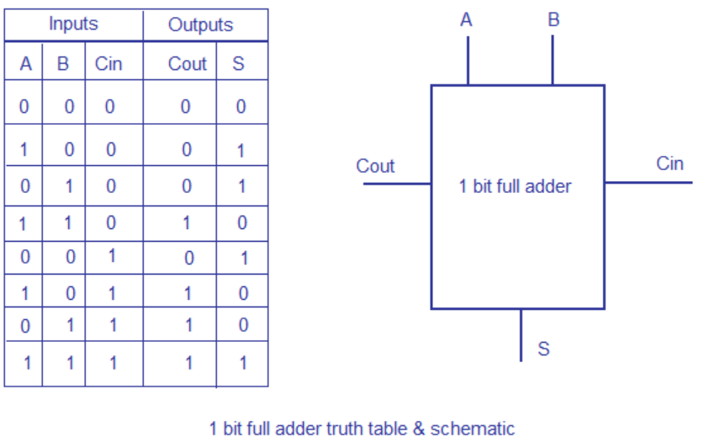
Naïve implementation: 1-bit adder
Use an adder. Let:
A=0
B=1
C_in=C_out
S= !C_in
Then if x is signal,
x = C_in = C_out = !S
And we pass x to C_in of next adder in chain, read out s later

Slide 5
Naïve Implementation: Verilog
If we simply say s<=a+b @ posedge clk,
We may have logic spread all around the chip, and may not even use carries
Fortunately, quartus has megafunctions which consolidate logic
And allow for use of carries

Slide 6
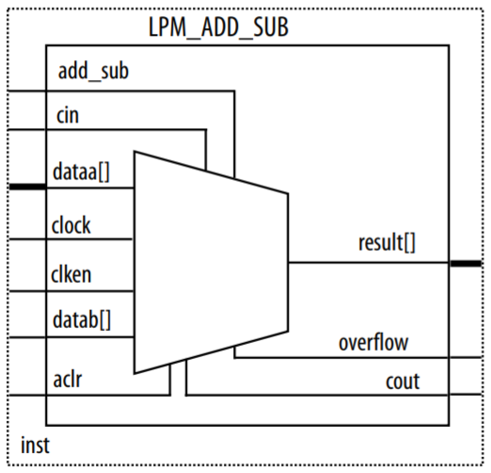
Naïve implementation: LPM Add/Sub Module
Quartus Megafunction
Implements addition/subtraction
Uses carry chain (when told to)
Special arguments for maximizing speed, constant inputs, etc.
X(t)
0
!X(t+dt)
1
X(t+dt)

Slide 7
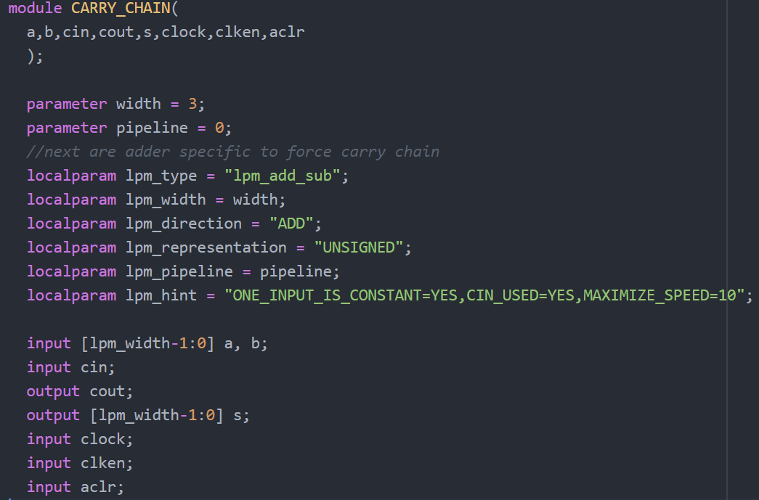
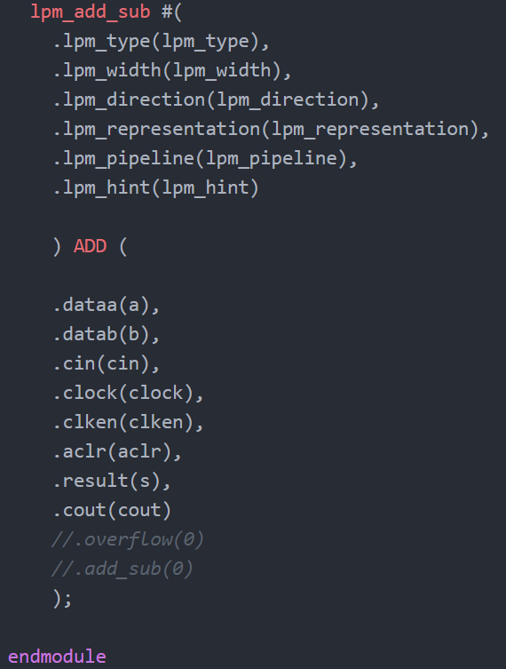
Naïve implementation: 3-bit Adder

Slide 8
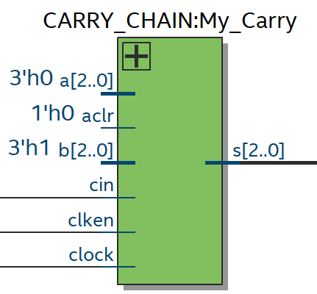
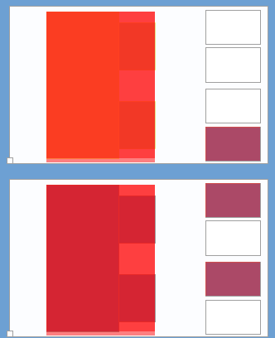
Naïve implementation: 3-bit Adder
Layout is compact (right), but registers in different spots (inhomogeneous)

Slide 9
Naïve implementation: Problems
LPM quartus module can’t specify gate-level structure
Means individual carries (logic combinational cells) use different ports
Means registers in different locations
Means signal travel times are variable
Have to control for this

Slide 10
Advanced implementation: Controlled Placement
First step to control is to specify where logic is placed
Then we can worry about gates, routing, LUTs, etc.
Accomplished in 3 ways:
1: through the chip planner GUI (slow)
2: using logic-lock to specify REGION to be placed in (vague)
3: editing QSF directly with lines specifying location of individual logic (best)

Slide 11
Controlled Placement: Syntax
Edit the quartus settings file (.qsf) with lines of the form
set_location_assignment CELLTYPE_XVALUE_YVAUE_ZVALUE “NAME”
Where CELLTYPE is either LABCELL, MLABCELL, or FF (register/flipflop)
And X,Y are positions on the FPGA grid with lower left origin, and Z specifies the location of the individual cell within a LAB/MLAB
And “NAME” is the name as viewed in the Resource Property Editor under Chip Planner
See Quartus II University Interface Program (QUIP) Tutorial

Slide 12
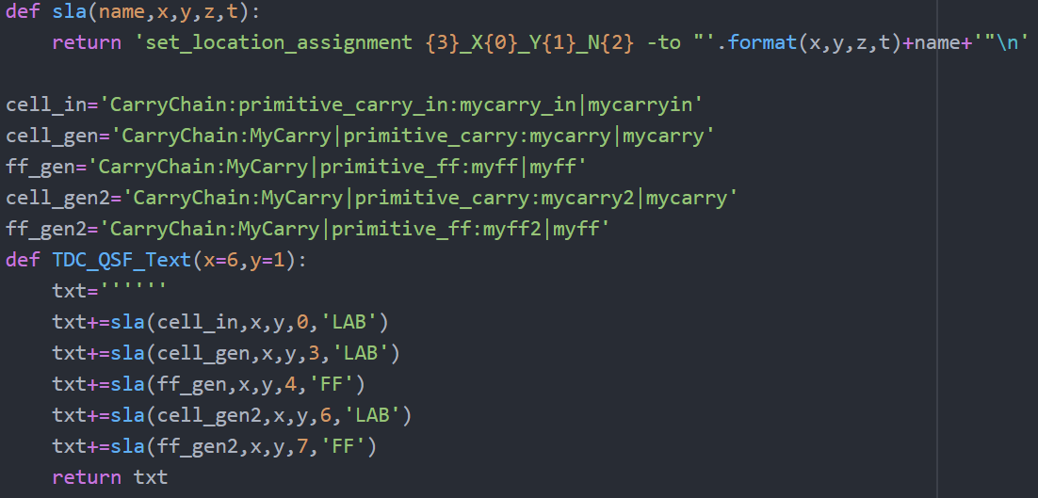
Controlled Placement Example: Python→QSF

Slide 13
Advanced Implementation: Logic Primitives
Altera supports low-level logic primitives in two ways
1: Standardized library universal to Intel FPGAs (this is what you will find documentation on)
2: FPGA-specific primitives which are totally undocumented (as far as I can tell)
Only reason not to use the 1st is those don’t allow for specification of individual ports used in combinational logic cells
The 2nd however nominally allow for this (more on issues later)

Slide 14
Cyclone V Primitives
Found in quartus source files,
C:\intelFPGA\18.1\quartus\eda\sim_lib\cyclonev_atoms
Going through the files we pluck out several modules including
cyclonev_lcell_comb
cyclonev_ff
Which we use to control individual logic cells and registers

Slide 15
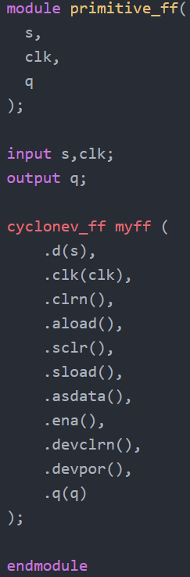
Register Primitive
Takes in s output from LCELL
Also clock for when register latches
Outputs value from register

Slide 16
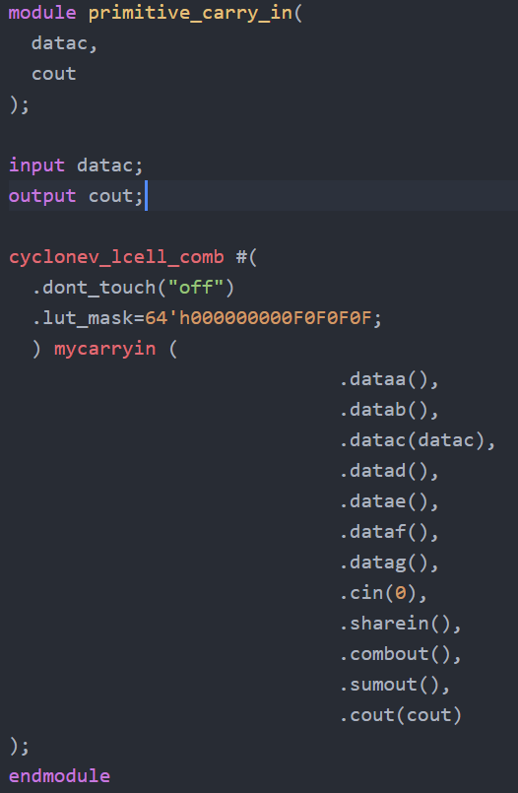
Carry-In Primitive on CycloneV
Before the adders can add, we have to transfer over the input data to the carry of a logic cell
This module takes in the bit to be carried
Uses the DATAC port for input and carry_out of LABCELL for output
Copied what quartus instantiated with the carry chain LPM megafunction by hand (as a starting point)
Note: will come back to “dont_touch”

Slide 17
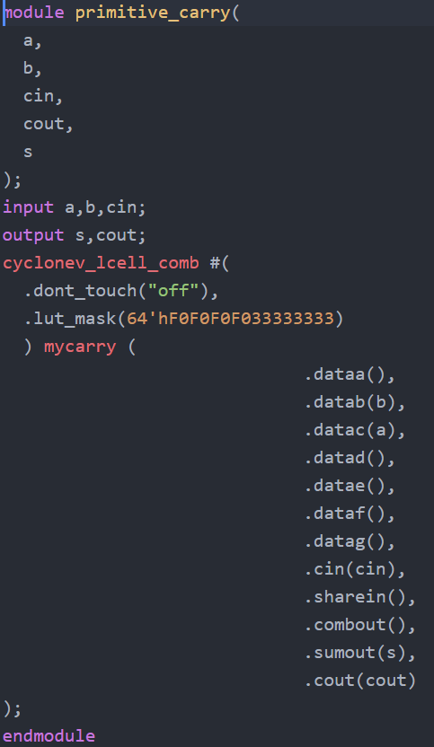
Carry Primitive
Inputs a=0, b=1, cin
Outs sum “s”, cout
Copied LUT by hand from megafunction

Slide 18
Aside: LUT Masks
LUT masks are hex values which specify the branches of the multiplexer tree traversed by the combinational cell
In other words, they tell Quartus what logical function to implement
Hastily drawn example on next slide

Slide 19
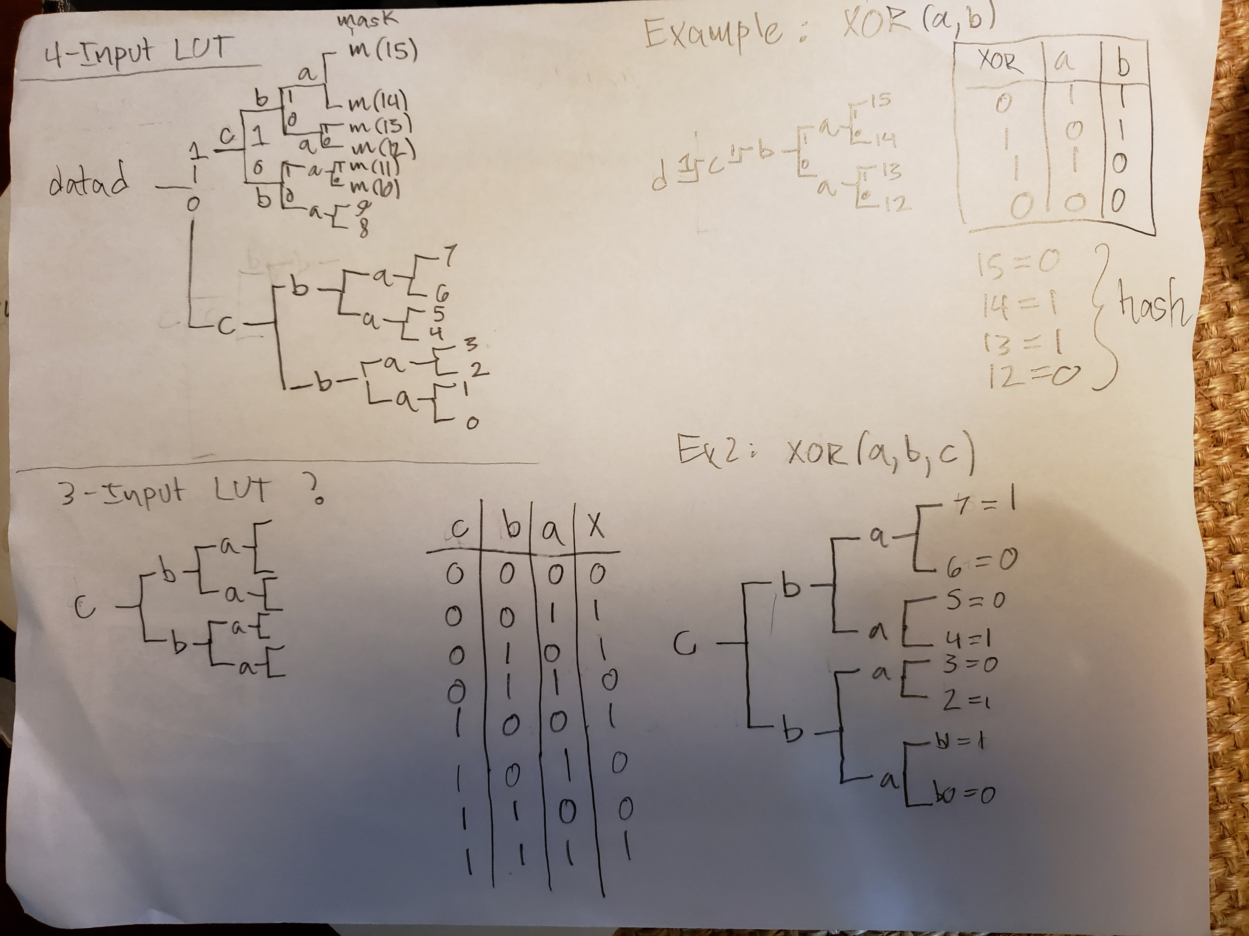
LUT Masks Example
Try populating the LUT of your favorite function by hand and you will get the idea

Slide 20
LUT/Primitives Additional Reference
See https://forums.intel.com/s/question/0D50P00003yyPcjSAE/designing-with-low-level-primitives?language=en_US
For someone looking to build a TDC using low level primitives!
One of the posts has an old Intel handout for LUT’s and primitives, which I adapted to Cyclone V (perhaps incorrectly – peer review!)

Slide 21
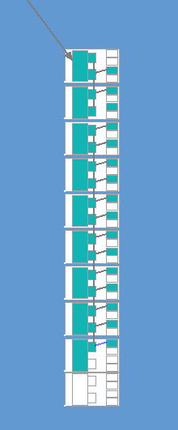
Advanced Design Example
16-bit Carry Chain (right)
Two PLL’s out of sync
@rising edge of first, flip a bit
Continuously pass this bit’s value into carry chain
@rising edge of 2nd , latch registers in carry chain

Slide 22
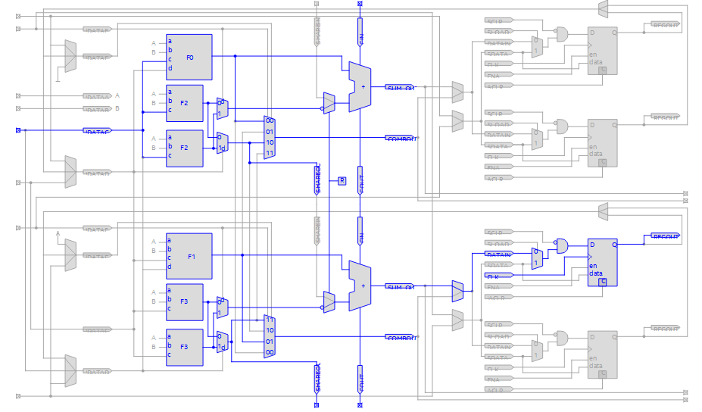
First LABCELL in Carry Chain
Top cell:
Node goes into DATAC
Carry in is empty
Carry out is DATAC
Bottom cell:
CIN is COUT from above (node)
SUMOUT is !node
Carryout is node

Slide 23
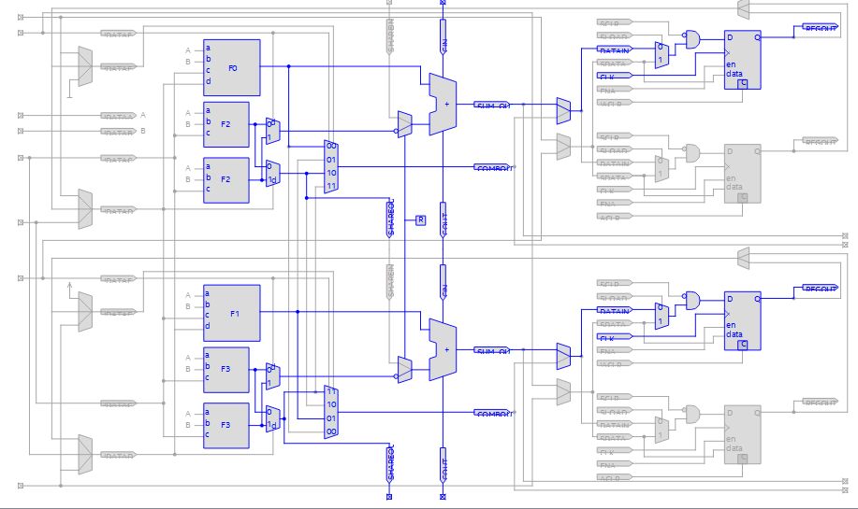
Successive LABCELLs
Just pass carry
Quartus optimizes the LUT to get rid of unnecessary inputs for constant 0 and 1 if we DO NOT specify “don’t_touch”
Appears(?) to function as expected; might be better than using addition of unneeded bits

Slide 24
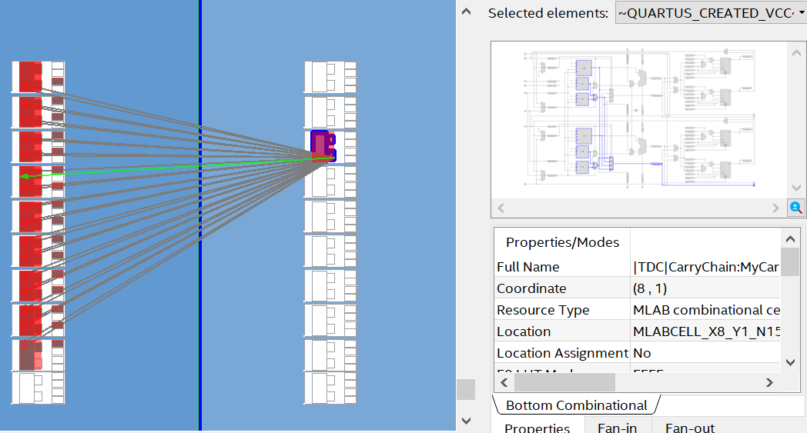
Note on “dont_touch”=“on”
Quartus synthesizes “VCC_I~” and uses A and B ports even though I specify B and C
Presumably due to current requirements
Some carry cells even use A,B and C
Might not be able to control at gate-level the way we want, but may not matter if synthesis is consistent

Slide 25
PLL Dynamic Phase Shift
Use two PLLs, out of phase, for flipping bit and registering respectively
Can change phase dynamically (without re-synthesizing)
Can change phase shift using an editable bit in memory instance
Using finite state machine to control logic
More descriptions coming in next update, along with discussion of timing constraints
Goal is to be able to calibrate TDC

