Slide 1
MQTT
Message Queuing Telemetry Transport

Slide 2
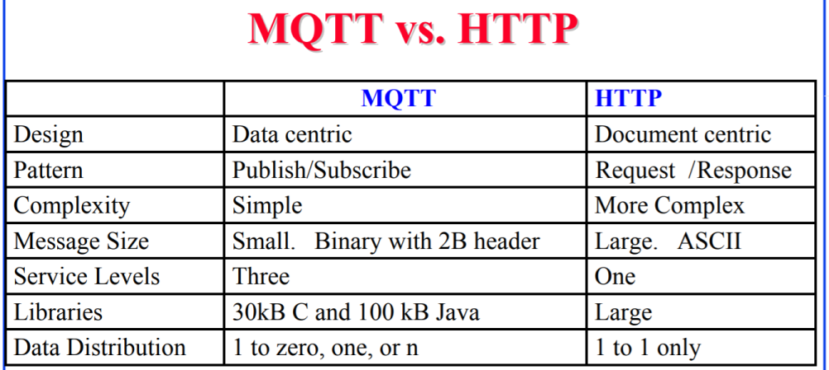
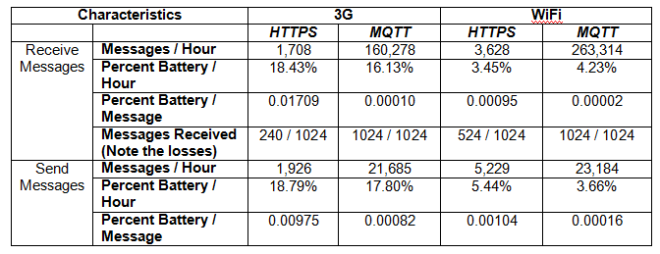
Introduction to MQTT
1. MQTT is a Client Server publish/subscribe messaging transport protocol.
2. It is light weight, open, simple, and designed so as to be easy to implement.
These characteristics make it ideal for use in constrained environments such as for communication in Machine to Machine (M2M) and Internet of Things (IoT) contexts where a small code footprint is required and/or network bandwidth is at a premium.

Slide 3
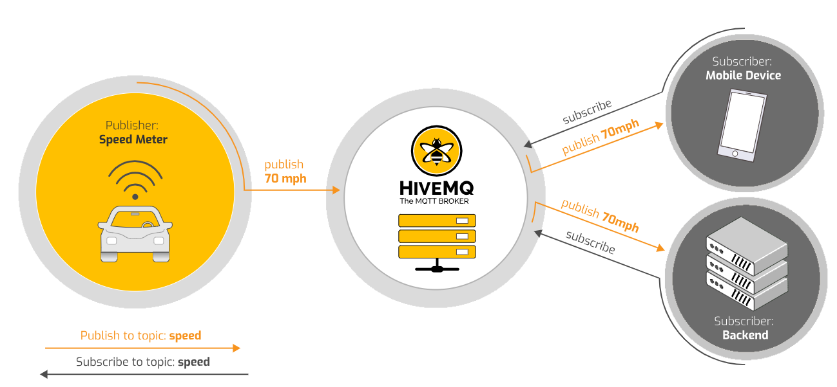
Scalability
Operations can be highly parallelized and messages can be processed in an event-driven way
Message Filtering
Subject-based, content-based and type-based filtering
Publish & Subscribe (Pub/sub)
Decouples the client that sends a message from the clients that receive the messages
Space decoupling: Publisher and subscriber do not need to know each other (for example, no exchange of IP address and port).
Time decoupling: Publisher and subscriber do not need to run at the same time.
Synchronization decoupling: Operations on both components do not need to be interrupted during publishing or receiving.
Beware
Published data structure must be known.
Published message might not be read by any subscriber.

Slide 4
MQTT
1. MQTT uses subject-based filtering of messages. Every message contains a topic (subject).
2. MQTT has quality of service (QoS) levels
3. MQTT is especially easy to use on the client-side. Unlike most pub/sub systems having the logic on the broker-side, MQTT uses a client library that makes it a light-weight protocol.
A message queue stores message until they are consumed
A message is only consumed by one client
Queues are named and must be created explicitly, not on the fly.
MQTT != Message Queue

Slide 5
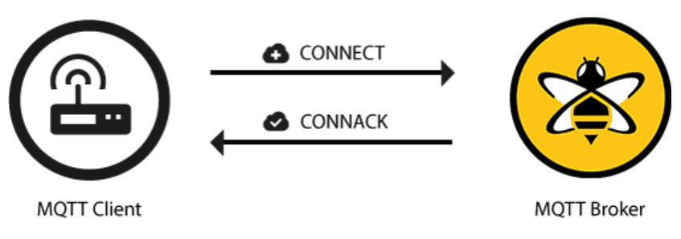
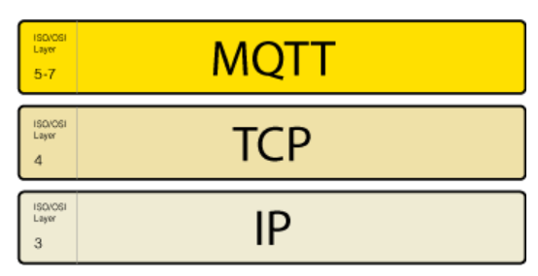
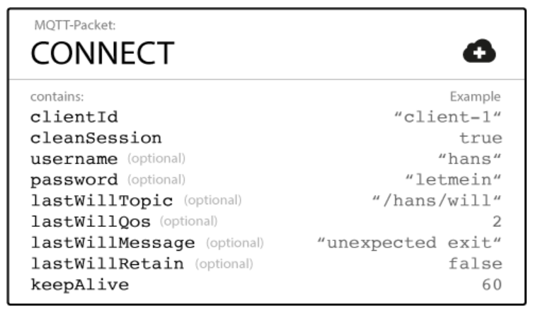
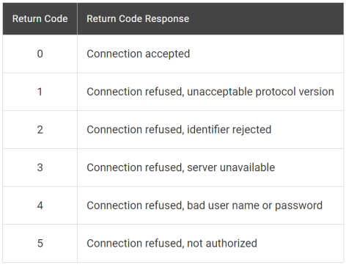
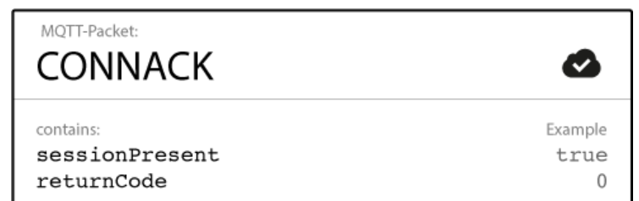
Client, Broker and Connection Establishment
The broker is highly scalable, integratable into backend systems, easy to monitor, and (of course) failure-resistant.
Receiving all messages,
filtering the messages,
Determining who is subscribed to each message, and sending the message to these subscribed clients.
An MQTT client is any device (from a micro controller up to a full-fledged server) that runs an MQTT library and connects to an MQTT broker over a network.

Slide 6
MQTT Publish, Subscribe & Unsubscribe

Slide 7
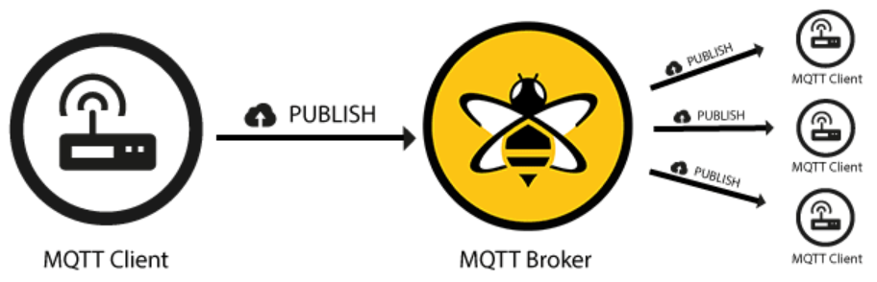
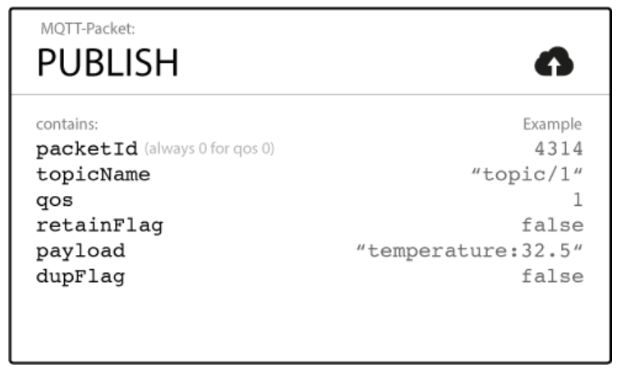
Topic Name The topic name is a simple string that is hierarchically structured with forward slashes as delimiters.
QoS This number indicates the Quality of Service Level (QoS) of the message. There are three levels: 0,1, and 2.
Retain Flag This flag defines whether the message is saved by the broker as the last known good value for a specified topic. When a new client subscribes to a topic, they receive the last message that is retained on that topic.
Payload This is the actual content of the message. MQTT is data-agnostic. It is possible to send images, text in any encoding, encrypted data, and virtually every data in binary.
Packet Identifier The packet identifier uniquely identifies a message as it flows between the client and broker. The packet identifier is only relevant for QoS levels greater than 0.
DUP flag The flag indicates that the message is a duplicate and was resent because the intended recipient (client or broker) did not acknowledge the original message. This is only relevant for QoS greater than 0.
MQTT Publish

Slide 8
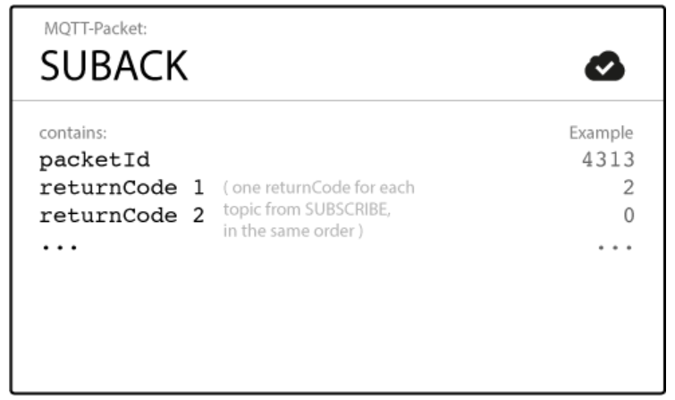
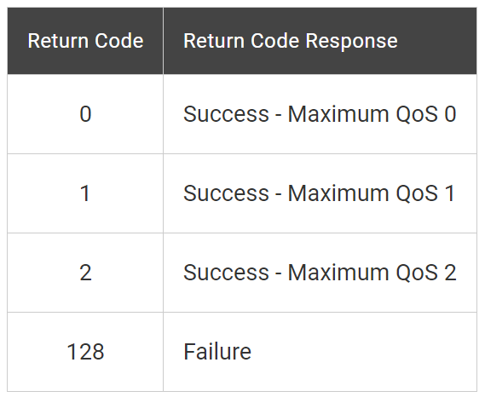
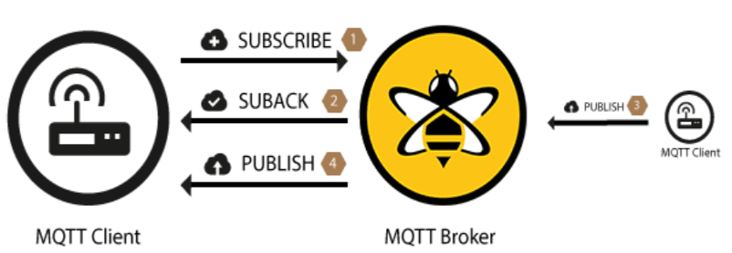
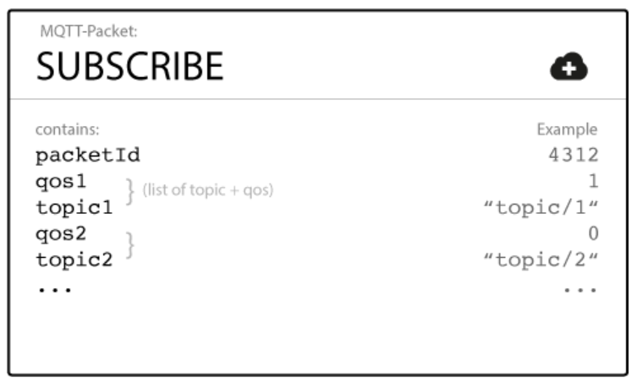
MQTT Subscribe
Packet Identifier The packet identifier uniquely identifies a message as it flows between the client and broker.
List of Subscriptions A SUBSCRIBE message can contain multiple subscriptions for a client. Each subscription is made up of a topic and a QoS level. The topic in the subscribe message can contain wildcards that make it possible to subscribe to a topic pattern rather than a specific topic.

Slide 9
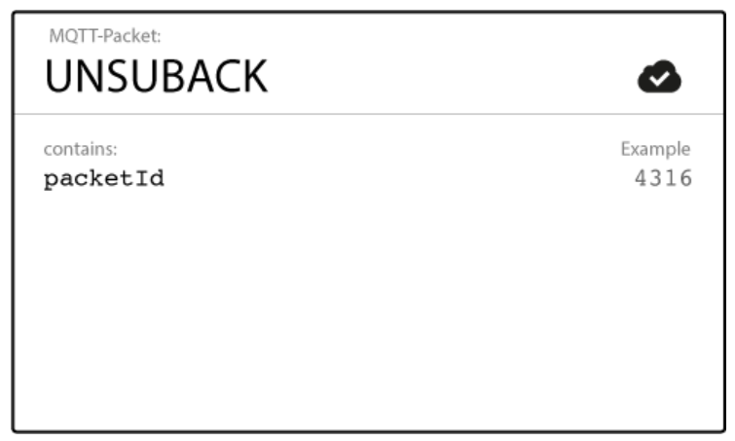
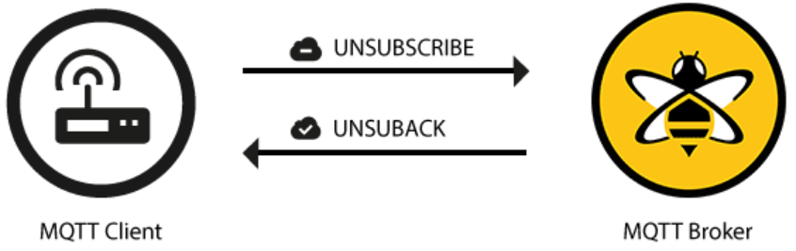
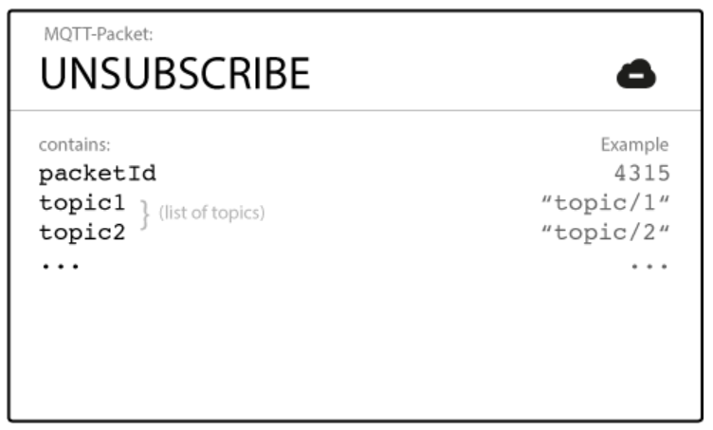
MQTT Unsubscribe

Slide 10
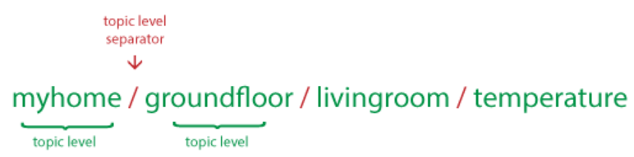
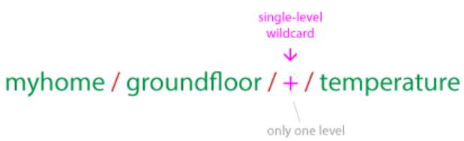
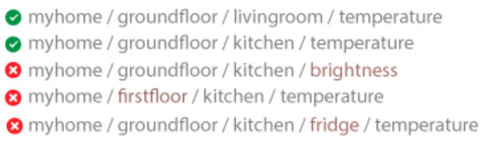
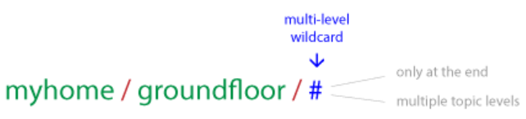
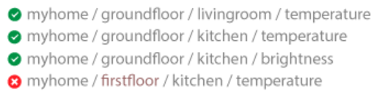
MQTT Topics & Best Practices
Topics case sensitive
Wildcards
Single Level: +
Multi Level: #

Slide 11
MQTT Topics & Best Practices
Topics beginning with $
The $-symbol topics are reserved for internal statistics of the MQTT broker.
For example:
AWS uses these for various purposes in their IoT Platform
https://docs.aws.amazon.com/iot/latest/developerguide/topics.html

Slide 12
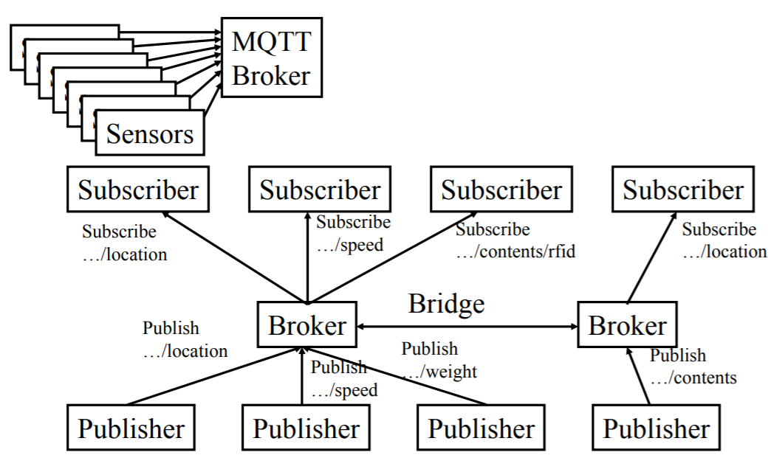
MQTT Topics & Best Practices

