Slide 1
Dropout
Notes:
0

Slide 2
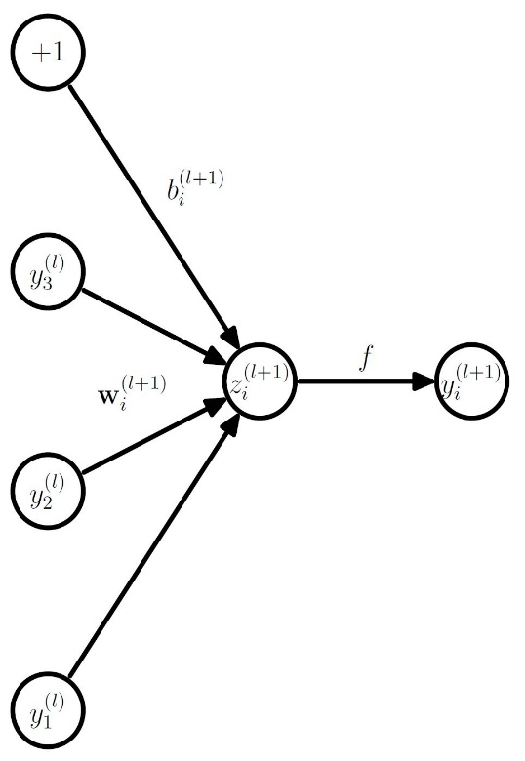
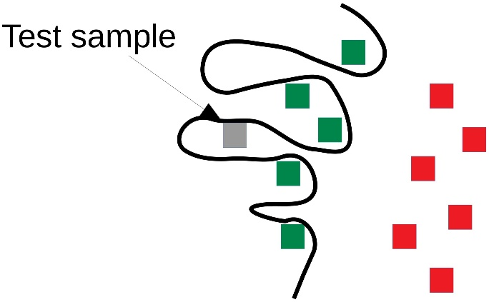
Overfitting
2 equation per neuron in an artificial neural network
Calculation of activation
Calculation of state using bias and weighted input from prior layer
each neuron has its on input weights each weight is a network parameter
adding a neuron to a layer means adding several parameters to the network
too many parameters can lead to overfitting
[1]
[5]

Slide 3
Overfitting
[4]

Slide 4
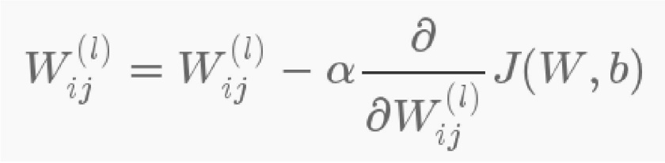
Overfitting
network with too many parameters can adapt to noise in training data
noise different to test data
“memorization” of training data
co-adaption between layers through chain rule:
neuron updated according to the behavior of the other neurons
neurons may change so they correct the mistakes of other neurons
[5]

Slide 5
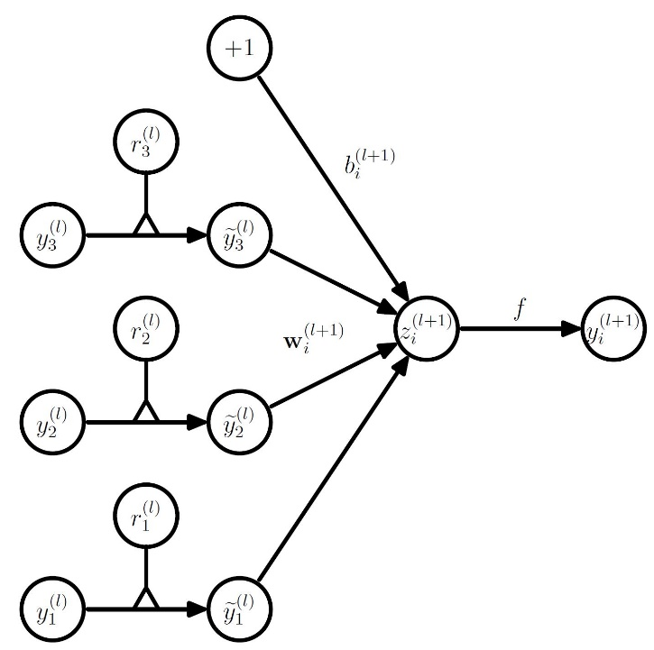
Dropout
solution: randomly dropping neurons of the net to train with thinner networks and to stop co-adaption
adding a layer that drops a neuron with the probability p
[1]

Slide 6
[4]

Slide 7
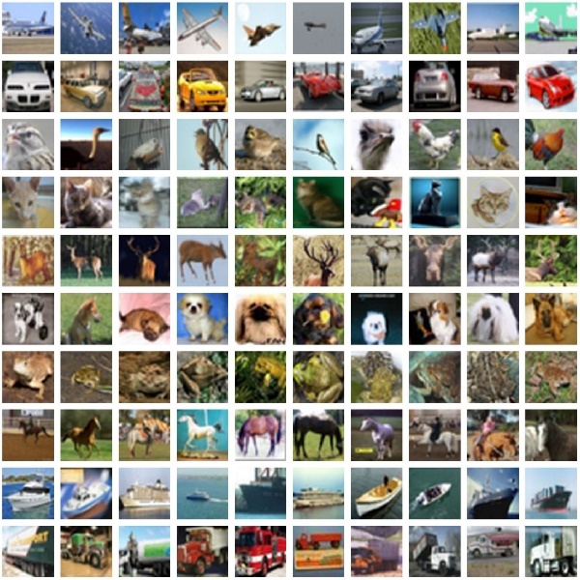
Experiments
setup
Modell: Alexnet more than 650000 neurons and over 62 million parameters won 2012 ImageNet LSVRC-2012 competition with 15.3% error rate (vs 26.2 % second place) [3]
data: CIFAR 10/100 60000 images 3-channel color and 32x32 pixels 10 different classes with 6000 images each 100 different classes with 600 images each[1]
[1]

Slide 8
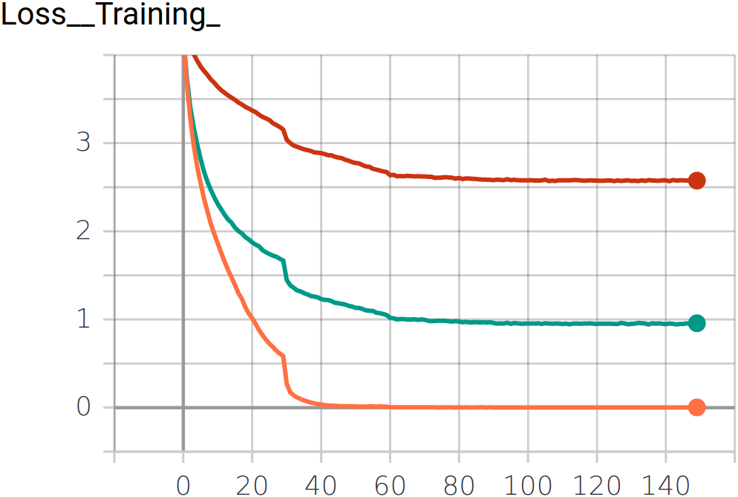
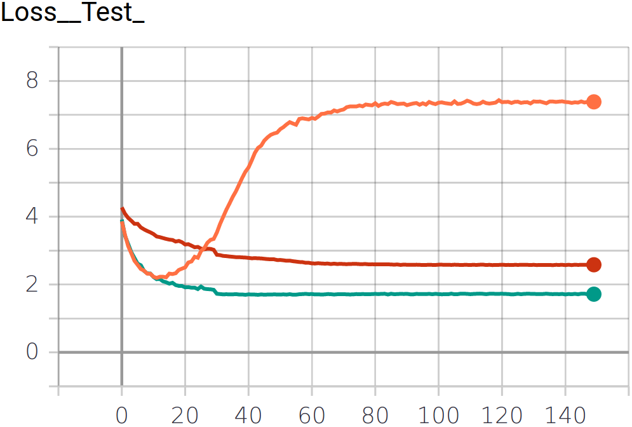
Loss function comparison
Loss function with and without dropout
P = 0,0
P = 0,5
P = 0,9

Slide 9
Effect of dropout probability
correlation between error rate and dropout probability

Slide 10
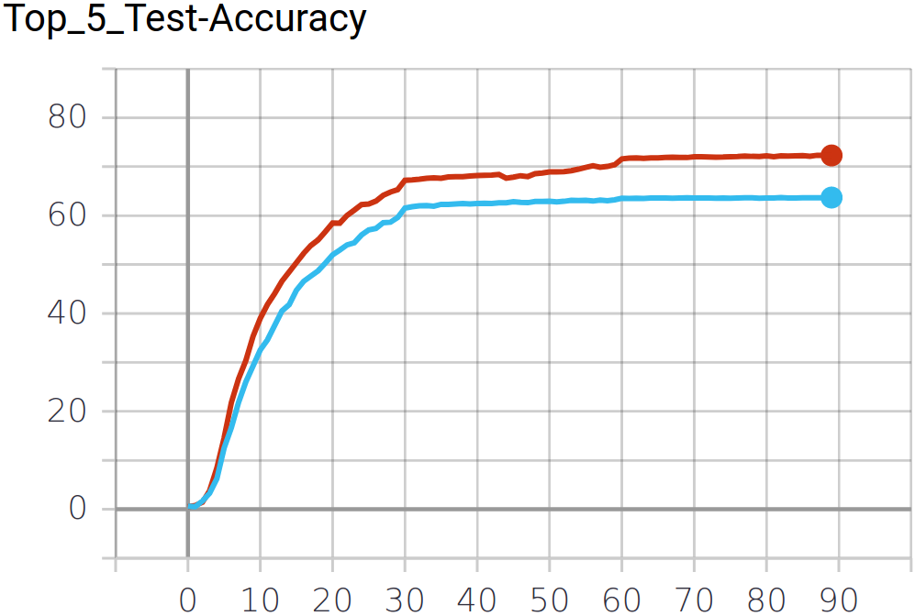
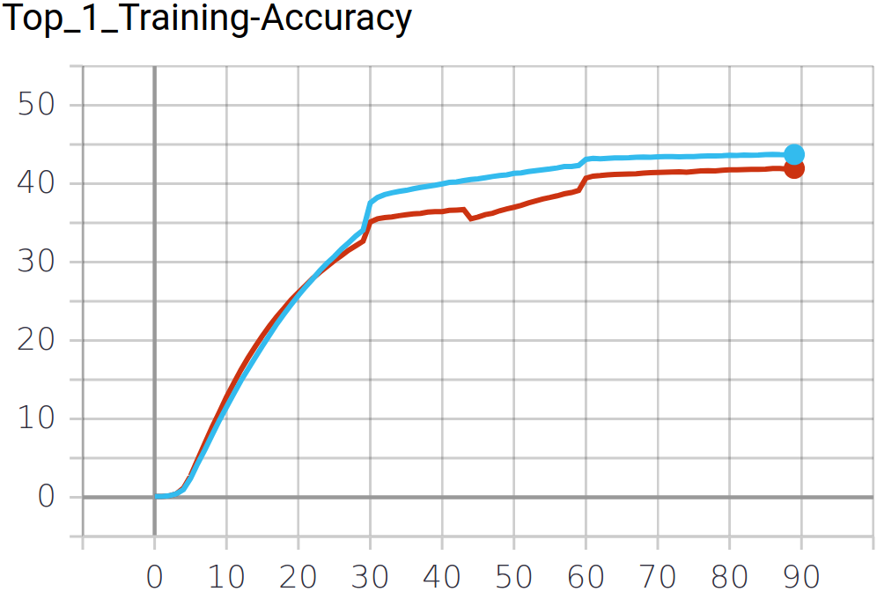
Effect of dropout probability
Effect of dropout in correlation to data size
0.5 Dropout Probability
No Dropout

Slide 11
Conclusion
dropout can prevent overfitting
dropout can decrease error rate by using the principle of combining several trained thinner networks
dropout adds noise to the input signal
dropout rate has a sweet spot
dropout increases learning time
the effect of dropout on error rate is dependent on the available size of training data

Slide 12
Sources
[1] „Dropout: A Simple Way to Prevent Neural Networks from Overﬁtting” Srivastava, Hinton, Krizhevsky et. al. (2014): https://www.cs.toronto.edu/~hinton/absps/JMLRdropout.pdf
[2] GitHub Project: https://github.com/iceboy910447/ALEXNET-CIFAR10
[3] „A Walk- through of Alexnet“, Hao Gao (2017): https://medium.com/@smallfishbigsea/a-walk-through-of-alexnet- 6cbd137a5637
[4] „Preventing Deep Neural Network from Overfitting“, Piotr Skalski (2018) : https://towardsdatascience.com/preventing-deep-neural-network-from- overfitting-953458db800a
[5] „Deep Learning – An Introduction Beyond Buzzwords“ Janis Keuper (2019): https://elearning.hs-offenburg.de/moodle/pluginfile.php/429832/mod_resource/ content/1/1_Deep_Learning_Intro.pdf

