Slide 1
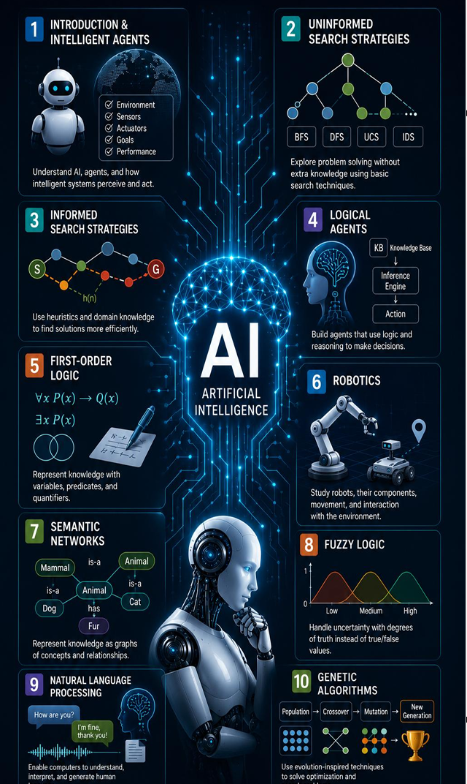

Insert relevant picture related to the topic
TGB2013/TFB2073/TEB2023_092 : Artificial Intelligence
WEEK 03
GitHub, Python & VS Code Basic Installations
DEPARTMENT OF COMPUTING
FACULTY OF SCIENCE, MANAGEMENT & COMPUTING
© 2026 INSTITUTE OF TECHNOLOGY PETRONAS SDN BHD
All rights reserved. No part of this document may be reproduced, stored in a retrieval system or transmitted in any form or by any means (electronic, mechanical, photocopying, recording or otherwise) without the permission of the copyright owner.

Slide 2
LEARNING OUTCOMES
Install Git & create a GitHub account
Install and verify Python
2.1 Run python --version
2.2 Confirm pip is available
Install VS Code & extensions
3.1 Configure the Python extension
3.2 Connect VS Code to Git
4. Clone a repo & run a script

Slide 3
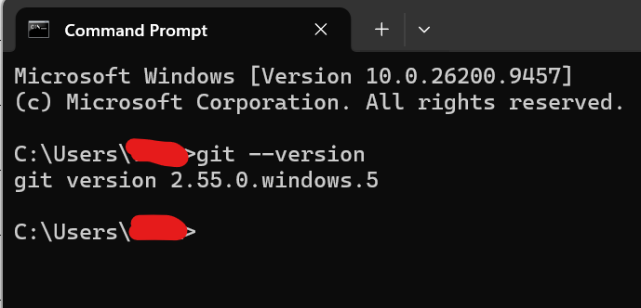
TOPIC 1: INSTALLING GIT & GITHUB
Git itself must be installed, regardless of which editor you use. Here's the distinction:
GitHub = the website/account (sign up at github.com, no installation needed for that part)
Git = the actual version-control engine that runs commits, pushes, pulls, etc. on your machine
VS Code and Visual Studio don't bundle Git, they only provide a UI on top of it. If Git isn't installed, their Git/Source Control panels will just show an error asking you to install it. You can't get around this by only using the GitHub website.
1. Download Git for Windows
Go to git-scm.com/download/win — the download starts automatically for your system.
2. Run the installer, keep default options
Run the installer. Defaults are fine for nearly everything; just make sure "Git from the command line and also from 3rd-party software" is selected (it's the default) so both the terminal and your editor can use it.
3. Verify it installed
Open Command Prompt or PowerShell and run git --version. You should see a version number.
4. Set your identity
git config --global user.name "Your Name" git config --global user.email "you@example.com" This is what gets attached to every commit you make.

Slide 4
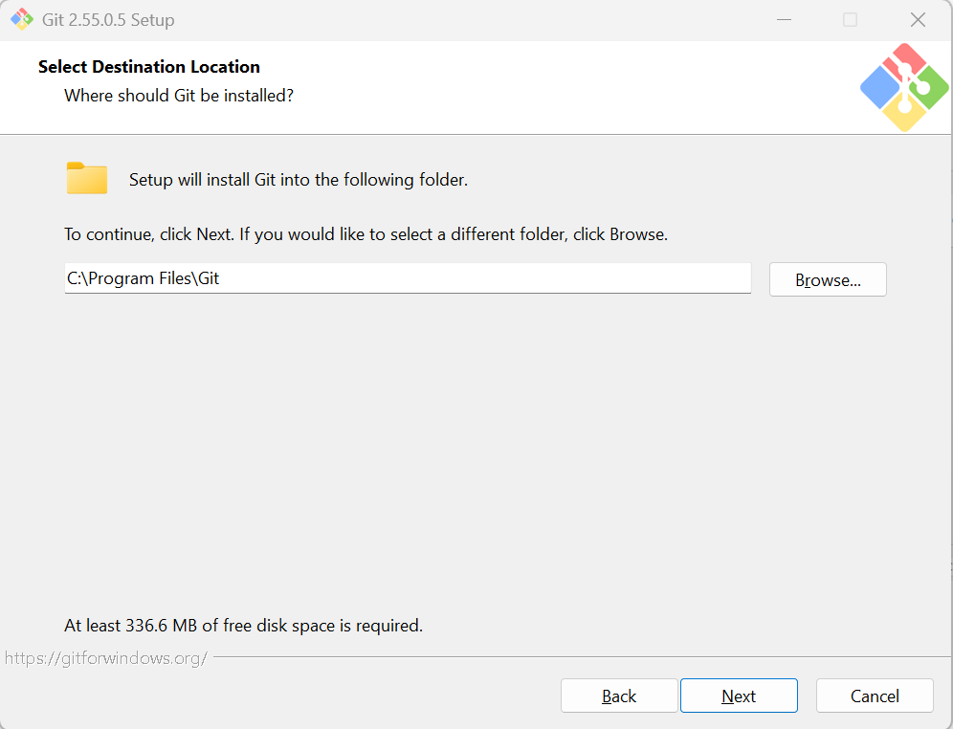
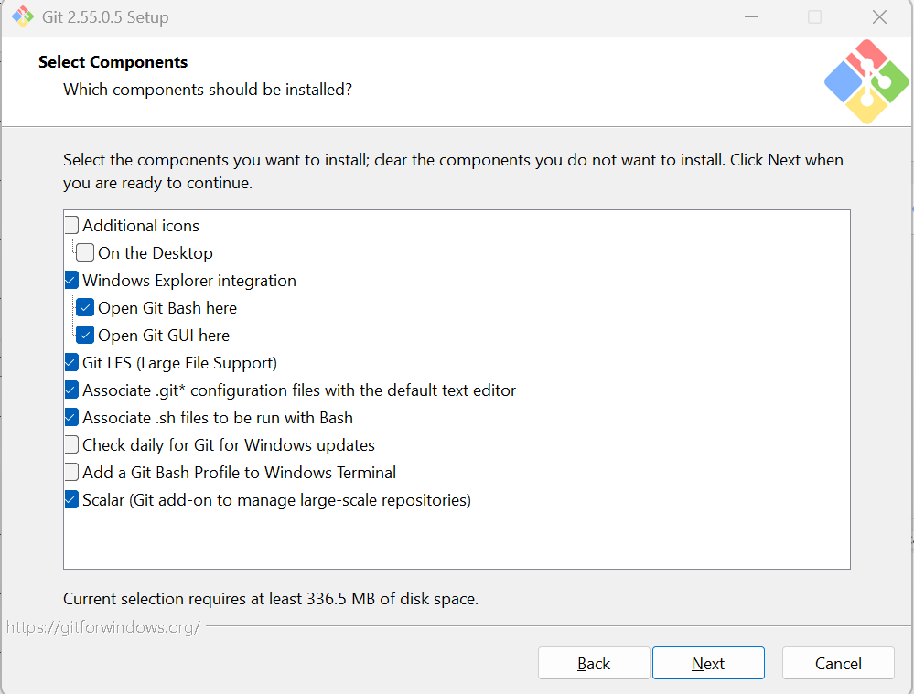
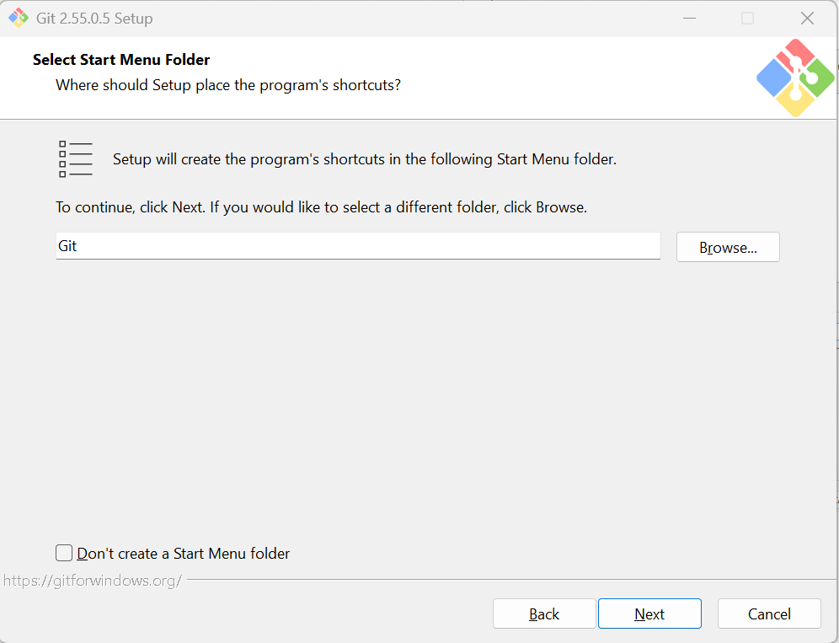
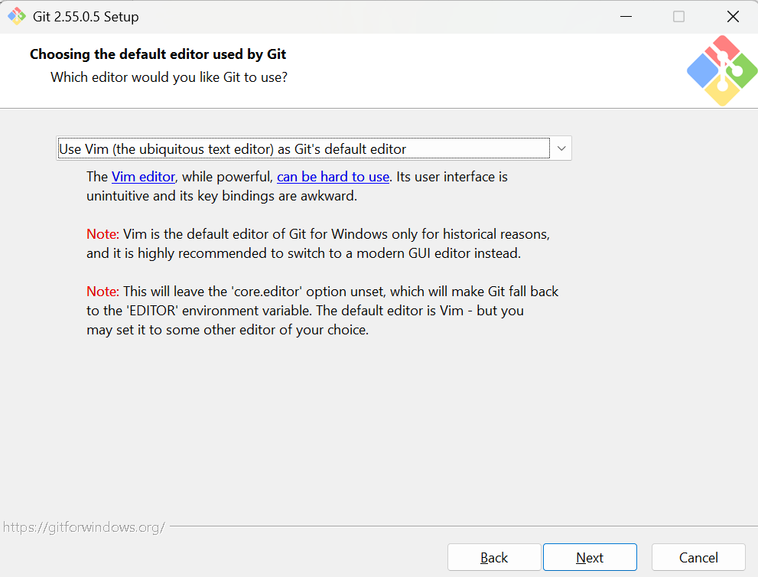
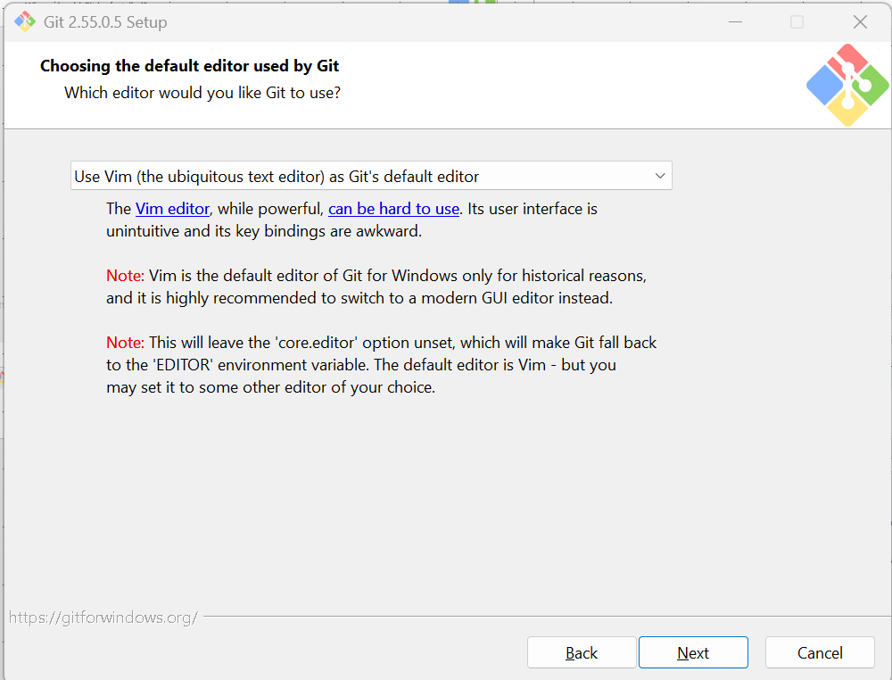
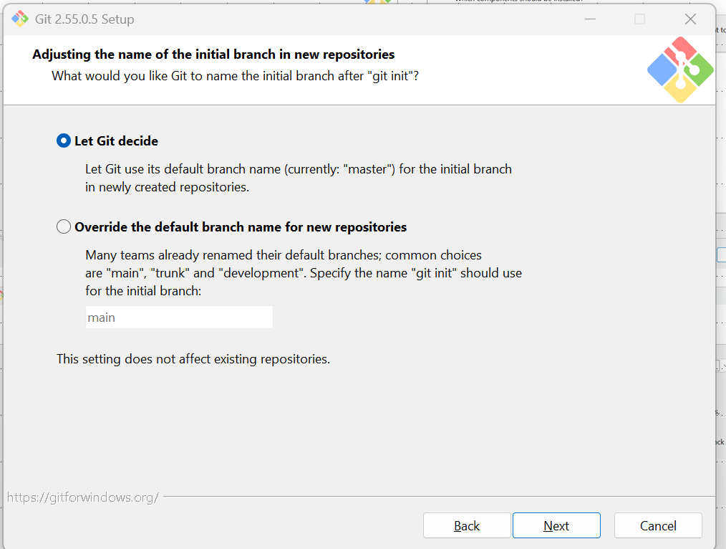
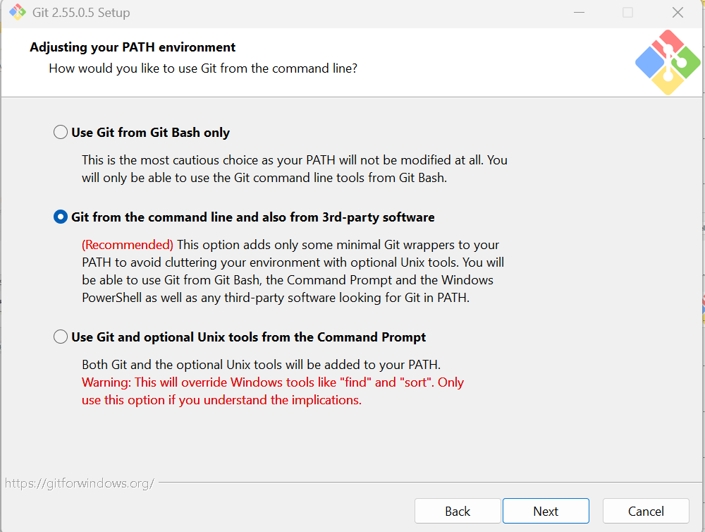
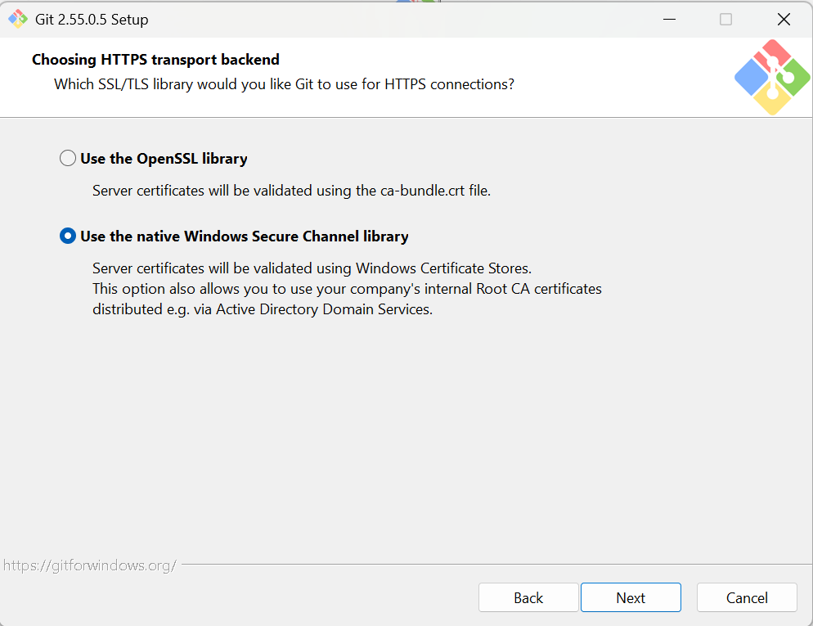
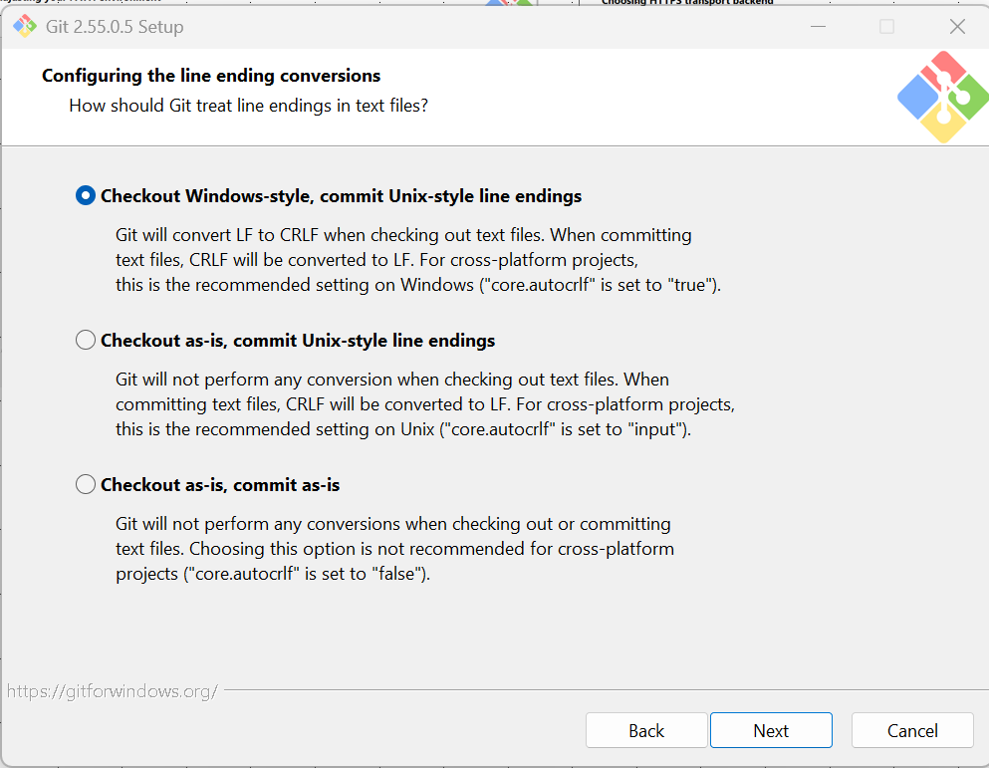
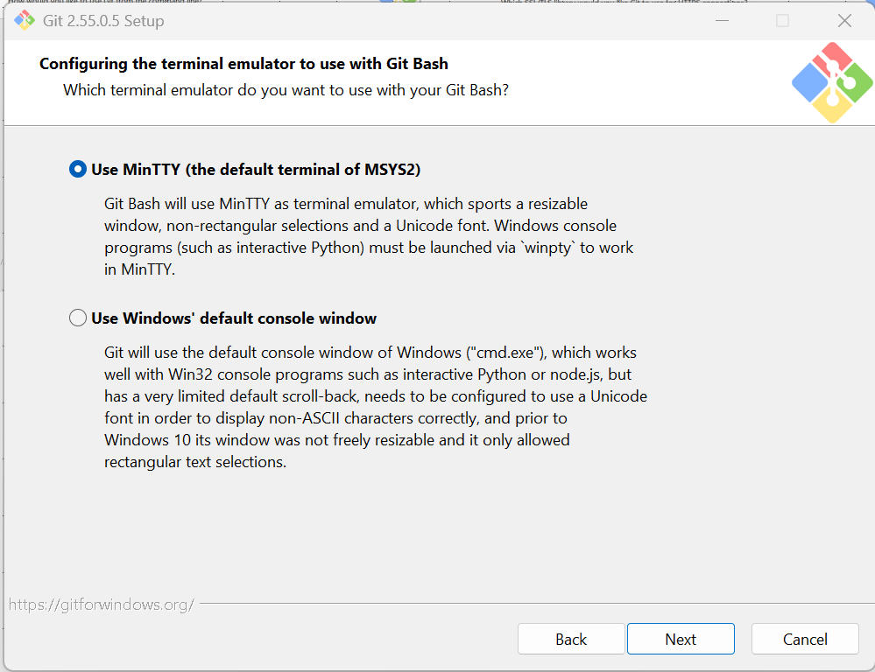
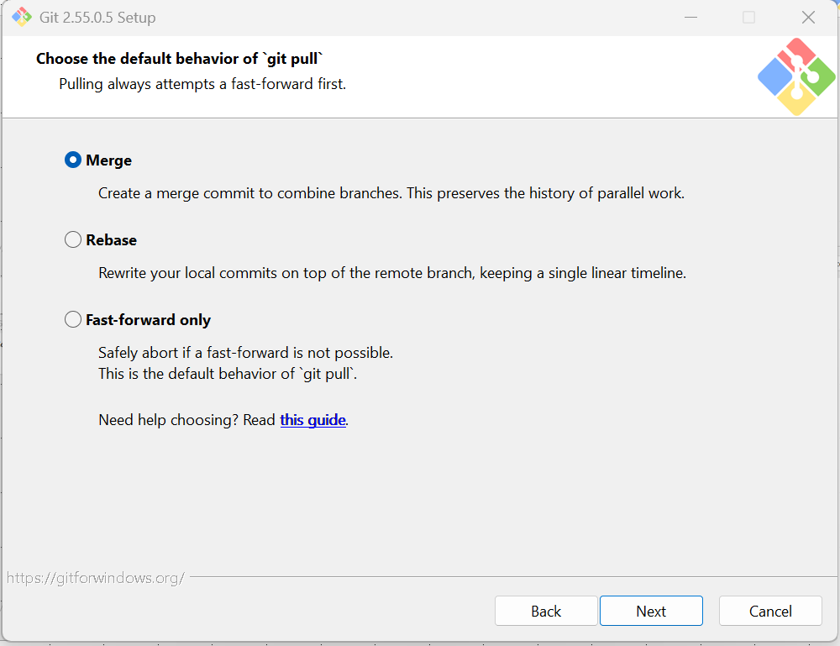
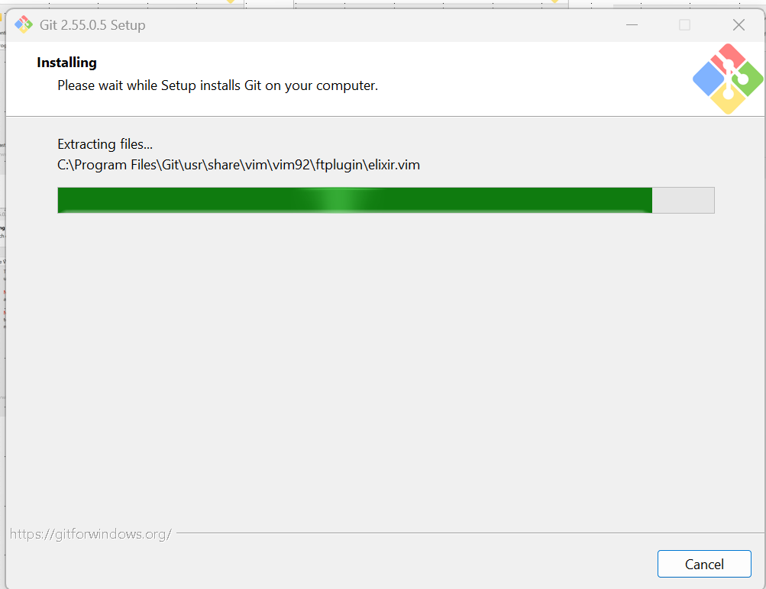

Slide 5
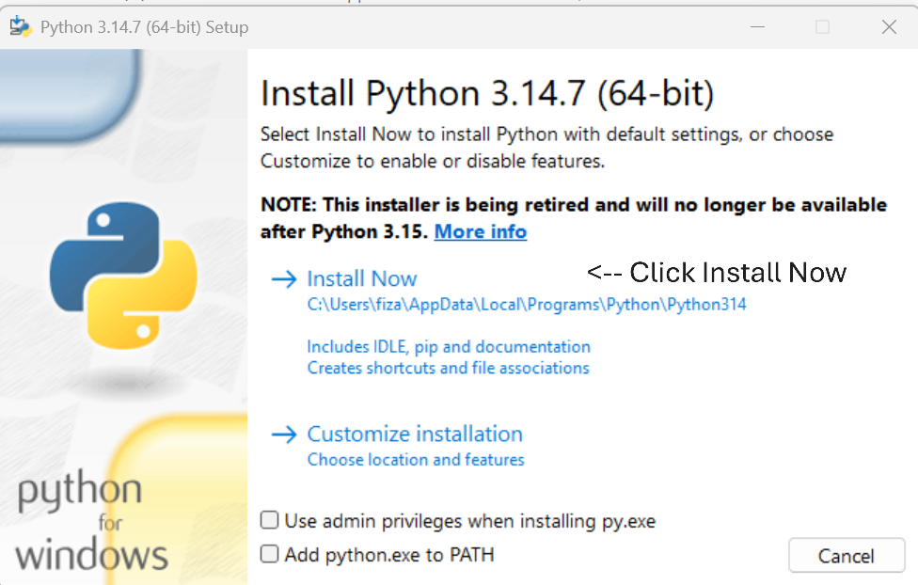
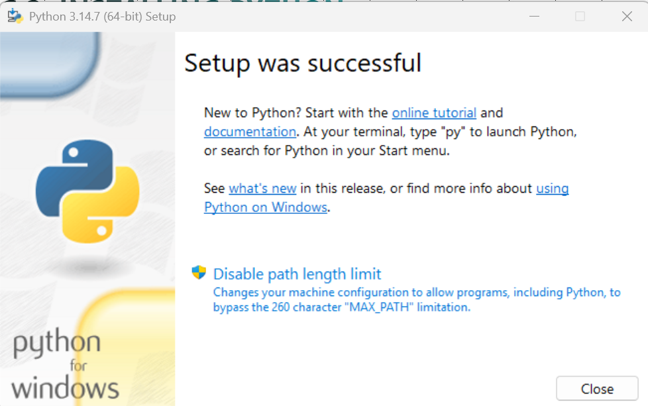
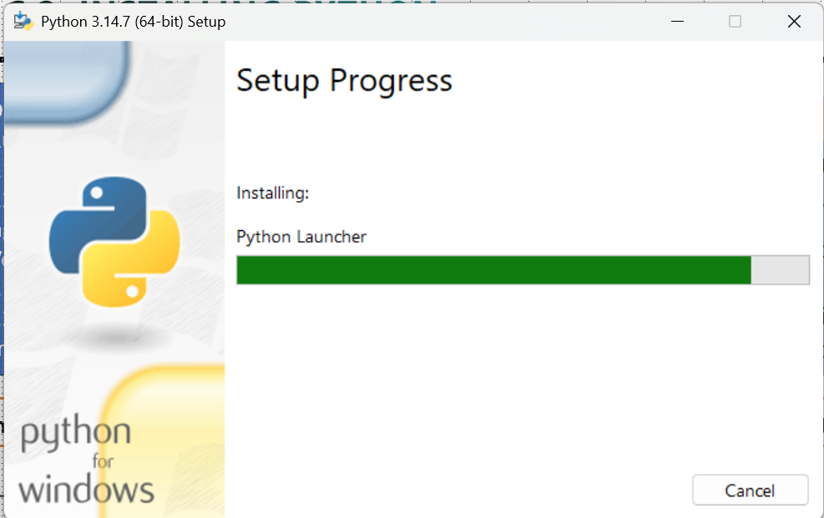

TOPIC 2: INSTALLING PYTHON
Download Python (python.org)
Run the installer
2.1 Windows: check "Add to PATH"
2.2 macOS/Linux: use package manager
Verify the installation
3.1 python --version
3.2 pip --version
4. Create a venv: python -m venv
Editor | Bundles Python?
VS Code | No, never. You must install Python from python.org yourself. VS Code just detects whatever's on your system.
Visual Studio | Can optionally bundle one. When you check "Python development" in the installer, an expandable panel on the right lets you also tick a specific Python interpreter version to install alongside it.
Tip:
1. Install Python from python.org first, then let VS Code / Visual Studio detect it — rather than relying on an editor to provide it.
2. On Windows, use py --version instead of python –version, Windows may redirect python to the Microsoft Store

Slide 6
TOPIC 3: VS Code set up
Download & install VS Code
Go to code.visualstudio.com, download the installer for your OS, and run it. On Windows, keep "Add to PATH" checked in the setup options.
2. Install essential extensions
2.1 Python extension (Microsoft)
2.2 GitLens & Git Graph
3. Create your project folder
In File Explorer / Finder, create a folder called AI wherever you want the project to live (e.g. Documents/AI).
4. Open the folder in VS Code
Launch VS Code > File > Open Folder... > select AI. Build out your subfolders (all_datasets/, all_experiments/, etc.) from “Chapter0_Python_Toolkit” ppt.
5. Confirm Git and Python are installed
Open the integrated terminal (Ctrl+`) and run git --version and python --version. If either is missing, install Git from git-scm.com and Python from python.org first.
6. Connect to GitHub
Click the Accounts icon (bottom-left) > Sign in with GitHub. Then open the Source Control panel (Ctrl+Shift+G) > Initialize Repository > Publish to GitHub, choosing public or private.
7. Create the virtual environment
Ctrl+Shift+P > "Python: Create Environment" > Venv > select your Python interpreter. VS Code creates .venv inside AI and offers to install requirements.txt if one exists.
8. Select it as the active interpreter
If not prompted automatically, Ctrl+Shift+P > "Python: Select Interpreter" > choose the one listed under .venv.
9. Verify it's active
Open a new integrated terminal — you should see (.venv) at the start of the prompt, confirming it's active and ready to use.

Slide 7
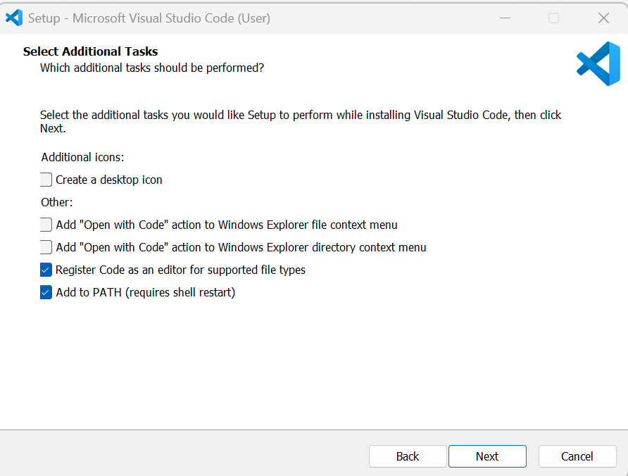
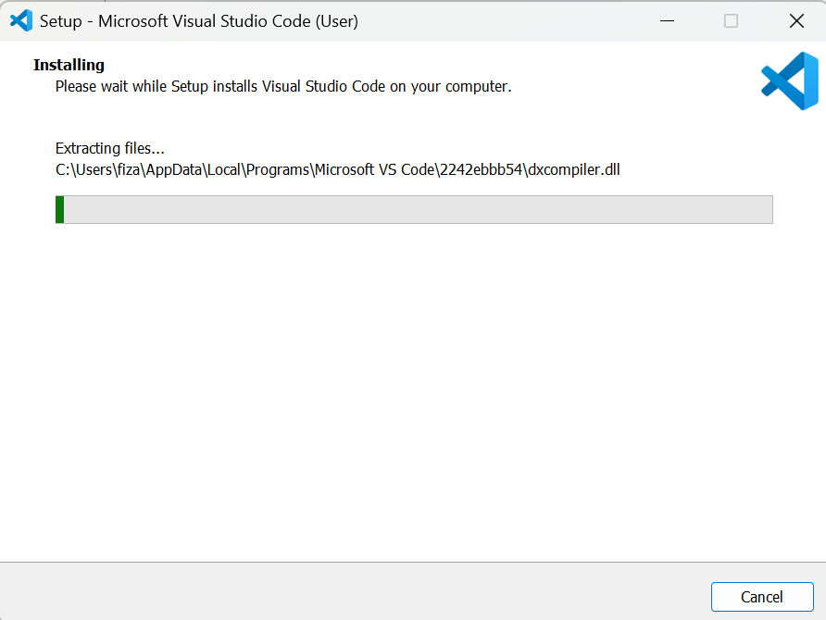
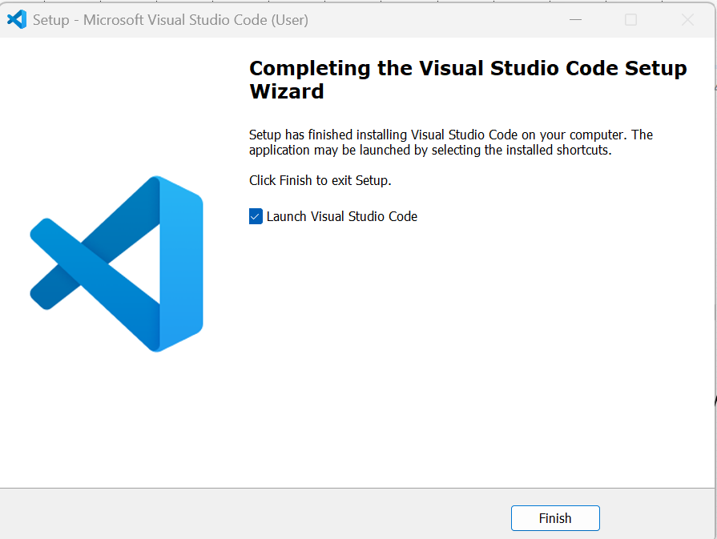
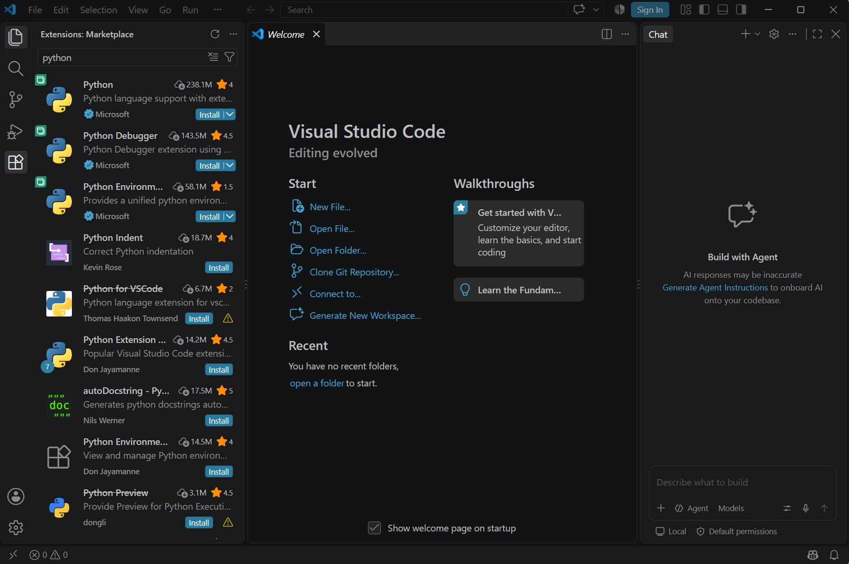
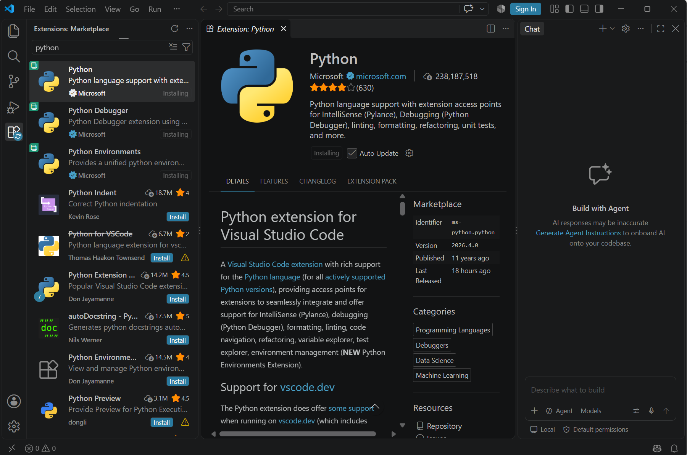
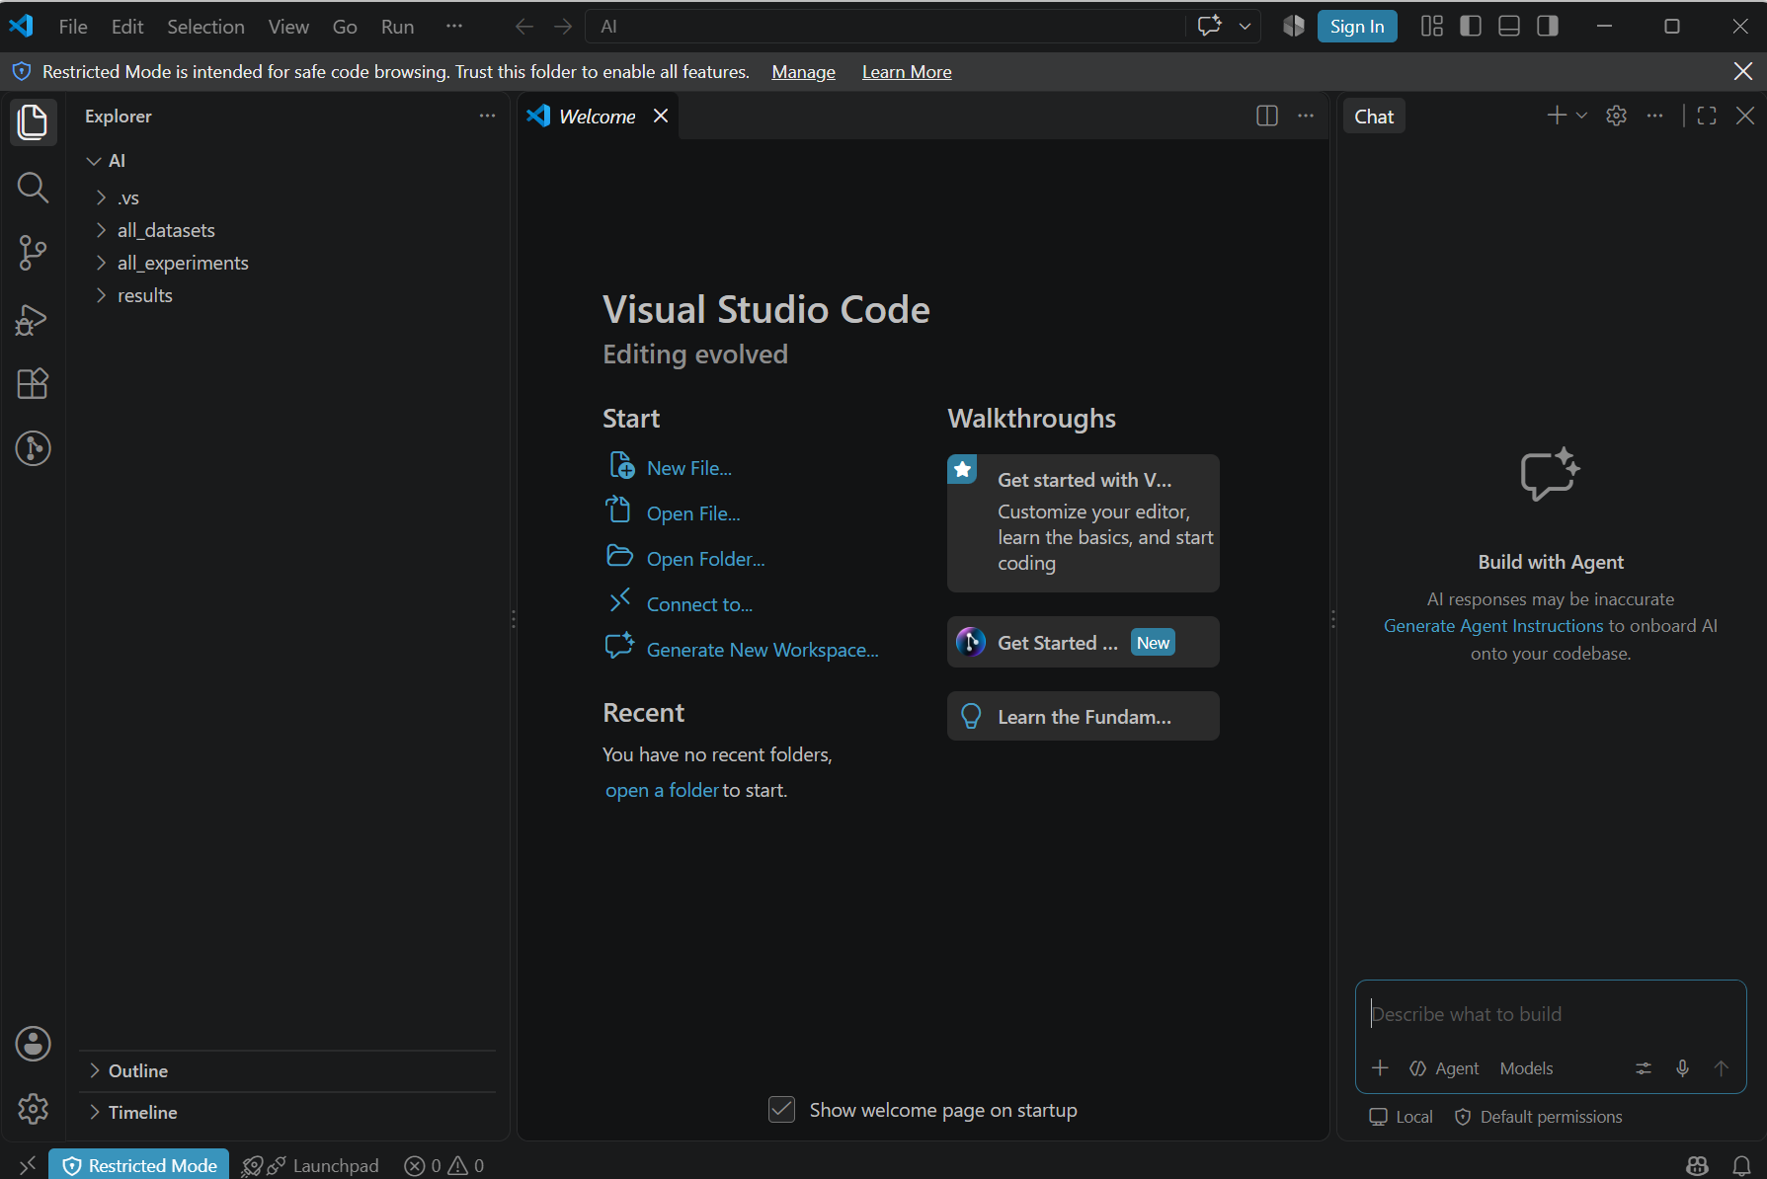

Slide 8
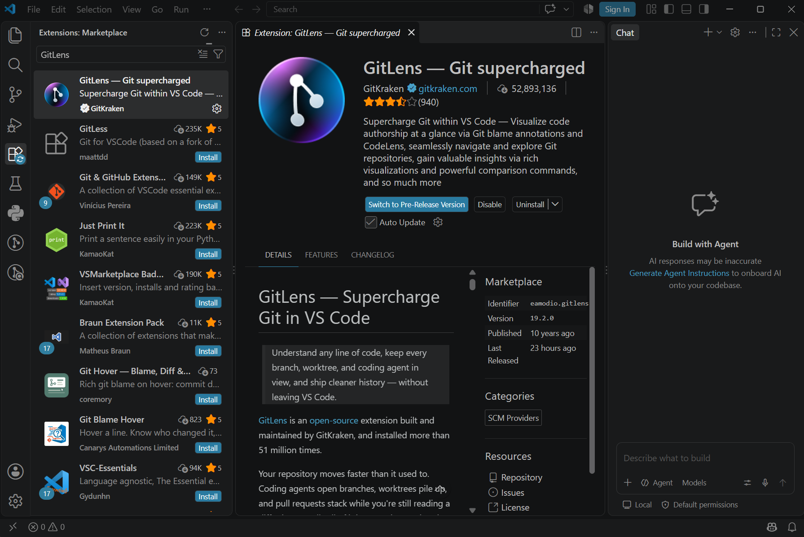
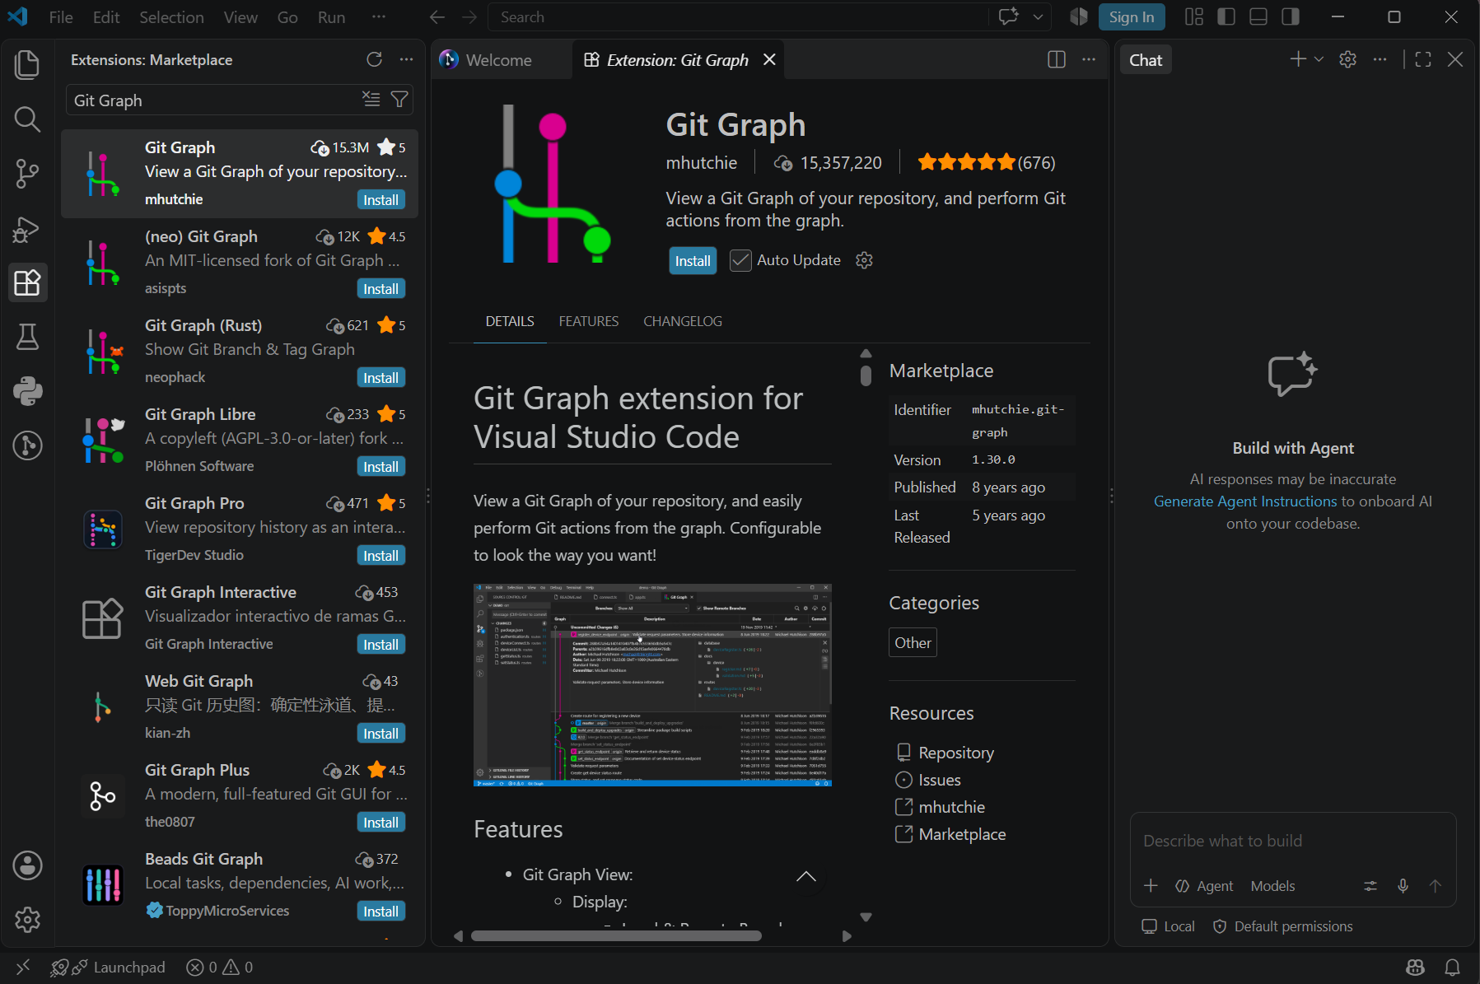
Check this particular GitLens by GitKraken to install
Check this particular Git Graph by mhutchie

Slide 9
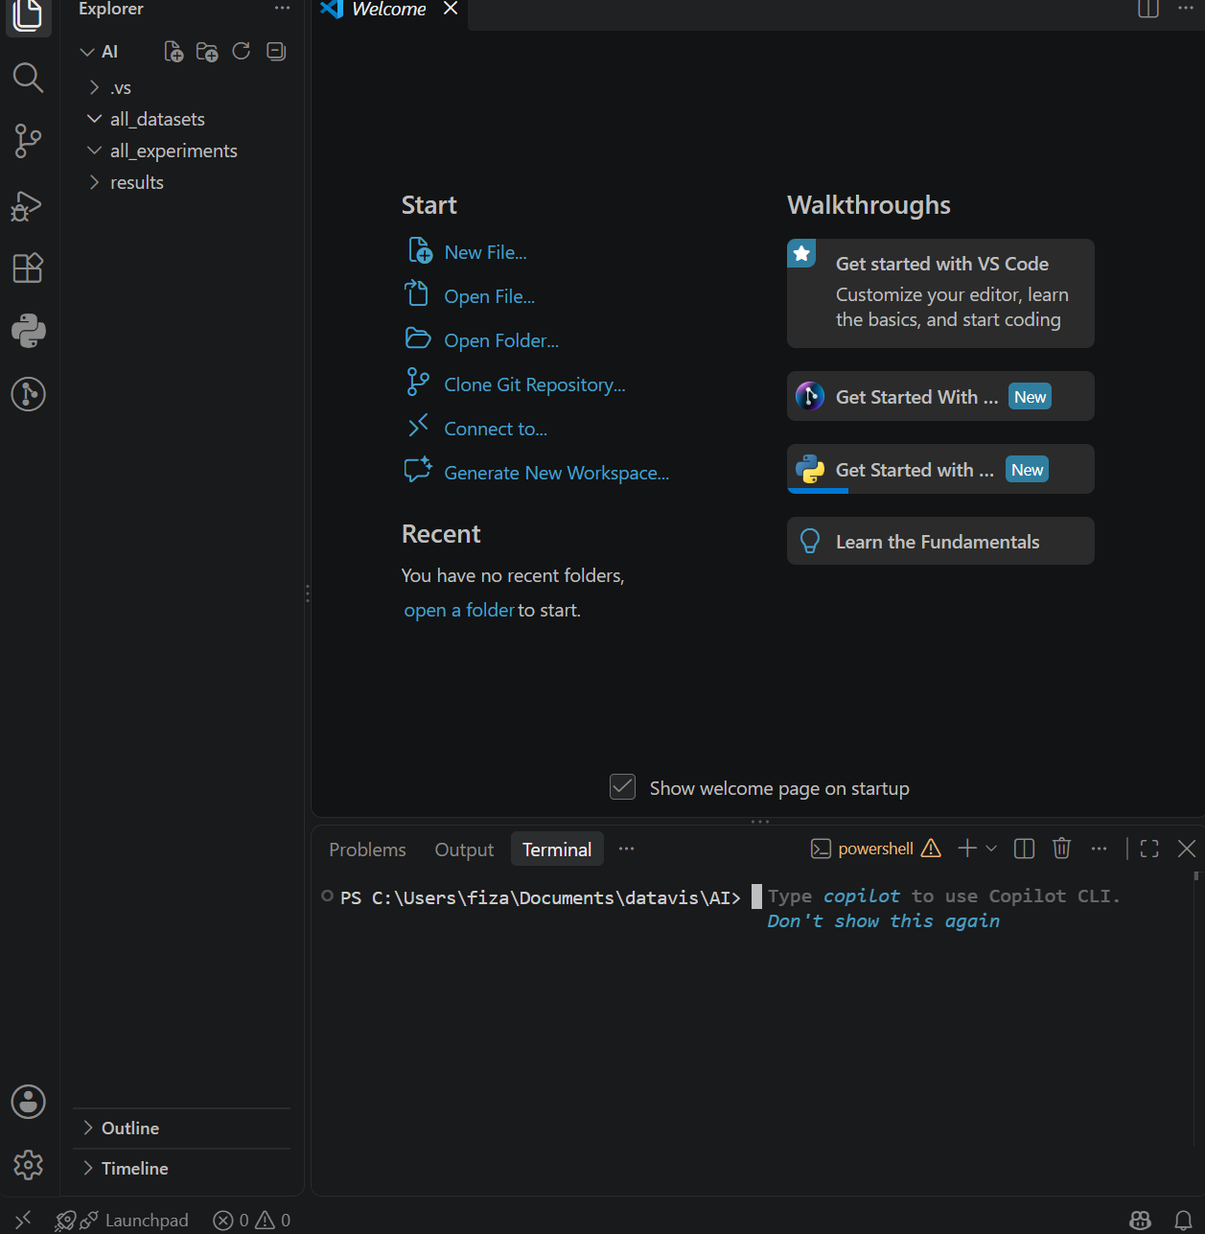
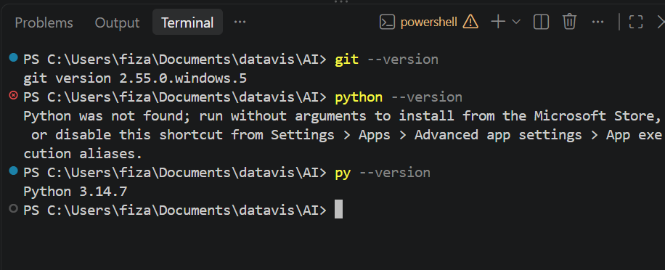
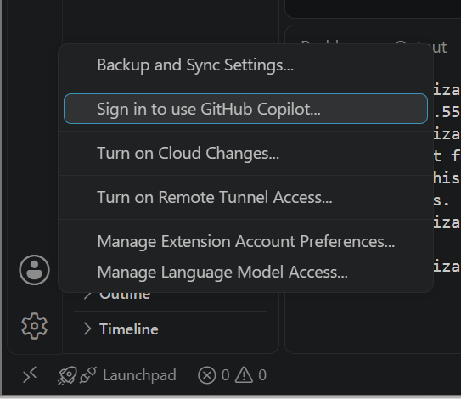
After Ctrl + ` … Terminal opens at the bottom of the editor.
While finding version, for windows user, python --version might throw error, so use py --version to get the required installed python version.
Sign in to GitHub

Slide 10
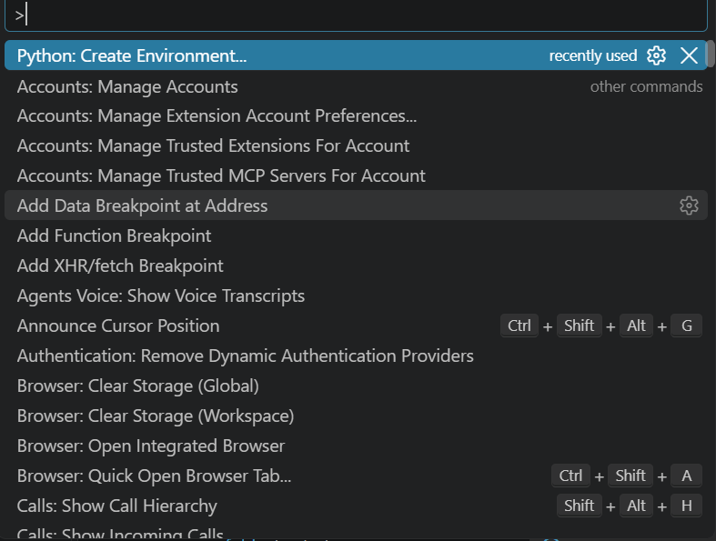
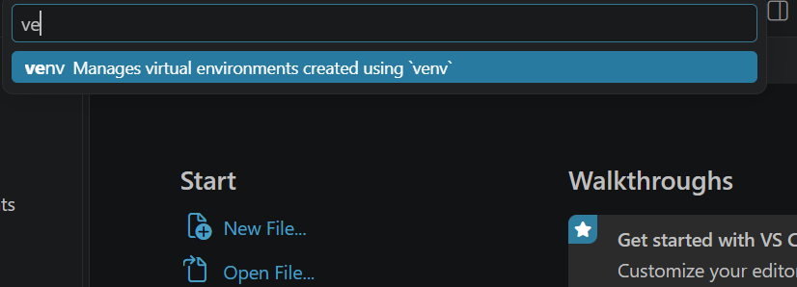
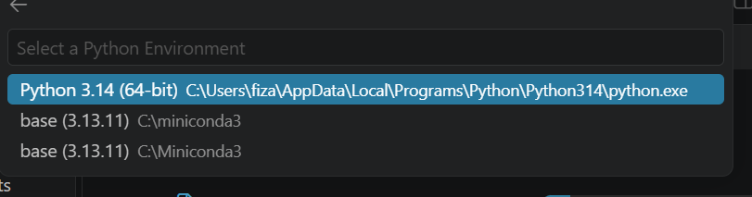
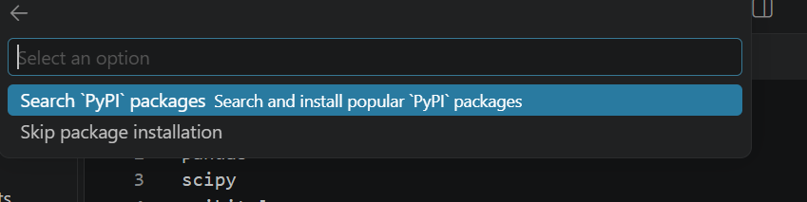
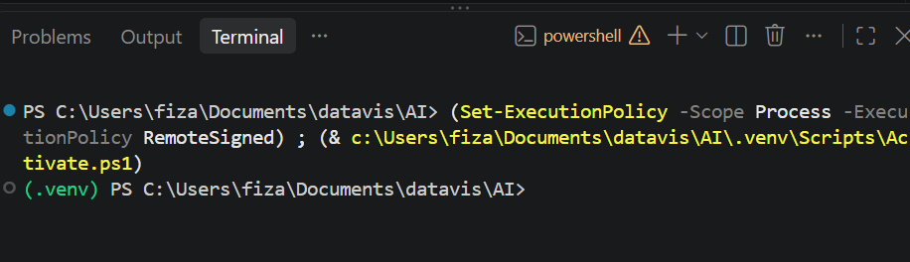
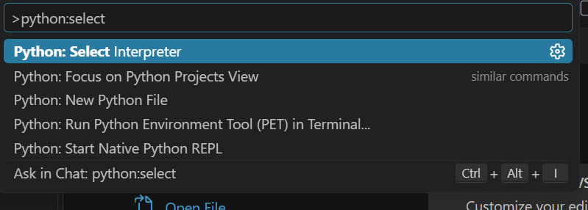
Skip package installation.

Slide 11
Visual Studio set up
1. Download & install Visual Studio
Go to visualstudio.microsoft.com, download Community (free) or your licensed edition, and run the installer.
2. Select the Python workload
In the Visual Studio Installer, check "Python development" under Workloads, then click Install (or Modify if already installed).
3. Visual Studio doesn't use this extension model for these two things at all:
Git support is built directly into the IDE, the Git Changes window and Git Repository window (with its own commit graph) are there by default. There's no separate GitLens/Git Graph equivalent to add.
4. Create and open your project folder
Create the AI folder in File Explorer, then in Visual Studio: File > Open > Folder... > select AI. Build out your subfolders from Solution Explorer.
5. Confirm Git and Python are installed
Open View > Terminal and run git --version and python --version. Install Git from git-scm.com or Python from python.org first if either is missing.
6. Connect to GitHub
Git menu > "Clone Repository" (to pull an existing repo) or "Create Git Repository" (to start fresh) > sign in with your GitHub account when prompted > choose to push AI to a new or existing GitHub repo.
7 Open the Python Environments window
View > Python Environments (only appears once the Python workload is installed).
8. Create the virtual environment
Click "Add Environment" > Virtual Environment > point it at your requirements.txt so Visual Studio installs everything automatically.
9. Set it as the active environment
Right-click the new environment > "Set as Current Environment" so all scripts in this project run inside .venv.

Slide 12
To be checked in next class
Screenshot of all three tools
1.1 Screenshot Git & Python versions
1.2 Screenshot the VS Code welcome screen

Slide 13
SUMMARY
Git & GitHub enable version control
Python installed and verified
2.1 python --version confirms it
2.2 pip manages packages
VS Code ties it together
3.1 Python extension for coding
3.2 Git integration for commits
4. Next: writing your first script

Slide 14
THANK YOU
DEPARTMENT OF COMPUTING
FARAHIDA.MAUSOR@UTP.EDU.MY
Lab 01-01-10: Data Analytic Lab

