Slide 1
The Limitations of Deep Learning in Adversarial Settings
IEEE 2016

Slide 2
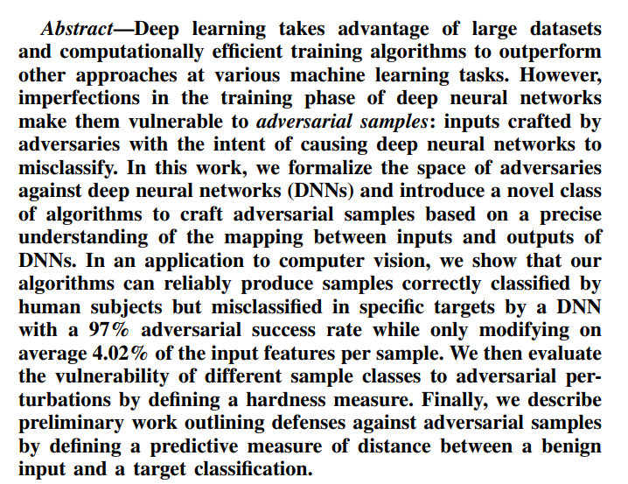
Abstract

Slide 3
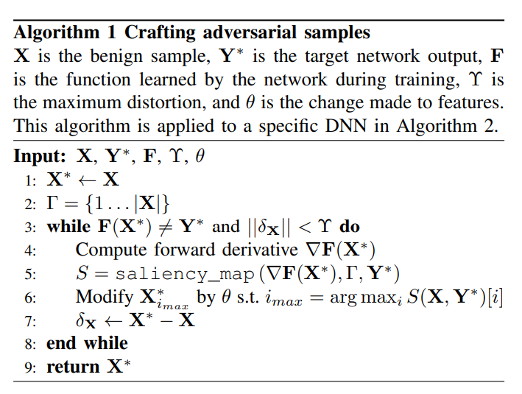

Slide 4
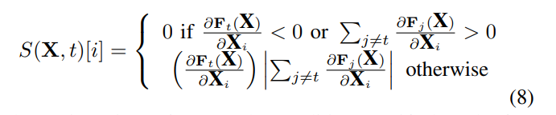
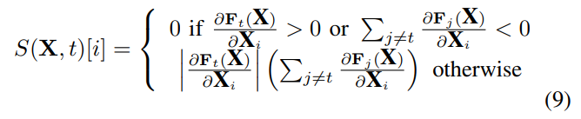
Saliency map
Adversary saliency map

Slide 5
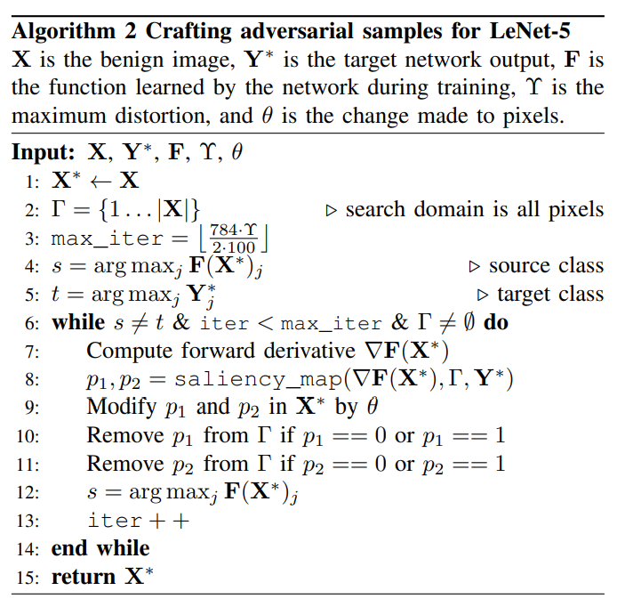

Slide 6
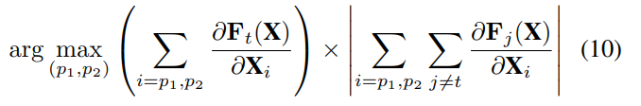
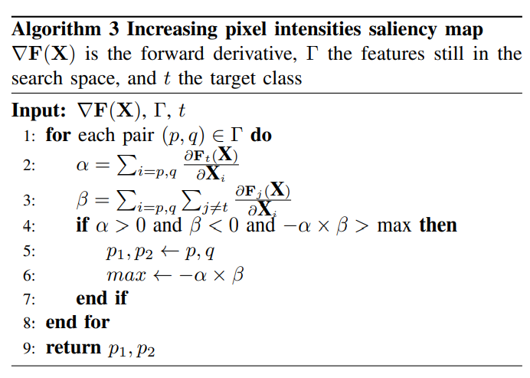
Saliency map aims to find pairs of pixels (p1, p2)

Slide 7


Hardness of a target class relatively to a given source class
Derived from the trapezoidal rule

Slide 8


Adversarial distance of sample X to class t
Robustness of a network F against adversarial perturbations

Slide 9
Adversarial Attack on Graph Structured Data
ICML 2018

Slide 10
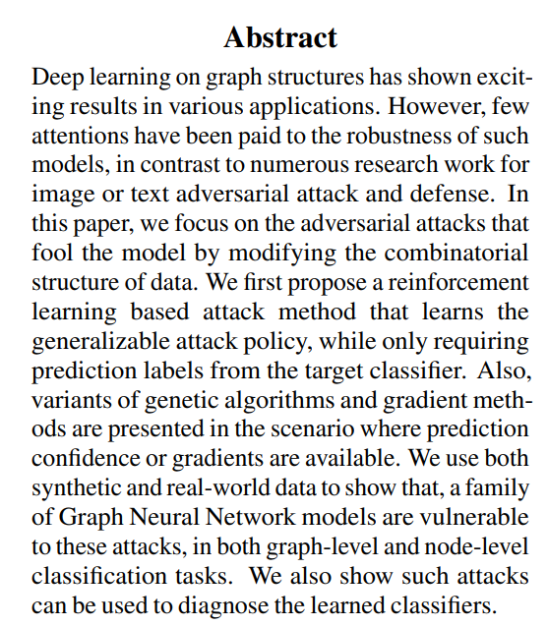
Reinforcement learning based attack method that learns the generalizable attack policy, while only requiring prediction labels from the target classifier

Slide 11
Adversarial Attacks on Neural Networks for Graph Data
KDD 2018

Slide 12
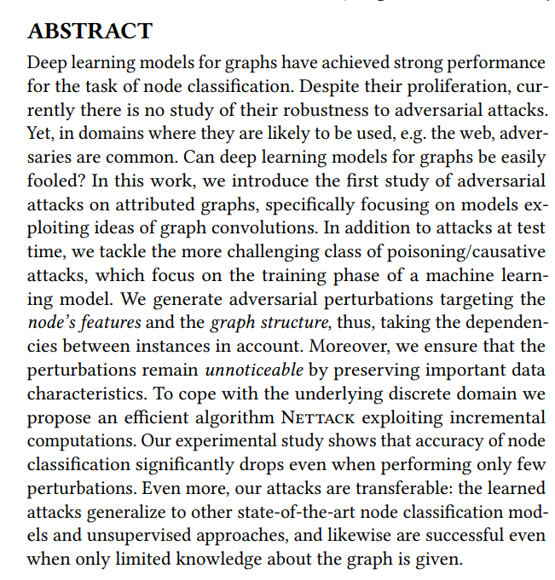

Slide 13
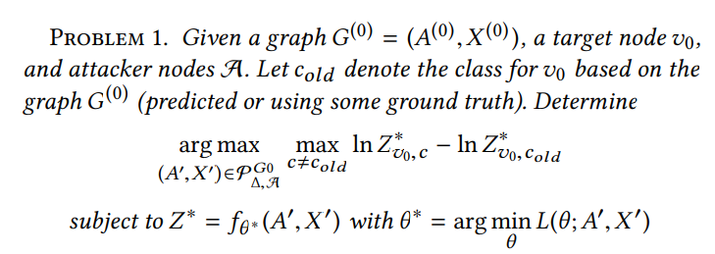
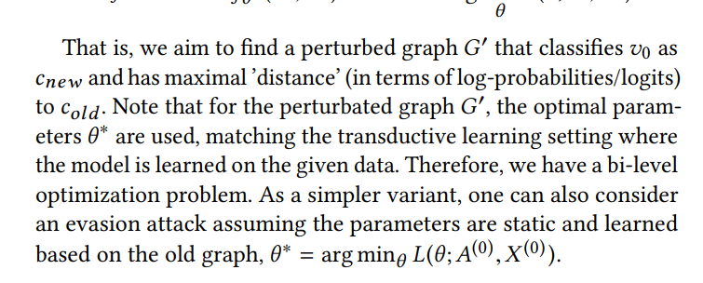

Slide 14
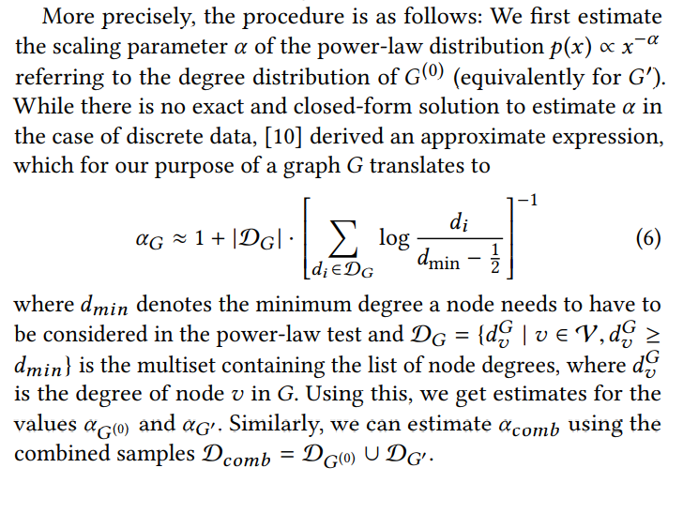
Unnoticeable Perturbations – Graph structure preserving perturbations

Slide 15
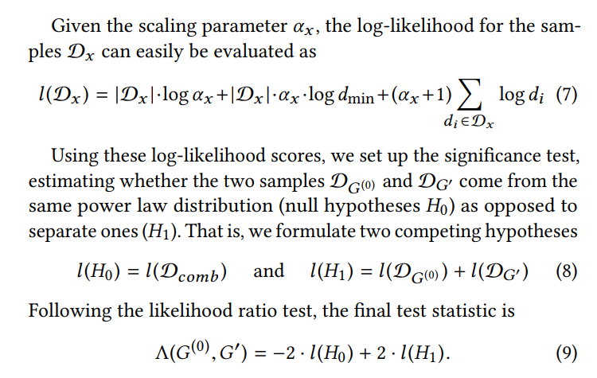
Unnoticeable Perturbations – Graph structure preserving perturbations

Slide 16

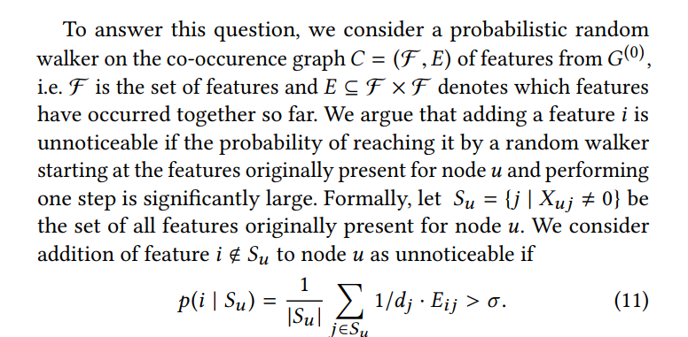
Unnoticeable Perturbations – Feature statistics preserving perturbations

Slide 17
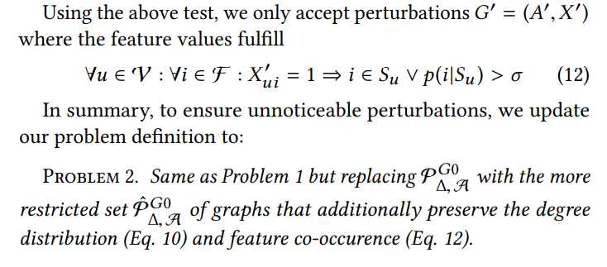

Slide 18
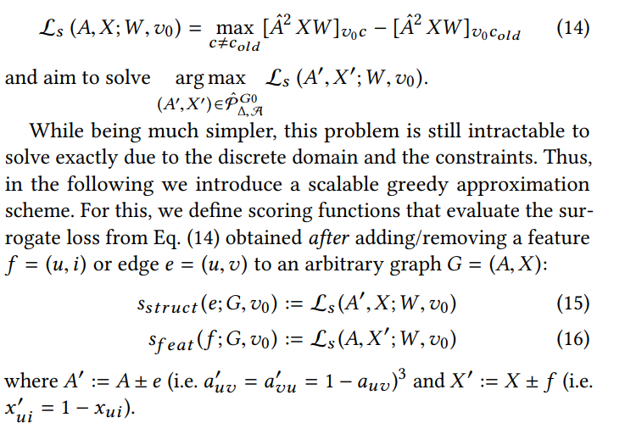
Generating adversarial graphs

Slide 19
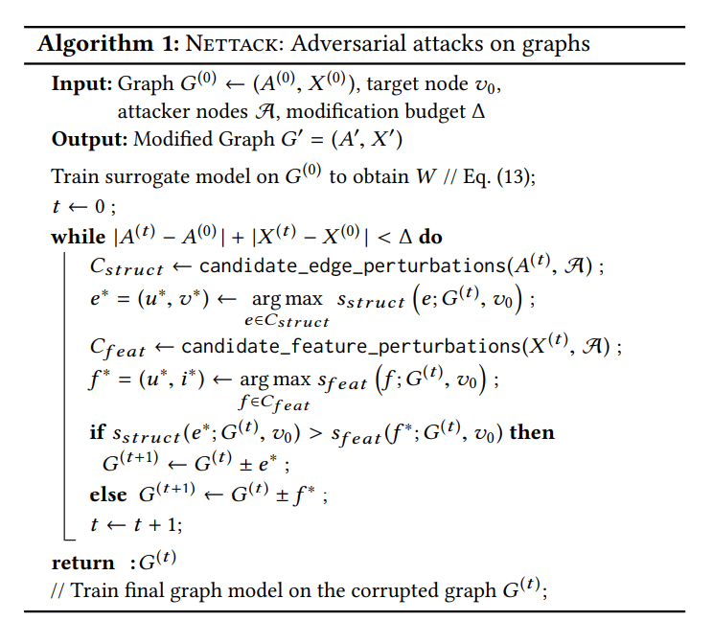
Fast computation of score functions

Slide 20
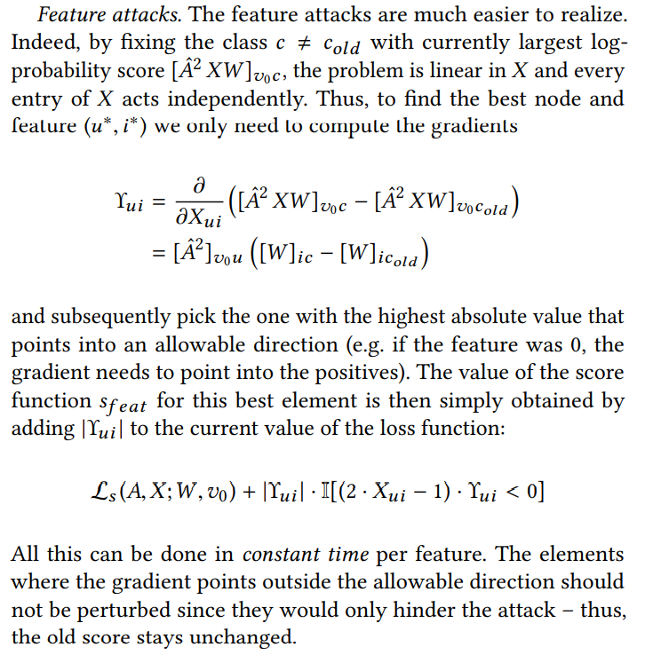

Slide 21
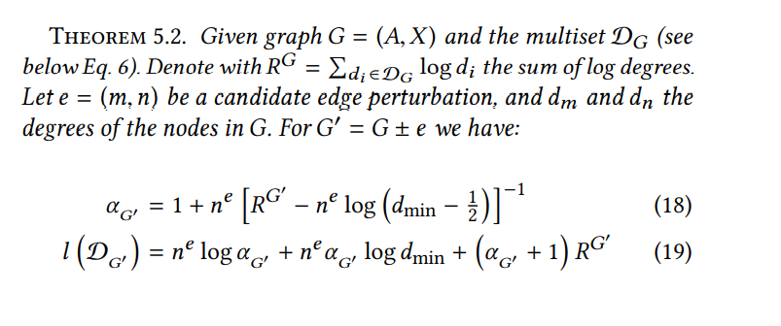
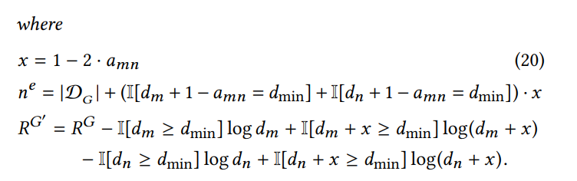
Fast computation of candidate sets

Slide 22
Network Embedding as Matrix Factorization : Unifying DeepWalk, LINE, PTE, and node2vec
WSDM 2018

Slide 23
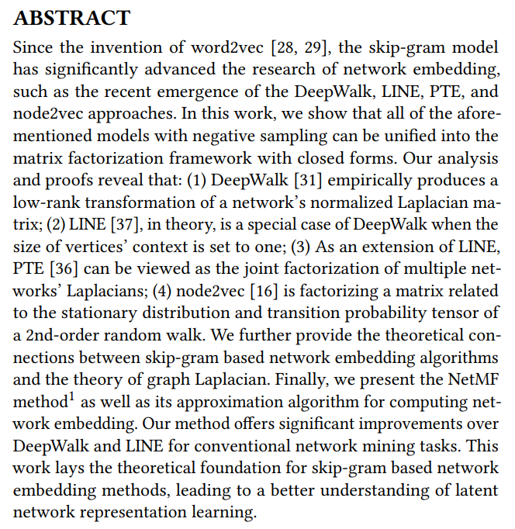

Slide 24

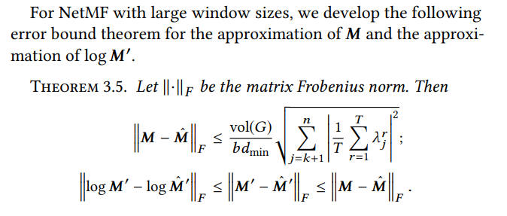
NetMF

Slide 25
Adversarial Attacks on Node Embeddings via Graph Poisoning
ICML 2019

Slide 26
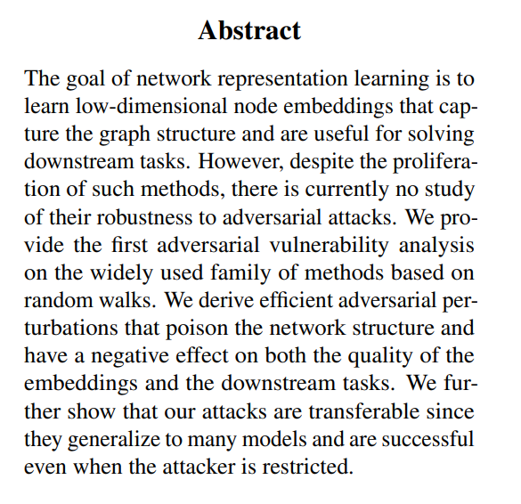

Slide 27
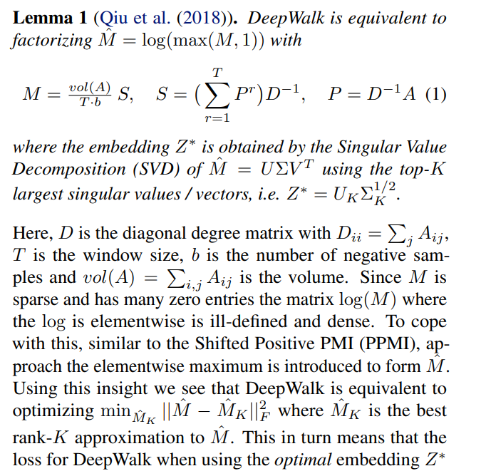

Slide 28
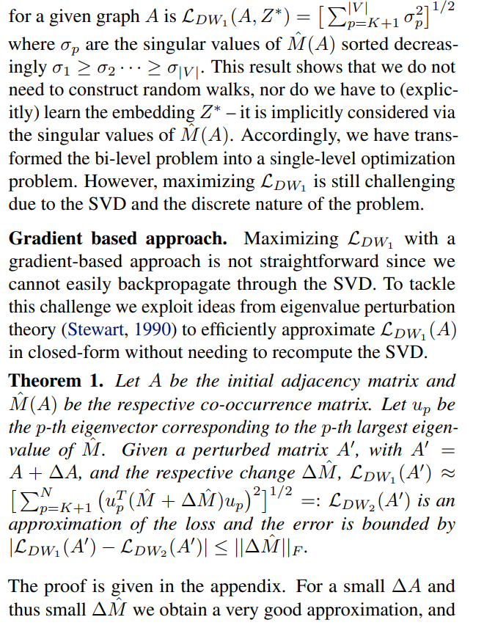
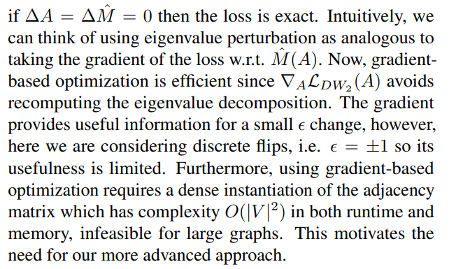

Slide 29
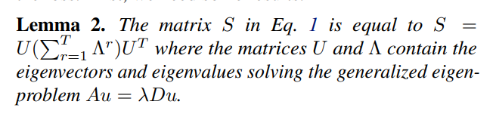
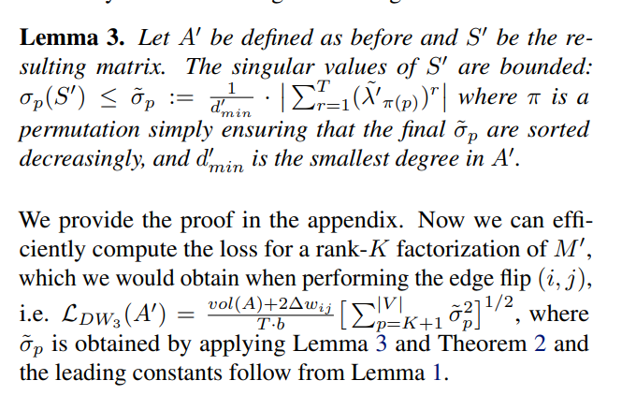
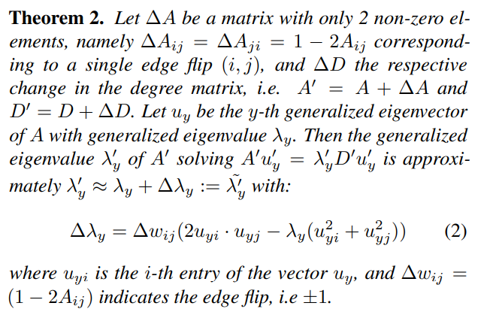

Slide 30
Topology Attack and Defense for Graph Neural Networks : An Optimization Perspective
ICIAJ 2019

Slide 31
Adversarial Examples on Graph Data : Deep Insights into Attack and Defense
ICIAJ 2019

Slide 32
Adversarial Attacks on Graph Neural Networks via Meta Learning
ICLR 2019

Slide 33
A Restricted Black-box Adversarial Framework Towards Attacking Graph Embedding Models
AAAI 2020

Slide 34
Towards More Practical Adversarial Attacks on Graph Neural Networks
NIPS 2020

