Slide 1
Shared memory π-calculation & The STREAM benchmark

Slide 2
How this presentation is organized
Presenting shared memory π-calculation:
Objective
Requirements
Code and scaling study
Conclusion
STREAM benchmark:

Slide 3
Shared memory π-calculation

Slide 4
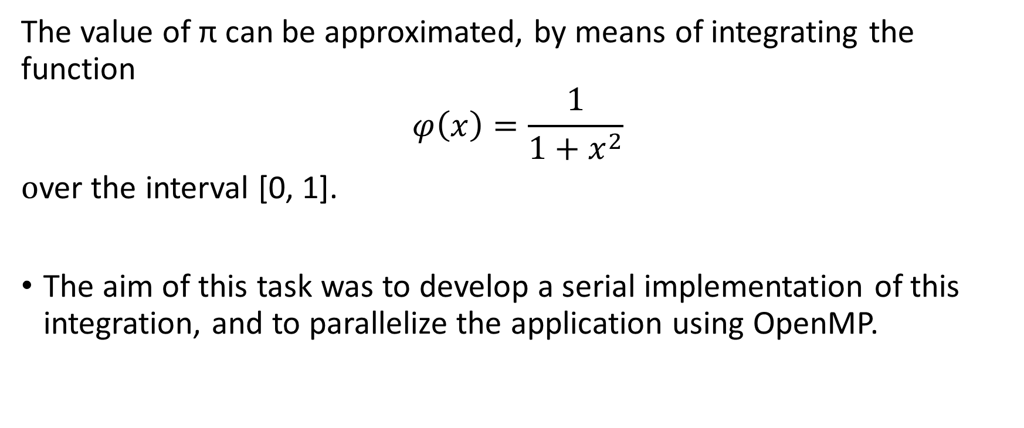
Objective
The value of π can be approximated, by means of integrating the function
$$φ\left(x\right)=\frac{1}{1+x^{2}}$$
over the interval [0, 1].
The aim of this task was to develop a serial implementation of this integration, and to parallelize the application using OpenMP.

Slide 5
Requirements
Develop a serial implementation that integrates function ϕ(x) over [0, 1].
Parallelize your application using OpenMP
critical directive
reduction summation order.
Perform a scaling study of your algorithm.
OMP_NUM_THREADS
Weak scaling
Strong scaling

Slide 6
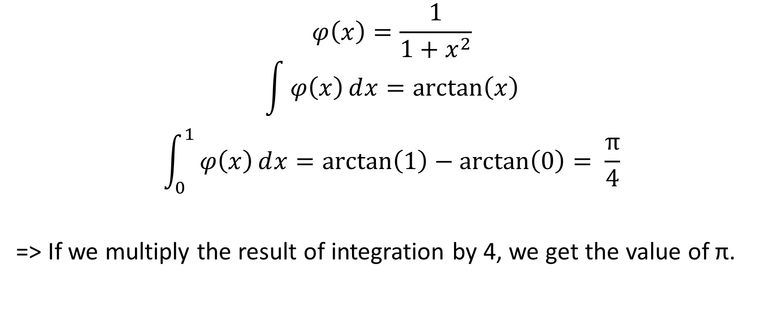
Mathematical background
$$φ\left(x\right)=\frac{1}{1+x^{2}}$$
$$\int{φ\left(x\right)ⅆx=\arctan\left(x\right)}$$
$$\int_{0}^{1}{φ\left(x\right)ⅆx=\arctan\left(1\right)−\arctan\left(0\right)= \frac{π}{4}}$$
=> If we multiply the result of integration by 4, we get the value of π.

Slide 7
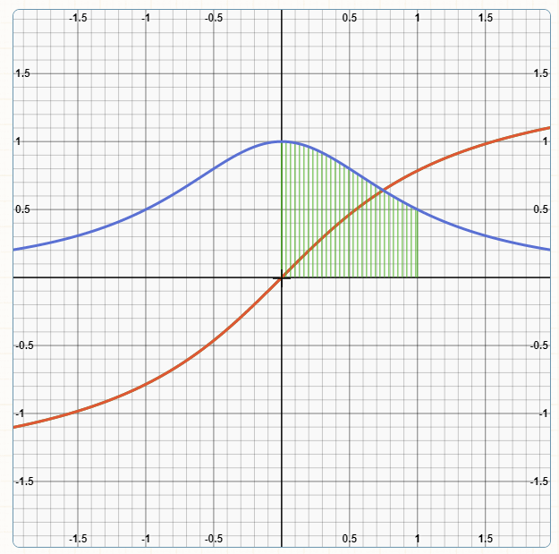
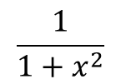

Graph:
$$\frac{1}{1+x^{2}}$$
$$\arctan\left(x\right)$$

Slide 8
Code
double h, y, sum;
//number of partitions
long n = 100000000;
h = 1. / n;
sum = 0;
for (i = 0; i <= n; i++) {
//calculate function value at current partition
y = phi(i*h);
//add current function value to sum
sum += y;
}
sum *= 4. * h; //value of pi

Slide 9
The critical directive
Specifies a region of code that must be executed by only one thread at a time.
#pragma omp parallel for private(y), shared(sum)
for (i = 0; i <= n; i++) {
y = phi(i*h);
#pragma omp critical
sum += y;
}

Slide 10
Scaling study – Critical directive
Weak scaling:
n = 1 000 000
Strong scaling:
n = 100 000 000.
N/No. of threads | n/16 | 2n/32 | 4n/64 | 8n/128
Execution time (s) | 17.931 | 36.884 | 76.407 | 149.951
No. of threads | 16 | 32 | 64 | 128
Execution time (s) | 73.772 | 73.902 | 77.451 | 78.489

Slide 11
The reduction clause
Performs a reduction operation on the variables that appear in its list.
#pragma omp parallel for private(y), reduction(+: sum)
for (i = 0; i <= n; i++) {
y = phi(i*h);
sum += y;
}

Slide 12
Scaling study – Reduction clause
Weak scaling:
n = 1 000 000 000
Strong scaling:
n = 1 000 000 000.
N/No. of threads | n/16 | 2n/32 | 4n/64 | 8n/128
Execution time (s) | 0.176 | 0.181 | 0.202 | 0.302
No. of threads | 16 | 32 | 64 | 128
Execution time (s) | 0.610 | 0.325 | 0.196 | 0.188

Slide 13
Conclusion
Using the critical directive kills performance because threads have to access the critical section one after another.
Parallelizing with the reduction clause leads to faster execution once more threads are introduced.
Strong scaling shows that if the problem is big enough adding more threads to parallelize it works up to a certain point. It will have diminishing returns once the problem chunks are so small that the overhead of adding more threads doesn’t help anymore.

