Slide 1
Shared memory π-calculation & The STREAM benchmark

Slide 2
How this presentation is organized
Presenting shared memory π-calculation:
Objective
Requirements
Code and scaling study
Conclusion
STREAM benchmark:

Slide 3
Shared memory π-calculation

Slide 4
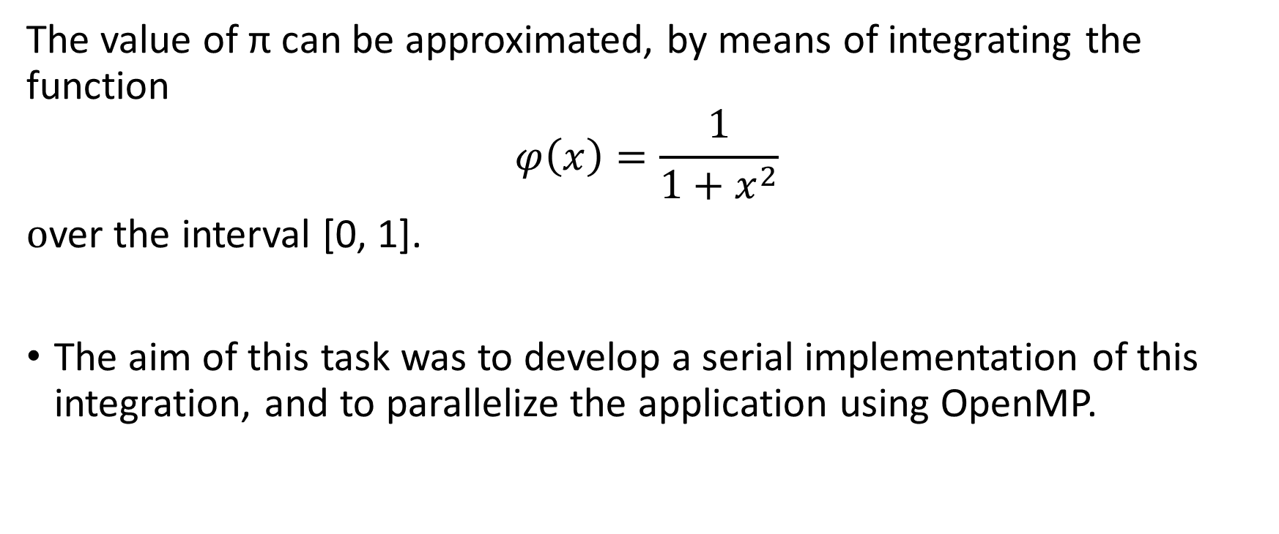
Objective
The value of π can be approximated, by means of integrating the function
$$φ\left(x\right)=\frac{1}{1+x^{2}}$$
over the interval [0, 1].
The aim of this task was to develop a serial implementation of this integration, and to parallelize the application using OpenMP.

Slide 5
Requirements
Develop a serial implementation that integrates function ϕ(x) over [0, 1].
Parallelize your application using OpenMP
critical directive
reduction summation order.
Perform a scaling study of your algorithm.
OMP_NUM_THREADS
Weak scaling
Strong scaling

Slide 6
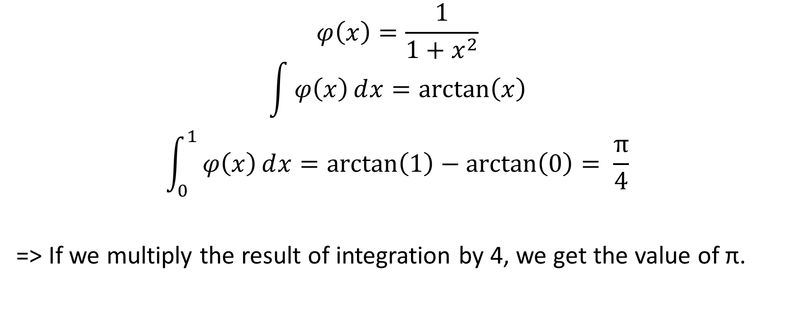
Mathematical background
$$φ\left(x\right)=\frac{1}{1+x^{2}}$$
$$\int{φ\left(x\right)ⅆx=\arctan\left(x\right)}$$
$$\int_{0}^{1}{φ\left(x\right)ⅆx=\arctan\left(1\right)−\arctan\left(0\right)= \frac{π}{4}}$$
=> If we multiply the result of integration by 4, we get the value of π.

Slide 7
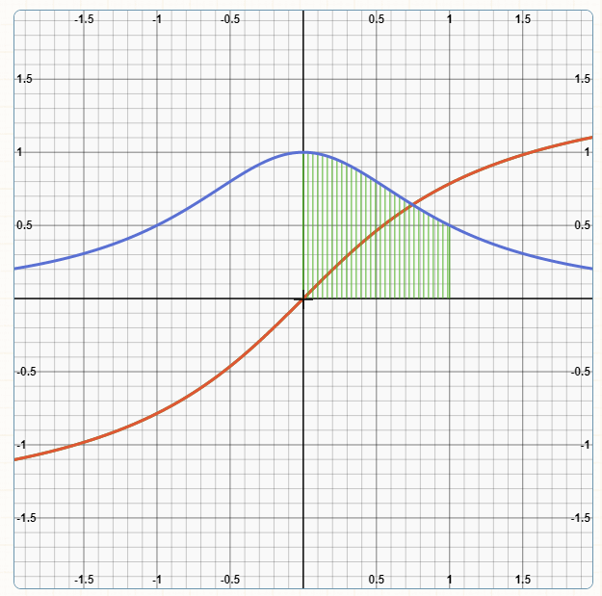
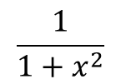

Graph:
$$\frac{1}{1+x^{2}}$$
$$\arctan\left(x\right)$$

Slide 8
Code
double h, y, sum;
//number of partitions
long n = 100000000;
h = 1. / n;
sum = 0;
for (i = 0; i <= n; i++) {
//calculate function value at current partition
y = phi(i*h);
//add current function value to sum
sum += y;
}
sum *= 4. * h; //value of pi

Slide 9
The critical directive
Specifies a region of code that must be executed by only one thread at a time.
#pragma omp parallel for private(y), shared(sum)
for (i = 0; i <= n; i++) {
y = phi(i*h);
#pragma omp critical
sum += y;
}

Slide 10
Scaling study – Critical directive
Weak scaling:
n = 1 000 000
Strong scaling:
n = 10 000 000.
N/No. of threads | n/16 | 2n/32 | 4n/64 | 8n/128 | 16n/256
Execution time (ms) | 752 | 1452 | 2917 | 5920 | 19458
No. of threads | 16 | 32 | 64 | 128 | 256
Execution time (ms) | 7304 | 7390 | 7374 | 7780 | 13523

Slide 11
The reduction clause
Performs a reduction operation on the variables that appear in its list.
#pragma omp parallel for private(y), reduction(+: sum)
for (i = 0; i <= n; i++) {
y = phi(i*h);
sum += y;
}

Slide 12
Scaling study – Reduction clause
Weak scaling:
n = 1 000 000
Strong scaling:
n = 10 000 000.
N/No. of threads | n/16 | 2n/32 | 4n/64 | 8n/128 | 16n/256
Execution time (ms) | 31 | 37 | 50 | 73 | 209
No. of threads | 16 | 32 | 64 | 128 | 256
Execution time (ms) | 35 | 36 | 47 | 69 | 113

Slide 13
Conclusion

