Slide 1
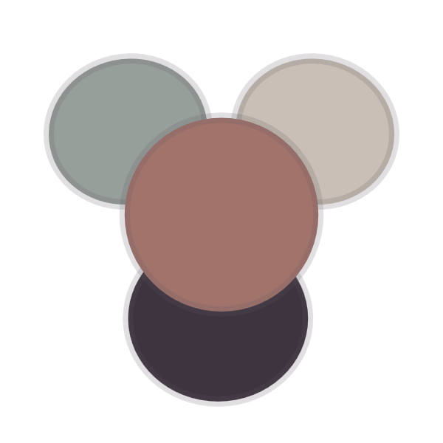
inm
OKLCH palette for quiet interfaces
Warm stone, soft clay, deep plum.
A low-chroma color system for editorial tools, dashboards, and calm creative product UI.
Design system overview
inm · 2026

Slide 2
What we'll cover
Agenda
01
Foundations
Anchors, tokens, modes
02
In product
Dense, scannable UI
03
Contrast
APCA, both modes
04
Handoff
Tailwind v4 & v3
inm — agenda
02

Slide 3
01 — Foundations
Four anchors, tuned into UI tokens.

Slide 4
How the palette works
Quiet by default, clear on intent.
1
Warm canvas
Stone in light, plum in dark — never pure black or white.
Hierarchy comes from tone and border, not from color noise or heavy shadow. One action color does the signalling; everything else stays calm.
2
Clay is the signal
The single accent for actions, links, and active state.
3
Mist for state
A cool support tone for quiet statuses and metadata.
inm — foundations
04

Slide 5
What you get
A system, not a swatch file.
Four anchors
Light & dark
APCA-tuned
Plum, clay, mist, and stone tuned into a full token scale.
One semantic map drives both modes with identical behavior.
Contrast measured per surface, not guessed from hex math.
Quiet elevation
Dense-ready
Portable handoff
Hierarchy from border and tone — shadows used sparingly.
Built for tables, dashboards, and editorial tools.
Exports cleanly to Tailwind v4 and v3 configs.
inm — features
05

Slide 6
Same roles, two moods
Light and dark share the same behavior.
Light mode
Dark mode
Editorial workspace
Active
Creative console
Live
Dashboard controls
Review
Review queue
Open
Portfolio index
Ready
Status stream
Synced
Apply palette
Apply palette

Slide 7
Drop-in tokens
No build step. Just variables.
inm.css
1 2 3 4 5 6 7
/* light scope — warm stone canvas */ :root {
--bg: oklch(81% .017 64.6); --text: oklch(28% .020 322); --accent: oklch(48% .065 28); --border: oklch(74% .011 58); }
inm — implementation
07

Slide 8
Readable by the numbers
APCA-informed contrast, both modes.
Body text
Accent
Body, dark
Chroma
65
47
-82
Low
APCA Lc · light
Lc on canvas
APCA Lc · dark
0.01–0.07 OKLCH
inm — contrast
08

Slide 9
Role by role
Semantic tokens at a glance.
TOKEN
USE
APCA LC
STATUS
text.body
Primary reading text
-82
Ship
text.muted
Metadata, captions
-58
Ship
accent.clay
Actions, links, active
-61
Ship
border.hair
Surface divisions
-14
Review
cool.mist
Quiet status tone
-44
Review
inm — token table
09

Slide 10
How it rolls out
From tokens to shipped product.
Week 1
Week 2
Week 3
Week 4
Adopt tokens
Build components
Tune contrast
Ship & hand off
Drop in the OKLCH variables; wire light and dark roots.
Buttons, inputs, rows, badges on the shared scale.
Check APCA across surfaces; adjust muted and accent.
Export Tailwind config; document in DESIGN.md.
inm — rollout
10

Slide 11
How adoption works
Four steps to a shipped palette.
1
Drop in the tokens
Add the OKLCH variables and wire the light and dark roots — no build step required.
2
Build on the scale
Compose buttons, inputs, rows, and badges from the shared semantic tokens.
3
Tune the contrast
Check APCA across every surface; nudge muted and accent until both modes read clean.
4
Hand it off
Export the Tailwind config and document the system in a portable DESIGN.md.
inm — process
11

Slide 12
Who's behind it
The maintainers.
Ida Mraz
Rune Kalla
Sena Oro
Vel Antu
Maintainer
Systems design
Product UI
Docs
Owns the palette spec and contrast targets.
Builds the token pipeline and Tailwind output.
Tests the system in dense dashboards and tools.
Keeps DESIGN.md portable and handoff-ready.
inm — team
12

Slide 13
Calm at the edges
Built for real product surfaces.
Editorial workspaces and long-form tools
Dense dashboards that stay scannable
Creative consoles in light and dark
inm — in product
13

Slide 14
Calm by design
Quiet interfaces, warm at the edges.
Pair the palette with low-chroma, warm imagery — never cool, saturated, or high-glare.

Slide 15
“
Use elevation sparingly. Prefer border and tonal changes for most hierarchy.
— inm design principles

Slide 16
inm
Calm, scannable, warm.
Semantic OKLCH tokens, light and dark modes, and a portable handoff for Tailwind.
github.com/iceice666/inm

