Slide 1
Analysis of Family Income
and
Expenditure Survey
Group 01:
Gillian Parkinson
Zihe Xu
Baoyin Ling(Presenter)
Ying Chen(Presenter)
Yu Shi(Presenter)

Slide 2
01
Introduction
02
Exploratory Data Analysis
CONTENTS
03
Analysis of Covariate Relationships
04
Formal Model Analysis
05
Conclusion and Future Work

Slide 3
01
Introduction

Slide 4

Introduction
Background
Family income and expenditure can be affected by several factors
Aim
What household related variables influence the number of people living in a household
Data Information
Family Income and Expenditure Survey recorded in the Philippine
Data from the Cordillera Administrative Region

Slide 5
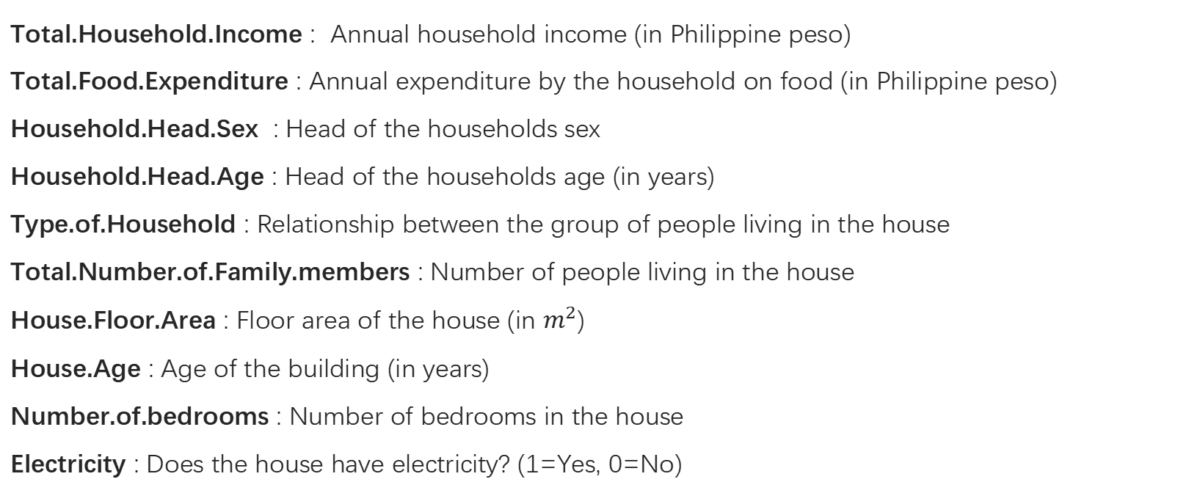
Introduction
1725 observations of 10 variables
Total.Household.Income : Annual household income (in Philippine peso)
Total.Food.Expenditure : Annual expenditure by the household on food (in Philippine peso)
Household.Head.Sex : Head of the households sex
Household.Head.Age : Head of the households age (in years)
Type.of.Household : Relationship between the group of people living in the house
Total.Number.of.Family.members : Number of people living in the house
House.Floor.Area : Floor area of the house (in $m^{2}$)
House.Age : Age of the building (in years)
Number.of.bedrooms : Number of bedrooms in the house
Electricity : Does the house have electricity? (1=Yes, 0=No)
Categorical
Response
Binary

Slide 6
02
Exploratory Data
Analysis

Slide 7
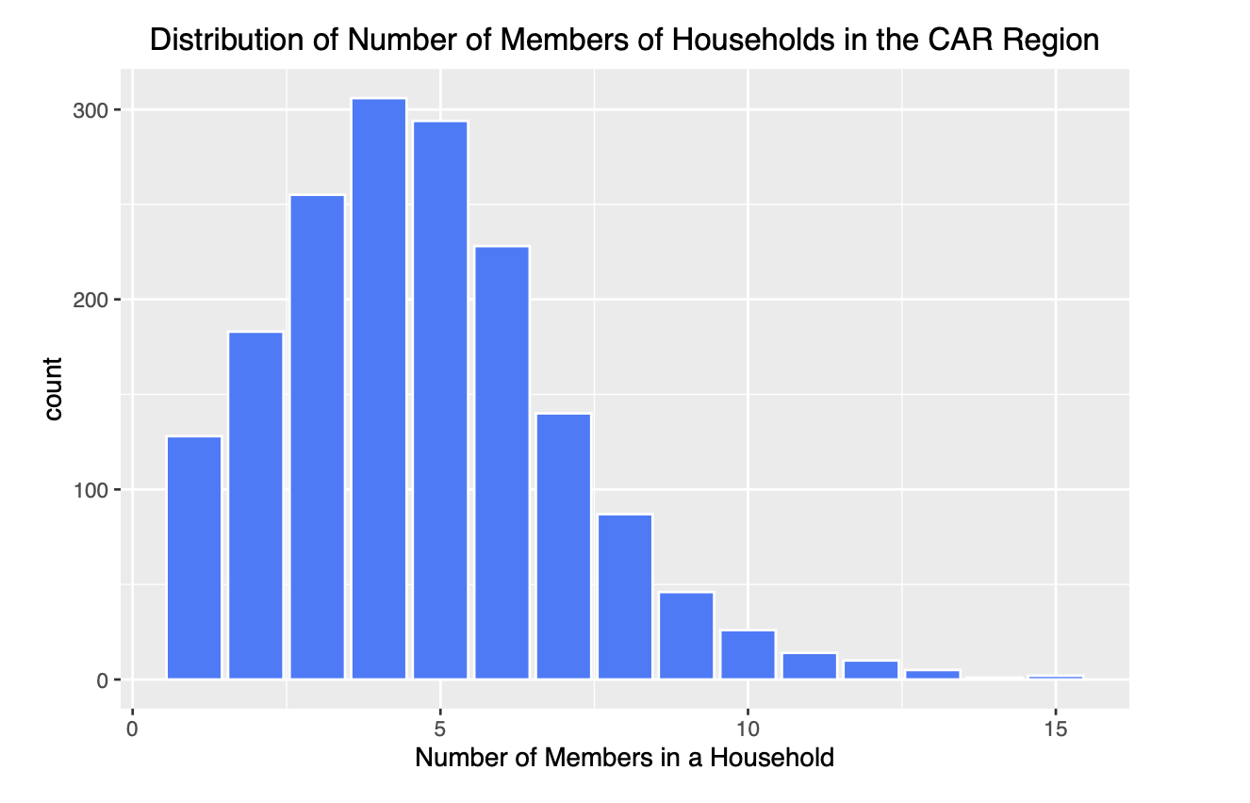
Exploratory Data Analysis
Response Variable
Right-skewed
Most of the family size is between 3-6 people, among which the family with 4 people is the most

Slide 8
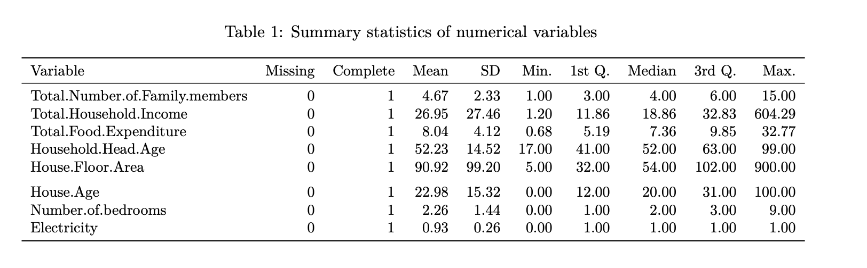
Exploratory Data Analysis
Numerical Variable
Response Variable has mean 4.67 and median 4
Possible outliers of Total Household Income and House Floor Area

Slide 9
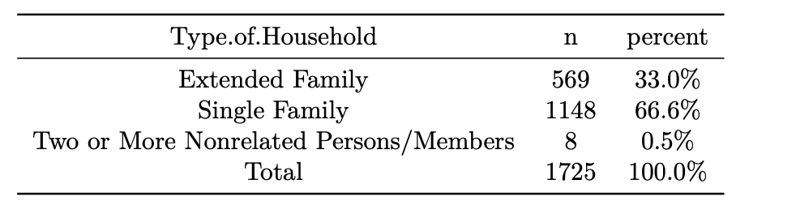
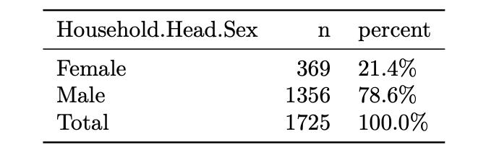
Exploratory Data Analysis
Categorical Variable
Most of the family are single family
Less than a quarter had a female head of household

Slide 10
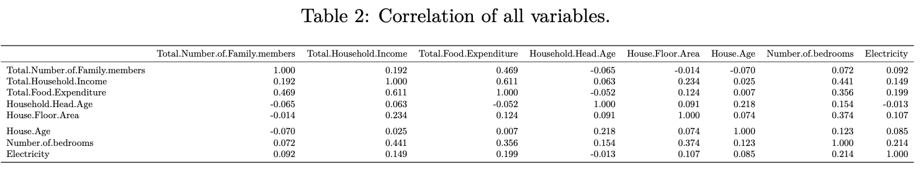
Exploratory Data Analysis
Moderate positive correlation between the total household income and the household food expenditure
Weak positive correlation between the total household income and the number of bedrooms in the household
Weak positive correlation between the number of family members and total food expenditure
The other variables are very weakly correlated

Slide 11
03
Analysis of Covariate Relationships

Slide 12
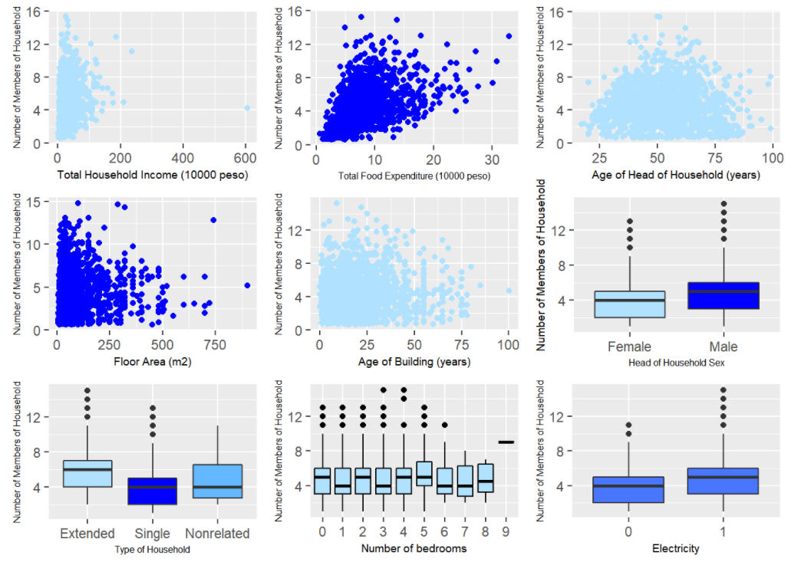
Analysis of Covariate Relationships
It shows that total food expenditure, age of the head of household, sex of the head of household and age of the house seem to have a weak effect on the number of people in the household.

Slide 13
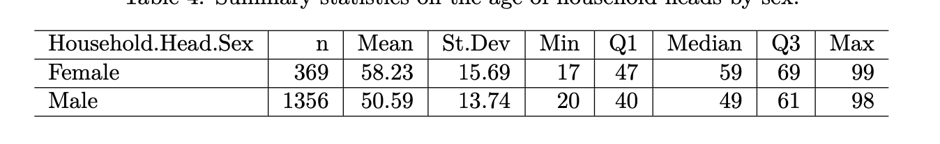
Analysis of Covariate Relationships
Household head Gender & Age
The relationship between gender and age
From summary table and boxplot we can see the mean age of female household head is much older than male, but the minimum and maximum ages of household heads do not appear to differ greatly according to the individuals' sex.

Slide 14
Analysis of Covariate Relationships
Income and Expenditure
The fitted model may be being heavily influenced by the extreme values, particularly by one extreme point.
Remove the maximum data and plot the chart again, the scatterplot of total household income against total food expenditure suggests a moderate positive correlation

Slide 15
04
Formal Model
Analysis

Slide 16
Poisson Regression Model
The response variable of the Total Number of Family Members (or members of the household) can be viewed as a count and therefore a Poisson Regression model is considered.
Overdispersion: For a Poisson model to be suitable, the mean and variance should be equal and so these assumptions are checked first. From Table, we see the variation of total number of family members is only marginally larger than the mean of total number of family members, thus, the possibility of over-dispersion in our model is not a significant issue.
Mean | 4.669373
Variance | 5.446049

Slide 17
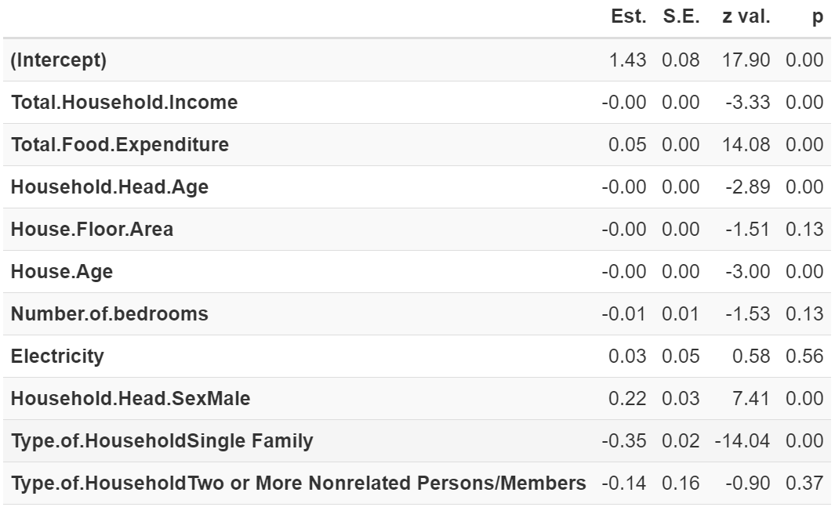
Poisson Regression Model
Now for all the explanatory variables, the results are modeled as follows.
The poisson model fitted with all possible covariates concludes there are six statistically significant predictors at the 5% level. These are the total household income and food expenditure, the age and gender of the head of the household, the age of the house and if it is a single family household.

Slide 18
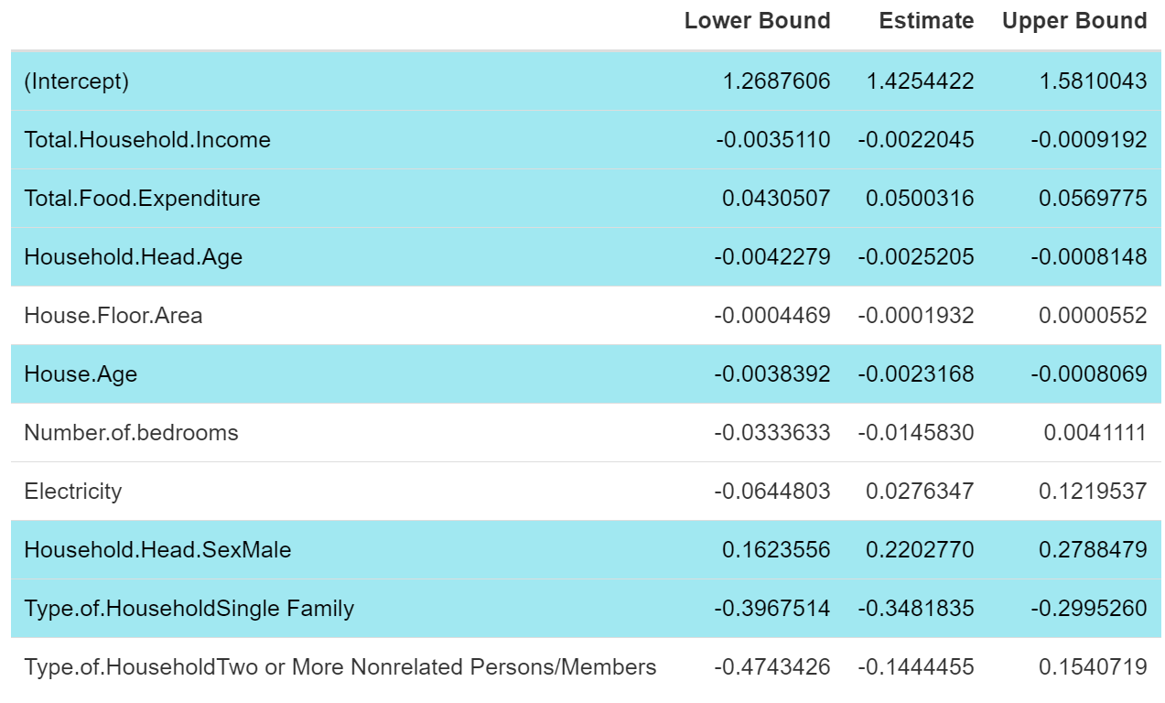
Poisson Regression Model
From the table we can see that the confidence intervals for area, number of bedrooms, and electricity include 0. This indicates that these three variables essentially have no effect on the number of people in the household, which exactly validates the results for the p-value. Therefore，we refit the model.

Slide 19
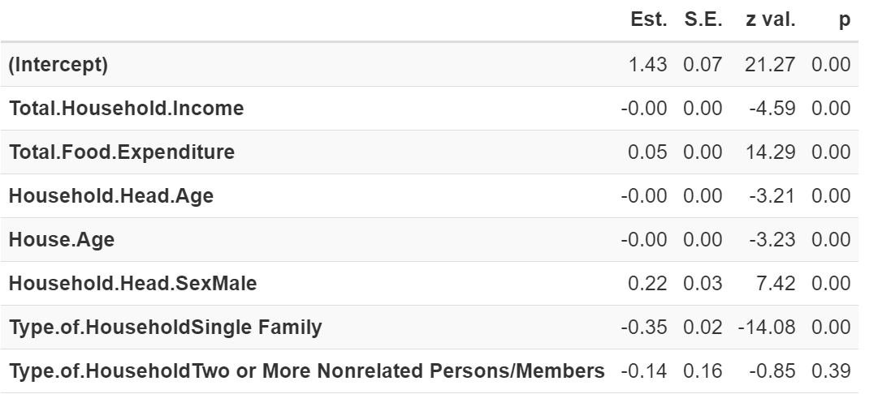
Poisson Regression Model
The second modeling results are as follows
We refitted the model to include only the previously identified significant variables and again evaluated the 95% confidence intervals for the estimated parameters, and these values can be seen in the table.

Slide 20
Poisson Regression Model
The p-values for total household income, total food expenditure, head of the households age, age of house, and head of the households sex in this model are all less than 0.05. This indicates that these variables are significant for the response variable (household size).

Slide 21
Poisson Regression Model
It is important to note that the p-value for Family type of two or more unrelated individuals is greater than 0.05, thus indicating that a family type of two or more nonrelated persons is not a statistically significant explanatory variable, but households composed of a single family (p value <0.05) is a statistically significant predictor for the number of members of a household.

Slide 22
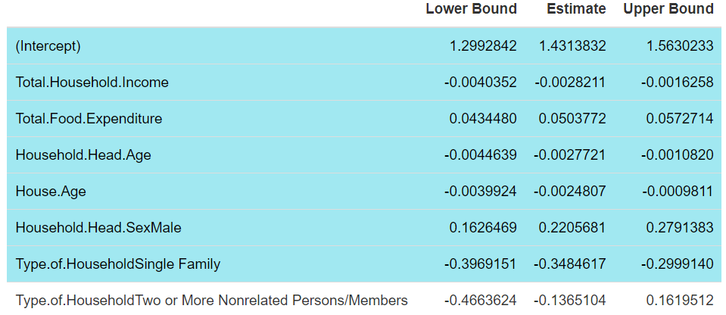
Poisson Regression Model
95% Confidence Intervals
The confidence intervals in this table get out the same conclusion for the fitted results.

Slide 23
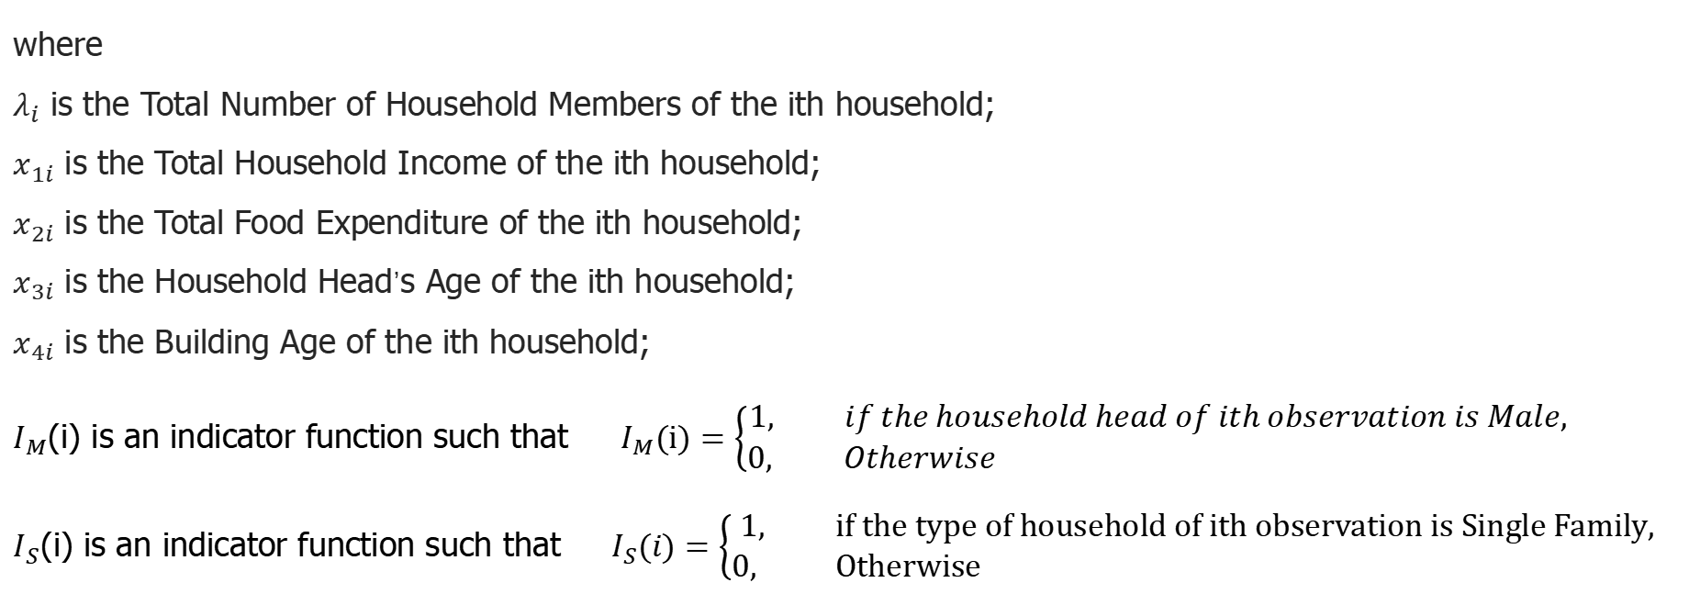
Poisson Regression Model
log($λ_{i}$)=$1.431−0.003x_{1i}+0.050x_{2i}−0.003x_{3i}−0.002x_{4i}+0.221I_{M}(i)$
$$−0.348I_{S}(i)+ ε_{i}, ε\sim N(0,σ^{2})$$
where
$λ_{i}$ is the Total Number of Household Members of the ith household;
$x_{1i}$ is the Total Household Income of the ith household;
$x_{2i}$ is the Total Food Expenditure of the ith household;
$x_{3i}$ is the Household Head’s Age of the ith household;
$x_{4i}$ is the Building Age of the ith household;
$I_{M}$(i) is an indicator function such that $I_{M}(i)=\left\{\begin{aligned}1, if the household head of ith observation is Male, \\ 0, Otherwise \end{aligned}\right.$
$I_{S}$(i) is an indicator function such that $I_{S}(i)=\left\{\begin{aligned}1, if the type of household of ith observation is Single Family, \\ 0, Otherwise \end{aligned}\right.$

Slide 24
Poisson Regression Model
log($λ_{i}$)=$1.431−0.003x_{1i}+0.050x_{2i}−0.003x_{3i}−0.002x_{4i}+0.221I_{M}(i)$
$$−0.348I_{S}(i)+ ε_{i}, ε\sim N(0,σ^{2})$$
From the formula, we can see that $x_{1}$, $x_{3}$,$x_{4}$ and $I_{S}$ have a negative effect on the response variable, while the other $x_{2}$ and $I_{M}$ have a positive effect.

Slide 25
Conclusion
and
Future Work
05

Slide 26
Conclusion
Combining the p-values and confidence intervals for each variable, we can conclude that Total Household Income, Total Food Expenditure, Head of Household Age and Sex, Age of the House, and if the Household is a Single or Extended Family, all have an effect on the number of members in a household.

Slide 27
Future Work
Correlation between explanatory variables suggest that there might have multicollinearity
Detect multicollinearity and remove related variables can improve our model

Slide 28
Thank You For Watching

