Slide 1
Optimal gaze control
through reinforcement learning

Slide 2
What is it really?
A biologically inspired robotics model.
A general learning strategy for where to look to optimise the current task.

Slide 3
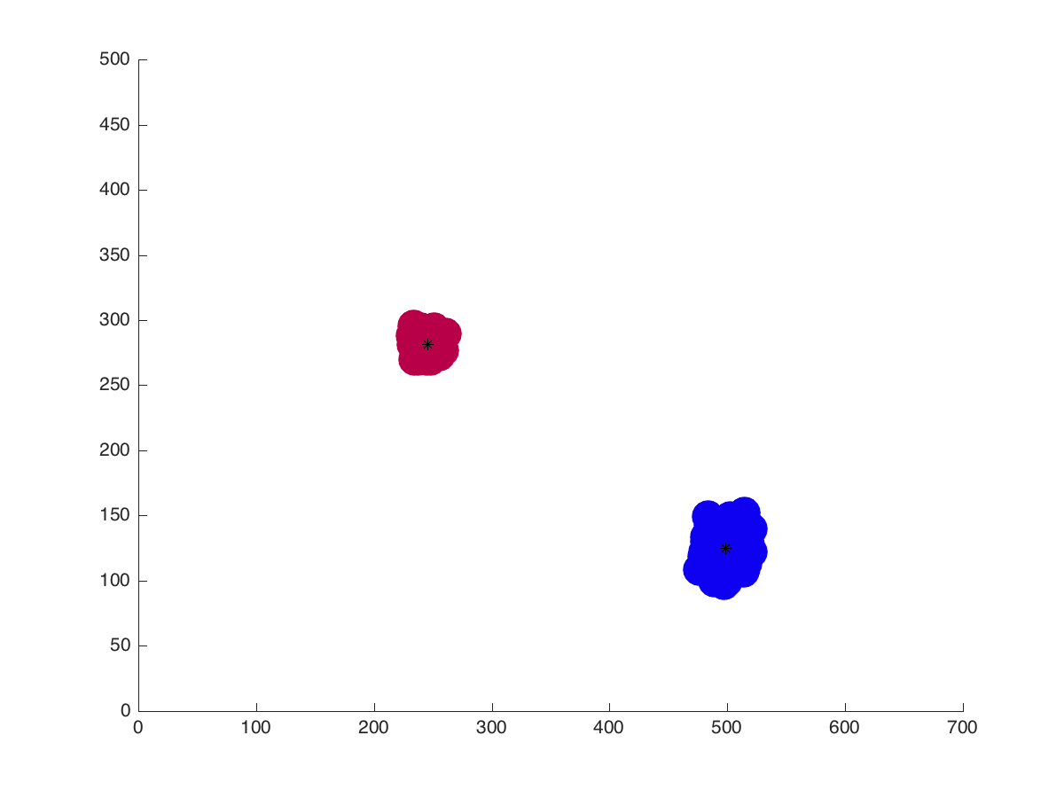

Slide 4
Previous Work
Optimal gaze control thesis by Nunez Varela
Decision under uncertainty paper by Rashej Rao ( 2010 )

Slide 5
Prerequisite
1. Particle Filters
2. Reinforcement Learning
3. Radial Basis Function Networks

Slide 6
Prerequisite
1. Particle Filters
2. Reinforcement Learning
3. Radial Basis Function Networks
4. Learning formula for where to optimally look

Slide 7
1. Particle Filter
Approximates the state of the system (i.e. object location).
Approximates the current uncertainty on the object location.

Slide 8
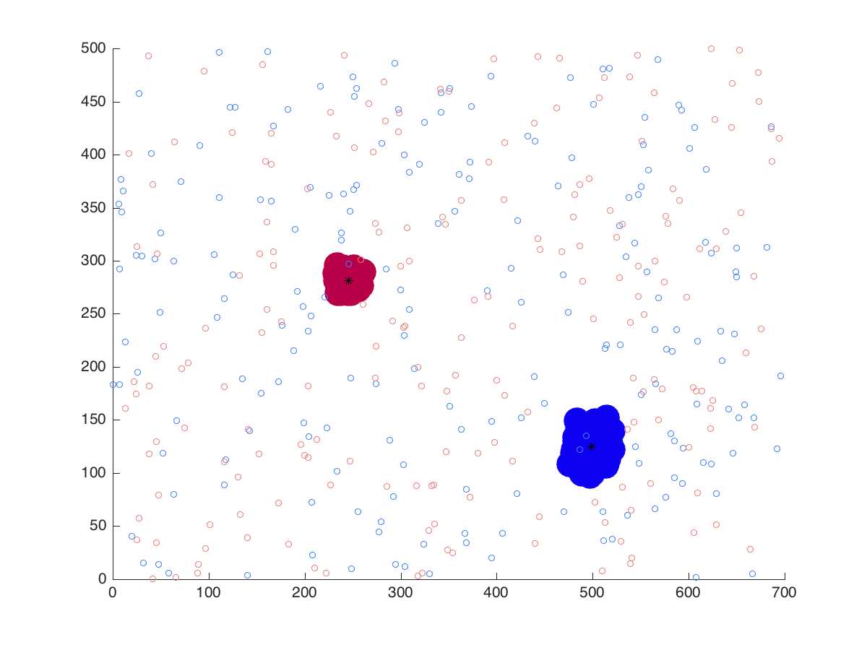

Slide 9
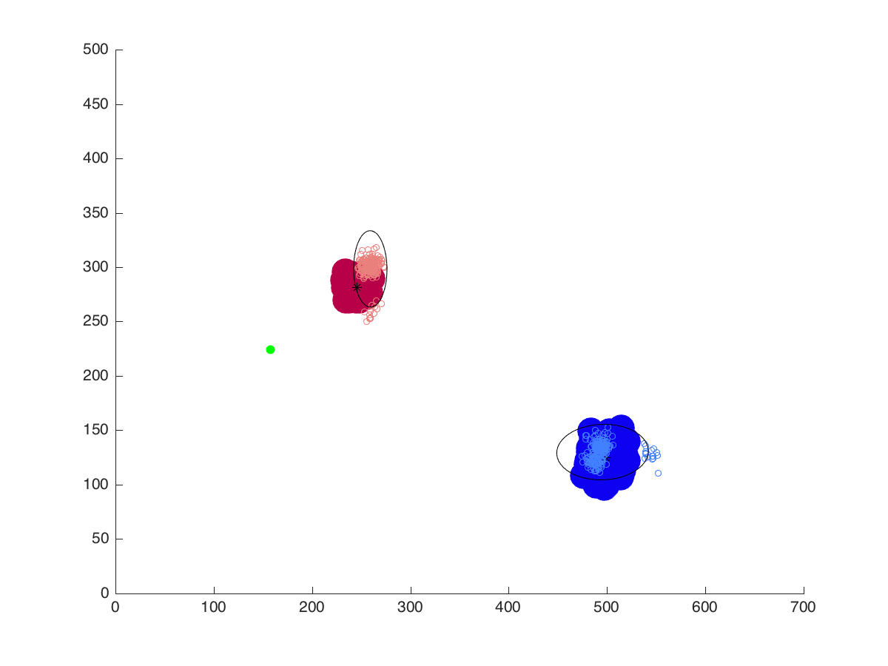

Slide 10
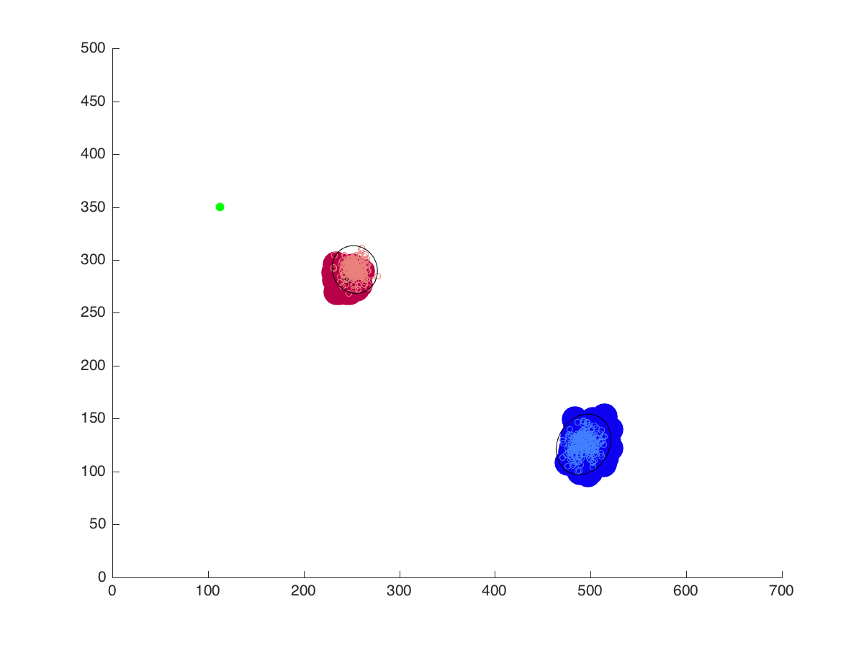

Slide 11
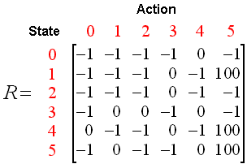
2. Reinforcement learning
Teaches robot task objective through positive and negative rewards
image source: http://mnemstudio.org

Slide 12
Problems
Suitable for discrete space, but our space has continuous values.
What do we do ?

Slide 13
Problems
Suitable for discrete space, but our space has continuous values.
What do we do ?
Store the reward for state – action pairs in a neural network.

Slide 14
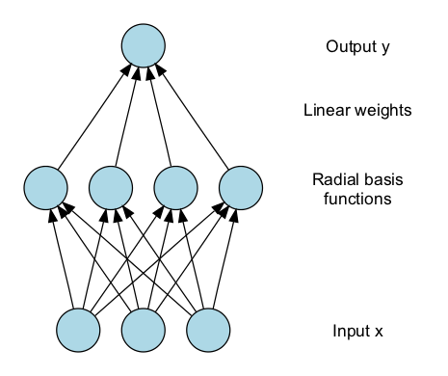
Radial Basis Function Networks
image source: http://en.wikipedia.org/

Slide 15
Rashej Rao
Radial Basis Functions are used to store the reward and action.

Slide 16
Rashej Rao
Radial Basis Functions are used to store the reward and action.
Network input is the belief space.
For Rao, it is a state b_{s} = [ p(left) p(right) ]
In our case it is the eigen value and reward value of each target.

Slide 17
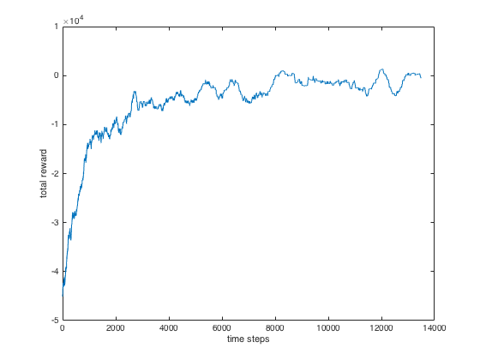
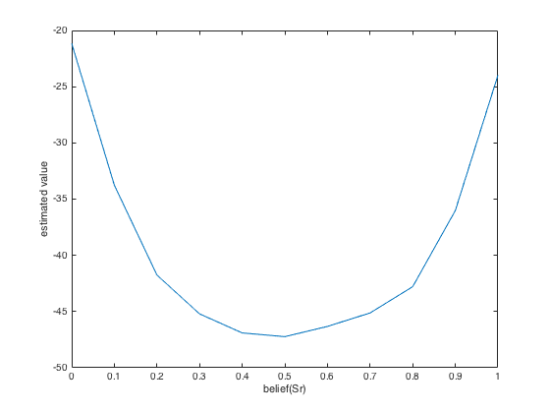
Rashej Rao (implementation)

Slide 18
Current Progress
Implemented reinforcement learning over grasping uncertainty

Slide 19
