Slide 1


Media Buffet
Expand your interest's search for movies, books and games based on the same content

Slide 2


The Big Pitch
Imagine you want to make a movie or write a book based on something. But you don't want to scour the internet to see if the idea has been done. That's where Media Buffet comes in

Slide 3

What It Does
Our app cross references movies, games and books to find titles based on each other. Set parameters to specify your searches using key-words and titles.

Slide 4
App Demo
App Demo - Multi Media Search App
Git Hub Link

Slide 5

The Struggle
CSS
JS
We had to learn a new CSS framework
Creating dropdowns and overall laying out the page
Working with the collapsible divs
Github!! (But now we are pros...)
Three different APIs means different response objects, which means different functions
RAWG API results required some customization

Slide 6
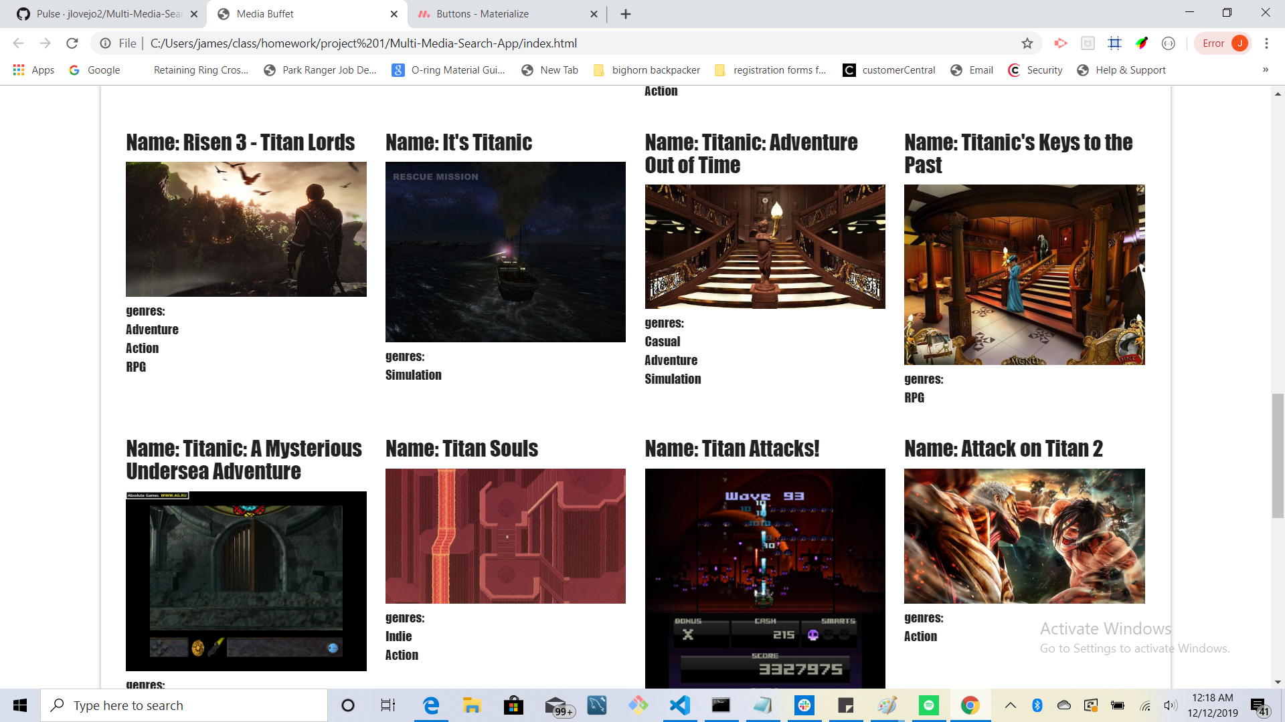
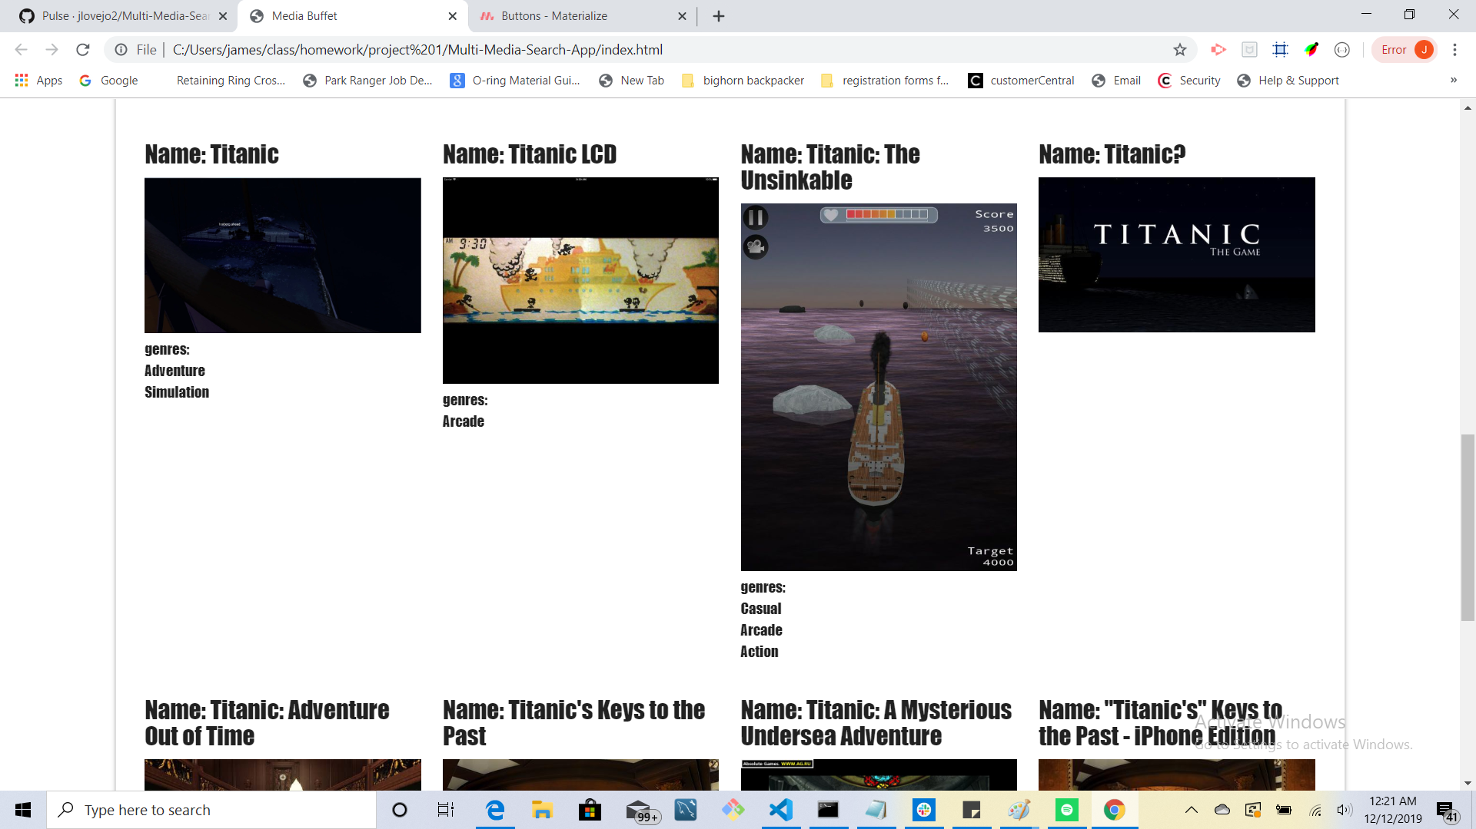
An example of an issue we came across with API

Slide 7
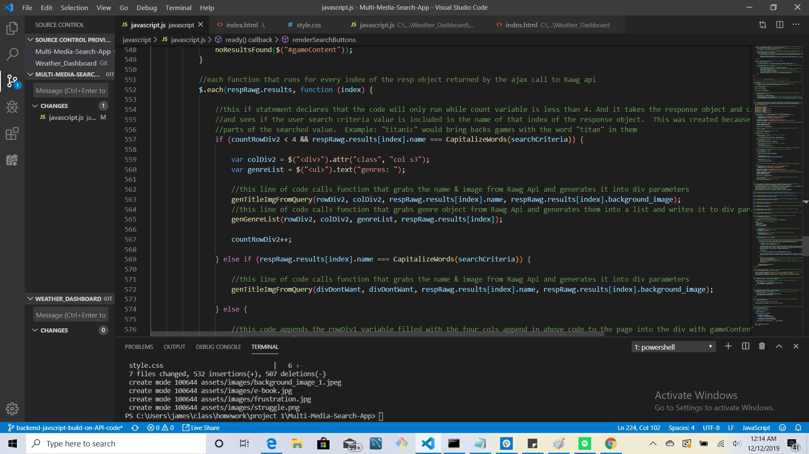
Solution

Slide 8
Version 2.0
Create new pulldown search options for user (ex: author/director/creator)
Add more rendered results to divs ( Ex: purchase website links)
Have divs generate when the search results are created instead of always being on the page
APIs results being displayed doesn't always match the badge count

Slide 9
Recources
OMDB: http://www.omdbapi.com/
Google Books: https://developers.google.com/books
Rawg: https://rawg.io/apidocs
Materialize CSS: https://materializecss.com/
By: James Lovejoy, Kobii Hoyos-Watkins, Iliana Vargas, Martin Munoz, Sergio Perez

