Slide 1
Parsing
Jaruloj Chongstitvatana
Department of Mathematics and Computer Science
Chulalongkorn University

Slide 2
Outline
Bottom-up parsing
  Shift-reduce parsers
  LR(0) parsing
    LR(0) items
    Finite automata of items
    LR(0) parsing algorithm
    LR(0) grammar
  SLR(1) parsing
    SLR(1) parsing algorithm
    SLR(1) grammar
    Parsing conflict
Top-down parsing
  Recursive-descent parsing
  LL(1) parsing
    LL(1) parsing algorithm
    First and follow sets
    Constructing LL(1) parsing table
    Error recovery

Slide 3

Introduction
Parsing is a process that constructs a syntactic structure (i.e. parse tree) from the stream of tokens.
We already learn how to describe the syntactic structure of a language using (context-free) grammar.
So, a parser only need to do this?
Stream of tokens
Parser
Parse tree
Context-free grammar

Slide 4
Top–Down Parsing Bottom–Up Parsing
A parse tree is created from root to leaves
The traversal of parse trees is a preorder traversal
Tracing leftmost derivation
Two types:
  Backtracking parser
  Predictive parser
A parse tree is created from leaves to root
The traversal of parse trees is a reversal of postorder traversal
Tracing rightmost derivation
More powerful than top-down parsing
Try different structures and
backtrack if it does not matched
the input
Guess the structure of the parse tree
from the next input
2301373

Slide 5
Parse Trees and Derivations
E
E ⇒ E + E
⇒ id + E
⇒ id + E * E
⇒ id + id * E
⇒ id + id * id
E ⇒ E + E
⇒ E + E * E
⇒ E + E * id
⇒ E + id * id
⇒ id + id * id
E
E
+
E
E
id
*
id
id
Top-down parsing
E
E
+
E
E
E
id
*
id
id
Bottom-up parsing

Slide 6

Top-down Parsing
What does a parser need to decide?
  Which production rule is to be used at each point of time ?
How to guess?
What is the guess based on?
  What is the next token?
    Reserved word if, open parentheses, etc.
  What is the structure to be built?
    If statement, expression, etc.

Slide 7
Top-down Parsing
Why is it difficult?
  Cannot decide until later
    Next token: if Structure to be built: St
    St → MatchedSt | UnmatchedSt
    UnmatchedSt →
    if (E) St| if (E) MatchedSt else UnmatchedSt
    MatchedSt → if (E) MatchedSt else MatchedSt |...
  Production with empty string
    Next token: id Structure to be built: par
    par → parList | λ
    parList → exp , parList | exp

Slide 8
Recursive-Descent
Write one procedure for each set of productions with the same nonterminal in the LHS
Each procedure recognizes a structure described by a nonterminal.
A procedure calls other procedures if it need to recognize other structures.
A procedure calls match procedure if it need to recognize a terminal.

Slide 9
Recursive-Descent: Example
E → E O F | F
O → + | -
F → ( E ) | id
procedure F
{ switch token
{ case (: match(‘(‘);
E;
match(‘)’);
case id: match(id);
default: error;
}
}
For this grammar:
  We cannot decide which rule to use for E, and
  If we choose E → E O F, it leads to infinitely recursive loops.
Rewrite the grammar into EBNF
procedure E
{ F;
while (token=+ or token=-)
{ O; F; }
}
E ::= F {O F}
O ::= + | -
F ::= ( E ) | id
procedure E
{ E; O; F; }

Slide 10
Match procedure
procedure match(expTok)
{ if (token==expTok)
then getToken
else error
}
The token is not consumed until getToken is executed.

Slide 11
Problems in Recursive-Descent
Difficult to convert grammars into EBNF
Cannot decide which production to use at each point
Cannot decide when to use λ-production A→ λ

Slide 12
LL(1) Parsing
LL(1)
  Read input from (L) left to right
  Simulate (L) leftmost derivation
  1 lookahead symbol
Use stack to simulate leftmost derivation
  Part of sentential form produced in the leftmost derivation is stored in the stack.
  Top of stack is the leftmost nonterminal symbol in the fragment of sentential form.

Slide 13
Concept of LL(1) Parsing
Simulate leftmost derivation of the input.
Keep part of sentential form in the stack.
If the symbol on the top of stack is a terminal, try to match it with the next input token and pop it out of stack.
If the symbol on the top of stack is a nonterminal X, replace it with Y if we have a production rule X → Y.
  Which production will be chosen, if there are both X → Y and X → Z ?

Slide 14
Example of LL(1) Parsing
F
n
E ⇒TX
FNX
(E)NX
(TX)NX
(FNX)NX
(nNX)NX
(nX)NX
(nATX)NX
(n+TX)NX
(n+FNX)NX
(n+(E)NX)NX
(n+(TX)NX)NX
(n+(FNX)NX)NX
(n+(nNX)NX)NX
(n+(nX)NX)NX
(n+(n)NX)NX
(n+(n)X)NX
(n+(n))NX
(n+(n))MFNX
(n+(n))*FNX
(n+(n))*nNX
(n+(n))*nX
(n+(n))*n
T
N
(
(
n
+
(
n
)
)
*
n
$
X
E
F
n
A
+
F
)
(
E → T X
X → A T X | λ
A → + | -
T → F N
N → M F N | λ
M → *
F → ( E ) | n
T
N
T
N
E
X
X
Finished
M
*
F
)
F
n
T
N
N
E
X
$

Slide 15
LL(1) Parsing Algorithm
Push the start symbol into the stack
WHILE stack is not empty ($ is not on top of stack) and the stream of tokens is not empty (the next input token is not $)
SWITCH (Top of stack, next token)
  CASE (terminal a, a):
  Pop stack; Get next token
  CASE (nonterminal A, terminal a):
  IF the parsing table entry M[A, a] is not empty THEN
    Get A →X₁ X₂ ... X_{n} from the parsing table entry M[A, a] Pop stack;
    Push X_{n} ... X₂ X₁ into stack in that order
  ELSE Error
  CASE ($,$): Accept
  OTHER: Error

Slide 16

LL(1) Parsing Table
If the nonterminal N is on the top of stack and the next token is t, which production rule to use?
Choose a rule N → X such that
  X ⇒* tY or
  X ⇒* λ and S ⇒* WNtY
t
N
X
N
X
Y
t
Q
Y
t
…
…
…

Slide 17
First Set
Let X be λ or be in V or T.
First(X ) is the set of the first terminal in any sentential form derived from X.
  If X is a terminal or λ, then First(X ) ={X }.
  If X is a nonterminal and X → X₁ X₂ ... X_{n} is a rule, then
    First(X₁) -{λ} is a subset of First(X)
    First(X_{i} )-{λ} is a subset of First(X) if for all j<i First(X_{j}) contains {λ}
    λ is in First(X) if for all j ≤n First(X_{j})contains λ

Slide 18
Examples of First Set
exp → exp addop term |
term
addop → + | -
term → term mulop factor | factor
mulop → *
factor → (exp) | num
First(addop) = {+, -}
First(mulop) = {*}
First(factor) = {(, num}
First(term) = {(, num}
First(exp) = {(, num}
st → ifst | other
ifst → if ( exp ) st elsepart
elsepart → else st | λ
exp → 0 | 1
First(exp) = {0,1}
First(elsepart) = {else, λ}
First(ifst) = {if}
First(st) = {if, other}

Slide 19
Algorithm for finding First(A)
For all terminals a, First(a) = {a}
For all nonterminals A, First(A) := { }
While there are changes to any First(A)
  For each rule A → X₁ X₂ ... X_{n}
    For each X_{i} in {X₁, X₂, …, X_{n} }
      If for all j<i First(X_{j}) contains λ,
      Then
      add First(X_{i})-{λ} to First(A)
    If λ is in First(X₁), First(X₂), ..., and First(X_{n})
    Then add λ to First(A)
If A is a terminal or λ, then First(A) = {A}.
If A is a nonterminal, then for each rule A →X₁ X₂ ... X_{n}, First(A) contains First(X₁) - {λ}.
If also for some i<n, First(X₁), First(X₂), ..., and First(X_{i}) contain λ, then First(A) contains First(X_{i+1})-{λ}.
If First(X₁), First(X₂), ..., and First(X_{n}) contain λ, then First(A) also contains λ.

Slide 20
Finding First Set: An Example
exp → term exp’
exp’ → addop term exp’ | λ
addop → + | -
term → factor term’
term’ → mulop factor term’ | λ
mulop → *
factor → ( exp ) | num
 | First
exp
exp’
addop
term
term’
mulop
factor
λ
+ -
+ -
( num
λ
*
*
( num
( num

Slide 21
Follow Set
Let $ denote the end of input tokens
If A is the start symbol, then $ is in Follow(A).
If there is a rule B → X A Y, then First(Y) - {λ} is in Follow(A).
If there is production B → X A Y and λ is in First(Y), then Follow(A) contains Follow(B).

Slide 22
Algorithm for Finding Follow(A)
Follow(S) = {$}
FOR each A in V-{S}
Follow(A)={}
WHILE change is made to some Follow sets
FOR each production A → X₁ X₂ ... X_{n},
FOR each nonterminal X_{i}
  Add First(X_{i+1} X_{i+2}...X_{n})-{λ} into Follow(X_{i}).
  (NOTE: If i=n, X_{i+1} X_{i+2}...X_{n}= λ)
IF λ is in First(X_{i+1} X_{i+2}...X_{n}) THEN
Add Follow(A) to Follow(X_{i})
If A is the start symbol, then $ is in Follow(A).
If there is a rule A → Y X Z, then First(Z) - {λ} is in Follow(X).
If there is production B → X A Y and λ is in First(Y), then Follow(A) contains Follow(B).

Slide 23
Finding Follow Set: An Example
exp → term exp’
exp’ → addop term exp’ | λ
addop → + | -
term → factor term’
term’ → mulop factor term’ |λ
mulop → *
factor → ( exp ) | num
 | First
exp
exp’
addop
term
term’
mulop
factor
Follow
( num
( num
$
$
$
)
)
)
)
λ
+ -
+ -
+ -
$
)
+ -
+ -
( num
+ -
( num
$
$
)
)
λ
*
*
*
*
( num
( num

Slide 24
Constructing LL(1) Parsing Tables
FOR each nonterminal A and a production A → X
FOR each token a in First(X)
A → X is in M(A, a)
IF λ is in First(X) THEN
FOR each element a in Follow(A)
Add A → X to M(A, a)

Slide 25
Example: Constructing LL(1) Parsing Table
First Follow
exp {(, num} {$,)}
exp’ {+,-, λ} {$,)}
addop {+,-} {(,num}
term {(,num} {+,-,),$}
term’ {*, λ} {+,-,),$}
mulop {*} {(,num}
factor {(, num} {*,+,-,),$}
1 exp → term exp’
2 exp’ → addop term exp’
3 exp’ → λ
4 addop → +
5 addop → -
6 term → factor term’
7 term’ → mulop factor term’
8 term’ → λ
9 mulop → *
10 factor → ( exp )
11 factor → num
 | ( | ) | + | - | * | n | $
exp
exp’
addop
term
term’
mulop
factor
1
1
3
2
2
3
4
5
6
6
8
8
8
7
8
9
10
11

Slide 26
LL(1) Grammar
A grammar is an LL(1) grammar if its LL(1) parsing table has at most one production in each table entry.

Slide 27
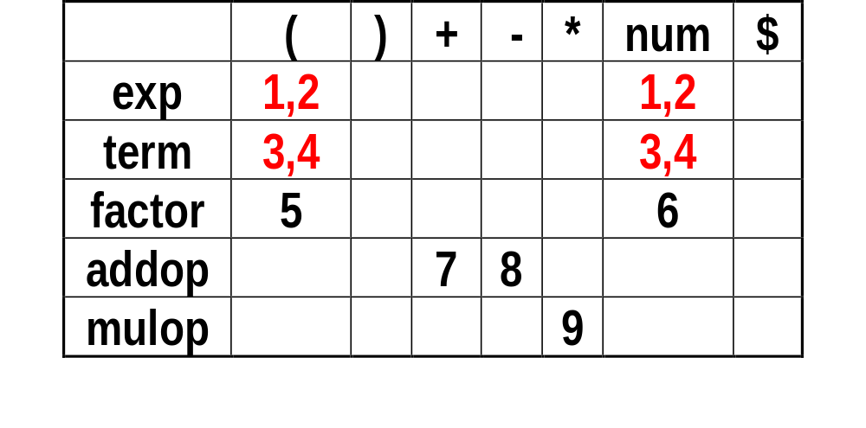
LL(1) Parsing Table for non-LL(1) Grammar
1 exp → exp addop term
2 exp → term
3 term → term mulop factor
4 term → factor
5 factor → ( exp )
6 factor → num
7 addop → +
8 addop → -
9 mulop → *
First(exp) = { (, num }
First(term) = { (, num }
First(factor) = { (, num }
First(addop) = { +, - }
First(mulop) = { * }

Slide 28
Causes of Non-LL(1) Grammar
What causes grammar being non-LL(1)?
  Left-recursion
  Left factor

Slide 29
Left Recursion
Immediate left recursion
  A → A X | Y
  A → A X₁ | A X₂ |…| A X_{n} | Y₁ | Y₂ |... | Y_{m}
General left recursion
  A => X =>* A Y
Can be removed very easily
  A → Y A’, A’ → X A’| λ
  A → Y₁ A’ | Y₂ A’ |...| Y_{m} A’, A’ → X₁ A’| X₂ A’|…| X_{n} A’| λ
Can be removed when there is no empty-string production and no cycle in the grammar
A=Y X*
A={Y₁, Y₂,…, Y_{m}} {X₁, X₂, …, X_{n}}*

Slide 30
Removal of Immediate Left Recursion
exp → exp + term | exp - term | term
term → term * factor | factor
factor → ( exp ) | num
Remove left recursion
exp → term exp’
exp’ → + term exp’ | - term exp’ | λ
term → factor term’
term’ → * factor term’ | λ
factor → ( exp ) | num
exp = term (± term)*
term = factor (* factor)*

Slide 31
General Left Recursion
Bad News!
  Can only be removed when there is no empty-string production and no cycle in the grammar.
Good News!!!!
  Never seen in grammars of any programming languages

Slide 32
Left Factoring
Left factor causes non-LL(1)
  Given A → X Y | X Z. Both A → X Y and A → X Z can be chosen when A is on top of stack and a token in First(X) is the next token.
A → X Y | X Z
can be left-factored as
A → X A’ and A’ → Y | Z

Slide 33
Example of Left Factor
ifSt → if ( exp ) st else st | if ( exp ) st
can be left-factored as
ifSt → if ( exp ) st elsePart
elsePart → else st | λ
seq → st ; seq | st
can be left-factored as
seq → st seq’
seq’ → ; seq | λ

Slide 34
Outline
Bottom-up parsing
  Shift-reduce parsers
  LR(0) parsing
    LR(0) items
    Finite automata of items
    LR(0) parsing algorithm
    LR(0) grammar
  SLR(1) parsing
    SLR(1) parsing algorithm
    SLR(1) grammar
    Parsing conflict
Top-down parsing
  Recursive-descent parsing
  LL(1) parsing
    LL(1) parsing algorithm
    First and follow sets
    Constructing LL(1) parsing table
    Error recovery

Slide 35
Bottom-up Parsing
Use explicit stack to perform a parse
Simulate rightmost derivation (R) from left (L) to right, thus called LR parsing
More powerful than top-down parsing
  Left recursion does not cause problem
Two actions
  Shift: take next input token into the stack
  Reduce: replace a string B on top of stack by a nonterminal A, given a production A → B

Slide 36
Example of Shift-reduce Parsing
Grammar
  S’ → S
  S → (S)S | λ
Parsing actions
Stack Input Action
$ ( ( ) ) $ shift
$ ( ( ) ) $ shift
$ ( ( ) ) $ reduce S → λ
$ ( ( S ) ) $ shift
$ ( ( S ) ) $ reduce S → λ
$ ( ( S ) S ) $ reduce S → ( S ) S
$ ( S ) $ shift
$ ( S ) $ reduce S → λ
$ ( S ) S $ reduce S → ( S ) S
$ S $ accept
Reverse of
rightmost derivation
from left to right
1 ⇒ ( ( ) )
2 ⇒ ( ( ) )
3 ⇒ ( ( ) )
4 ⇒ ( ( S ) )
5 ⇒ ( ( S ) )
6 ⇒ ( ( S ) S )
7 ⇒ ( S )
8 ⇒ ( S )
9 ⇒ ( S ) S
10 S’ ⇒ S

Slide 37
Example of Shift-reduce Parsing
Grammar
  S’ → S
  S → (S)S | λ
Parsing actions
Stack Input Action
$ ( ( ) ) $ shift
$ ( ( ) ) $ shift
$ ( ( ) ) $ reduce S → λ
$ ( ( S ) ) $ shift
$ ( ( S ) ) $ reduce S → λ
$ ( ( S ) S ) $ reduce S → ( S ) S
$ ( S ) $ shift
$ ( S ) $ reduce S → λ
$ ( S ) S $ reduce S → ( S ) S
$ S $ accept
1 ⇒ ( ( ) )
2 ⇒ ( ( ) )
3 ⇒ ( ( ) )
4 ⇒ ( ( S ) )
5 ⇒ ( ( S ) )
6 ⇒ ( ( S ) S )
7 ⇒ ( S )
8 ⇒ ( S )
9 ⇒ ( S ) S
10 S’ ⇒ S
handle
Viable prefix

Slide 38
Terminologies
Right sentential form
  sentential form in a rightmost derivation
Viable prefix
  sequence of symbols on the parsing stack
Handle
  right sentential form + position where reduction can be performed + production used for reduction
LR(0) item
  production with distinguished position in its RHS
Right sentential form
  ( S ) S
  ( ( S ) S )
Viable prefix
  ( S ) S, ( S ), ( S, (
  ( ( S ) S, ( ( S ), ( ( S , ( (, (
Handle
  ( S ) S. with S → λ
  ( S ) S . with S → λ
  ( ( S ) S . ) with S → ( S ) S
LR(0) item
  S → ( S ) S.
  S → ( S ) . S
  S → ( S . ) S
  S → ( . S ) S
  S → . ( S ) S

Slide 39
Shift-reduce parsers
There are two possible actions:
  shift and reduce
Parsing is completed when
  the input stream is empty and
  the stack contains only the start symbol
The grammar must be augmented
  a new start symbol S’ is added
  a production S’ → S is added
    To make sure that parsing is finished when S’ is on top of stack because S’ never appears on the RHS of any production.

Slide 40
LR(0) parsing
Keep track of what is left to be done in the parsing process by using finite automata of items
  An item A → w . B y means:
    A → w B y might be used for the reduction in the future,
    at the time, we know we already construct w in the parsing process,
    if B is constructed next, we get the new item A → w B . Y

Slide 41
LR(0) items
LR(0) item
  production with a distinguished position in the RHS
Initial Item
  Item with the distinguished position on the leftmost of the production
Complete Item
  Item with the distinguished position on the rightmost of the production
Closure Item of x
  Item x together with items which can be reached from x via λ-transition
Kernel Item
  Original item, not including closure items

Slide 42

Finite automata of items
Grammar:
  S’ → S
  S → (S)S
  S → λ
Items:
  S’ → .S
  S’ → S.
  S → .(S)S
  S → (.S)S
  S → (S.)S
  S → (S).S
  S → (S)S.
  S → .
S
S’ → .S
S’ → S.
λ
λ
S → .(S)S
S → .
(
λ
λ
S
λ
S → (.S)S
S → (S.)S
λ
)
S
S → (S).S
S → (S)S.

Slide 43
DFA of LR(0) Items
S
S’ → .S
S → .(S)S
S → .
S
S’ → S.
S’ → .S
S’ → S.
λ
λ
S → (S.)S
S → .(S)S
S → .
(
S
λ
λ
λ
)
(
S → (.S)S
S → .(S)S
S → .
S
S → (.S)S
S → (S.)S
)
(
(
S → (S).S
S → .(S)S
S → .
λ
S → (S).S
S
S
S → (S)S.
S → (S)S.

Slide 44
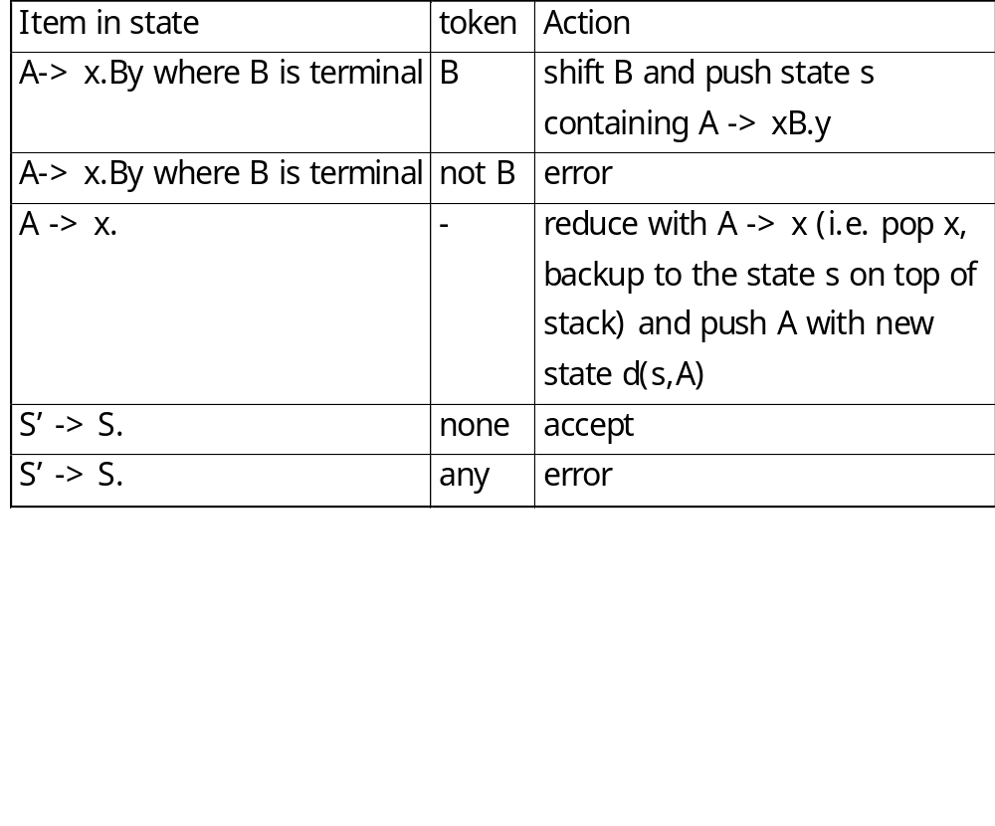
LR(0) parsing algorithm

Slide 45
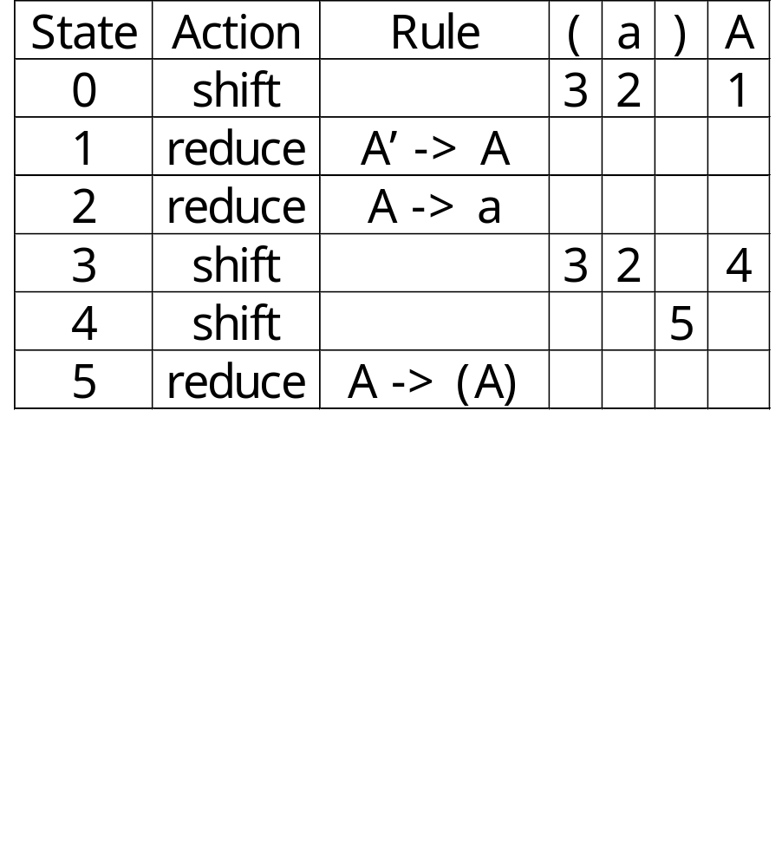
LR(0) Parsing Table
A
A’ → A.
A’ → .A
A → .(A)
A → .a
1
0
a
A → a.
2
(
a
A → (.A)
A → .(A)
A → .a
4
A
A → (A.)
3
)
(
A → (A).
5

Slide 46
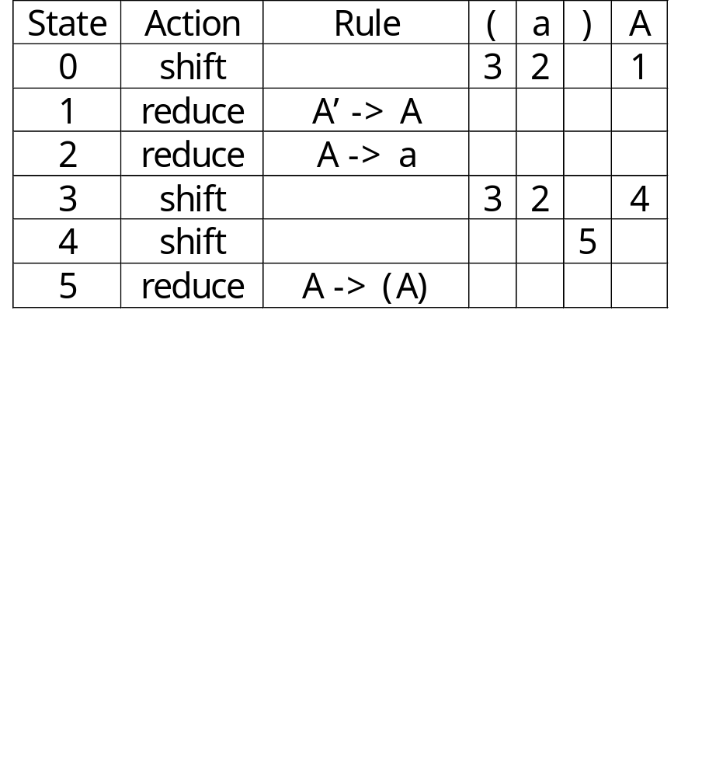
Example of LR(0) Parsing
Stack Input Action
$0 ( ( a ) ) $ shift
$0(3 ( a ) ) $ shift
$0(3(3 a ) ) $ shift
$0(3(3a2 ) ) $ reduce
$0(3(3A4 ) ) $ shift
$0(3(3A4)5 ) $ reduce
$0(3A4 ) $ shift
$0(3A4)5 $ reduce
$0A1 $ accept

Slide 47

Non-LR(0)Grammar
Conflict
  Shift-reduce conflict
    A state contains a complete item A → x. and a shift item A → x.By
  Reduce-reduce conflict
    A state contains more than one complete items.
A grammar is a LR(0) grammar if there is no conflict in the grammar.
S’ → .S
S → .(S)S
S → .
S
S’ → S.
1
0
S → (S.)S
3
(
S
)
S → (.S)S
S → .(S)S
S → .
2
(
(
S → (S).S
S → .(S)S
S → .
4
S
S → (S)S.
5

Slide 48
SLR(1) parsing
Simple LR with 1 lookahead symbol
Examine the next token before deciding to shift or reduce
  If the next token is the token expected in an item, then it can be shifted into the stack.
  If a complete item A → x. is constructed and the next token is in Follow(A), then reduction can be done using A → x.
  Otherwise, error occurs.
Can avoid conflict

Slide 49
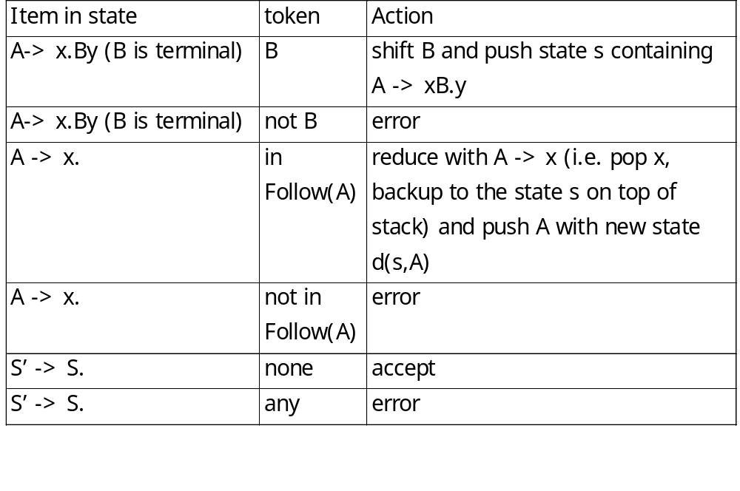
SLR(1) parsing algorithm

Slide 50
SLR(1) grammar
Conflict
  Shift-reduce conflict
    A state contains a shift item A → x.Wy such that W is a terminal and a complete item B → z. such that W is in Follow(B).
  Reduce-reduce conflict
    A state contains more than one complete item with some common Follow set.
A grammar is an SLR(1) grammar if there is no conflict in the grammar.

Slide 51
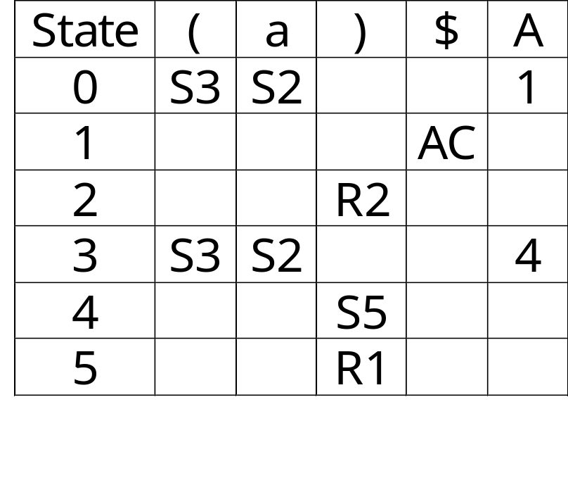
SLR(1) Parsing Table
A → (A) | a
A’ → .A
A → .(A)
A → .a
A
A’ → A.
1
a
0
A → a.
2
(
a
A → (.A)
A → .(A)
A → .a
A
A → (A.)
3
4
)
(
A → (A).
5

Slide 52
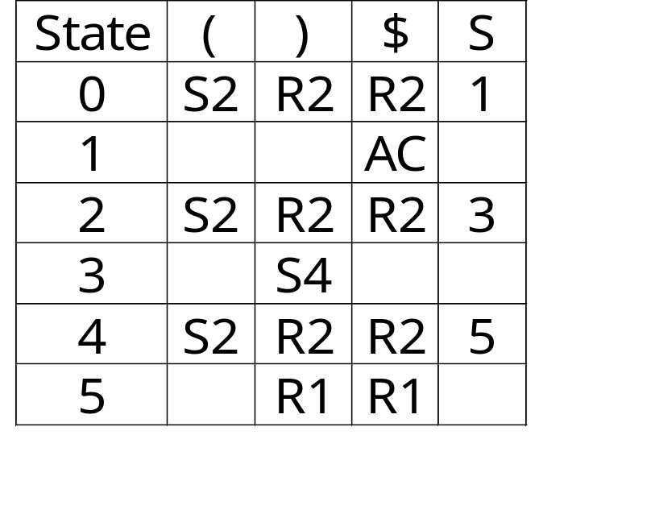
SLR(1) Grammar not LR(0)
S’ → .S
S → .(S)S
S → .
S
S → (S)S | λ
S’ → S.
1
0
S → (S.)S
3
(
S
S → (.S)S
S → .(S)S
S → .
)
2
S → (S).S
S → .(S)S
S → .
(
(
4
S
S→ (S)S.
5

Slide 53
Disambiguating Rules for Parsing Conflict
Shift-reduce conflict
  Prefer shift over reduce
    In case of nested if statements, preferring shift over reduce implies most closely nested rule for dangling else
Reduce-reduce conflict
  Error in design

Slide 54
Dangling Else
S’ → .S 0
S → .I
S → .other
I → .if S
I → .if S else S
S
S’ → S. 1
I → if S else .S 6
S → .I
S → .other
I → .if S
I → .if S else S
I
I
S → I. 2
S
I
I → .if S else S 7
if
else
other
other
if
state | if | else | other | $ | S | I
0 | S4 |  | S3 |  | 1 | 2
1 |  |  |  | ACC
2 |  | R1 |  | R1
3 |  | R2 |  | R2
4 | S4 |  | S3 |  | 5 | 2
5 |  | S6 |  | R3
6 | S4 |  | S3 |  | 7 | 2
7 |  | R4 |  | R4
other
S → .other 3
other
I → if .S 4
I → if .S else S
S → .I
S → .other
I → .if S
I → .if S else S
I → if S. 5
I → if S. else S
S
if

Slide 55
End

