Slide 1

웹서버구축 [스몰과제3] 20175105_곽영주

Slide 2
문제1 – 소스코드(html)
<!DOCTYPE html>
<html lang="en">
<head>
<meta charset="UTF-8">
<meta http-equiv="X-UA-Compatible" content="IE=edge">
<meta name="viewport" content="width=device-width, initial-scale=1.0">
<title>HallymQuickService</title>
<!-- css 파일 -->
<link rel="stylesheet" type="text/css" href="hallymQuickService.css"/>

Slide 3
<script>
// tabs 선택
function tabChange(tabNum){
var tabContent = document.getElementsByClassName("tabContent");
var size = tabContent[0].childElementCount;
var i = 0;
// tabs 중에 선택한 tab의 tabContent 보여주기
for(i; i<size; i++){
if(i+1 == tabNum){
tabContent[0].children[i].classList.add("active");
document.getElementById(tabContent[0].children[i].id).style.display = "block";
}
else{
tabContent[0].children[i].classList.remove("active");
document.getElementById(tabContent[0].children[i].id).style.display = "none";
}
}
}

Slide 4
// tabContent 이미지 반전
function imgChange(quickNum){
var s = document.getElementsByClassName("active");
var d = s[0].getElementsByClassName("quick"+quickNum);
// 이미지 반전
if(d[0].children[0].style.display == "block"){
d[0].children[0].style.display = "none";
d[0].children[1].style.display = "block";
d[0].children[2].style.color = "white";
}
else{
d[0].children[0].style.display = "block";
d[0].children[1].style.display = "none";
d[0].children[2].style.color = "black";
}
}
</script>
</head>

Slide 5
<body>
<div class="quickService">
<h3>Quick Service</h3>
<div class="tabs">
<ul>
<li><a href="#" onclick="tabChange(1)">재학생</a></li>
<li><a href="#" onclick="tabChange(2)">교수</a></li>
</ul>
</div>
<div class="tabContent">
<!-- 재학생 -->
<div id="student" class="active" style="display: block;">
<table>
<tr>

Slide 6
<td>
<a class="quick1" onclick="imgChange(1)" href="#">
<img style="display: block;" src="https://www.hallym.ac.kr/dam/jcr:5dbe6dda-7236-4e67-a552-e6108ddc0973/quick-ico1.png" alt="통합정보시스템"/>
<img style="display: none;" src="https://www.hallym.ac.kr/dam/jcr:b002e03b-36b2-44b7-86b6-17f295e1028a/quick-ico1-hov.png" alt="통합정보시스템"/>
<span>통합정보시스템</span>
</a>
</td>
<td>
<a class="quick2" onclick="imgChange(2)" href="#">
<img style="display: block;" src="https://www.hallym.ac.kr/dam/jcr:b47f5bac-1acd-4f18-94b3-5afb59efcacf/quick-ico2.png" alt="SmartLEAD">
<img style="display: none;" src="https://www.hallym.ac.kr/dam/jcr:bb842a48-4c5e-4635-b2e9-edf076cafe46/quick-ico2-hov.png" alt="SmartLEAD"/>
<span>SmartLEAD</span>
</a>
</td>

Slide 7
<td>
<a class="quick3" onclick="imgChange(3)" href="#">
<img style="display: block;" src="https://www.hallym.ac.kr/dam/jcr:6606b6a8-9b26-4b6b-987c-64eaf5d26bd9/quick-ico11.png" alt="셔틀버스">
<img style="display: none;" src="https://www.hallym.ac.kr/dam/jcr:37329832-4a0a-484b-9026-9c68eb2d5300/quick-ico11-hov.png" alt="셔틀버스">
<span>셔틀버스</span>
</a>
</td>
<td>
<a class="quick4" onclick="imgChange(4)" href="#">
<img style="display: block;" src="https://www.hallym.ac.kr/dam/jcr:8e2409f1-5ab0-41c0-b640-b97d05d35e50/quick-ico14.png" alt="통학버스">
<img style="display: none;" src="https://www.hallym.ac.kr/dam/jcr:bb1f4623-00d1-40c0-a692-8cba5941da1c/quick-ico14-hov.png" alt="통학버스">
<span>통학버스</span>
</a>
</td>
</tr>

Slide 8
<tr>
<td>
<a class="quick5" onclick="imgChange(5)" href="#">
<img style="display: block;" src="https://www.hallym.ac.kr/dam/jcr:b39e4dfe-7f4f-49f0-8b41-ec5177ef1dee/quick-ico5.png" alt="일송기념도서관">
<img style="display: none;" src="https://www.hallym.ac.kr/dam/jcr:69153b18-6be2-4572-8643-702f6cdfdabe/quick-ico5-hov.png" alt="일송기념도서관">
<span>일송기념도서관</span>
</a>
</td>
<td>
<a class="quick6" onclick="imgChange(6)" href="#">
<img style="display: block;" src="https://www.hallym.ac.kr/dam/jcr:2bbc0755-53c2-4567-8d95-b028aeeb7433/quick-ico6.png" alt="학생생활관">
<img style="display: none;" src="https://www.hallym.ac.kr/dam/jcr:d87a757c-7690-4332-8d96-341c09dd993e/quick-ico6-hov.png" alt="학생생활관">
<span>학생생활관</span>
</a>
</td>

Slide 9
<td>
<a class="quick7" onclick="imgChange(7)" href="#">
<img style="display: block;" src="https://www.hallym.ac.kr/dam/jcr:740e8f2a-f4e8-4a2d-85ea-87e7dbab7339/quick-ico8.png" alt="현장실습지원센터">
<img style="display: none;" src="https://www.hallym.ac.kr/dam/jcr:1aa99505-6a81-45f2-8677-6a328f3af830/quick-ico8-hov.png" alt="현장실습지원센터">
<span>현장실습지원센터</span>
</a>
</td>
<td>
<a class="quick8" onclick="imgChange(8)" href="#">
<img style="display: block;" src="https://www.hallym.ac.kr/dam/jcr:99f81262-801e-4f4f-86c0-bcc28c04856c/quick-ico9.png" alt="캠퍼스맵">
<img style="display: none;" src="https://www.hallym.ac.kr/dam/jcr:9f407c6c-bc63-4114-80af-48c3388ea23c/quick-ico9-hov.png" alt="캠퍼스맵">
<span>캠퍼스맵</span>
</a>
</td>
</tr>
</table>
</div>

Slide 10
<!-- 교수 -->
<div id="professor" class="" style="display: none;">
<table>
<tr>
<td>
<a class="quick1" onclick="imgChange(1)" href="#">
<img style="display: block;" src="https://www.hallym.ac.kr/dam/jcr:5dbe6dda-7236-4e67-a552-e6108ddc0973/quick-ico1.png" alt="통합정보시스템"/>
<img style="display: none;" src="https://www.hallym.ac.kr/dam/jcr:b002e03b-36b2-44b7-86b6-17f295e1028a/quick-ico1-hov.png" alt="통합정보시스템"/>
<span>통합정보시스템</span>
</a>
</td>
<td>
<a class="quick2" onclick="imgChange(2)" href="#">
<img style="display: block;" src="https://www.hallym.ac.kr/dam/jcr:b47f5bac-1acd-4f18-94b3-5afb59efcacf/quick-ico2.png" alt="SmartLEAD">
<img style="display: none;" src="https://www.hallym.ac.kr/dam/jcr:bb842a48-4c5e-4635-b2e9-edf076cafe46/quick-ico2-hov.png" alt="SmartLEAD"/>
<span>SmartLEAD</span>
</a>
</td>

Slide 11
<td>
<a class="quick3" onclick="imgChange(3)" href="#">
<img style="display: block;" src="https://www.hallym.ac.kr/dam/jcr:6606b6a8-9b26-4b6b-987c-64eaf5d26bd9/quick-ico11.png" alt="셔틀버스">
<img style="display: none;" src="https://www.hallym.ac.kr/dam/jcr:37329832-4a0a-484b-9026-9c68eb2d5300/quick-ico11-hov.png" alt="셔틀버스">
<span>셔틀버스</span>
</a>
</td>
<td>
<a class="quick4" onclick="imgChange(4)" href="#">
<img style="display: block;" src="https://www.hallym.ac.kr/dam/jcr:9e600d8e-069c-4f2c-aab5-c2a9bffe7d6b/quick-ico25.png" alt="전자출결시스템">
<img style="display: none;" src="https://www.hallym.ac.kr/dam/jcr:c7771218-ec28-4a0c-b411-d962b3dea9e5/quick-ico25-hov.png" alt="전자출결시스템">
<span>전자출결시스템</span>
</a>
</td>
</tr>

Slide 12
<tr>
<td>
<a class="quick5" onclick="imgChange(5)" href="#">
<img style="display: block;" src="https://www.hallym.ac.kr/dam/jcr:3f0cbb61-447d-4935-8420-5261bd8c1ba5/quick-ico26.png" alt="한림그룹웨이">
<img style="display: none;" src="https://www.hallym.ac.kr/dam/jcr:53682dcb-4902-49b2-8d59-e1f1f590f5aa/quick-ico26-hov.png" alt="한림그룹웨이">
<span>한림그룹웨이</span>
</a>
</td>
<td>
<a class="quick6" onclick="imgChange(6)" href="#">
<img style="display: block;" src="https://www.hallym.ac.kr/dam/jcr:9734f9f4-bf6d-44e5-a10e-1425416bfab7/quick-ico3.png" alt="채용시스템">
<img style="display: none;" src="https://www.hallym.ac.kr/dam/jcr:f2d7f301-26f4-4239-9ef2-14d2cbbaeb99/quick-ico3-hov.png" alt="채용시스템">
<span>채용시스템</span>
</a>
</td>

Slide 13
<td>
<a class="quick7" onclick="imgChange(7)" href="#">
<img style="display: block;" src="https://www.hallym.ac.kr/dam/jcr:8b4317c1-fc17-409e-a0f6-f09909e3b445/quick-ico28.png" alt="행정부서/기관">
<img style="display: none;" src="https://www.hallym.ac.kr/dam/jcr:d2d45346-9f5d-4baa-af14-2753eca561a6/quick-ico28-hov.png" alt="행정부서/기관">
<span>행정부서/기관</span>
</a>
</td>
<td>
<a class="quick8" onclick="imgChange(8)" href="#">
<img style="display: block;" src="https://www.hallym.ac.kr/dam/jcr:d333fd64-5be1-4ccf-8338-d1990e13d4bf/quick-ico29.png" alt="발전기금">
<img style="display: none;" src="https://www.hallym.ac.kr/dam/jcr:4a7cd29b-2eda-446f-a78f-0161be28e955/quick-ico29-hov.png" alt="발전기금">
<span>발전기금</span>
</a>
</td>
</tr>
</table>
</div>
</div>
</div>
</body>
</html>

Slide 14
문제1 – 소스코드(css)
/* quickService */
.quickService {
background-color: dodgerblue;
width: 50%;
}
.quickService h3 {
color:white;
text-align: center;
margin: 0;
}

Slide 15
/* tabs */
.tabs {
background-color: lightgray;
}
.tabs ul {
margin: 0;
padding: 0;
text-align: center;
}
.tabs ul li {
display: inline-block;
list-style-type: none;
padding-left: 10px;
padding-right: 10px;
}

Slide 16
.tabs ul li a {
color: black;
text-decoration: none;
}
.tabs ul li a:hover {
color:white;
}
/* tabContent */
.tabContent{
background-color: white;
}
.tabContent table {
width: 100%;
}

Slide 17
.tabContent table tr td {
width: 20%;
}
.tabContent table tr td:hover {
background-color: blue;
}
.tabContent table tr td a {
text-align: center;
display: block;
text-decoration: none;
}
.tabContent table tr td a span{
color:black;
}
.tabContent table tr td a img {
display: block;
margin: 0 auto;
}

Slide 18
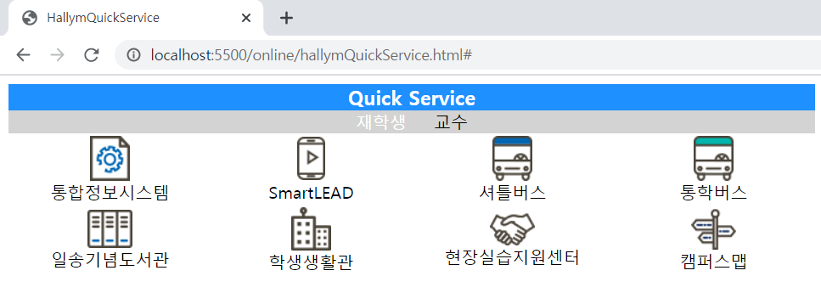
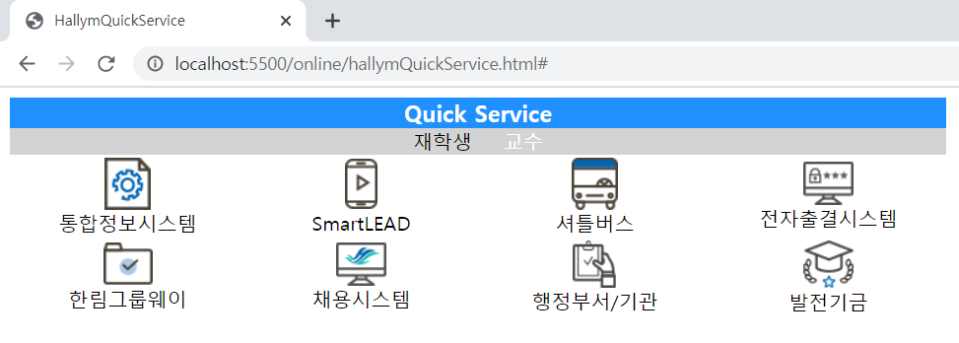
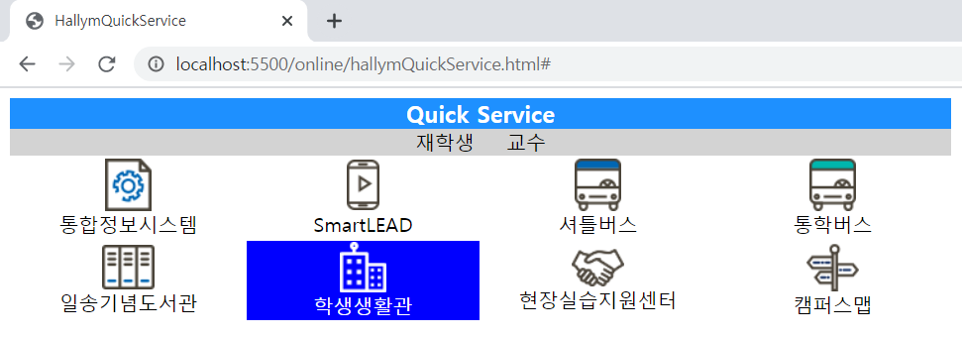
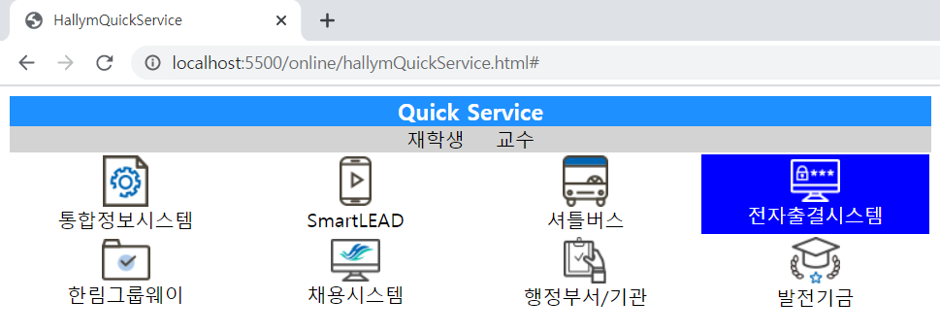
문제1 - 실행결과

