Slide 1

웹서버구축 [5주차_대면실습과제] 20175105_곽영주

Slide 2
문제1 - 소스코드
<!DOCTYPE html>
<html lang="en">
<head>
<meta charset="UTF-8">
<meta http-equiv="X-UA-Compatible" content="IE=edge">
<meta name="viewport" content="width=device-width, initial-scale=1.0">
<title>menu1</title>
<style>

Slide 3
.menu {
list-style-type: none;
margin: 0;
padding: 0;
}
.menu li {
border-style: solid;
margin: 20px 10px;
padding: 10px;
width: 30%;
color: lightskyblue;
cursor: pointer;
}
.menu li a {
text-decoration: none;
color: lightskyblue;
}
#color:hover {
background-color: lightskyblue;
transition: all 1s;
}

Slide 4
#color:hover a {
color: white;
transition: all 1s;
}
#xOffset:hover {
margin-left: 50px;
transition: all 1s;
}
#border:hover{
border-width: 10px;
transition: all 1s;
}
#size:hover{
height: 200px;
transition: all 1s;
}
</style>
</head>

Slide 5
<body>
<ul class="menu">
<li id="color"><a href="#">color change</a></li>
<li id="xOffset"><a href="#">x offset change</a></li>
<li id="border"><a href="#">border change</a></li>
<li id="size"><a href="#">size change</a></li>
</ul>
</body>
</html>

Slide 6
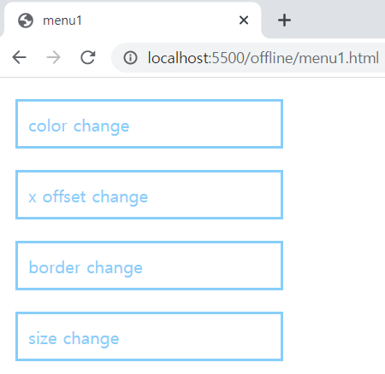
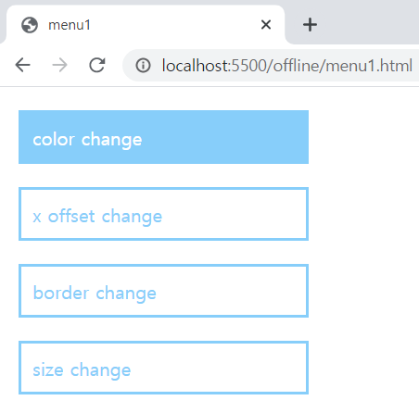
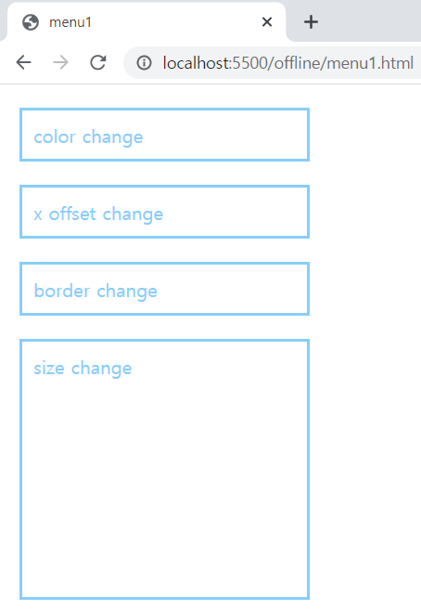
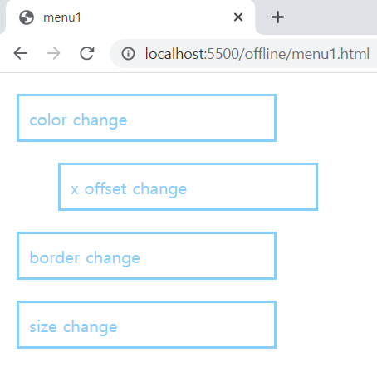
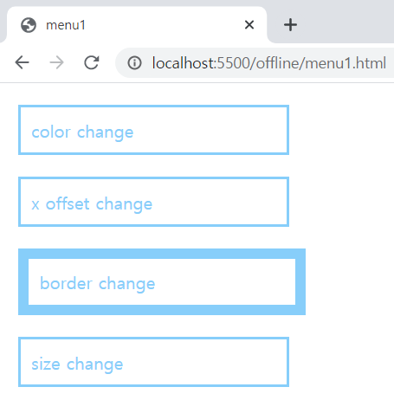
문제1 - 실행결과

Slide 7
문제2 - 소스코드
<!DOCTYPE html>
<html lang="en">
<head>
<meta charset="UTF-8">
<meta http-equiv="X-UA-Compatible" content="IE=edge">
<meta name="viewport" content="width=device-width, initial-scale=1.0">
<title>menu2</title>
<style>
.menu {
list-style-type: none;
margin: 10px;
padding: 0;
}
.menu li {
margin: 0;
padding: 20px 50px;
float: left;
background-color: wheat;
}

Slide 8
.menu li a {
text-decoration: none;
color: white;
}
.menu li a:hover {
color: brown;
}
</style>
</head>
<body>
<ul class="menu">
<li><a href="#">menu01</a></li>
<li><a href="#">menu02</a></li>
<li><a href="#">menu03</a></li>
<li><a href="#">menu04</a></li>
</ul>
</body>
</html>

Slide 9
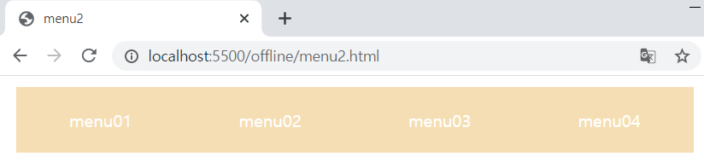
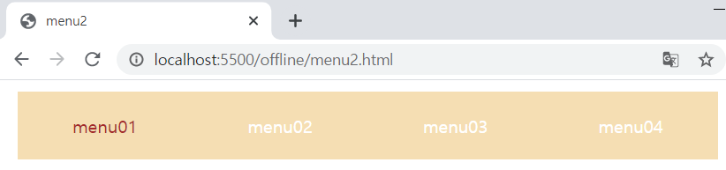
문제2 - 실행결과

