Slide 1

웹서버구축 [스몰과제1] 20175105_곽영주

Slide 2
문제1 - 소스코드
<!DOCTYPE html>
<html lang="en">
<head>
<meta charset="UTF-8">
<title>Style_chage</title>
<script>
function style_chage(){
var span = document.getElementById("mySpan");
span.style.display = "block";
span.style.color = "green";
span.style.fontSize = "40px";
span.style.width = "6em";
span.style.border = "5px dotted magenta";
span.style.margin = "20px";
}
</script>
</head>
<body>
<h1>CSS 스타일 동적 변경</h1>
<hr/>
<p style="color:blue">
이것은
<span id="mySpan" style="color:red">문장입니다.</span>
</p>
<input type="button" value="스타일 변경" onclick="style_chage()"/>
</body>
</html>

Slide 3
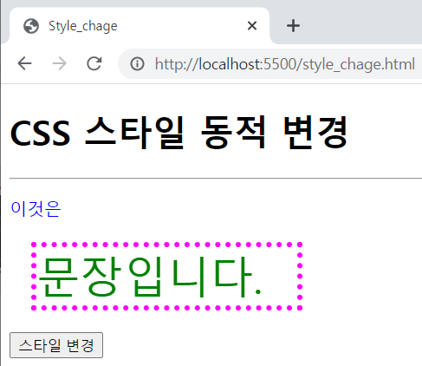
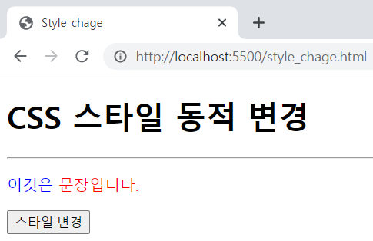
문제1 - 실행결과

Slide 4
문제2 - 소스코드
<!DOCTYPE html>
<html lang="en">
<head>
<meta charset="UTF-8">
<title>Calculator</title>
<script>
function calculator(){
var exp = document.getElementById("expression");
var re = eval(exp.value);
document.getElementById("result").value = re;
}
</script>
</head>
<body>
<h1>onclick, 계산기 만들기</h1>
<hr/>
<div>
<p>계산하고자 하는 수식을 입력하고 계산 버튼을 눌러봐요.</p>
<form>
<div>
<label>식</label>
<input type="text" id="expression"/>
</div>
<div style="display:inline">
<label>값</label>
<input type="text" id="result"/>
</div>
<div style="display:inline">
<input type="button" value="계산" onclick="calculator()"/>
</div>
</form>
</div>
</body>
</html>

Slide 5
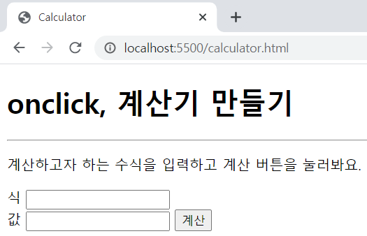
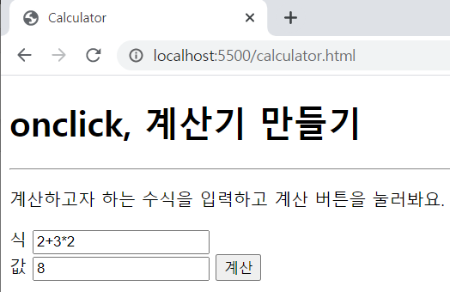
문제2 - 실행결과

Slide 6
문제3 - 소스코드
<!DOCTYPE html>
<html lang="en">
<head>
<meta charset="UTF-8">
<title>Screen</title>
</head>
<body>
<h1>스크린 장치에 관한 정보</h1>
<hr/>
<p>
<script>
document.write("availHeight: " + screen.availHeight + "<br/>")
document.write("availWidth: " + screen.availWidth + "<br/>")
document.write("colorDepth: " + screen.colorDepth + "<br/>")
document.write("pixelDepth: " + screen.pixelDepth + "<br/>")
document.write("height: " + screen.height + "<br/>")
document.write("width: " + screen.width + "<br/>")
</script>
</p>
</body>
</html>

Slide 7
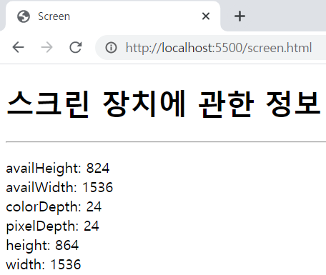
문제3 - 실행결과

