Slide 1

웹서버구축 [스몰과제4] 20175105_곽영주

Slide 2
문제1 - 소스코드
<!DOCTYPE html>
<html lang="en">
<head>
<meta charset="UTF-8">
<meta http-equiv="X-UA-Compatible" content="IE=edge">
<meta name="viewport" content="width=device-width, initial-scale=1.0">
<title>반응형 웹 : 응용1</title>
<style>
@media (max-width: 599px){
body{ background: red; }
}
@media (min-width: 600px) and (max-width: 799px){
body{ background: green; }
}
@media (min-width: 800px){
body{ background: blue; }
}
</style>
</head>

Slide 3
<body>
<h1>Chelsea Football Club</h1>
<p>Chelsea Football Club is an English professional football club based in Fulham, London. Founded in 1905, the club competes in the Premier League, the top division of English football. Chelsea are among England's most successful clubs, having won over thirty competitive honours, including six league titles and six European trophies. Their home ground is Stamford Bridge.</p>
</body>
</html>

Slide 4
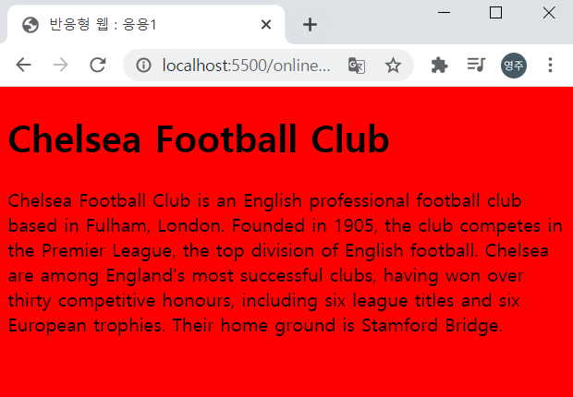
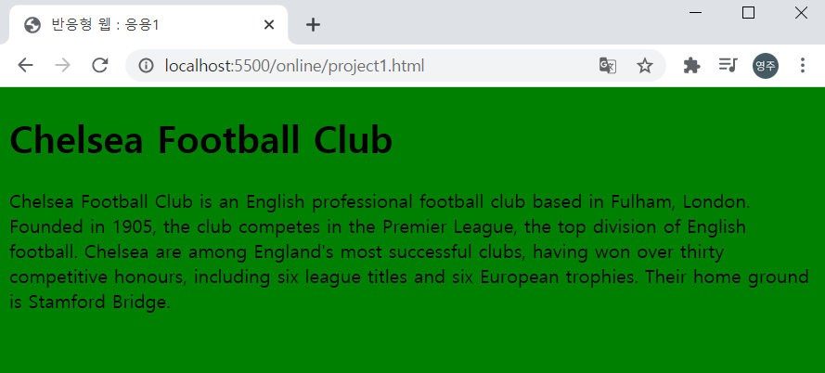
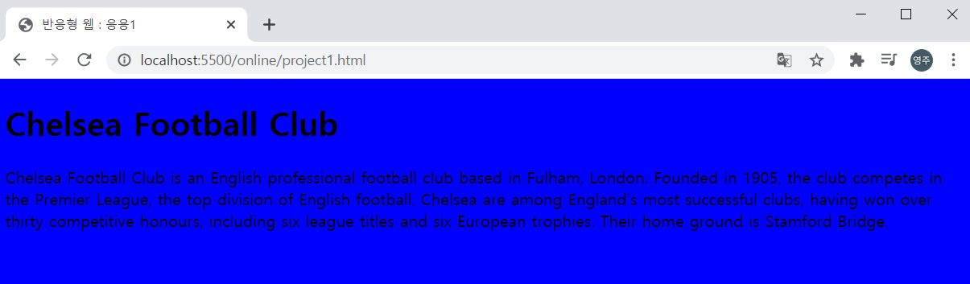
문제1 - 실행결과

Slide 5
문제2 - 소스코드
<!DOCTYPE html>
<html lang="en">
<head>
<meta charset="UTF-8">
<meta http-equiv="X-UA-Compatible" content="IE=edge">
<meta name="viewport" content="width=device-width, initial-scale=1.0">
<title>반응형 웹 : 응용2</title>
<style>
@media screen and (orientation: portrait){
body{ background-color: red; }
}
@media screen and (orientation: landscape){
body{ background-color: green; }
}
</style>
</head>

Slide 6
<body>
<h1>Chelsea Football Club</h1>
<p>Chelsea Football Club is an English professional football club based in Fulham, London. Founded in 1905, the club competes in the Premier League, the top division of English football. Chelsea are among England's most successful clubs, having won over thirty competitive honours, including six league titles and six European trophies. Their home ground is Stamford Bridge.</p>
</body>
</html>

Slide 7
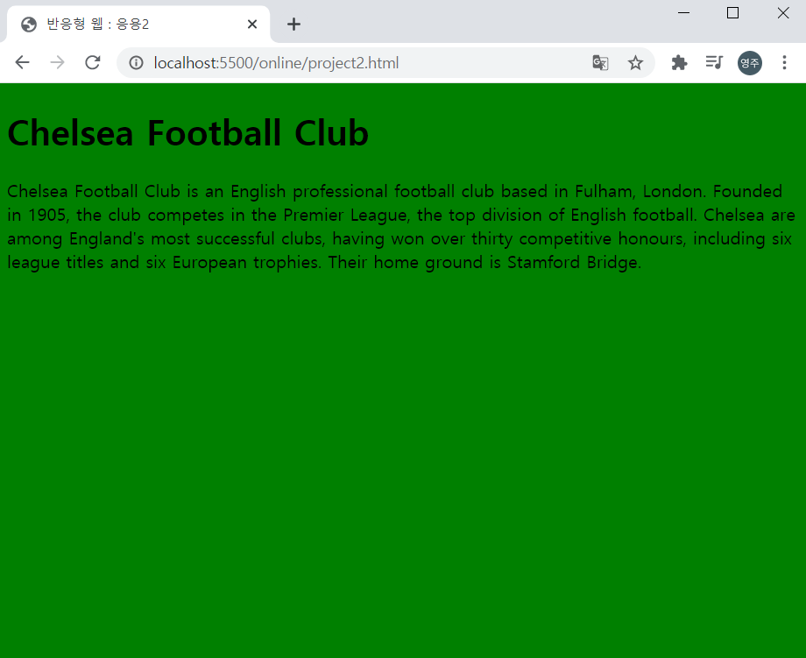
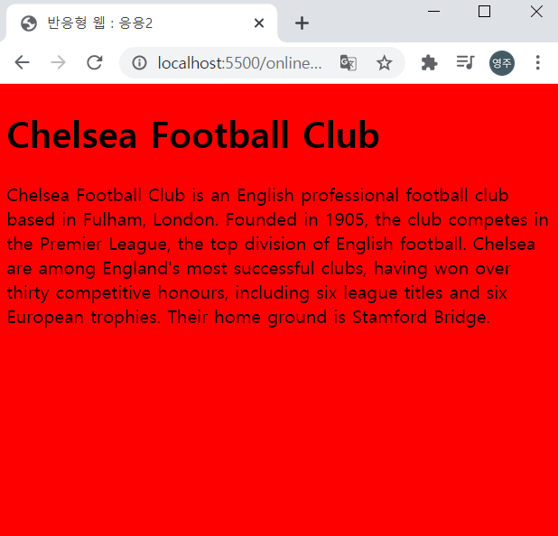
문제2 - 실행결과

Slide 8
문제3 - 소스코드
<!DOCTYPE html>
<html lang="en">
<head>
<meta charset="UTF-8">
<meta http-equiv="X-UA-Compatible" content="IE=edge">
<meta name="viewport" content="width=device-width, initial-scale=1.0">
<title>반응형 웹 : 응용3</title>

Slide 9
<style>
*{
margin: 0;
padding: 0;
}
body{
width: 960px;
margin: 0 auto;
overflow: hidden;
}
#menu{
width: 260px;
float: left;
}
#section{
width: 700px;
float: right;
}
@media screen and (max-width: 767px){
body{ width: auto; }
#menu { width: auto; float: none; }
#section { width: auto; float: none; }
}
</style>
</head>

Slide 10
<body>
<div id="menu">
<ul>
<li>메뉴A</li>
<li>메뉴B</li>
<li>메뉴C</li>
</ul>
</div>
<div id="section">
<h1>Chelsea Football Club</h1>
<p>Chelsea Football Club is an English professional football club based in Fulham, London. Founded in 1905, the club competes in the Premier League, the top division of English football. Chelsea are among England's most successful clubs, having won over thirty competitive honours, including six league titles and six European trophies. Their home ground is Stamford Bridge.</p>
</div>
</body>
</html>

Slide 11
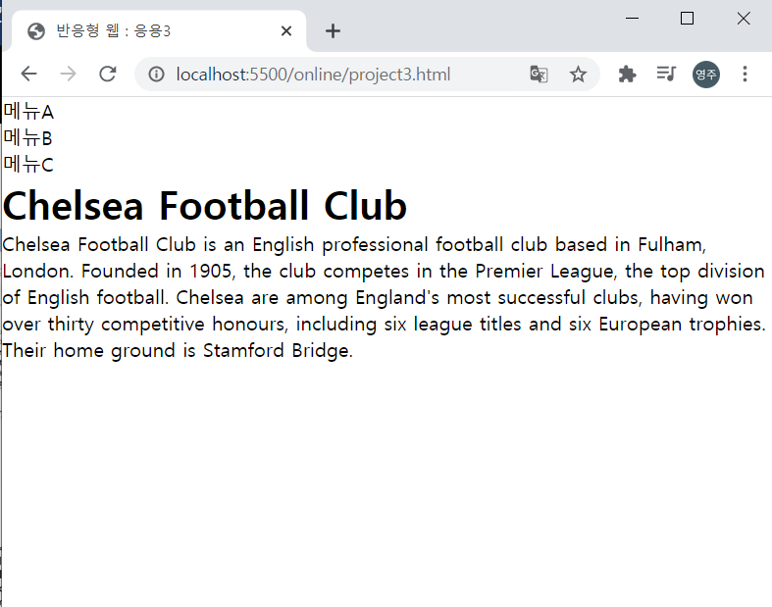
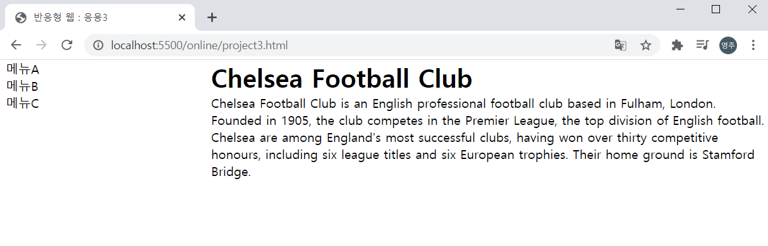
문제3 - 실행결과

