Slide 1

웹서버구축 [스몰과제12] 20175105_곽영주

Slide 2
문제1 – 소스코드(insert01.jsp)
<%@ page contentType="text/html; charset=utf-8" %>
<html>
<head>
<title>Database SQL</title>
</head>
<body>
<form method="post" action="insert01_process.jsp">
<p>아이디 : <input type="text" name="id">
<p>비밀번호 : <input type="password" name="passwd">
<p>이름 : <input type="text" name="name">
<p><input type="submit" value="전송">
</form>
</body>
</html>

Slide 3
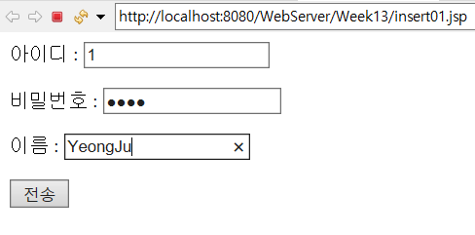
문제1 - 실행결과

Slide 4
문제2 – 소스코드(dbconn.jsp)
<%@ page import="java.sql.*" %>
<%
Connection conn = null;
String url = "jdbc:mysql://localhost:3306/WebServer";
String user = "root";
String password = "1234";
Class.forName("com.mysql.jdbc.Driver");
conn = DriverManager.getConnection(url, user, password);
%>

Slide 5
문제3 – 소스코드(insert01_process.jsp)
<%@ page contentType="text/html; charset=utf-8" %>
<%@ page import="java.sql.*" %>
<html>
<head>
<title>Database SQL</title>
</head>
<body>
<%@ include file="dbconn.jsp" %>
<%
request.setCharacterEncoding("utf-8");
String id = request.getParameter("id");
String passwd = request.getParameter("passwd");
String name = request.getParameter("name");
Statement stmt = null;

Slide 6
문제3 – 소스코드(insert01_process.jsp)
try{
String sql = "INSERT INTO member(id, passwd, name) VALUES('" + id + "','" + passwd + "','" + name + "')";
stmt = conn.createStatement();
stmt.executeUpdate(sql);
out.println("member 테이블 삽입이 성공했습니다.");
}catch(SQLException ex){
out.println("member 테이블 삽입이 실패했습니다.<br>");
out.println("SQLException: " + ex.getMessage());
}finally{
if(stmt != null)
stmt.close();
if(conn != null)
conn.close();
}
%>
</body>
</html>

Slide 7

문제3 - 실행결과

Slide 8
문제4 – 소스코드(insert02_process.jsp)
<%@ page contentType="text/html; charset=utf-8" %>
<%@ page import="java.sql.*" %>
<html>
<head>
<title>Database SQL</title>
</head>
<body>
<%@ include file="dbconn.jsp" %>
<%
request.setCharacterEncoding("utf-8");
String id = request.getParameter("id");
String passwd = request.getParameter("passwd");
String name = request.getParameter("name");
PreparedStatement pstmt = null;

Slide 9
문제4 – 소스코드(insert02_process.jsp)
try{
String sql = "INSERT INTO member(id, passwd, name) VALUES(?,?,?)";
pstmt = conn.prepareStatement(sql);
pstmt.setString(1, id);
pstmt.setString(2, passwd);
pstmt.setString(3, name);
pstmt.executeUpdate();
out.println("member 테이블 삽입이 성공했습니다.");
}catch(SQLException ex){
out.println("member 테이블 삽입이 실패했습니다.<br>");
out.println("SQLException: " + ex.getMessage());
}finally{
if(pstmt != null)
pstmt.close();
if(conn != null)
conn.close();
}
%>
</body>
</html>

Slide 10

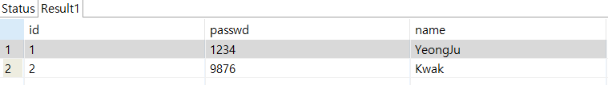
문제4 - 실행결과

Slide 11
문제5 – 소스코드(select01.jsp)
<%@ page contentType="text/html; charset=utf-8" %>
<%@ page import="java.sql.*" %>
<html>
<head>
<title>Database SQL</title>
</head>
<body>
<%@ include file="dbconn.jsp" %>
<table width="300" border="1">
<tr>
<th>아이디</th>
<th>비밀번호</th>
<th>이름</th>
</tr>
<%
ResultSet rs = null;
Statement stmt = null;
try{
String sql = "SELECT * FROM member";
stmt = conn.createStatement();
rs = stmt.executeQuery(sql);
while(rs.next()){
String id = rs.getString("id");
String pw = rs.getString("passwd");
String name = rs.getString("name");

Slide 12
문제5 – 소스코드(select01.jsp)
%>
<tr>
<td><%= id %></td>
<td><%= pw %></td>
<td><%= name %></td>
</tr>
<%
}
}catch(SQLException ex){
out.println("member 테이블 호출이 실패했습니다.<br>");
out.println("SQLException: " + ex.getMessage());
}finally{
if(rs != null)
rs.close();
if(stmt != null)
stmt.close();
if(conn != null)
conn.close();
}
%>
</table>
</body>
</html>

Slide 13
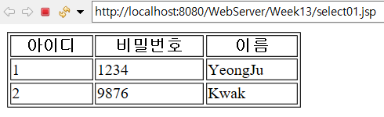
문제5 - 실행결과

