Slide 1
Isaac Parker
D3.js a tool for visualization
and
Distance reading

Slide 2
Question
How does Data visualization aid in distance reading
How can distance reading aid in telling a story about the work without reading it.

Slide 3
Tool/ Source
D3.js – Javascript Library
Huffington Post and American Library Association – Data collection of Works similar to Romeo and Juliet
Last.fm - Songs similar to one another

Slide 4
What is D3
Data visualization, JavaScript library for producing dynamic, interactive data visualization in web applications.

Slide 5
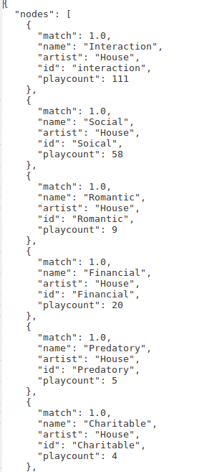
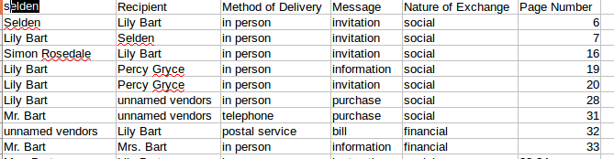
Process
1. Using D3 and creating a generic visualization tool
2. Copy all data from sources to proper format
3. Run Data in visualization tool

Slide 6
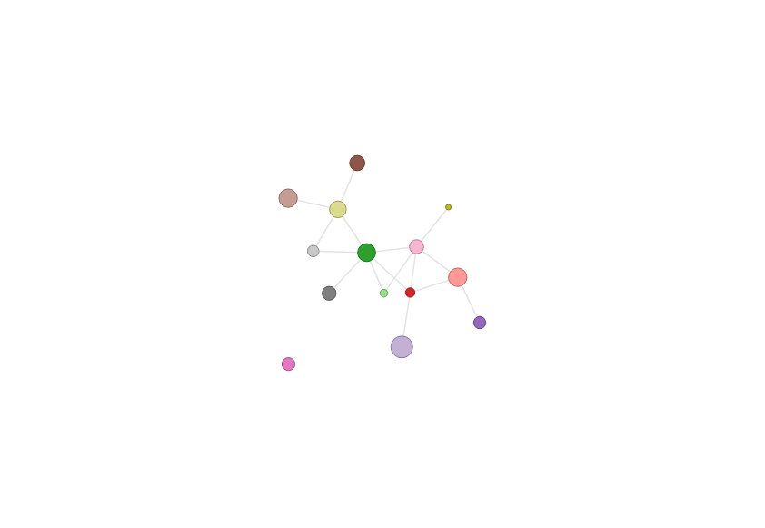
Visualizations

Slide 7
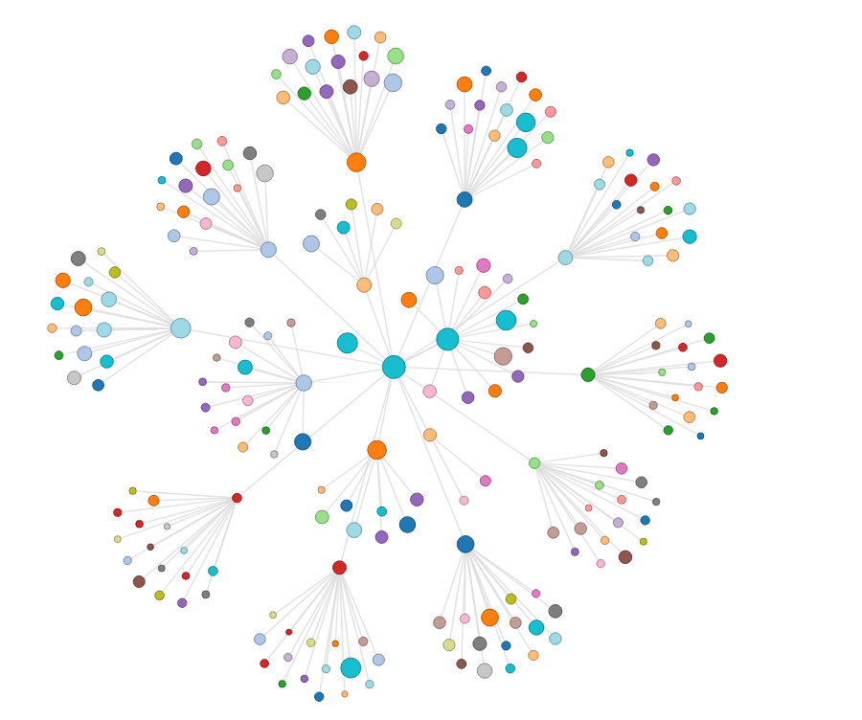
Visualizations

Slide 8
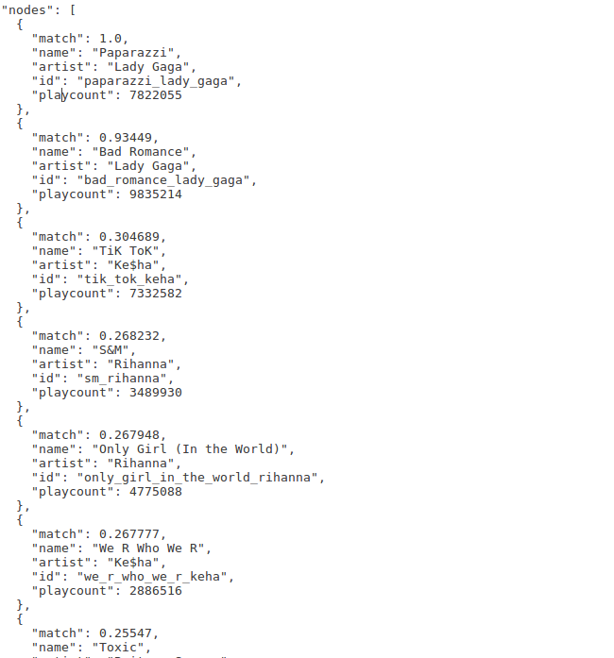
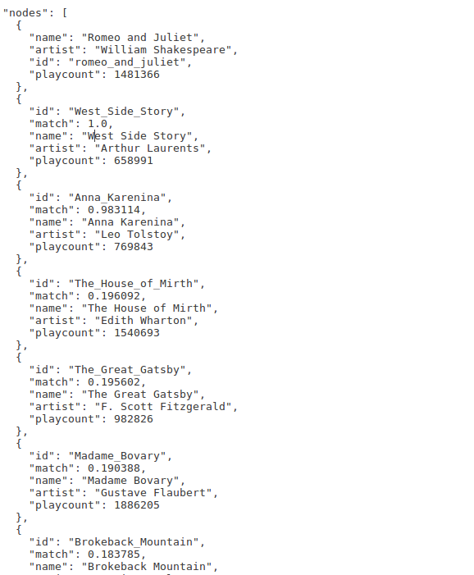
Behind the Visuals

Slide 9
Results
Distance reading does require some context of the source used
Distance reading can be applied to things other than simply books
Relational visualizations can be used to provide a good based understanding of the total work of art without ever having to interact with it directly.

