Slide 1
데이터 변환 data transformation

Slide 2
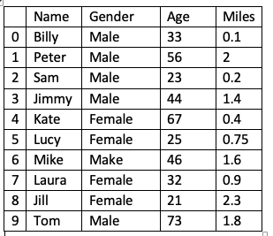
Handling dataset
We create original scale columns to visualize with a count plot graph using sns.countplot()
Displaying results is a good way to understand when working with datasets

Slide 3
Ordinal Scale Variables
create new columns that will display values on an ordinal scale : Age Group and Activity Level
“Age Group” will be created by putting the values from the “Age” variable into three categories : young, middle-aged, and old
“Activity Level” we will label anyone who walks over 1 mile as “active” an under 1 mile as “inactive”.

Slide 4
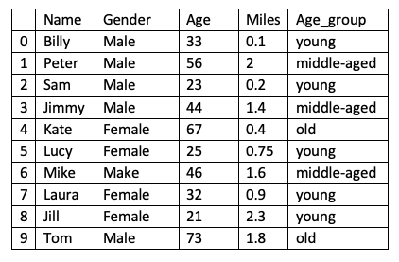
pandas.Series.apply()
add new columns wth ordinal values
people['Age_group'] = people['Age'].apply(age_groups)
Notes:
def age_groups(age):
if age <= 35:
return 'young’
elif 35 <= age <= 60:
return 'middle-aged’
else:
return 'old'

Slide 5
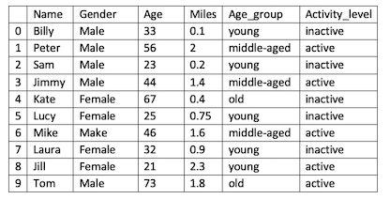
Pass a lambda function to apply
people['Activity_level'] = people['Miles'].apply(lambda x: 'active' if x > 1 else 'inactive' )

Slide 6
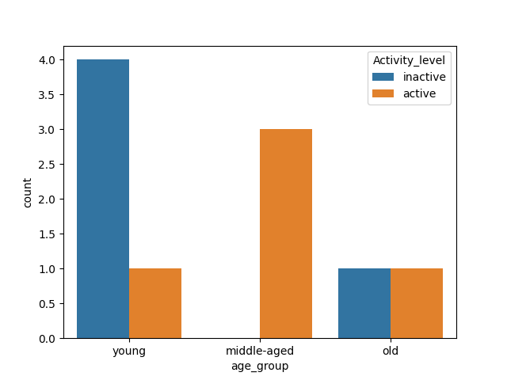
Display our new Columns in a count plot graph
sns.countplot(x='Age_group', hue='Activity_level', data=people)
Notes:
From the count plot graph, we can quickly make the following observations
- The majority of young people are inactive
- there are no inactive people in the middle-aged group
- There are as many inactive old people as active people.

