Slide 1
센서데이터 수집 (Glove High Temperature)
백석대학교 강윤희
yhkang@bu.ac.kr

Slide 2
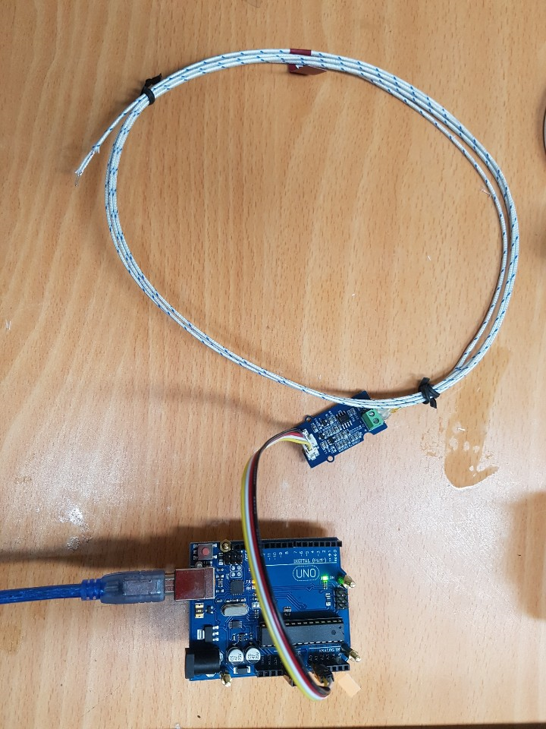
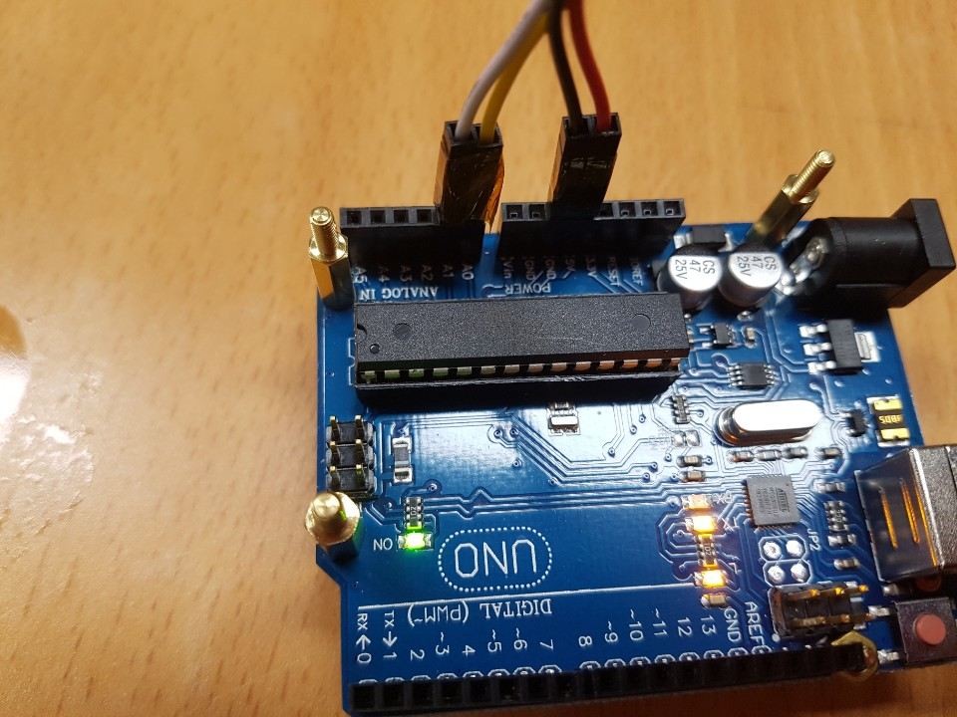
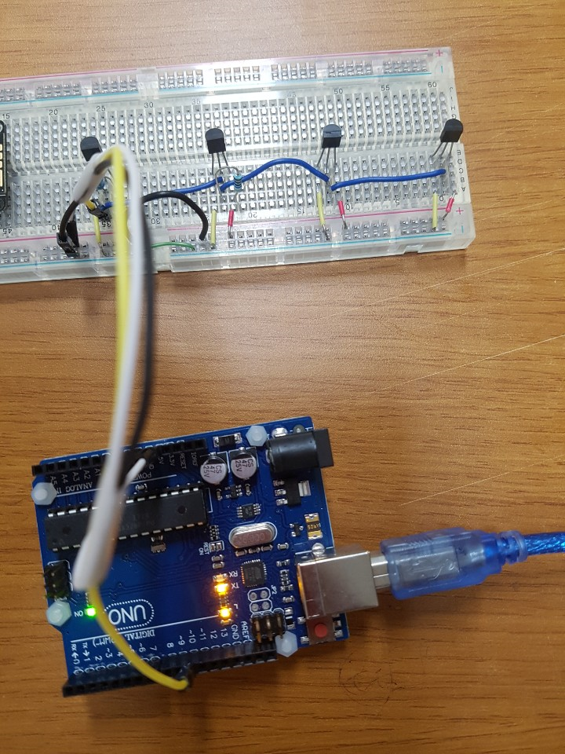
물리 센서 센싱환경 구성

Slide 3
(아두이노)온도센싱 획득
#include "High_Temp.h"
HighTemp ht(A1, A0);
void setup()
{
Serial.begin(115200);
Serial.println("grove - high temperature sensor");
ht.begin();
}
void loop()
{
Serial.print("Grove");
Serial.print("\t");
Serial.print(ht.getThmc());
Serial.print("\t");
Serial.println(ht.getThmcVol());
delay(100);
}

Slide 4
(PC,RP) 센싱데이터 수집
import time
import serial
import argparse
from numpy import array, asarray
import matplotlib.pyplot as plt

Slide 5
(PC,RP) 센싱데이터 수집
def parse_args():
# Parse command line arguments
ap = argparse.ArgumentParser(description="Glove HighTemp data receiver")
ap.add_argument("-i", "--input", required=True,
help="input channel")
ap.add_argument("-s", "--speed", required=True,
help="speed rate")
ap.add_argument("-c", "--count", required=True,
help=“sample #")
return vars(ap.parse_args())

Slide 6
(PC,RP) 센싱데이터 수집
def maketuple(variables, names):
return tuple(variables[n] for n in names)

Slide 7
(PC,RP) 센싱데이터 수집
temp = 0
y = 0
def getTemp(response):
tempList = response.split('\t')
temp = float(tempList[1])
y = float(tempList[2])
if (len(tempList) == 3):
if type(float(tempList[1])) is float:
temp = float(tempList[1])
else:
print(‘[NA] marked to zero')
tempList[1] = 0.0
temp = float(tempList[1])
if type(float(tempList[2])) is float:
y = float(tempList[2])
else:
print(‘[NA] marked to zero')
tempList[2] = 0.0
y = float(tempList[2])
yprTuple = maketuple(vars(), 'temp y'.split())
outputYpr = "{} - {}".format(temp, y)
print(outputYpr)
return yprTuple

Slide 8
(PC,RP) 센싱데이터 수집
SENSOR_TYPE='Grove'
def main(args):
ser = serial.Serial(
port=args["input"],
baudrate=int(args["speed"]),
)
if ser.is_open == True:
ser.close()
ser.open()
i = 0
diff = 0
prev_temp = 0
xs_scaled = []
xs = []
while True:
while ser.inWaiting() == 0:
pass
response = ser.readline()
response = str(response, encoding="utf-8")
gyroTuple = (0, 0)
if response.startswith(SENSOR_TYPE):
gyroTuple = getTemp(response)
xs_scaled.append(gyroTuple[0])
diff = gyroTuple[0] - prev_temp
xs.append(diff)
prev_temp = gyroTuple[0]
if i < int(args["count"]):
i = i + 1
else:
break

Slide 9
(PC,RP) 센싱데이터 수집
xs_scaled = asarray(xs_scaled)
xs = asarray(xs)
plt.subplot(211)
plt.plot(xs_scaled[:], label='measurements')
plt.plot(xs[:], label='difference')
plt.legend(loc=4)
plt.show()
if __name__ == '__main__':
args = parse_args()
main(args)
시각화

Slide 10
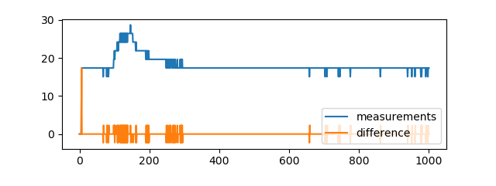
(PC,RP) 센싱데이터 수집
데이터 수집 가시화

Slide 11
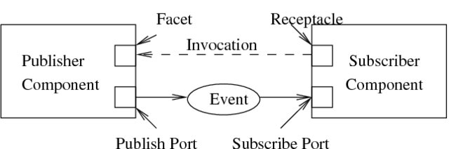
센서데이터 클라우드 전송
(전송패턴) 제어-push/데이터-pull 로 동작
데이터 큐
데이터 요청
데이터 도착
데이터 갱신
토픽 정의

Slide 12
Data collector
(cloud)
Pub/Sub : control
REST : data
REST
Pub/sub(like MQTT)
data
control
…
ID
Number of psensors
Max value
Min value
Average value
Sampling rate
Location
vsensor
config
psensor
Method
Data
sensor interface
cloud interface

