Slide 1

IFN 649 Advanced Networks Assessment2 Smart watering system
Lecturers: Prof Raja Jurdak
Dr. Gowri Ramachandran
Tutor name: Jun Wook Heo
Student ID： N10629297
Student Name： Chen Yun（Michael）
Notes:
For the project I‘m going talk about smart watering system

Slide 2

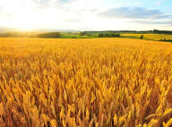
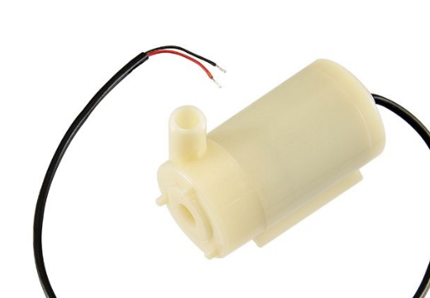
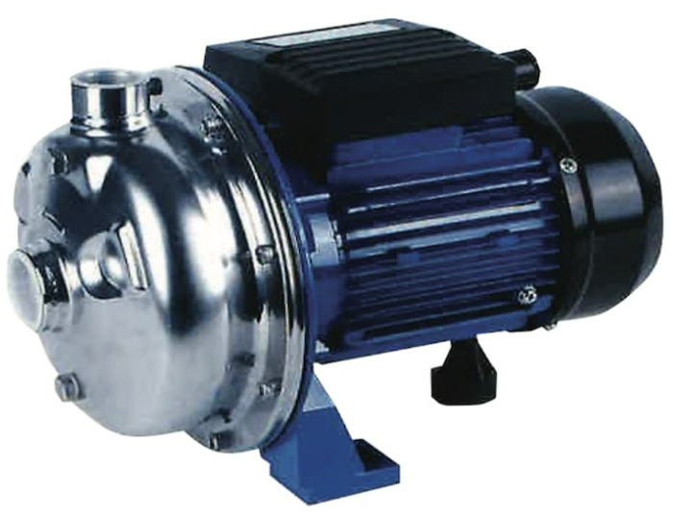


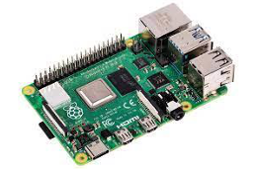

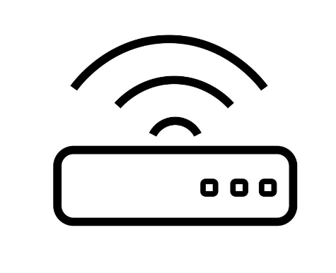

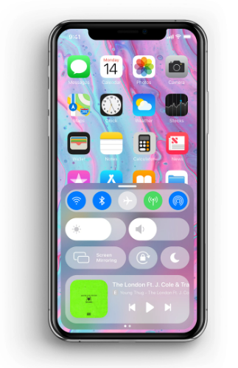
Description of project
Internet
d
Tier 1： outdoor
Tier 2
Tier 3
MCU
Rain sensor
Essential: MQTT Server
Optional: Web Service
Temperature sensor
MCU
Soil moisture sensor
Notes:
This project is mainly to address a problem of watering plants.
Different plants have different water requirements, and either leaving the water or overwatering will lead to the death of the plant.
And watering plants in hot or cold weather could lead to unhealthy for them
So using this system can help us to water the plants automatically.
As this diagram, the system include 3 layers.
Firstly, MCU is used to control some sensors in the first layer.
these sensors are mainly responsible for collect moisture data of soil, monitor the temperature of the environment and detect whether when it is raining.
the MCU is responsible for forwarding data to the second layer, or receiving order from the Raspberry PI to control the watering pump.
Next talk about the second layer, Raspberry PI exchanges data with first layer via Bluetooth.
At the here, I consider using wifi to replace Bluetooth, because WIFI can increase the distance and improve stability for transmission .
MQTT service will be used in this system . It is responsible to subscribe and publish data for Raspberry PI.
In addition, if I have enough time, I will build a web service based Nodejs to display the data on the web.
The detailed working principle of each layer will be introduced later.
。
The system can be used in many scenarios . For example, it can help farmers to water farm automatic.
Or at home it also can be used to water plant in the yard.
It can help people to save time and save water. The important is that it can keep the plants living healthy
Next, I will talk about each layer how does it work

Slide 3


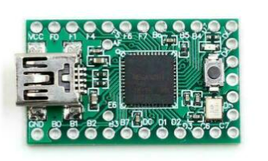
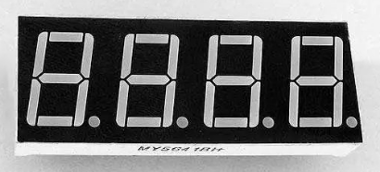
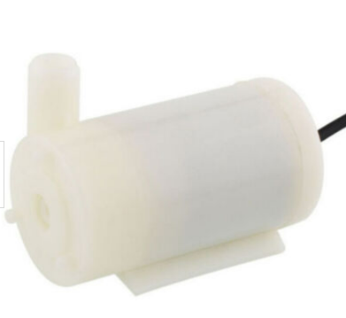
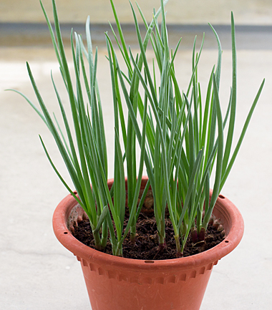
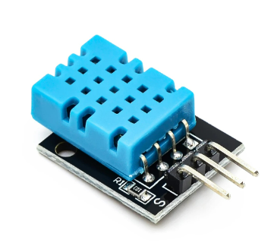
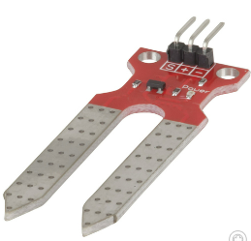
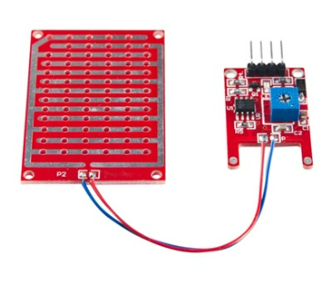
Sensor layer
Tier 2
Notes:
The first layer is sensor layer
There are three sensors used here and a water pump
The value of moisture will be got through the soil sensor
The rain sensor detects if it’s raining
The temperature sensor get the temperature from the environment
Digital tube display the value of soil moisture
Mcu can be used to send these data to the second layer or get the order from that to control the water pump
Temperature level will be considered
That means when the temperature is too high or too low, no water command is sent
Because it's bad for the health of the plant, when water a plant in the hot or cold wether
And When the raining, it will be stopped to monitor the soil sensors.

Slide 4




Edge Tier
MQTT Client running in Raspberry Pi (Linux OS)
Using a Script of Python to Sub & Pub message
Retrieve and Send data from or to Teensy by BT
Notes:
The second layer is edge layer
Because there is a Linux operation system will be runing on Raspberry PI, we can do a lot of things
Firstly, the second layer mainly response to process the data of first layer and give an order to first layer
Then, it will publish the data to the cloud
In this case, publishing data to the cloud will use MQTT or Socket
The connection to the first layer could use Bluetooth or wifi for data transmission
using Python to program a application to process the data
For Examples temperature determination, rain detection, and soil moisture detection.
The application also needs to give orders to the pump when the plant needs to be watered.同时还要判断是否达到浇水的条件给水泵的控制器下发指令。

Slide 5





Cloud tier
MQTT Server
An MQTT server is run to provide data forwarding services for the clients in the second layer
Web Server
Create a Web service and subscribe to the messages published by the tier 2 client and display them on the page
Notes:
In the third layer of cloud,
it is mainly to provide some persistent services
First of all, it is necessary to deploy the MQTT server. The MQTT server is developed based on Socket and uses TCP/IP protocol for data transmission,
so that it has a the reliability for transmission data
Then I could use Express to build a server that can visualize the data to the user.
Users can use mobile phones or laptops to access websites to browser data, or click a button to control the sensor.

Slide 6
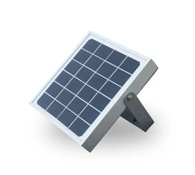
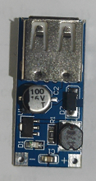

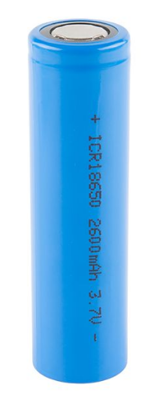
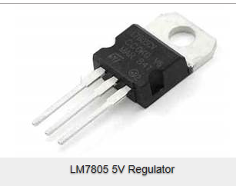
Consideration
Salary panel
12Volt
100-180mA
X4
Power
Power analysis
Supply:
12V & 400-800mA
Charge in 5-8 hours
Requirement：
Total：
Approximately 100mA
Use continuously for 26 hours
5V DC Converter
18650 battery
3.7 volt
26000mAH
LM7805 voltage regulator
 | Teensy | BlueTooth | Sensors
Power(W)
Voltage(V) | 5V | 3.3V | 3.3V
electric current(mA) | 10-30mA | 40mA-50mA | 4mA-10mA(per)
15 Watts
5 Volt
3 Ampere
Notes:
For this section, I mainly consider the power and security , because some devices I borrowed from Uni, that means I couldn‘t put them into a sealed plastic box.
For the power ,In this case. I will use the socket for the raspberry pi. Because it need 15 watts of power. But I will use the salary energy to supply the power to first layer.
I am very luck , I found one Salary panel from rubbish-bin and it does work,
then I get a voltage regulator from the Uni , it can change the voltage from 12 to 5
And I have measured the power consumption of all the devices
After calculation, use a battery to private the power can ensure the sensors with teensy working more than 20 hours.
And if I have 4 salary panels ,just need 5-8 hours ,the battery can be charged completely.
Even though I only have one solar panel, the whole system also works.
Therefor the power problem has been addressed, the system can be portable

Slide 7
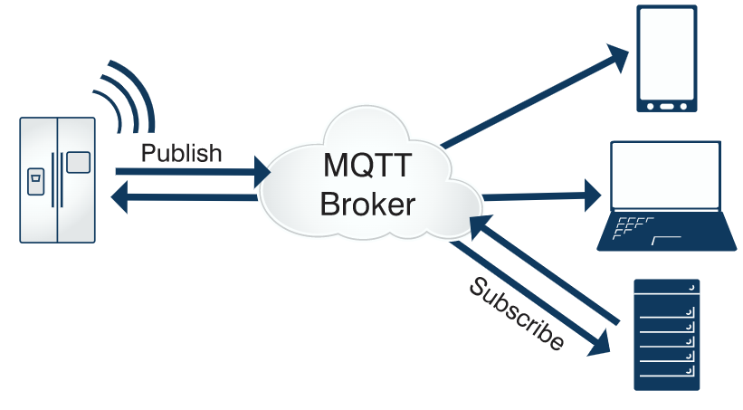
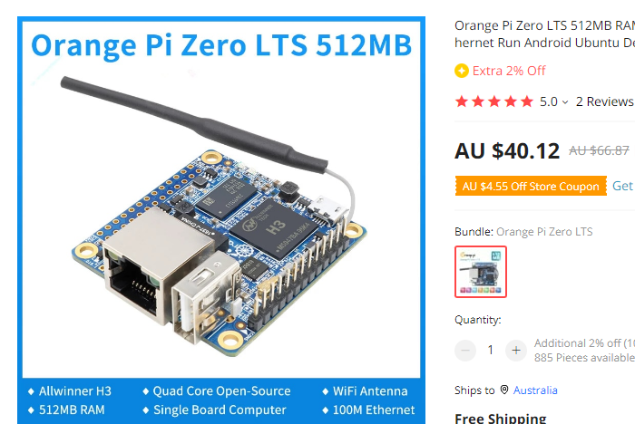
Consideration
Security
Devices Security
Set a specific KEY in MCU
Network Security
config /etc/mosquitto/mosquitto.conf
disable the allow_anonymous
Data Security
Using AWS-MySQL to storage the data
Cost
Total : 90 AUD in AU, but only 20 AUD in China (not include Raspberry Pi)
Notes:
For Security section, I can set a key when I program the code for Arduino ,and the sensors only can be turned on or off by getting correct message
After that ,I have to disable no useful port of Linux on raspberry pi and config the ssh connection module must be used the private key
and config the MQTT service to verify the username and password
Lastly for the data parts I could use the MySQL with AWS to storage the sensitive data
For the totally cost ,I have spent 90 dollar to buy these devices from jaycar.It’s so expensive
Because if I buy them on Chinese online markets ,only less than 20 dollar is enough .
And for Raspberry pi , I don’t consider this device
because a chip that can run Linux could replace the Raspberry PI, Such as Orange Pi，I often use it as a Linux platform to develop some application . It offers the same functionality as Raspberry PI, but cheaper than that.

Slide 8

Methodology
Research Method
Artefact-oriented research method
The final purpose of this project is that an intelligent watering completion system can be implemented, which can accept the user's command switch, and the system is portable. The unattended mode can make the system run continuously without any intervention to ensure the growth of the plant.
Research Structure
Propose
Specify a project goal to accomplish, which is already set in this case. Implement an intelligent watering system
Plan & Design
Develop execution plan and backup plan. Fully consider the problems that may occur in the project and look for solutions.
Collect and evaluate the equipment
Collect the equipment in the project and test it
Evaluate whether its functionality meets the requirements of the project
Experiment
Connect the device according to the designed circuit diagram
Write the code
Deploy the service
Test
Test the operation of the whole system under different conditions.
Delivery
Deliver and demonstrate the entire system
Notes:
this is my schedule for this project.
Because I have already done the first three parts so I will try to connect the devices like sensors from this week and programming in the next week .
So I think I can complete the whole project before the due date.

Slide 9
Thank you
Notes:
That’s all
Thank you!

