Slide 1



Fast Video Classification via
Adaptive Cascading of Deep Models
Haichen Shen Arvind Krishnamurthy | Seungyeop Han | Matthai Philipose
University of Washington | Rubrik | Microsoft
Notes:
Hello, I’m Haichen Shen from University of Washington. Today I’m going to present the work “Fast video classification via Adaptive Cascading of Deep Models”. This is a joint work with Seungyeop Han, Matthai Philipose, and Arvind Krishnamurthy.

Slide 2
Recognizing entities in every frame of videos
Convolutional neural networks (“Oracle” model)
  High accuracy in recognizing thousands of classes
  Expensive to execute
Simpler convolutional neural networks (”Compact” model)
  Low accuracy in recognizing thousands of classes
  Cheap to execute
How can we reconcile this?
Notes:
In this paper, we are focusing on the task of recognizing entities such as objects, people, and scenes in every frame of our day-to-day life videos.
As we may encounter thousands of such entities through our life, recognition model need to recognize all of them with high accuracy.
And Recent advances in Convolutional neural networks can achieve this.
However these CNN models are usually expensive to do inference for every frame in the videos
(click)
Alternatively, we can generate simpler versions that are much cheaper and faster to execute, but they suffer from lower accuracy.
(click)
So How can we reconcile this?

Slide 3
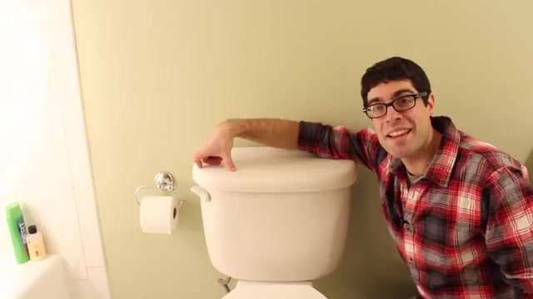
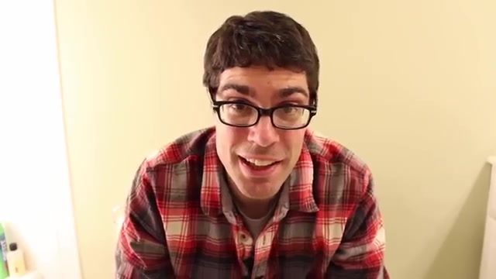
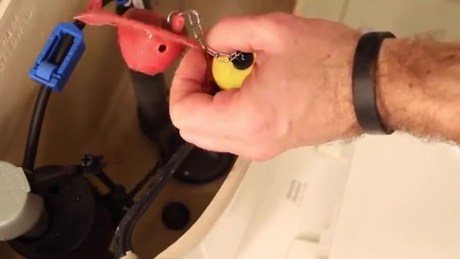
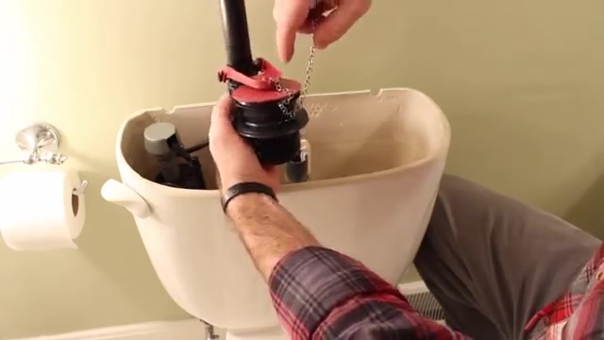



Object Skew in 1-minute video segments
DominantObjectCount: # of objects that account for 80% of all object occurrences in 1-minute segments
0:00 0:30 1:00 1:30 2:00 2:30 3:00
Segment 1
Segment 2
Segment 3
Day-to-day video contains a tiny subset of classes in a short interval.
Can we exploit temporal skew in a video to accelerate the recognition speed?
70% of segments have DominantObjectCount <= 10
DominantObjectCount
Notes:
We observe that day-to-day videos tend to have a small number of entities within a short interval
To verify this, we define one metric called DominantObjectCount as the number of object classes that account for 80% of all object occurrences in 1-min segments.
//For example, in this video clip showed below, Dominant objects in the first minute are toilet and person.
(click)
We analyzed 30 day-to-day videos from Youtube and split them into 1-min segments. We found that 70% of segments have DominantObjectCount no more than 10, and 90% have no more than 15
(click)
So can we exploit such temporal skew in the video to accelerate the recognition speed?

Slide 4
Approach: Cascade oracle model with a less expensive “compact” model
Compact model
dominant classes
all classes
Specialized model
“other”
Oracle model
Challenges:
Can specialized models have accuracy comparable to oracle models?
Can we produce specialized models fast enough during runtime?
How to determine when to switch specialized models without any ground truth data?
Notes:
To exploit the skew, we propose an architecture that cascades a cheap classifier with the oracle as follows
First, a compact CNN recognizes the dominant classes in the video, and plus one ”other” class.
In most cases, only the compact model is executed to get the result.
When the compact model predicts the input as “other”, we then execute the oracle.
(click)
We call this entire structure a specialized model.
(click)
Now the big problem here is that we need to do all this online, based on the live video we are seeing
**
are these online-trained models accurate enough
can we train them fast enough (remember they are deep networks!)
how do we get enough ground truth online for training the compact model, and when exactly should we train it?”
***
As we need to generate specialized models at runtime based on the video temporal context,
we need to address the following challenges.
can specialized models have accuracy comparable to oracle models?
can we train specialized models fast enough during runtime? how to determine dominant classes and when to produce a specialized model at runtime without any ground truth?

Slide 5
Specialized models have comparable accuracy under skewed distributions
Model | FLOPS | CPU lat. | GPU lat.
GoogLeNet (oracle) | 3.17G | 779 ms | 11.0 ms
Compact CNN | 0.82G | 218 ms | 4.4 ms
Object recognition (1000 classes)
Top-1 accuracy
Notes:
We use the object recognition as an example to compare the accuracy.
We select two models, one is the GoogleNet as oracle, the other is a compact CNN.
This compact CNN is unremarkable except that it is much faster than the googlenet.
(click)
When compact model and googlenet are both trained and tested on the uniformly distributed datasets, the accuracy of compact model is significantly lower than googlenet.
(click)
We then train the compact model to recognize 5 dominant classes, and cascade it with the googlenet to form a specialized model.
We test this model under skewed distribution where these 5 classes consists of 70 to 90% in the test dataset. Turns out, the specialized model becomes even more accurate than the googlenet.
(click)
Even when we allow up to to 20 dominant classes, specialized models still achieve competitive accuracy

Slide 6
Producing specialized models can be fast
We pre-train the compact models on the full, unskewed datasets during development time.
At the test time, fix the lower layers and only re-train the top fully connected layer of the compact model.
Cache feature vectors of compact models for all inputs in the training datasets.
Generate the specialized model ~10 seconds.
Notes:
***
Because we train online, we need to be fast.
The way we do this is by pre-trainiing the lower-layers and only retargeting the top layer at runtime.
This is super fast, it only takes a few seconds.
***
As we know that training neural networks can take a long time.
Reducing the time in generating specialized models is essential to make this scheme work in practical.
With the combination of these three techniques, we are able to generate specialized models in about 10 seconds.

Slide 7
Bandit-style algorithm to determine when to switch specialized models
Oracle Bandit Problem
  Exploration: use the oracle model to estimate the distribution.
  Exploitation: use a specialized model to accelerate the recognition
Windowed ε-Greedy (WEG) Algorithm
  Adaptively select the windows size for sampling.
  Produce a specialized model when a skew is detected.
  Use heuristics to detect skew changes while “exploiting” specialized models.
Notes:
**
When do we switch between oracle and specialized models?
We formulate this question as a non-stationary contextual bandit problem with many arms.
-- Basically, we explore the distribution by running the oracle and
-- Exploit it by running the specialized model for that distribution
-- We use windowing to handle stationarity.
--------------
During run time we need to determine when to switch the specialized models.
This problem resembles the bandit-style problem that balances the exploration that uses the oracle model to estimate the distribution, and the exploitation that uses a specialized model to accelerate the recognition speed.
We formalized this problem as oracle bandit problem.
And we propose the Windowed epsilon-Greedy (WEG) Algorithm to address it.

Slide 8
Evaluation
video | length (min) | oracle |  | WEG
 |  | acc. (%) | GPU lat. (ms) | acc. (%) | GPU lat. (ms)
Friends | 24 | 93.2 | 28.97 | 93.5 | 7.0 (x4.1)
Good Will Hunting | 14 | 97.6 | 28.84 | 95.1 | 3.7 (x7.8)
Ellen Show | 11 | 98.6 | 29.26 | 94.6 | 4.7 (x6.2)
The Departed | 9 | 93.9 | 29.18 | 93.5 | 6.9 (x4.2)
Ocean’s Eleven / Twelve | 6 | 97.9 | 28.97 | 96.0 | 12.3 (x2.4)
Notes:
Evaluation on movie and TV-show clips shows that our algorithm can speedup recognition by 2 to 8x with comparable accuracy.

