Slide 1
CartPole: OG vs NN vs Nuclei
From hand-written rules to a ReLU Q-network, patience, and more CPU cores
• [Author name] & Bryan [surname]
• Intelligent Agents | RL101 CartPole activity
• [email]

Slide 2
Outline
• 1 Introduction: motivation, objective, three experiments
• 2 Background / theory: MDP, physics, DQN, stabilisers, patience, parallel runs
• 3 Implementation: notebook design, agent settings, seeds
• 4 Analysis: methodology, time and space complexity
• 5 Experimental results: OG, NN, CPU vs GPU, Nuclei, comparison, time ledger
• 6 Conclusion, ideas to improve the activity, resources, Q&A
CartPole: OG vs NN vs Nuclei
2

Slide 3
Motivation
• CartPole-v1: push a cart left or right to keep a pole upright. Reward +1 per step, so the return is the number of steps survived (cap 500).
• The original activity (OG) solves it with two-line hand-written rules and ends with a bridge to DQN.
• Two extensions were built on top of it:
– NN: replace the rule by a learned ReLU Q-network and make its training trustworthy (patience, best checkpoint, CPU vs GPU time).
– Nuclei (Bryan): run the DQN lab's experiments on more CPU cores.
• Main question: what does each idea buy, in quality and in time?
CartPole: OG vs NN vs Nuclei | Introduction
3

Slide 4
Objective
Main objective
Integrate the two experiments in one notebook, keep them separate, and compare OG vs NN vs Nuclei on the same seeds, with the same protocol, measuring quality and wall-clock time.
• Understand why the OG rules work, and when they fail, before learning anything.
• NN: obtain a stable learned policy; show what patience, a grace period and checkpoint restore each contribute.
• Nuclei: measure what more cores buy and check that the results do not change.
• Report honestly: small samples, selection effects, what was not run.
CartPole: OG vs NN vs Nuclei | Introduction
4

Slide 5
Three experiments, one notebook
Section | Whose | What | How it is integrated
OG | course activity | state, actions, human play, rule-based policies, break-the-environment | 22 cells copied verbatim, stored outputs kept
NN | notebook author | ReLU DQN, double DQN + soft target, patience with grace period, CPU vs GPU | new cells, names prefixed NN
Nuclei | Bryan | DQN lab; joblib run_configs on 8 cores | 52 cells verbatim; two marked measurements added
Comparison | both | OG vs NN vs Nuclei: quality and time | new cells; time ledger for every cell
CartPole: OG vs NN vs Nuclei | Introduction
5

Slide 6
CartPole as a Markov decision process
• State s = (x, ẋ, θ, θ̇): cart position, cart velocity, pole angle, pole angular velocity.
• Actions: 0 = push left, 1 = push right (fixed force 10 N); reward +1 per step; time step 0.02 s.
• Terminated: |θ| > 0.2095 rad (12°) or |x| > 2.4 m, a true failure. Truncated: 500 steps (v0: 200), just the clock.
• Return G = Σ r_t = steps survived; goal: a policy π(s) → a that maximizes it.
Why the distinction matters
A time-limit cut is not a failure: the DQN target must bootstrap through truncation and stop only at termination.
CartPole: OG vs NN vs Nuclei | Background / Theory
6

Slide 7
Physics and the rule-based controller (OG)
Equations of motion (gymnasium source, Euler integration)
θ̈ = [ g·sinθ − cosθ·(F + m_p·l·θ̇²·sinθ)/M ] / [ l·(4/3 − m_p·cos²θ/M) ] ≈ 15.8·θ − 14.6·u, u = ±1
• Checked on the printed numbers: predicted Δθ̇ = 13.9 × 0.02 = 0.278; observed 0.2295 − (−0.0483) = 0.278.
• Gravity is unstable (15.8·θ) but one push (14.6) beats it at the failure angle (3.3): only the timing of the switch matters.
• Rule: push right iff s = θ + K·θ̇ ≥ 0. On s = 0 the angle decays as θ(t) = θ₀·e^(−t/K) (PD / sliding-mode control).
• K → 0 is the angle-only rule; K → ∞ is the angular-velocity-only rule.
CartPole: OG vs NN vs Nuclei | Background / Theory
7

Slide 8
From a Q-table to a Q-network
Bellman target and DQN loss
y = r + γ·(1 − terminated)·max_a' Q_target(s', a') L(θ) = E[ Huber( y − Q_θ(s, a) ) ]
• A table needs a finite state set: 10 bins per variable already give 10⁴ × 2 = 20,000 entries, growing as N⁴.
• The network Q_θ: R⁴ → R² is 4 → 128 → 128 → 2 with ReLU after both hidden layers and a linear output (17,410 parameters); policy = argmax_a Q_θ(s, a).
• Replay buffer (20,000 transitions, batch 64) breaks the correlation of consecutive steps; ε-greedy explores (1.0 → 0.05 over 5,000 steps).
• The loss is a surrogate: the success metric is the greedy episode return.
CartPole: OG vs NN vs Nuclei | Background / Theory
8

Slide 9
Stabilisers: double DQN and soft target
Double DQN
Soft (Polyak) target, every step
y = r + γ·(1 − terminated)·Q_target( s', argmax_a' Q_θ(s', a') )
θ_target ← (1 − τ)·θ_target + τ·θ, τ = 0.02
• Plain DQN: hard copy every 300 steps and a plain max (the lab default).
• Diagnosis of the plain run (N0): mean max-Q keeps growing (about 4 → 30–34 in 12,000 steps) while the greedy return swings between about 100 and 500.
• τ has a cliff: τ = 0.005–0.02 worked, τ = 0.05 collapsed on the development seeds.
CartPole: OG vs NN vs Nuclei | Background / Theory
9

Slide 10
Patience, grace period and best checkpoint
Algorithm
best = -inf ; bad = 0
every 1,000 steps (step t):
score = greedy return on 10 fixed validation episodes
if score > best + 1: best = score ; save a copy of the weights ; bad = 0
elif t >= grace: bad = bad + 1 # grace period: early plateaus never count
if bad >= P: stop
return the BEST saved weights (not the last ones)
• Restoring the best weights and stopping early are different effects.
• The grace period keeps an early plateau from stopping training (grace 15,000 steps, P = 10 in the final run).
CartPole: OG vs NN vs Nuclei | Background / Theory
10

Slide 11
Nuclei: more cores
• Bryan's run_configs sends each (configuration, seed) training to a worker with joblib.Parallel(n_jobs=8).
• The trainings are independent and each train() seeds itself, so parallel and sequential must give the same result. His comment claims it; we test it.
• The laptop has 8 logical but 4 physical cores, and every worker pays process start-up and a torch import.
Speed-up bound
S(n) ≤ 1 / ( (1 − p) + p/n ), and also capped by the number of rounds ⌈#trainings / n⌉
CartPole: OG vs NN vs Nuclei | Background / Theory
11

Slide 12
Implementation details
• Python, gymnasium 1.3, torch 2.11 (CUDA 12.8), joblib; one Jupyter kernel; 8 logical cores; RTX 4050 Laptop GPU.
• OG: 22 original cells copied verbatim; evaluate_policy is reused by every later section.
• NN: NNQNetwork, NNReplayBuffer, PatienceStopper, train_nn (options: double, tau, dropout, patience, grace, device).
• Nuclei: 52 of Bryan's cells verbatim, including his .long() fix for Windows; heaviest cells shipped unexecuted.
• Comparison: a hook records the network that Bryan's unchanged train() builds, so OG DQN weights can be scored.
• Every cell is timed from the notebook's own timestamps; the notebook is saved after every cell.
CartPole: OG vs NN vs Nuclei | Implementation
12

Slide 13
Agent settings (NN)
Item | Value
Network | 4 → 128 → 128 → 2, ReLU, linear output, 17,410 parameters
Optimiser / loss | Adam, lr 5e-4; Huber loss; gradient clip 10
Discount / batch / buffer | γ = 0.99; 64; 20,000 transitions; learning starts at 1,000
Exploration | ε: 1.0 → 0.05 over 5,000 steps
Target | plain: hard copy every 300 steps; recipe: double DQN + soft τ = 0.02
Patience | validation every 1,000 steps on 10 episodes; grace 15,000; P = 10; Δ = 1
Dropout (ablation) | 0.1 after both hidden layers; off when acting, validating and in the target net
CartPole: OG vs NN vs Nuclei | Implementation
13

Slide 14
Seeds and data roles
No dataset: episodes come from the simulator. What must be controlled is which seeds play which role.
Role | Seeds | Used for
Training starts | 1000 + training seed | learning only (ε-greedy, noisy)
Validation | 10,000 – 10,009 | patience decisions and checkpoint choice
Development | train 100–102, 200–204; test 20,000–20,049 | choosing the recipe (τ, double, ...)
First final | train 300–304; test 30,000–30,049 | showed why patience needs a grace period
FINAL | train 400–404; test 40,000–40,049 | nothing was tuned on these
CartPole: OG vs NN vs Nuclei | Implementation
14

Slide 15
Methodology
• One change at a time: plain → recipe → recipe + grace patience (and last weights vs restored best from the same run).
• Selection vs final: the recipe was chosen on development seeds; the grace period after seeing seeds 300–304; the headline numbers use seeds 400–404 nobody had looked at.
• Determinism: training is seeded and validation draws no random numbers, so patience runs follow the full run until they stop, and two independent runs of the same design gave identical tables.
• Time: time.perf_counter() around whole batches; torch.cuda.synchronize() before reading the clock on the GPU; contended times are labelled.
• Metric: greedy return on 50 fresh episodes, per training seed, with the failure mode where useful.
CartPole: OG vs NN vs Nuclei | Analysis
15

Slide 16
Time complexity
P = 17,410 parameters, B = 64 batch, T environment steps.
Per-operation complexity
• Acting: one forward pass, O(P) (about 3.5·10⁴ FLOPs).
• Replay add / sample: O(1) / O(B).
• Update (double DQN): forward on s, backward, forward on s' with both nets ≈ 10·B·P ≈ 1.1·10⁷ FLOPs; soft target O(P).
• Validation: V episodes × up to 500 steps × O(P).
Total complexity
T_train = O(T · B · P): patience reduces T (24,200 instead of 30,000 steps).
Measured: one update takes 2.8 ms on one CPU thread, far from the arithmetic bound, so call overhead dominates (not profiled).
CartPole: OG vs NN vs Nuclei | Analysis
16

Slide 17
Space complexity
Space requirements
• Replay buffer: 20,000 × (4 + 4) floats + action, reward, flag ≈ 48 B each ≈ 0.96 MB: O(N_buf).
• Parameters: 17,410 × 4 B ≈ 70 kB; online, target, gradients and two Adam moments ≈ 0.35 MB: O(P).
• Tabular alternative: N⁴ · 2 entries (20,000 for 10 bins), exponential in the number of variables.
Overall
S = O(N_buf + P) per training; with n workers, n × that plus one Python/torch runtime each.
CartPole: OG vs NN vs Nuclei | Analysis
17

Slide 18
Experimental setup
• All runs: one machine, CPU unless stated; 30,000-step budget for every DQN.
• OG: 4 rules × 20 episodes (seeds 0–19), plus earlier checks on 200 unseen seeds.
• NN: development sweeps (3–5 seeds, 12 configurations), story on seeds 300–304, live final run: 15 trainings, seeds 400–404.
• CPU/GPU: 5,000-step runs on three devices, per-operation timing, size sweep.
• Nuclei: Bryan's run_configs, 6 trainings × 6,000 steps at 1/2/4/8 workers.
• Comparison: OG DQN and NN, 5 seeds × 30,000 steps on 8 cores; sequential time measured on one training and scaled (labelled estimate).
• Trimmed to a 60-minute budget: Bryan's 50,000-step runs and Part 5 runs A–E are shipped unexecuted.
CartPole: OG vs NN vs Nuclei | Experimental Results
18

Slide 19
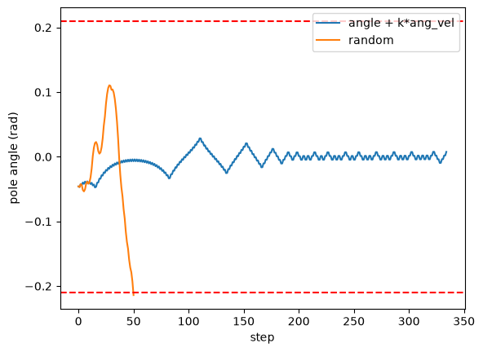
Results: OG rules (seeds 0–19)
Policy | Mean ± std | Ends by | Why
random | 24.0 ± 8.2 | pole | ignores the state
angle only | 40.9 ± 7.4 | pole, 20/20 | no damping: oscillation grows
angular velocity only | 198.7 ± 36.3 | cart, 20/20 | freezes rotation, not tilt: cart runs away
angle + K·ang. vel., K = 1 | 491.7 ± 36.2 | 19 time limit, 1 cart | PD / sliding-mode
• Earlier checks: K = 0.1–0.5 gave 500 ± 0 on seeds 0–19; on 200 unseen seeds K = 1 lost 30 episodes to the cart (477.2 ± 56.5), K = 0.25 / 0.5 gave 500 ± 0.
• Wider start noise (±0.3) cut K = 1 to 163.1; about 31% of such starts begin outside the 12° limit.
CartPole: OG vs NN vs Nuclei | Experimental Results
19

Slide 20
Results: choosing the recipe (development seeds 200–204)
Configuration | Restored best | Last weights
plain DQN (base) | 413.3 | 300.9
double + soft τ = 0.005 | 498.3 | 454.8
double + soft τ = 0.01 | 495.5 | 401.3
double + soft τ = 0.02 | 500.0 | 500.0
double + soft τ = 0.02 + input scaling | 493.8 | 294.6
double + soft τ = 0.05 | 231.0 | 60.8
• Not helpful on 3 seeds: lower γ (0.95: 375.4; 0.98: 323.0 vs 474.3), a 100k buffer, a higher learning rate.
• Winner's curse: about a dozen settings were compared on 3–5 seeds; the fresh-seed result is the honest gain.
CartPole: OG vs NN vs Nuclei | Experimental Results
20

Slide 21
Results: why patience needs a grace period (seeds 300–304)
Run | Test mean | Steps used
plain DQN, last weights | 472.0 | 30,000
plain DQN, restored best | 500.0 | 30,000
recipe, last weights (reported) | 401.8 | 30,000
recipe + dropout 0.1, last weights (reported) | 343.8 | 30,000
recipe + patience P = 3, no grace | 256.9 | 7,400
recipe + patience P = 5, no grace | 264.6 | 10,200
recipe + patience P = 10, no grace | 498.9 | 23,600
• Patience stopped inside the plateau before the breakthrough; one recipe seed collapsed to a dead network after scoring 500.
• Dropout did not help (single run, weak evidence). These seeds motivated the grace period.
CartPole: OG vs NN vs Nuclei | Experimental Results
21

Slide 22
Results: final NN experiment (fresh seeds 400–404)
Run | Test by seed | Mean ± std | Steps
plain DQN, last weights | 191 / 154 / 180 / 70 / 147 | 148.4 ± 42.4 | 30,000
plain DQN, restored best | 283 / 500 / 500 / 254 / 296 | 366.7 ± 109.7 | 30,000
recipe, last weights | 9 / 9 / 500 / 500 / 500 | 303.7 ± 240.4 | 30,000
recipe, restored best | 500 / 408 / 500 / 500 / 493 | 480.3 ± 36.0 | 30,000
recipe + grace patience | 500 / 408 / 500 / 500 / 493 | 480.3 ± 36.0 | 24,200
• Reproduced exactly by an independent run of the same design.
• OG rule on its own protocol: 491.7 ± 36.2; the best DQN is close, not above.
CartPole: OG vs NN vs Nuclei | Experimental Results
22

Slide 23
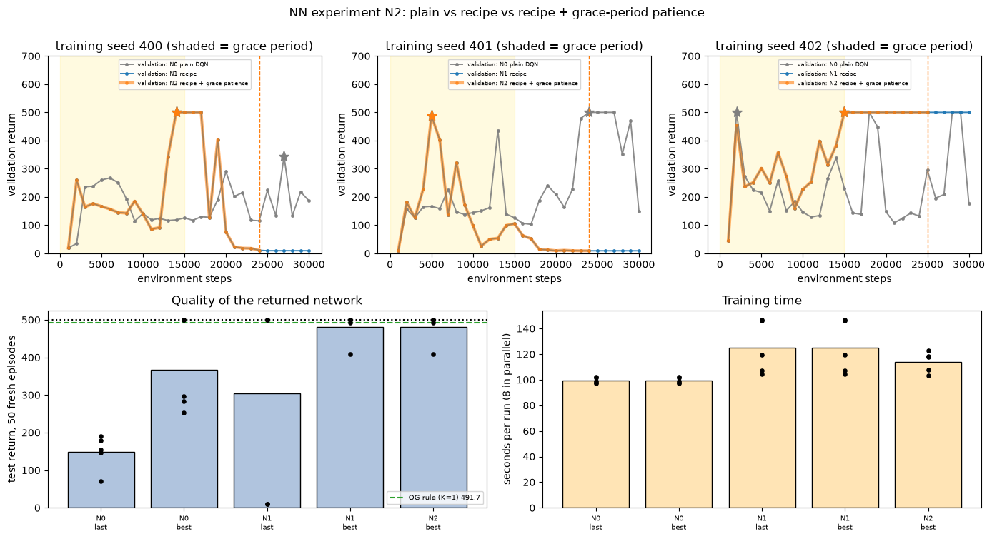
Figure: the final NN experiment
Top: validation curves (shaded = grace period, dashed = stop, star = best checkpoint). Bottom: test return and training time.
CartPole: OG vs NN vs Nuclei | Experimental Results
23

Slide 24
Results discussion: NN
• Largest effect: restoring the best checkpoint (plain 148 → 367; recipe 304 → 480). Two recipe runs ended on a dead network (score 9) after scoring 500.
• Grace-period patience returns the same networks as training to the end with 19% fewer steps. Without the grace period it stopped inside a plateau.
• The recipe adds about +113 over plain DQN once both restore the best (4 seeds better, 1 worse, 1 tied): much less than on the development seeds.
• Limits: 5 seeds per arm; grace length and P were designed after seeds 300–304; dropout evidence is a single run; contended per-run seconds are not clean timings.
• Not claimed: that the network beats the rule (it does not), or that τ = 0.02 is optimal (it sits near a cliff).
CartPole: OG vs NN vs Nuclei | Experimental Results
24

Slide 25
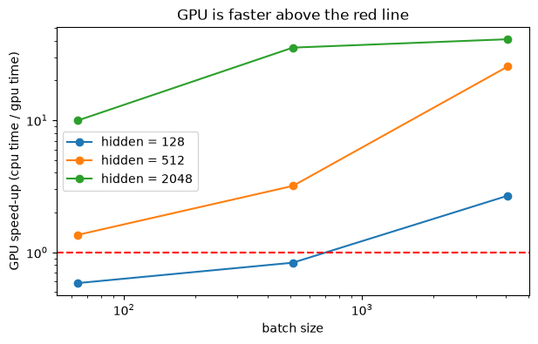
Results: CPU vs GPU (5,000-step runs)
Device | Seconds | Steps/s
CPU, 1 thread | 11.7 | 429
CPU, 4 threads | 11.8 | 424
GPU | 27.0 | 185
Operation (µs) | CPU | GPU
act | 144 | 722
sample + copy | 37 | 418
update | 2,785 | 5,152
• The GPU is 2.3× slower here: each step pays a CPU–GPU round trip and a copy, and the network is too small to repay them.
• It wins only for large models or batches (up to 41× at 2048 units, batch 4096).
CartPole: OG vs NN vs Nuclei | Experimental Results
25

Slide 26
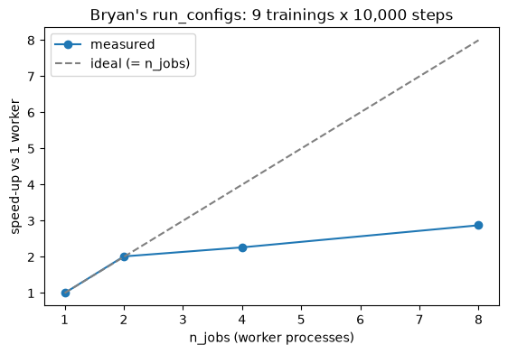
Results: Nuclei, more cores (Bryan's run_configs)
n_jobs | Seconds | Speed-up | Efficiency | Same curves?
1 | 61.5 | 1.00× | 100% | reference
2 | 30.5 | 2.01× | 101% | yes
4 | 27.1 | 2.26× | 57% | yes
8 | 21.4 | 2.88× | 36% | yes
• 6 trainings × 6,000 steps. His claim holds: curves are bit-for-bit identical at every n_jobs.
• Speed-up is capped by the workload (6 trainings, 4 physical cores) and by process start-up; more workers than physical cores add little.
CartPole: OG vs NN vs Nuclei | Experimental Results
26

Slide 27
Results: OG vs NN vs Nuclei (seeds 400–404, 50 fresh episodes)
Arm | Test by seed | Mean | Steps/run | 5 trainings, wall time
OG rule, K = 1 | deterministic | 500.0 | – | 0.4 s
OG DQN, 1 core | 141 / 161 / 130 / 112 / 148 | 138.2 | 30,000 | ≈ 226 s (estimate: 5 × 45 s)
Nuclei: OG DQN, 8 cores | identical networks | 138.2 | 30,000 | 72.9 s (measured)
NN, 1 core | 500 / 408 / 500 / 500 / 493 | 480.3 | 24,200 | ≈ 250 s (estimate: 5 × 50 s)
NN + Nuclei, 8 cores | identical networks | 480.3 | 24,200 | 84.3 s (measured)
• Quality: NN ≫ OG DQN (480.3 vs 138.2), but neither beats the rule (500.0 on these episodes).
• Nuclei changes cost, not quality: 3.1× (OG DQN) and 3.0× (NN) faster than the estimated 1-core time; weights bit-identical to sequential.
• NN costs 1.11× the time of the OG DQN on one core (50 s vs 45 s) for 3.5× the return.
CartPole: OG vs NN vs Nuclei | Experimental Results
27

Slide 28
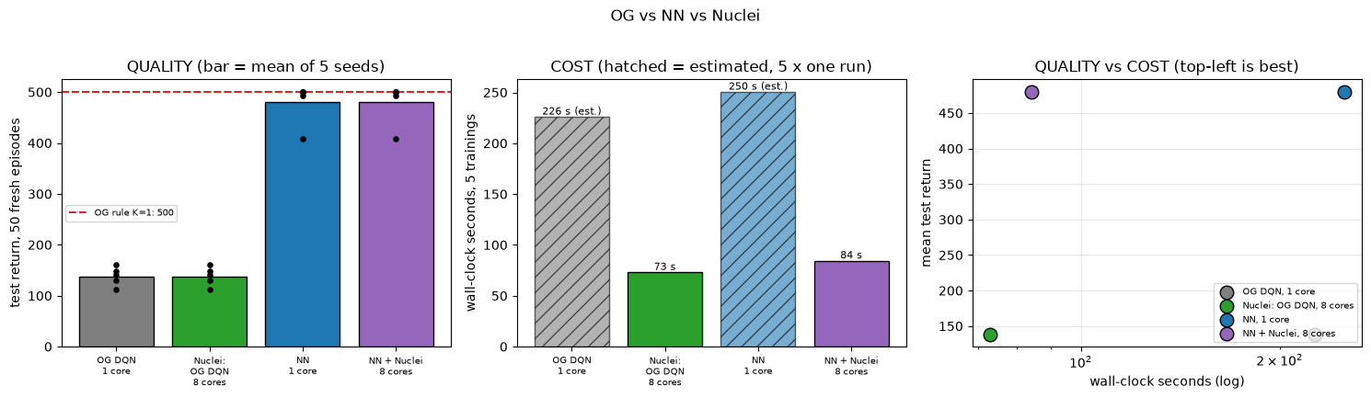
Figure: OG vs NN vs Nuclei
Left: quality. Middle: cost (hatched = estimated). Right: quality against cost, top-left is best.
CartPole: OG vs NN vs Nuclei | Experimental Results
28

Slide 29
Time tracked in every experiment
Experiment | What was timed | Time
N0 diagnosis | 3 trainings × 12,000 steps, in parallel | 33 s
N2 final run | 15 trainings × up to 30,000 steps, 8 in parallel | 267 s
N3 CPU vs GPU | 5,000-step runs, per-op, size sweep | 67 + 3 + 18 s
Nuclei scaling | 6 trainings × 6,000 steps at 1/2/4/8 workers | 141 s
Comparison | 4 batches of 30,000-step trainings | 268 s
Whole notebook | every executed code cell | 828 s (13.8 min)
Per-cell durations come from the notebook's own execution timestamps and are listed in the time ledger at its end.
CartPole: OG vs NN vs Nuclei | Experimental Results
29

Slide 30
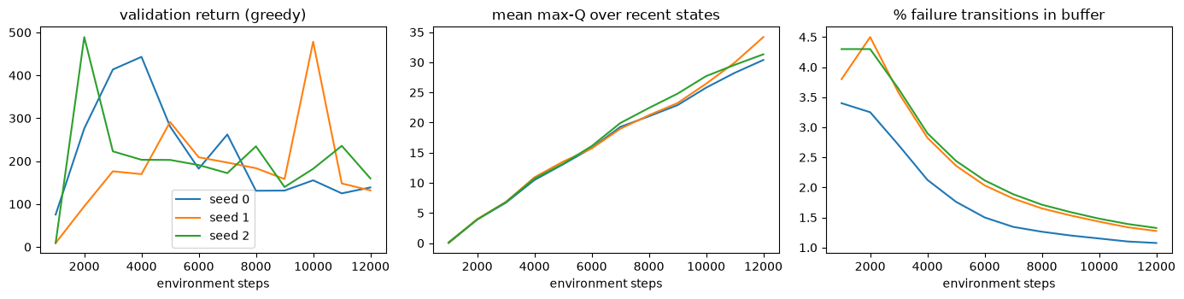
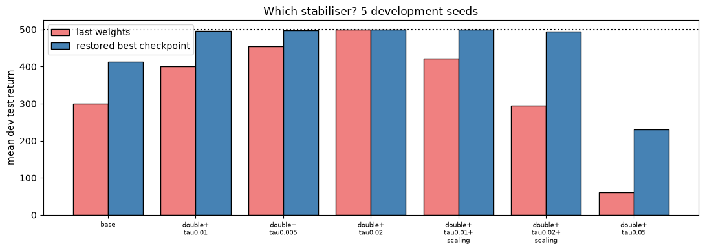
Figures: diagnosis and recipe selection
Left: N0, why plain DQN swings (validation return, mean max-Q, failure transitions in the buffer). Right: N1, choosing the recipe on development seeds.
CartPole: OG vs NN vs Nuclei | Experimental Results
30

Slide 31
Conclusion
• OG: two variables and a switching rule are enough (K ≤ 0.5 reaches 500); angle-only fails by pole, angular-velocity-only fails by cart.
• NN: a ReLU Q-network gets close to the rule (480.3 vs 491.7) only with stabilisers; the biggest single factor is restoring the best checkpoint; patience saves steps only with a grace period.
• CPU vs GPU: for this network the CPU wins (GPU 2.3× slower); the GPU pays off only for large models or batches.
• Nuclei: parallel runs give identical results; the speed-up is real but sub-linear.
• Main limitation: small samples (5 seeds), selection on seen seeds, trimmed timing runs.
• Future work: more seeds, a clean 1-core time for every arm, profile the update time, train with wide start noise.
CartPole: OG vs NN vs Nuclei | Conclusion and Resources
31

Slide 32
Ideas to improve the CartPole activity
• Fix OG: human-play text vs output; implement policy_mine and tune K; make Experiment A measure over episodes; make Experiment C a real ablation.
• Count failure modes (pole / cart / time) in evaluate_policy: it turns a number into an explanation.
• Separate tuning seeds from test seeds; report per seed, not only mean ± std (returns are capped at 500).
• NN: validate on greedy return; always restore the best weights; give patience a grace period; test the neighbours of a tuned setting (τ).
• Hardware: small networks on CPU; show the batch/width sweep so the GPU break-even is visible.
• Nuclei: size n_jobs to physical cores; keep seeding inside the worker; check identical results.
• Time: record it for every experiment (a ledger of every cell is in the notebook).
CartPole: OG vs NN vs Nuclei | Conclusion and Resources
32

Slide 33
Backup: likely questions
• Why does angle + K·angular velocity work? PD / sliding-mode: on s = 0 the angle decays as e^(−t/K); angle alone has no damping, velocity alone ignores tilt (the cart drifts).
• Why is patience on return, not loss? The loss keeps changing with the target scale while the greedy return swings between 100 and 500; the return is the goal.
• Patience or checkpoint restore, which helped? Restore: plain 148 → 367. Patience (with grace) then saved 19% of the steps at equal quality.
• Is the recipe proven better? Only weakly: +113 on 5 fresh seeds; the development gap was inflated by selection.
• Why is the GPU slower? The environment is on the CPU: each step pays a round trip and a copy; 17,410 parameters do too little work to repay it.
• Do more cores change results? No: identical curves at 1, 2, 4, 8 workers; only time changes.
CartPole: OG vs NN vs Nuclei | Conclusion and Resources
33

Slide 34
Resources
• Combined notebook: rl101-cartpole-OG-vs-NN-vs-Nuclei.ipynb
• Sources kept untouched: rl101-cartpole-basis-activity.ipynb, rl101-DQN_Replay_TargetNet_Bryan.ipynb
• Written analysis: CARTPOLE_PROJECT_STATUS_AND_IMPLEMENTATION_ANALYSIS.txt
• Reading: M. Hu, The Art of Reinforcement Learning, Apress 2023; Gymnasium CartPole-v1 documentation.
CartPole: OG vs NN vs Nuclei | Conclusion and Resources
34

Slide 35
Questions?

