Slide 1

RMAP Initiator Walkthrough
4Links Ltd

Slide 2
IP Core Features
Implements an RMAP Initiator to ECSS-E-ST-50-52C specification
Full RTL design (no software).
Integrates the 4Links SpaceWire CoDec.
Supports SpaceWire up to 200MBit (Xilinx Spartan-7).
AXI-Style User Interface.
Separate Header & Data Interfaces for Commands/Replies
Fully Open-Source Design (in VHDL).

Slide 3
Resource Usage
Xilinx Spartan 7 (@192 MHz) (CMOD-S7, XC7S25csga225-1)
FF – 835
LUT – 637
BRAM – 0.5
(Single-Ended IO)
** Note ** Critical path(s) are inside the SpW CoDec. This is being worked on.

Slide 4
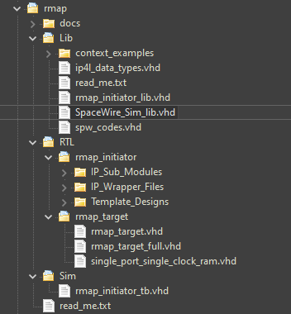
IP File Location
Import all files from /Lib apart from context_examples folder
Import all files from /RTL/… apart from Template_Designs, unless required
Import all files from /Sim
VHDL Rev should be set to VHDL 2008

Slide 5
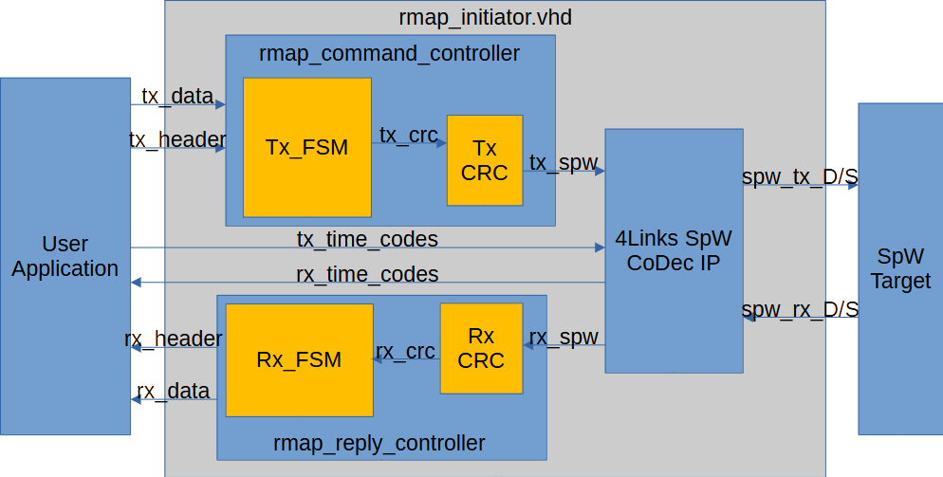
Core Architecture

Slide 6
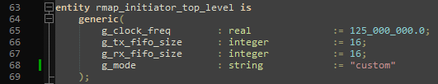
IP Core Configuration
Customisation through VHDL Generics
g_clock_freq
Frequency of base clock in Hz.
g_tx/rx_fifo_sze
Depth of Tx/Rx SpaceWire FIFO
g_mode
DDR input mode configuration. Use “custom” mode and insert DDR registers and desired
IO buffers outside of the IP Core
Use Diff/Single modes for behavioural simulation only.

Slide 7
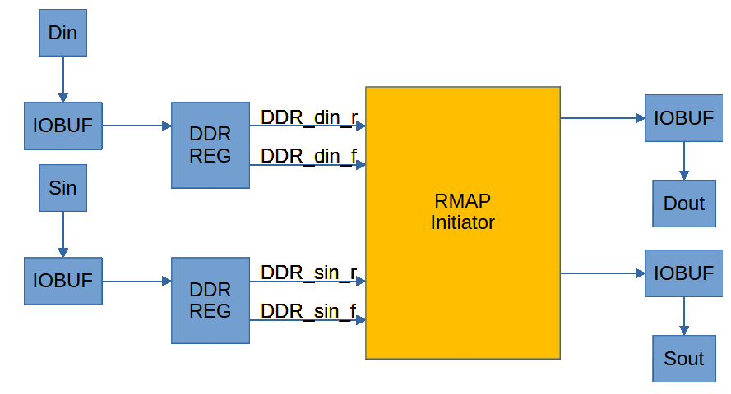
IP Core SpaceWire D/S Connection Scheme
DDR Registers / IO Buffers should be added by the user.
(use “custom” mode for g_mode generic)

Slide 8
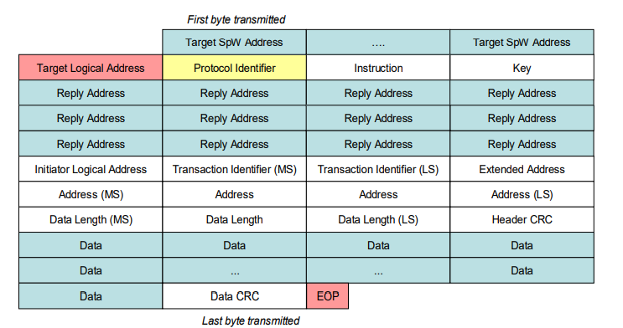
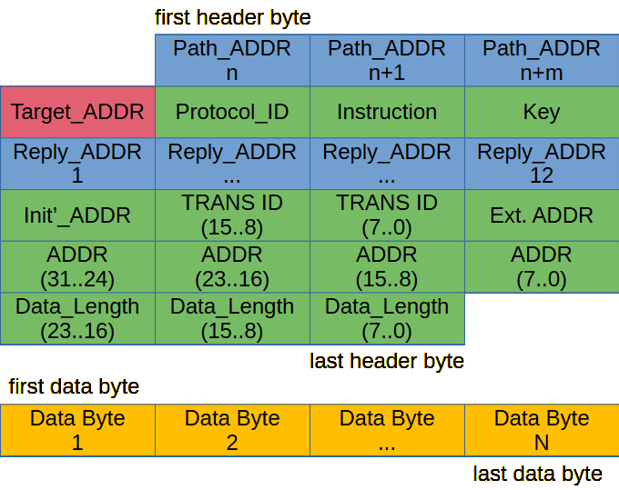
RMAP Command Format (Write to Target)
Standard RMAP Command Format
4Links RMAP Command Submission
IP automatically appends CRC(s) and EOPs when required

Slide 9
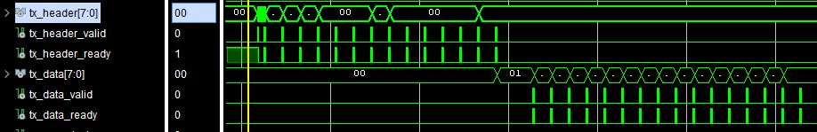
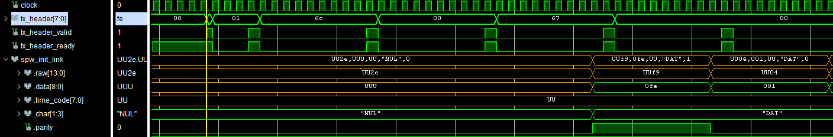
RMAP (Write) Command Submission
Header + Data Waveforms
Header Submission with SpaceWire Link Debugger

Slide 10
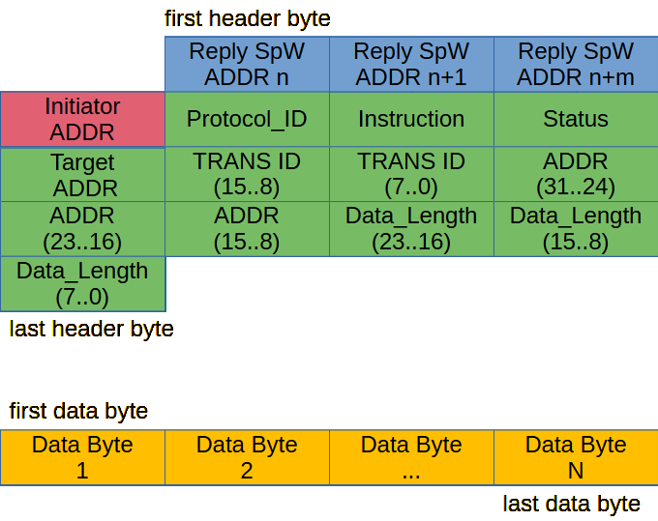
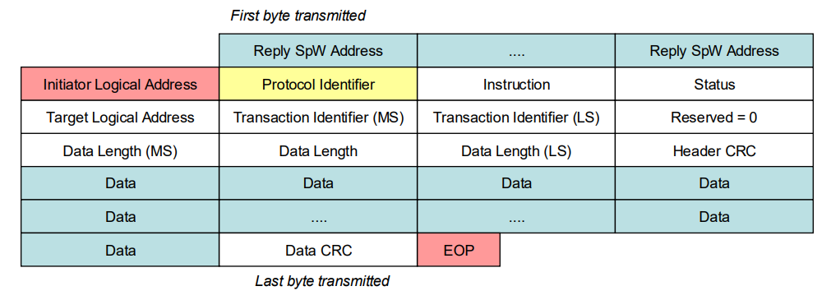
RMAP Reply Format (Read from Target)
CRC(s) & EOPs are not pushed to the user interface

Slide 11
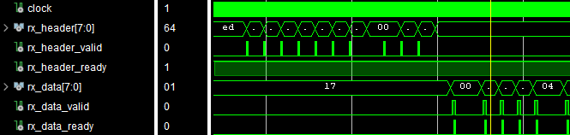
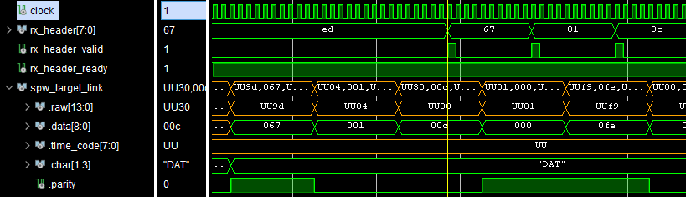
RMAP (Read) Reply Reception
Header + Data Waveforms
Header Reception with SpaceWire Link Debugger

Slide 12
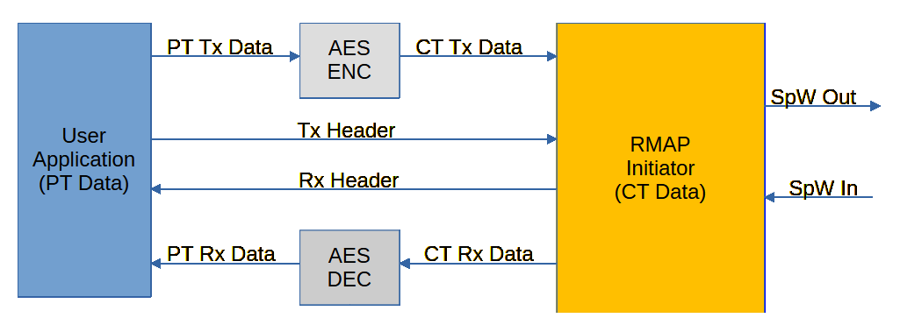
Application Note: Split Interface
Automatic Split of Data & Header in PT/CT Side Crypto Applications

Slide 13
RMAP Verification Packages
Design includes VHDL Package(s) to speed up design verification. This includes .
SpaceWire Link Debug Procedures
Protected-type RMAP Commands
IP Interface Handshake Procedures
Record-type IP interface Ports
See SpaceWire_Sim_lib.vhd & rmap_initiator_lib.vhd in /Lib

Slide 14

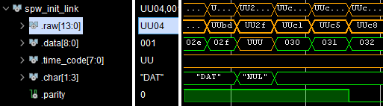
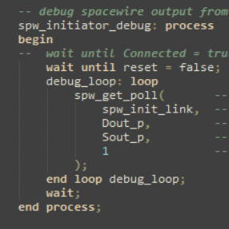
SpaceWire Debugging Procedure
Testbench Signals & Procedures
Simulator Waveform Signals

Slide 15
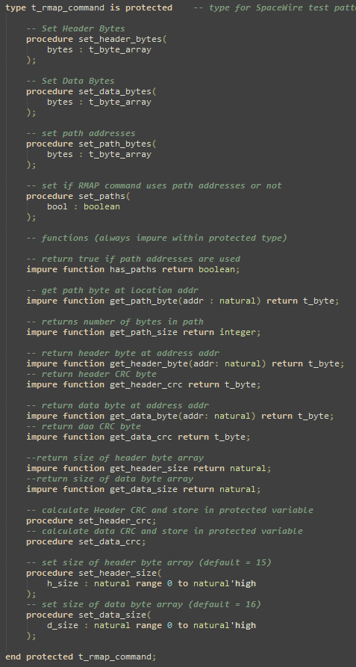
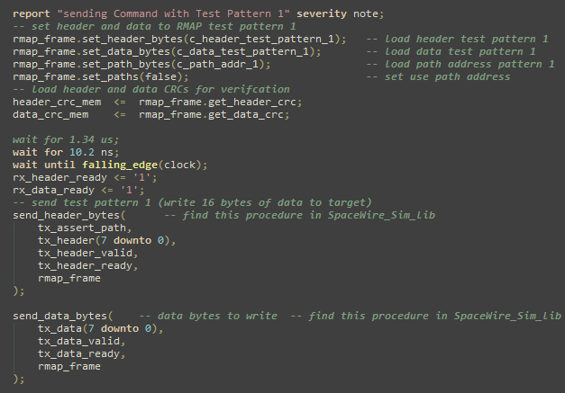
Protected Type RMAP Commands
Testbench Variables + Procedures
Find me on Line >450
of SpaceWire Sim Lib

Slide 16
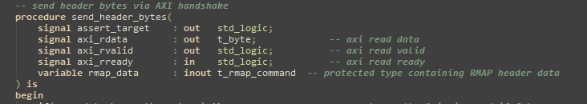
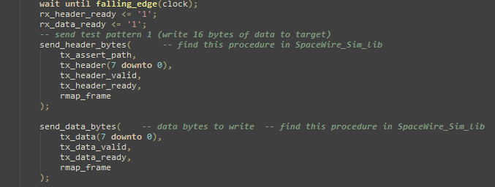

Handshake Testbench Procedures
Simplifies Ready/Valid Handshake for Testbench Stimuli
Procedures in Testbench
Find me on Line >1160 of SpaceWire Sim Lib

Slide 17
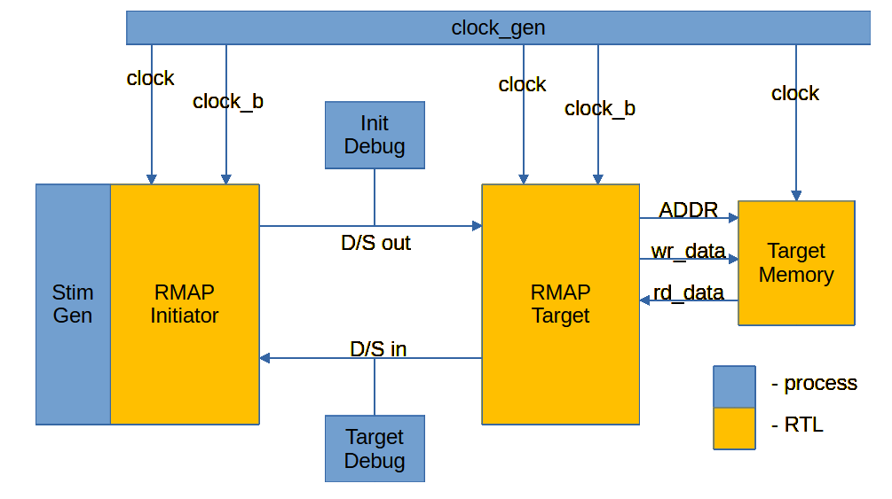
Testbench Example Design (Vivado)
4Links RMAP Initiator connected to the 4Links RMAP Target.
Initiator performs RMAP Write/Read commands. Results of Stimuli are checked and reported.
Creates a starting point for your own RMAP Designs & Testbenches

Slide 18
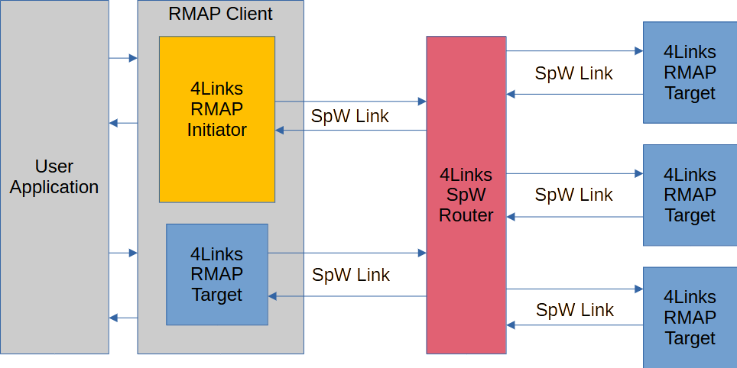
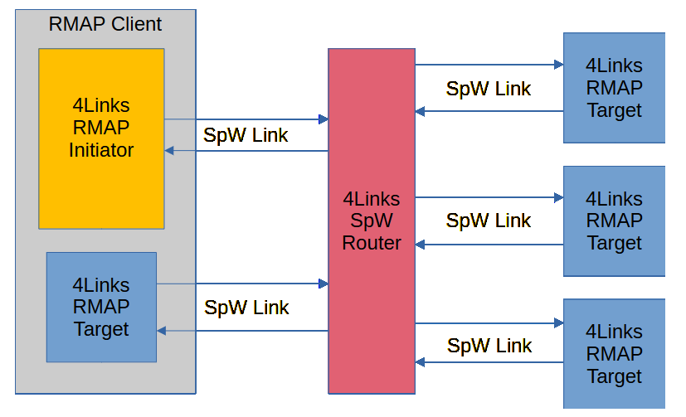
Application Note: RMAP Client
RMAP Client combines both Initiator and Target functions

