Slide 1

4Links Open-source Updates and RMAP Router Showcase
James E Logan
4Links Ltd

Slide 2
Slide Contents
Updates to VHDL Package management across our Opensource product range.
RMAP Router showcase
Introduction to SpaceWire Breakout Boards
RMAP Initiator: New Parallel Interface option at instantiation

Slide 3
Updates to Package Management
James E Logan
4Links Ltd

Slide 4
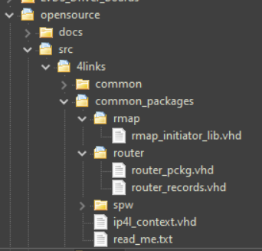
Common Packages & Contexts
~/4Links/common_packages
Library files required for IP instantiation
Each IP uses its own context clause.
Context clauses are contained in
~/4Links/common_packages/ip4l_context.vhd
Each package should be added to a VHDL library. The name of that Library is the sub-folder name in common_packages.
For example: router_pckg.vhd should be added to a VHDL library called “router”.

Slide 5
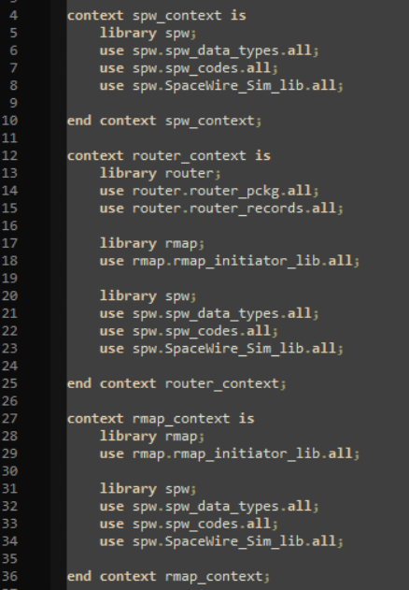
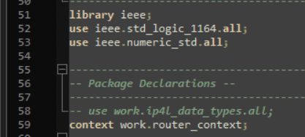
IP Context Declarations
The ip4l_context.vhd file should be kept in your “work” library.
Context are declared like packages and are a way of bundling multiple libraries and packages.

Slide 6
RMAP Router Showcase
James E Logan
4Links Ltd

Slide 7
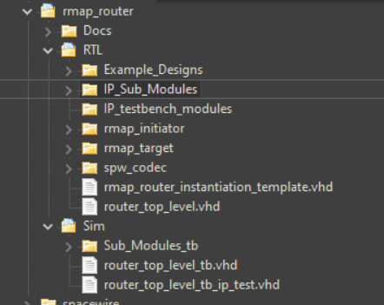
Router IP Files
~/4Links/rmap_router/RTL/IP_Sub_Modules
Contains the IP HDL files to be added to your project.
~/4Links/rmap_router/RTL/spw_codec
Contains a modified SpaceWire CoDec and Wrapper files. This codec has been optimized for running at high clock speeds by removing critical paths.
~/4Links/rmap_router/RTL/router_top_level.vhd
This is the top-level IP wrapper file. This wrapper knits together the RMAP router sub-modules into a single design which can be instantiated into your project.
~/4Links/rmap_router/RTL/rmap_target.vhd
Contains wrapper files for a custom rmap_target IP core used for Port 0 on the router.

Slide 8
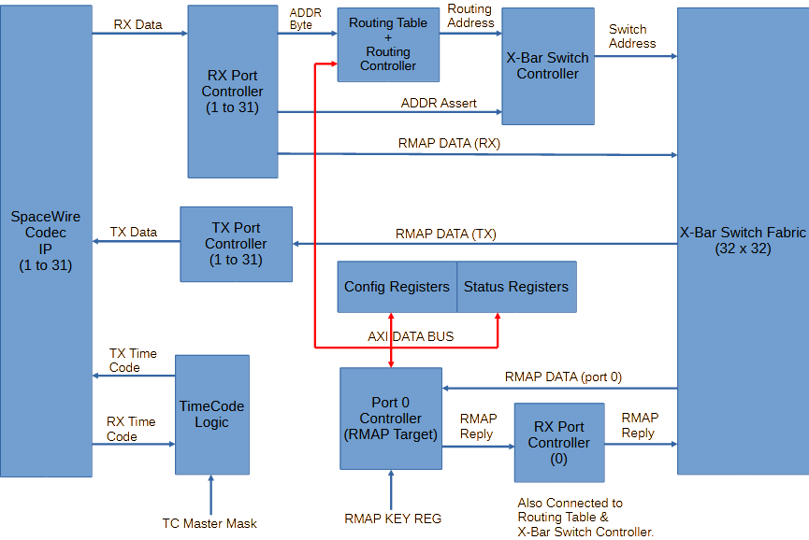
System Architecture
Port 0 (Virtual Port) is responsible for setting/reading configuration and status registers.
Port 0 Uses a Full RMAP target for processing Addressed bytes.

Slide 9
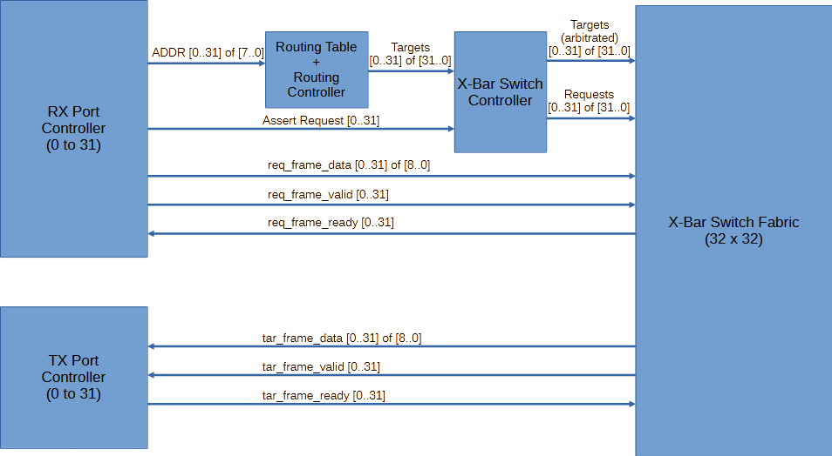
Rx - Tx Port Controller Configuration
Frame data moves from Rx Port Controller to Tx Port Controller through switching fabric.
1st RMAP byte is Target port address/logical address.
RMAP byte sent to Routing table to determine Target port address regardless of target or logical address format, Request line is asserted.
Routing table outputs target address(es) for requester port, submits to X-Bar switch controller.
Target port access arbitrated by X-Bar switch controller.
Once all target ports requested by the RX Port controller are assigned, “req_frame_ready” will be asserted.
Data is transferred across X-Bar fabric using AXI-Handshake.
Once RX Port has finished, it must de-assert the request line to release the assigned target ports.

Slide 10
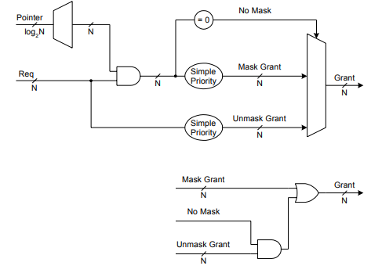
Routing Table: Input (Requester) Arbitration
Routing table is a shared resource.
Arbitration used to make access concurrently safe.
No Port priority, access is entirely fair to prevent starvation.
Fair Round-Robin Implemented.
Arbiters: Design Ideas & Coding Styles, Matt Weber,
Figure 12, Page 16.

Slide 11
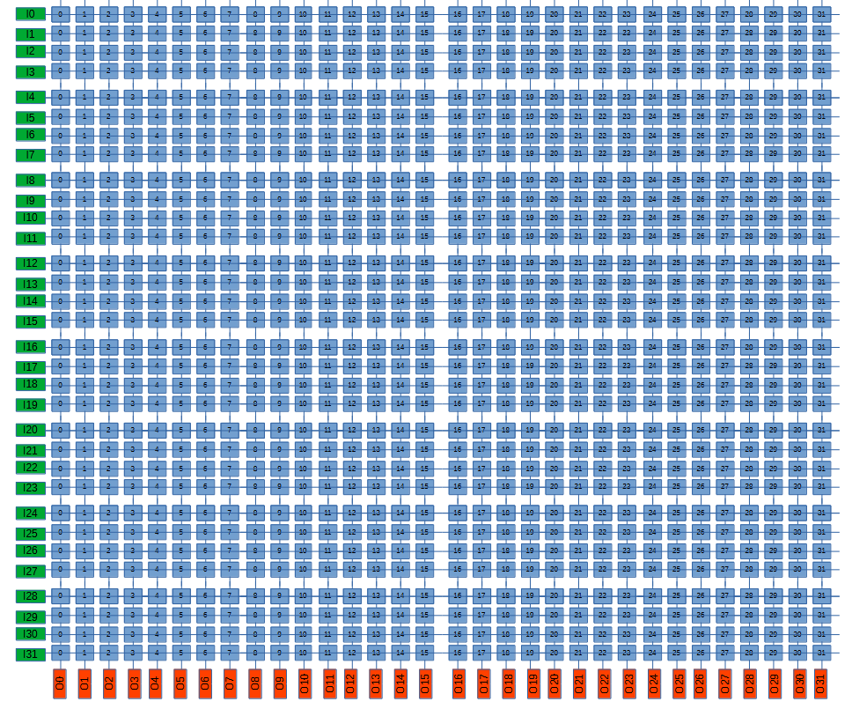
X-Bar Switch Fabric Architecture
The 32-Way X-Bar Switch can be viewed as a 32x32 matrix.
Each node on the matrix connects an input (requester) to an output (target).
Allows non-blocking access for non-conflicting requester/target pairs.
Requires output arbitration.

Slide 12
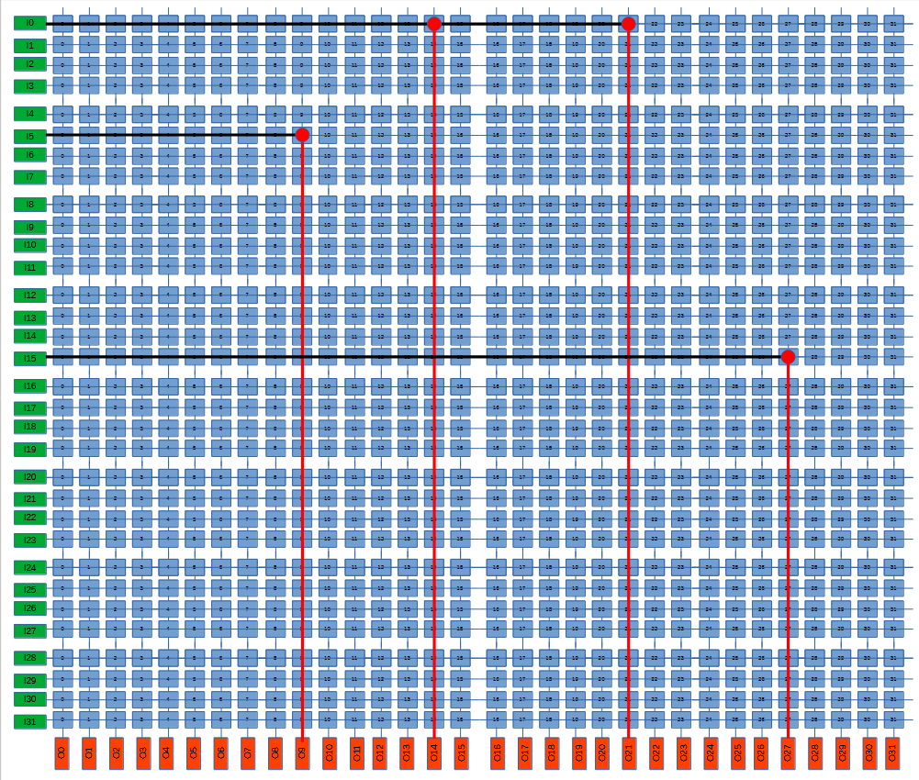
X-Bar Fabric: Addressing IO : Part 1
An NxN Array (where N = Number of Ports) contains IO mapping information.
For a given address, an input can access multiple outputs at once. However the reverse is not true.
Output access is dictated by an arbitration scheme.
Output addressing uses forced one-hot-encoding.
Inputs require a 1 to 32 Mux, outputs require a 32 to 1 Mux, where :
In(N) connects to Out(0-31)(N) and vice-versa.

Slide 13
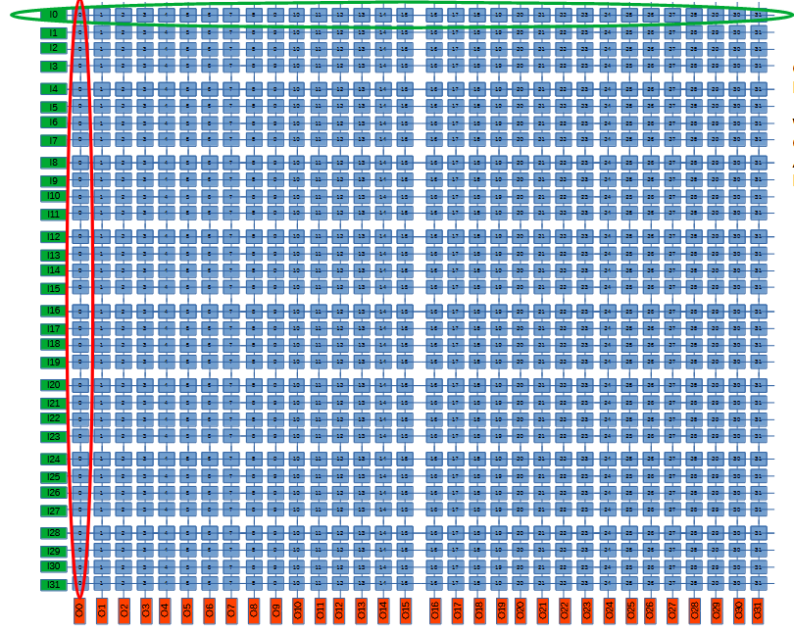
X-Bar Fabric: Addressing IO : Part 2
Note that Input Channel N uses a 32-bit array for addressing where multiple bits can be high.
Output Channel N is the same, however, only 1 bit can be high at a time.
Input port addressing can be expressed as an array of N x32Bits. Where each element(N) is the requester port number and each bit of each element is the target output port number.
Output port addressing can be viewed in a similar way except each element number is the target port and each bit of each element is the requester port.
A list of valid requesters per target can be attained from a list of targets per requester by rotating the arrays as seen in the figure to the right.
For implementation this can be achieved using two for-generate loops with address register routing.

Slide 14
X-Bar Fabric: Requester-Target Arbitration
Fair access round-robin arbitration scheme required for assigning targets to requesters
Request queue compared against granted queue.
If Request queue /= granted queue, no lock is acquired, pointer is shifted and next arbitration round is performed.
If a Request queue == granted queue, lock is acquired and target ports are “locked” until the outstanding request is de-asserted. Pointer is shifted and the next arbitration round is performed BEFORE ports are unlocked.
In Multicast, all targets must be acquired and freed simultaneously.
Releasing target ports is driven entirely by the requester port once a lock has been established.
Each arbitration “pass” takes 12 clock cycles.
Arbiters: Design Ideas & Coding Styles, Matt Weber,
Figure 12, Page 16.

Slide 15
Configuration Port (Port 0)
The Configuration port is an Internal Port with no physical connections.
The Configuration port controller uses a modified RMAP Target to implement RMAP based configuration of the router.
Any port on the router can access the configuration port by requesting port address 0.
RMAP Target implementation contains full Tx/Rx CRC calculation and checking.

Slide 16
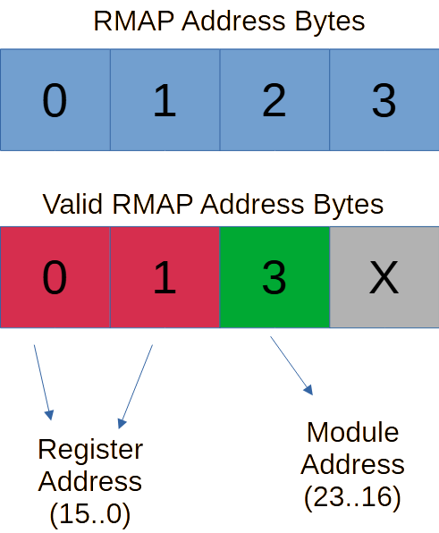
Configuration Port: Addressing
AXI-Lite style bus is used for moving data bytes.
Extended address field is unused.
Uses 3 byte address field. Bits 23-0 of 31-0 in RMAP address field.
Bits (15 downto 0) = Register Address
Bits (23 downto 16) = Module Address
Module address can be configured via constants and is set at design synthesis.

Slide 17

System Status/Config Registers
These registers are accessed separately from the routing table.
The module address list can be found (and modified) in router_pckg.vhd.
Each module contains 256 registers, organized into a 32x8 format.

Slide 18
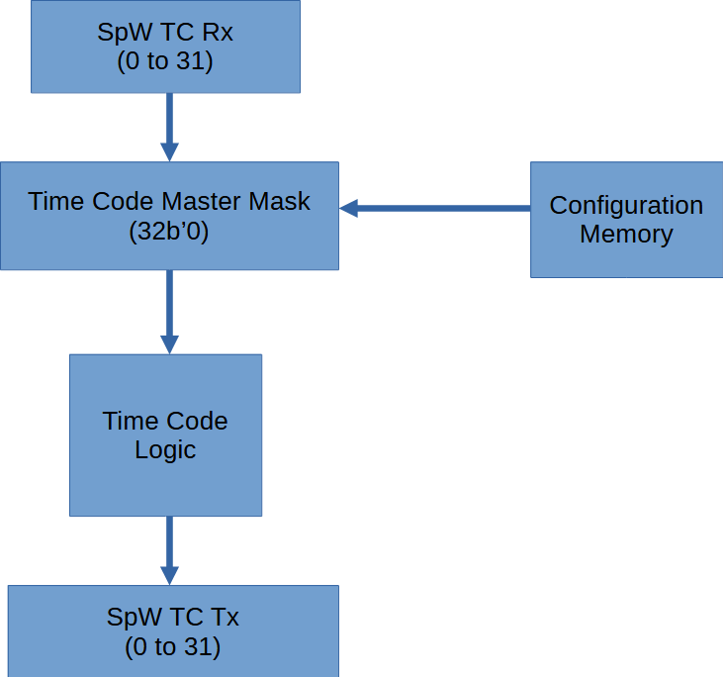
Time Code Register Behaviour
Set Timecode Master in Configuration Memory.
Received Time Codes will be checked using Modulo64 arithmetic.
New (valid) codes will be broadcast to all (enabled) ports on the network.
ECSS-E-ST-50-12C Page 85 Onwards

Slide 19
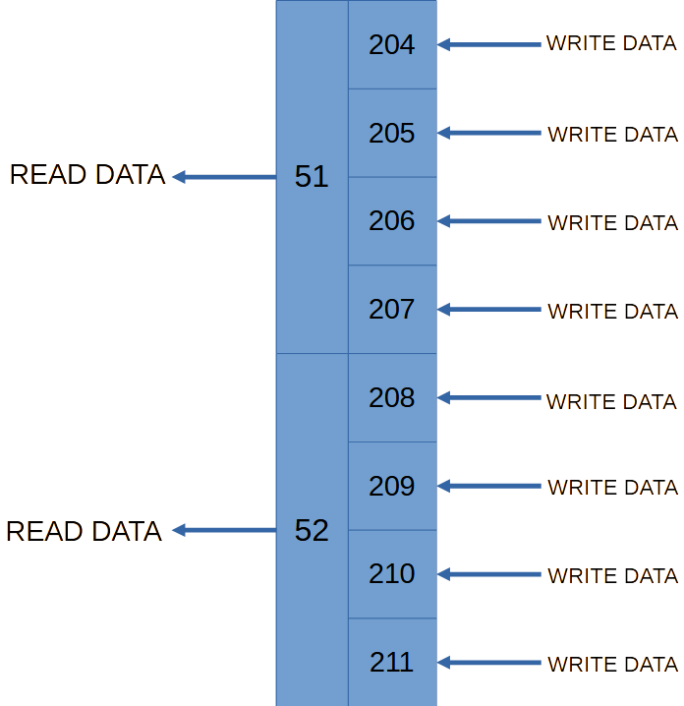
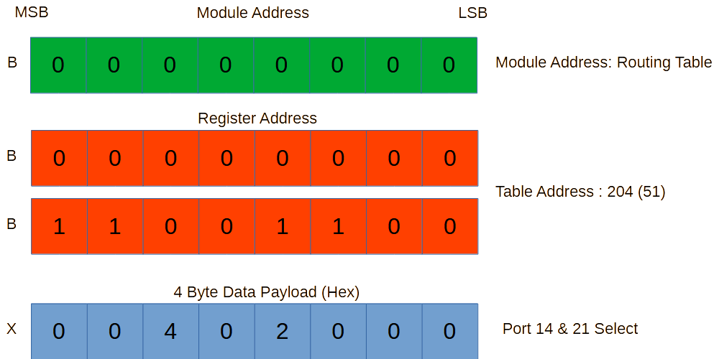
Modifying Routing Table with RMAP (Port 0)
Each routing table entry (0 to 255) requires 4 bytes of data
Mapping each element to a 1-byte write interface gives a memory map of 1024x8bits.
Take desired routing table address and multiply by 4 to get the address pointer (header).
E.g. the routing table entry 51 corresponds to the RMAP RD/WR address 204 to 207. Entry 52 is 208 – 211 etc.

Slide 20
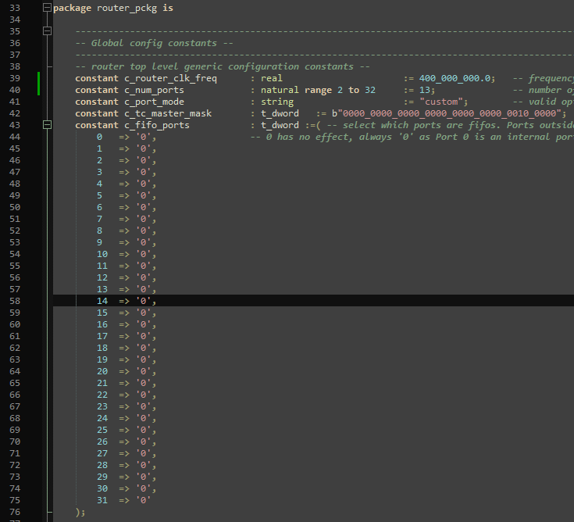
Router Configuration through package
Router configured through router_pckg.vhd.
Constant c_num_ports used to set the number of ports on top level. Where c_num_ports is the number of physical ports + 1.

Slide 21
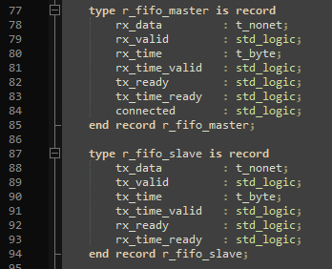
FIFO Port Generation
32-bit DWORD used to configure Port CoDec Configuration.
Generic : g_is_fifo.
Generic configured using a constant found in router_pckg.vhd.
Set ‘1’ to generate a fifo port, leave ‘0’ to generate a SpW CoDec

Slide 22
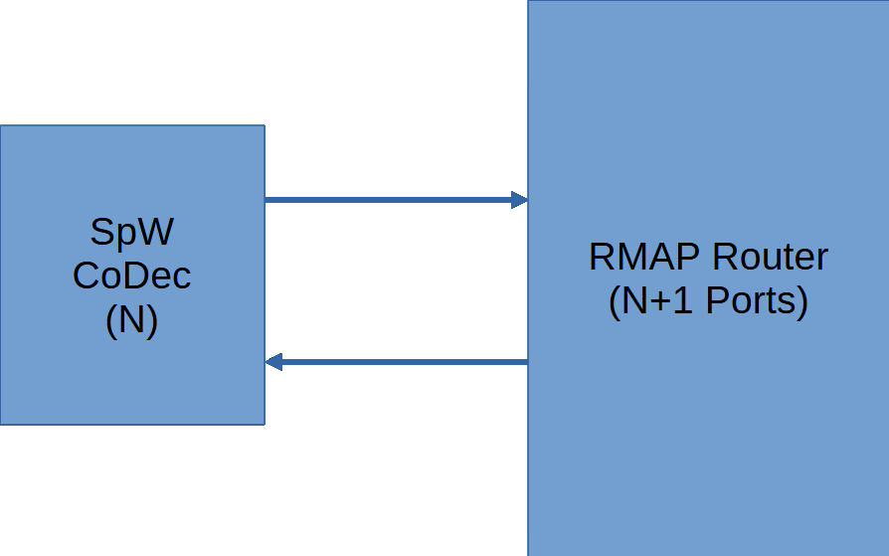
Simulation: Conventional Testbench
No Initiators/Targets, only SpaceWire CoDecs
Traffic generated for each port. Multiple concurrent transactions for both single and multicast requests.
Designed to stress-test the Routing logic and benchmark “worst-case” scenarios.

Slide 23
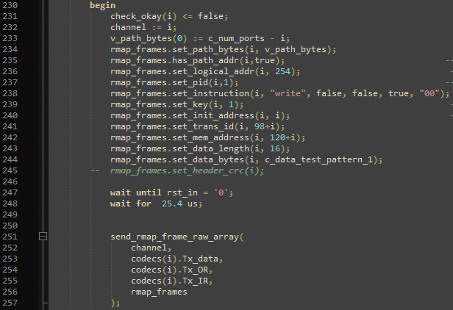
RMAP Command Building in Testbench
Protected type for RMAP commands.
One protected type functions as an array, the other for single channel.
VHDL 2008 does not allow for protected types to be initialized as arrays.

Slide 24
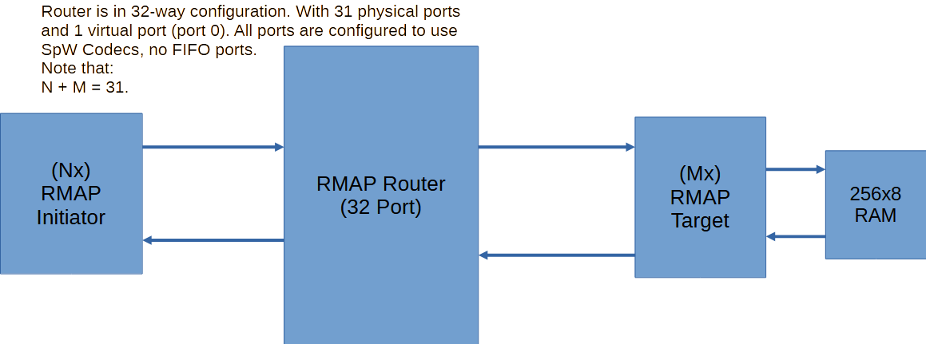
Simulation: IP Test Bench
RMAP Initiator(s) connected to RMAP Target(s) through the RMAP Router.
Each RMAP Target Data interface is connected to a 256x8Bit RAM Module.
Target/Initiator generation controller through Testbench Constant.
Initiator/Target interfaces accessed using record array signals.

Slide 25
Simulation: Functional Coverage
Any verification environment must stress the following parameters:
Initiator to target routing access.
Simultaneous Routing-Table Requests.
Concurrent Switch Fabric Access.
Multi-Cast Initiator to target access.
Configure Routing-table address
Read Routing Table address list
Read port status register.
Write port config register.
Time Code Reception & Broadcast
Unexpected EOP/EEP Recovery.

Slide 26
Simulation: Points of Interest
The X-Bar Switch fabric and routing table arbitration are key areas of interest in verification.
Failure to correctly route data is to be avoided at all costs. Failures here may lead to system lock-ups which are unacceptable.
The overall system performance greatly depends on the switching fabric and shared resource arbitration. Improper implementation will severely hinder the router performance.
Large combinatorial paths within the switching fabric have been broken up with register implementation. Increasing latency but allowing for higher operating frequency.

Slide 27
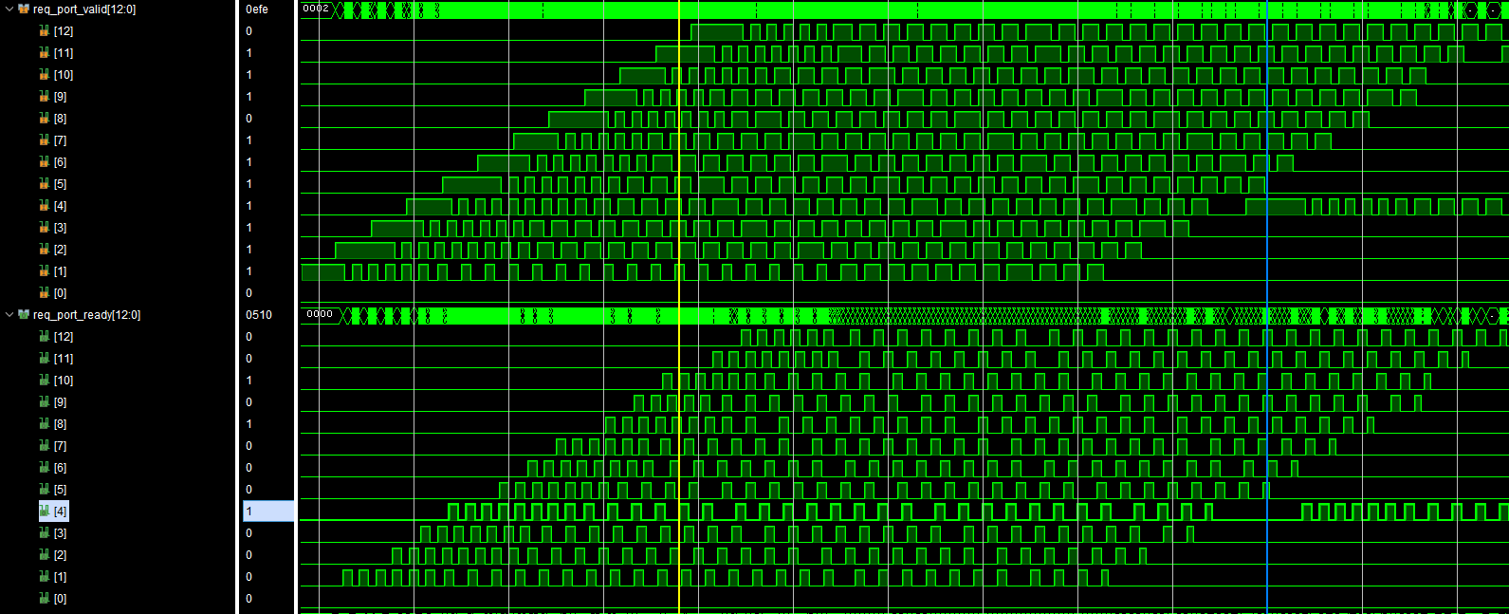
Requester-Target Handshake

Slide 28
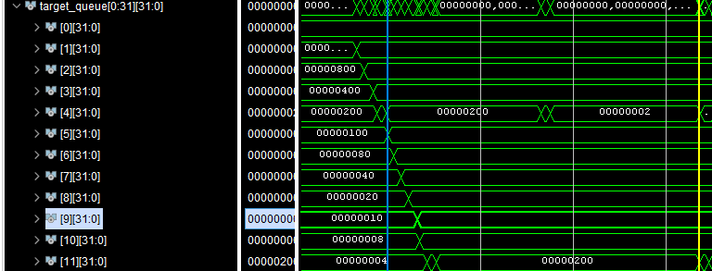
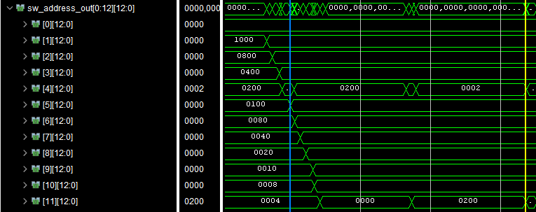
X-Bar Controller: Address Arbitration

Slide 29
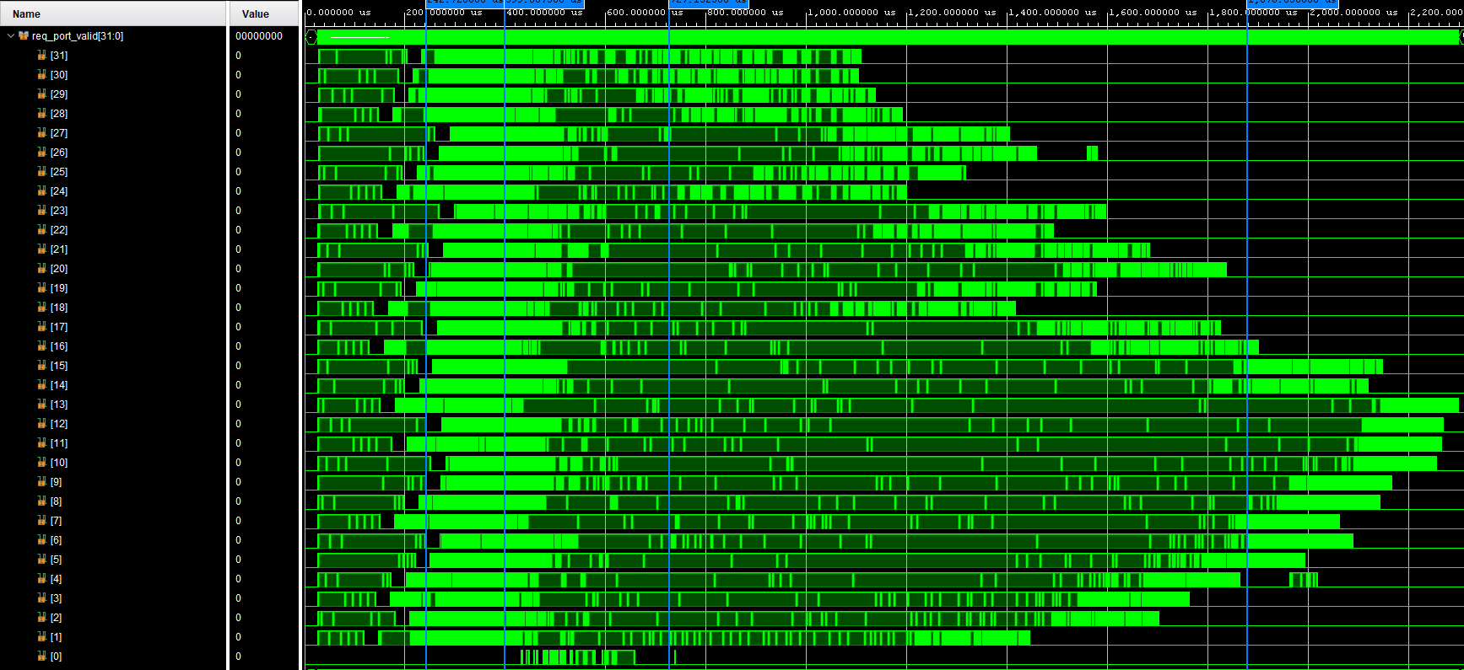
32-Port Router: req_port_valid TB Waveform

Slide 30
Modified Router CoDec
The RMAP Router uses a Customized version of 4Links Open-Source SpaceWire CoDec IP.
Uses full-synchronous Resets
Pipelined RX FCT timing logic
Adjusted Critical Paths
This allowed for 400MHz + Operation on Xilinx UltraScale Devices in a 12+1 port configuration.

Slide 31
Custom RMAP Target (Port 0 Controller)
A modified RMAP Target IP core is used for the Port 0 Controller.
Optimized state transitions on IO byte signal value
Removed “eslif” critical-path chains
Pipelined & optimized In-CRC Calculation logic
Reached 400MHz operation on a Xilinx Kintex UltraScale Device with a 12+1 port configuration. Includes full pin IO constraints.

Slide 32
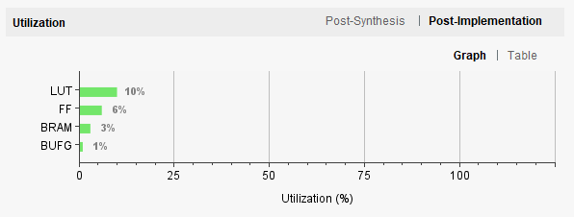
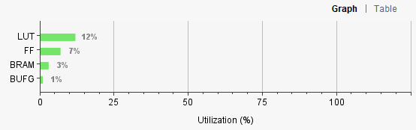
Resource Usage (Xilinx Kintex US+) (31+1)
Synthesis (Medium Area)
LUT-23004, FF-27982, BRAM-18
Implementation (Medium Area)
LUT-21877, FF -27983, BRAM-18
Synthesis (Max Performance)
LUT-27498, FF-32062, BRAM-18
Implementation (Max Performance)
LUT-26885, FF-32063, BRAM-18

Slide 33
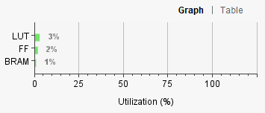
Xilinx XCKU040 Resource Usage
12 Ports (11 + 1), 400MHz Line Rate
Synthesis (Medium Area)
LUT-6604, FF-9840, BRAM-7
Implementation (Medium Area)
LUT-6367, FF-9865, BRAM-7
Synthesis (Max Performance)
LUT-8726, FF-10294, BRAM-7
Implementation (Max Performance)
LUT-7993, FF-10316, BRAM-7

Slide 34
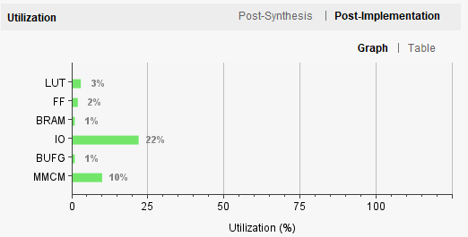
Xilinx XCKU040 Resource Usage
13 Ports (12 + 1), 400MHz Line Rate
Synthesis (Medium Area)
LUT-6298, FF-9873, BRAM-7.5
Implementation (Medium Area)
LUT-6316, FF-10389, BRAM-7.5
Synthesis (Max Performance)
LUT-8464, FF-10389, BRAM-7.5
Implementation (Max Performance)
LUT-7999, FF-10419, BRAM-7.5

Slide 35
Extended Design notes
Several optional, but desirable, features are omitted from the router IP. These features include:
Advance Port Statistics Registers
RMAP Interrupt Register(s)
Independent Port-Clocking/Pre-Scalars
All of these features can be added through modification of the existing router IP. The complexity of adding these features will greatly depend on your exact application and requirements.
As we continue to develop our IP these features may be added but 4Links cannot guarantee any outcomes or timescales. Please contact us for any custom requests and we will be happy to help.

