Slide 1

RMAP Router Showcase

Slide 2
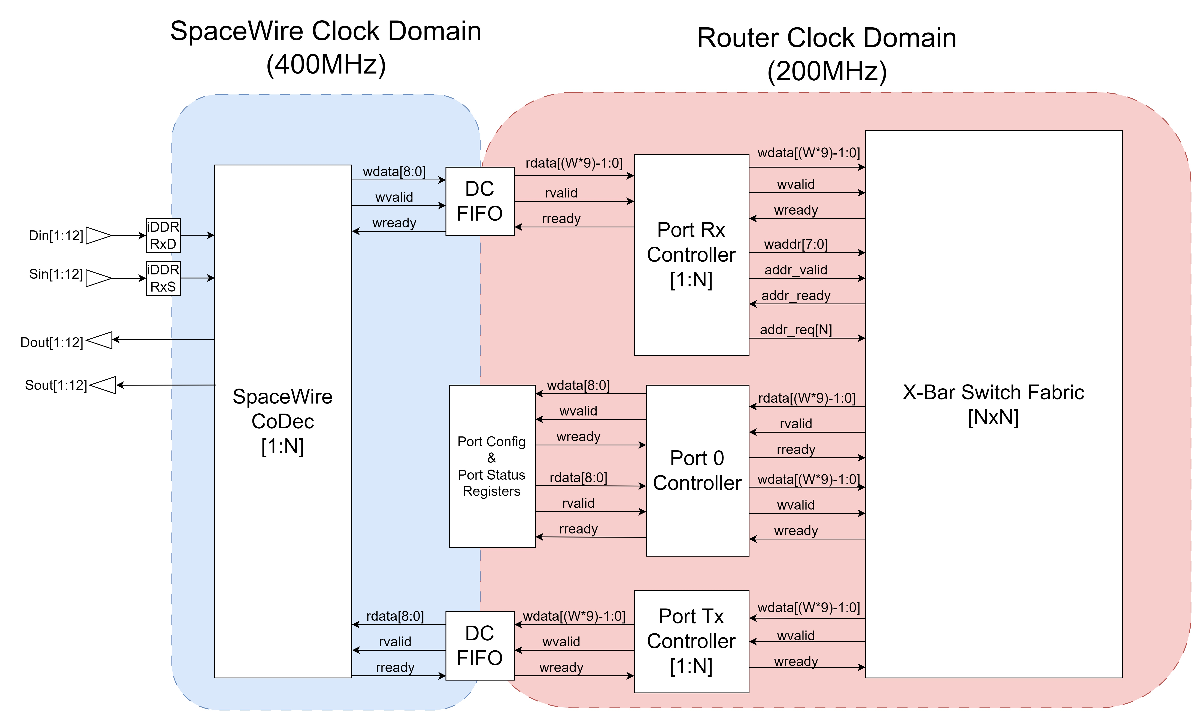
Router Top-Level Architecture

Slide 3
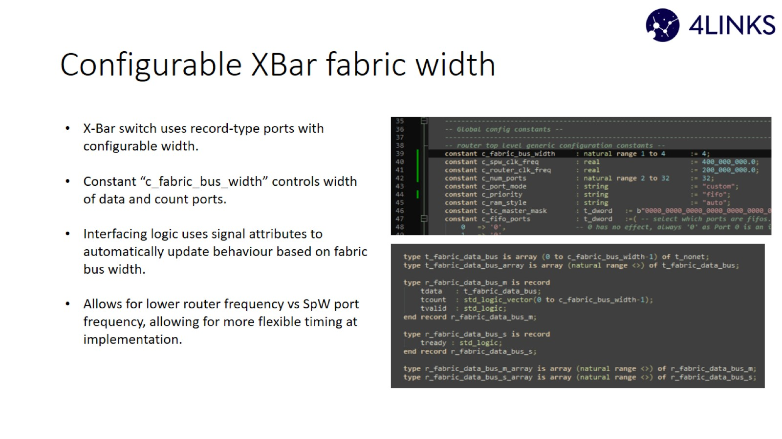
Configurable XBar fabric width

Slide 4
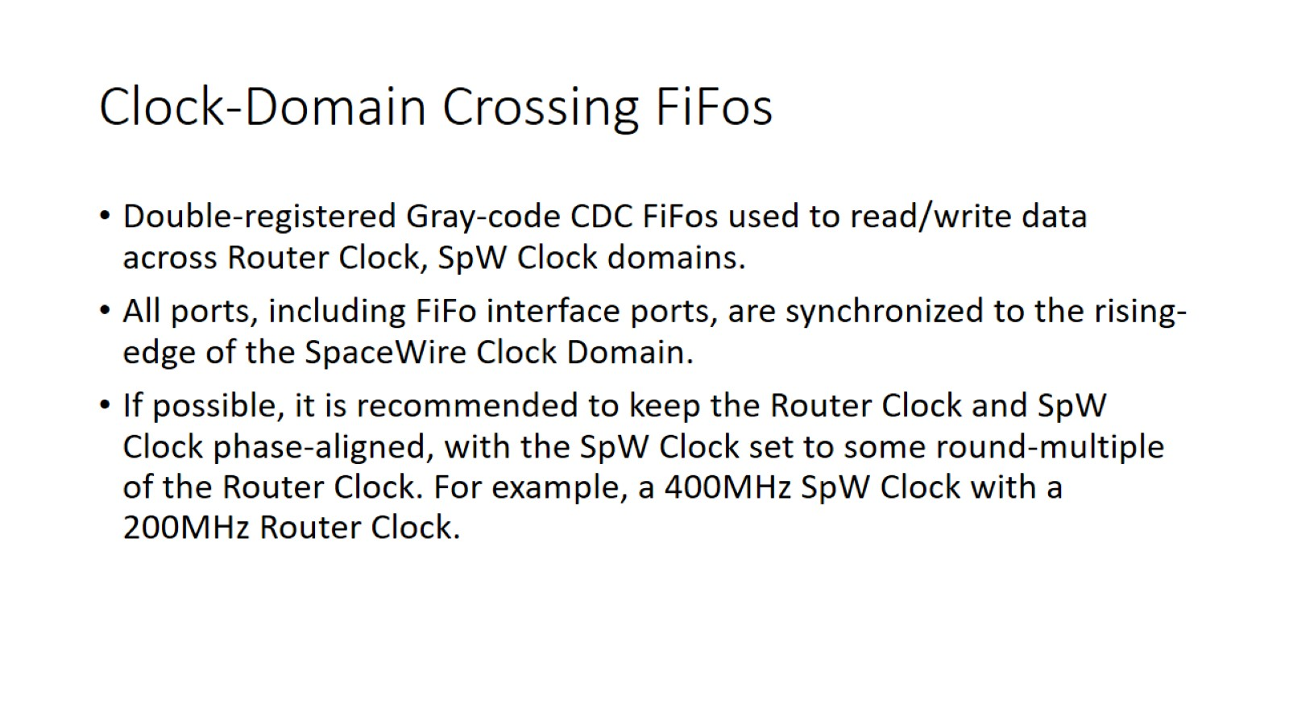

Clock-Domain Crossing FiFos

Slide 5
Round-Robin vs FiFo Port Request Arbitration
Fair round-robin still used for Routing-table access.
X-bar fabric controller can uses either FiFo or Round-Robin arbitration schemes.
FiFo-Scheme prioritizes older outstanding requests for output arbitration without blocking new requests.
Older requests receive priority arbitration access without blocking new requests from being assigned.

Slide 6
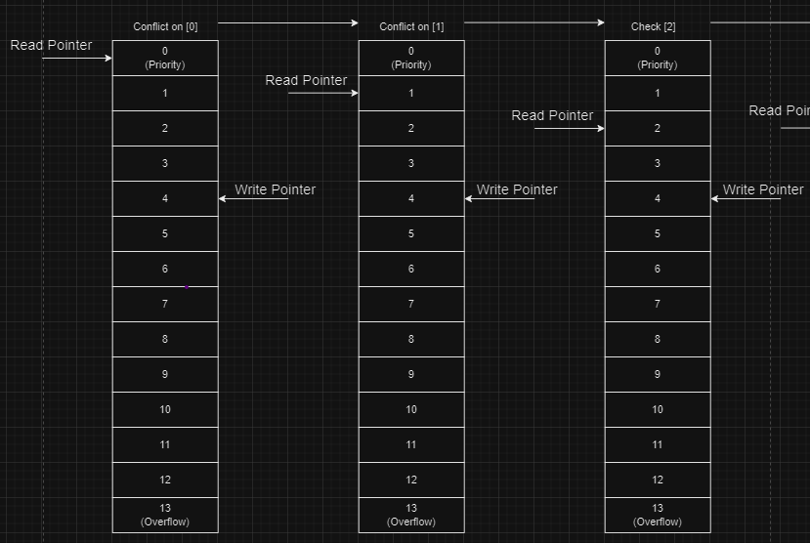
FiFo Arbitration Queue (1)
A single queue is used to submit requests, this example if for a 13-port router.
Queue size is N+1 where N is the total number of ports on the router.
Read pointer starts from 0th element (priority pointer) and attempts to assign output ports.
If no value can be assigned and the next queue element contains a valid request, then the next queue element is checked.

Slide 7
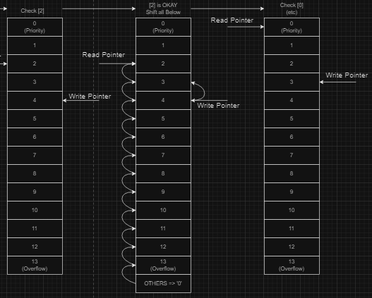
FiFo Arbitration Queue (2)
If the current read-pointer request is valid and can be assigned, then the request is pushed to the active request queue.
All queue elements below are moved up one space and the active queue element is removed from the queue.
The write pointer is also moved up one space.
Read-pointer goes back to 0th element and cycle repeats.

Slide 8
FiFo Arbitration Queue (3) (notes)
A request assignment conflict is determined by two factors.
Does the request targets conflict with the active target queue ?
Does the request targets conflict with the 0th queue element targets ?
If either of these statements are true, then the request cannot be assigned and the read-pointer is incremented.
The read-pointer wraps around to the 0th queue elements if all requests are checked and cannot be assigned.
The write pointer determines the queue element at which the next submitted request will be written to. The controller implements an FSM to make sure that writing into the queue is safe and cannot happen during a queue-shift operation.

Slide 9
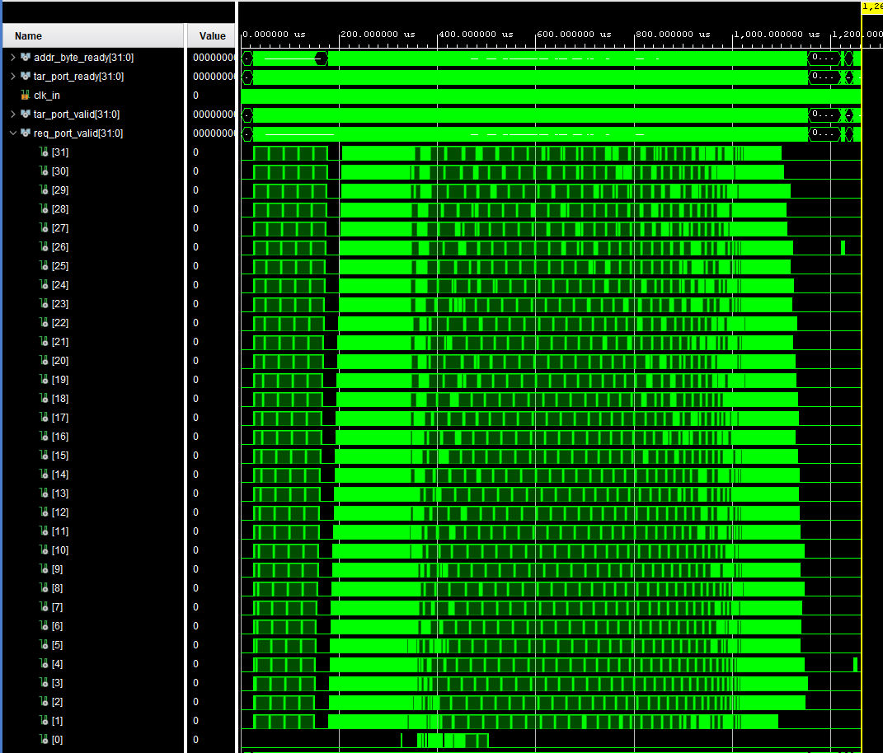
FiFo Arbitration Waveform (32 Ports)
Request-Target latency is more consistent
Stimuli for each port is normalized during conflict resolution.
All ports complete stimuli around 1100us.
Unlike RR there are no winners and losers. Where Winner ports complete ~450 us and around 1650 us.
Next slide contains the waveform view for the same router stimuli using RR arbitration

Slide 10
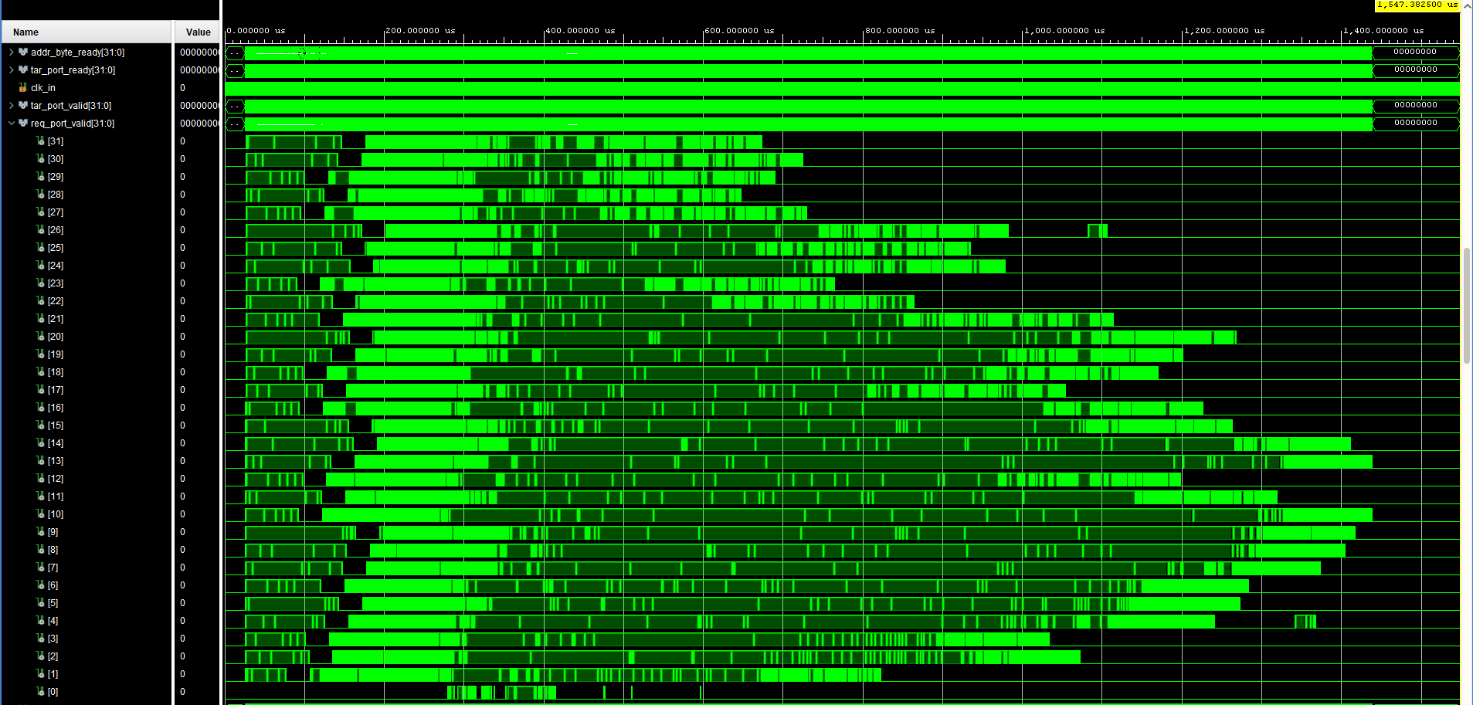
Round-Robin Arbitration Waveform (32 Ports)

