Slide 1
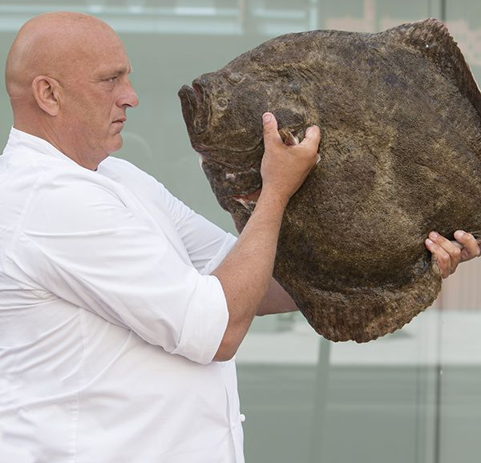
Inter-benchmark turbot North Sea
2018

Slide 2
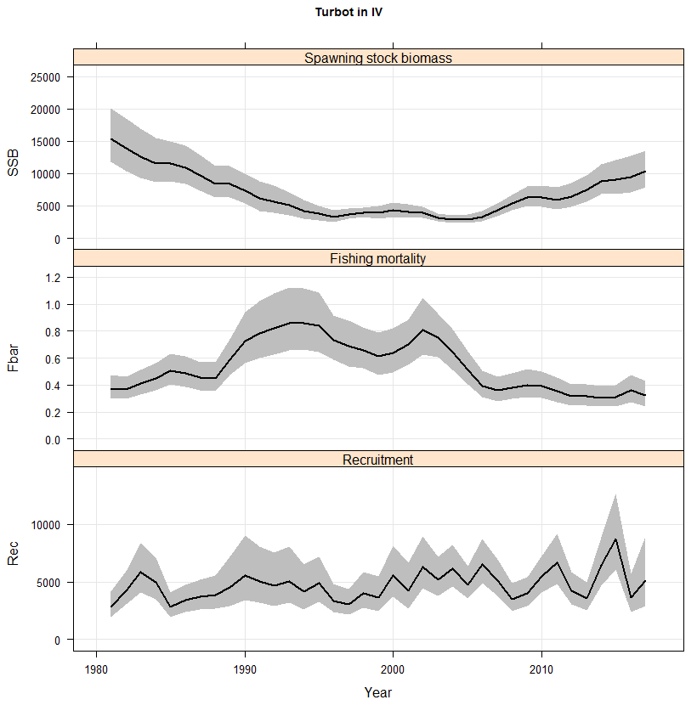
Why an Inter-benchmark 2018?
IBP 2017
WGNSSK 2018

Slide 3
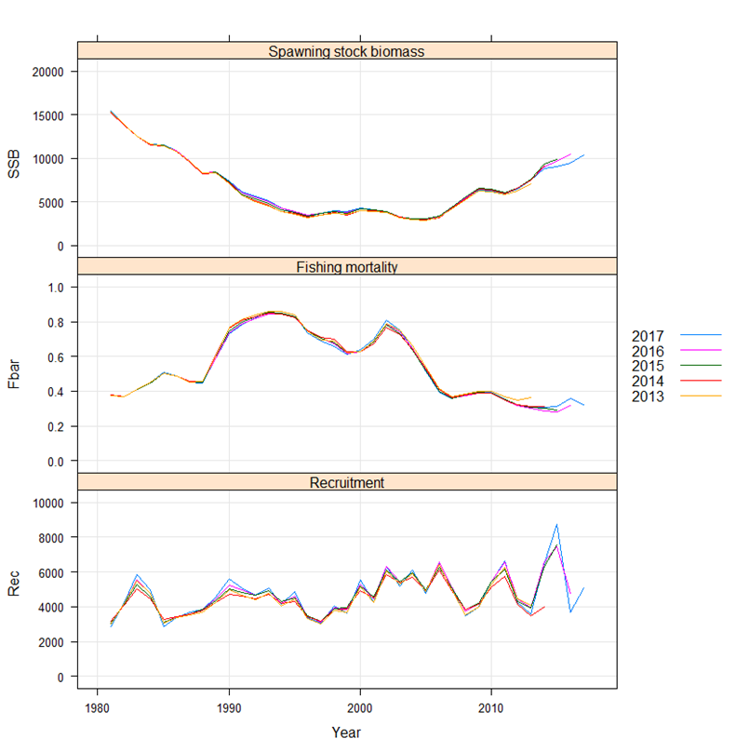
Why an Inter-benchmark 2018?
IBP 2017
WGNSSK 2018

Slide 4
What needs to be addressed:
Correct the mistake in the IBP2017 settings (using the NL LPUE series as an indicator of exploitable biomass rather than as an indicator of SSB)
Check the plus-group of the catch and survey data
Re-evaluate parameter bindings in the assessment configuration
Estimate reference points for either category I (using EQsim) or category III (using Spict)
Provide a short-term forecast

Slide 5
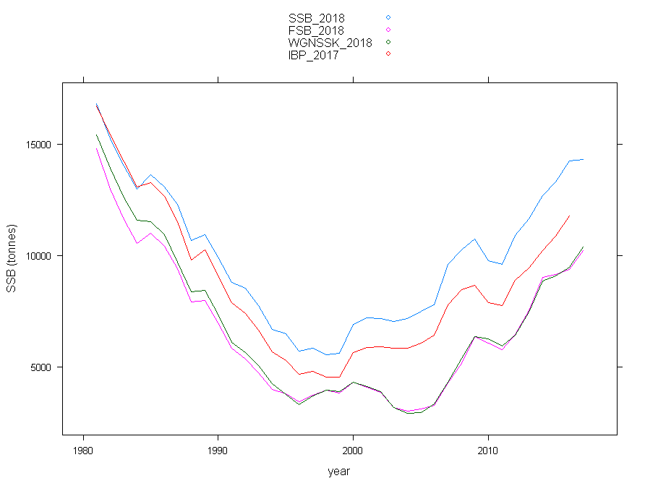
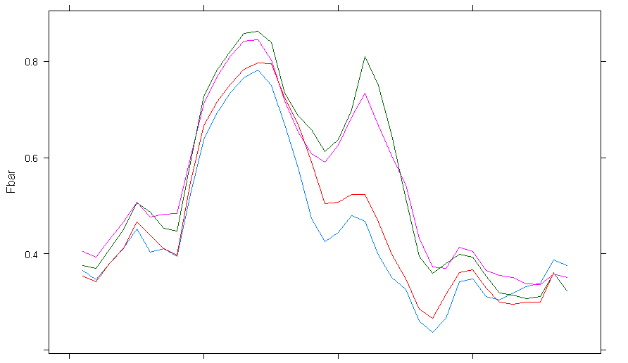
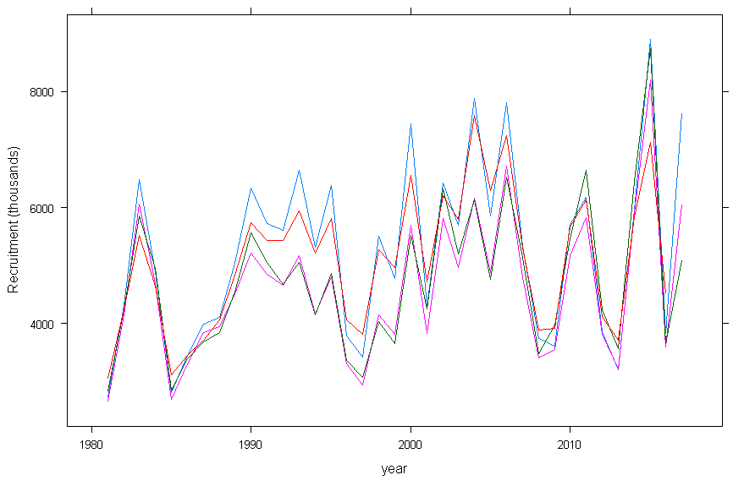
Biomass survey treatment.
IBP 2017 run:
Biomass treatment set to SSB
2016 data.
parameter config set to final IBP 2017 run.
SSB 2018:
Biomass treatment set to SSB
2017 data
parameter config set to base run IBP 2017.
FSB 2018:
Biomass treatment set to Exploitable biomass
2017 data
parameter config set to base run IBP 2017.
WGNSSK 2018:
Biomass treatment set to Exploitable biomass
2017 data
parameter config set to final IBP 2017 run.
SSB run using final parameter config

Slide 6
IBP 2018 – starting from scratch
Start assessment 1981
Surveys: SNS (2004), BTS-ISIS (1991) and NL LPUE
Plus-group of the catch 10+
Max age in surveys:
SNS = 6
BTS = 7
5. Parameter bindings reset to base run IBP 2017

Slide 7
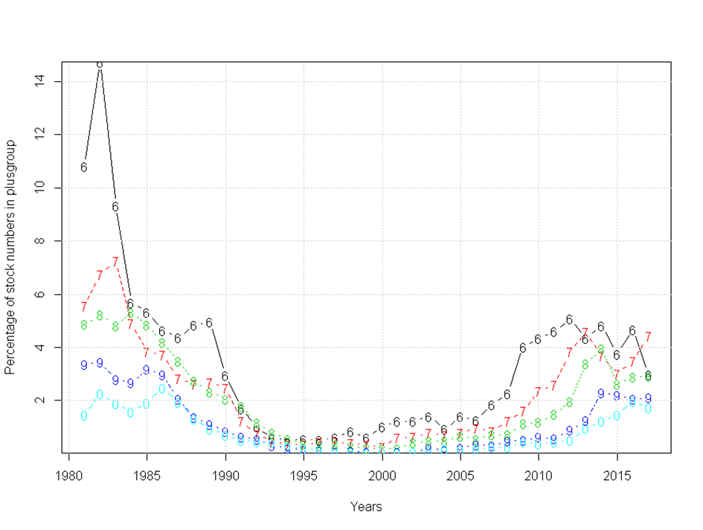
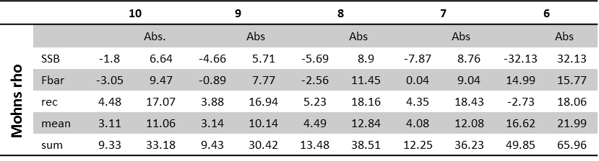
IBP 2018 – Plus group catch-at-age

Slide 8
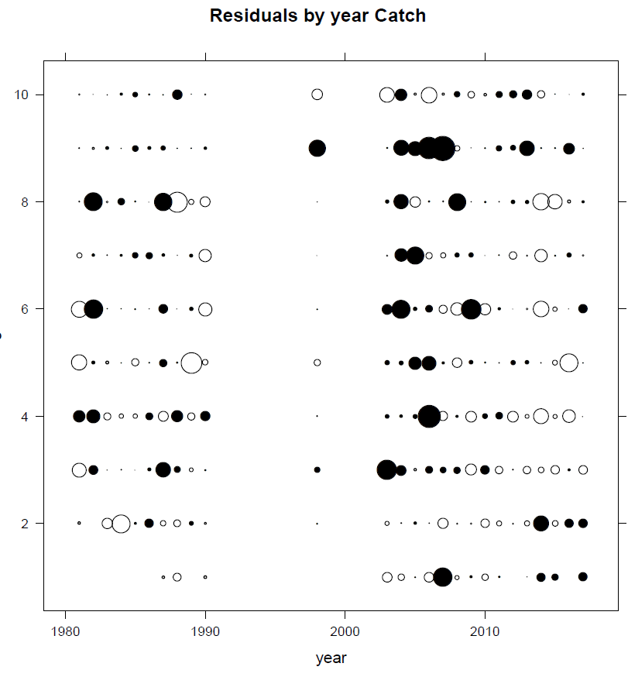
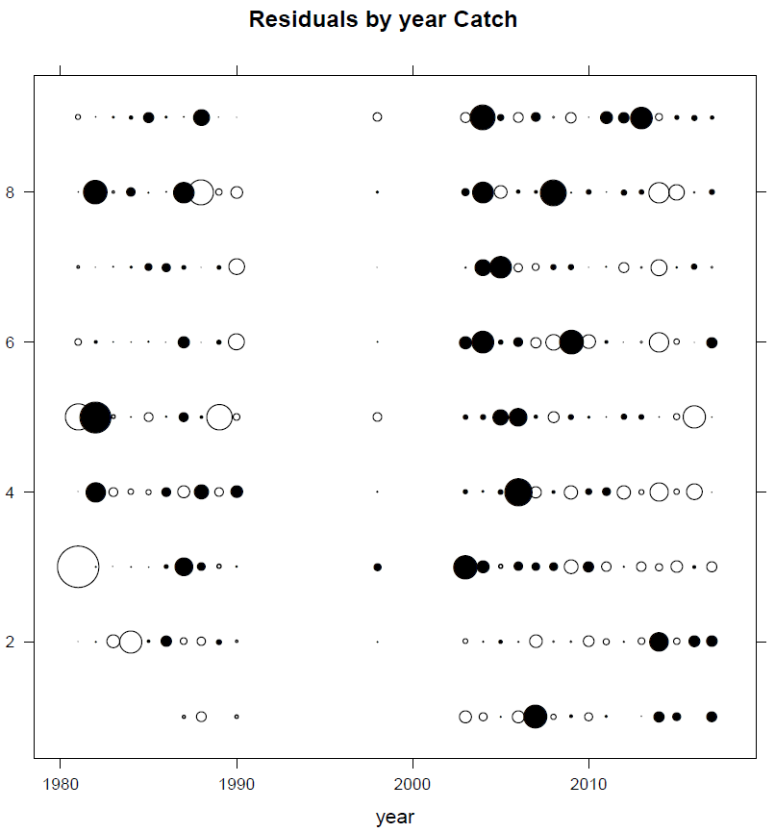
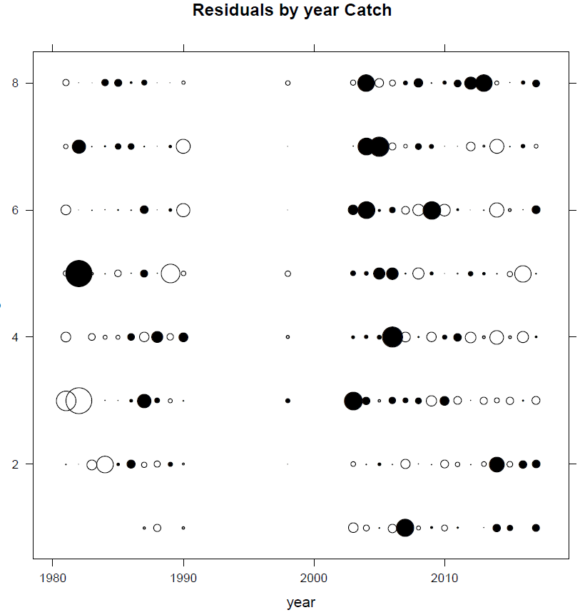
IBP 2018 – Plus group catch-at-age

Slide 9
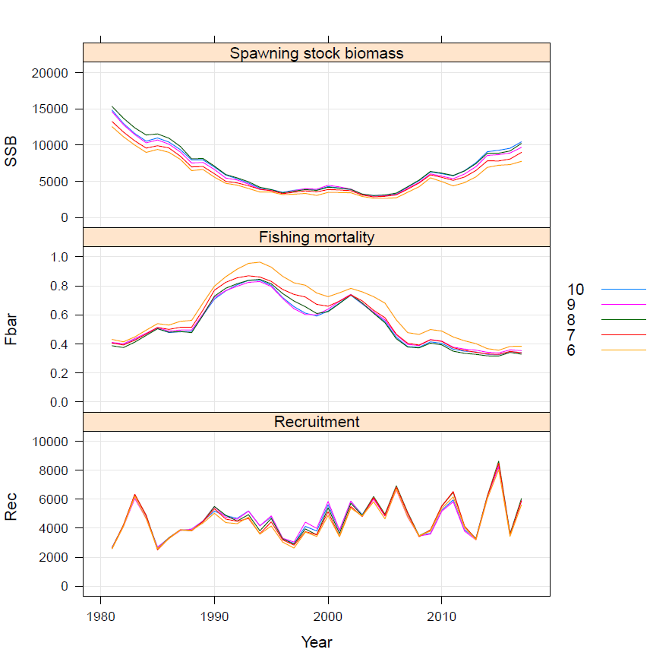
IBP 2018 – Plus group catch-at-age

Slide 10
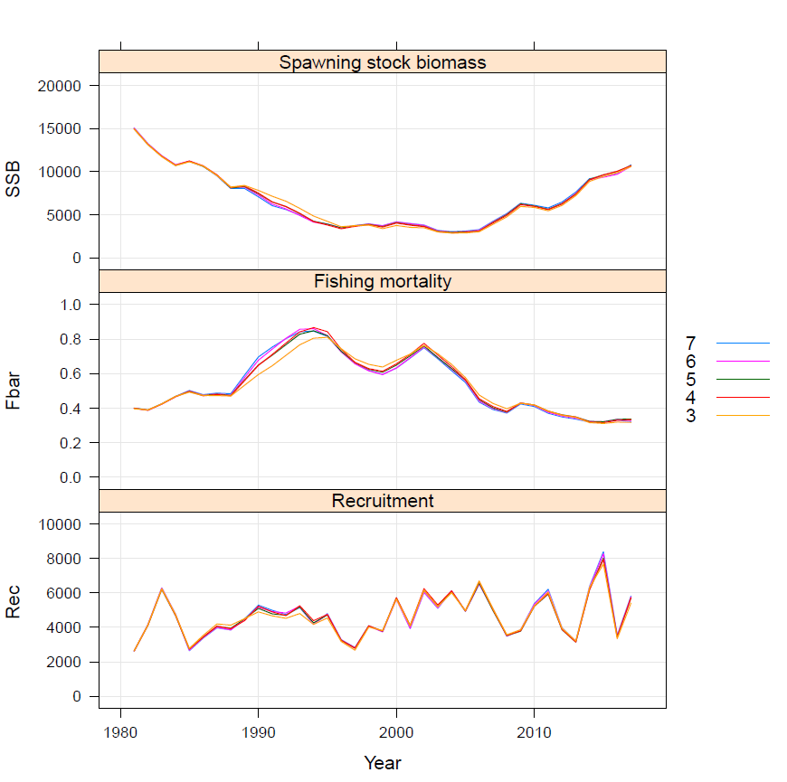
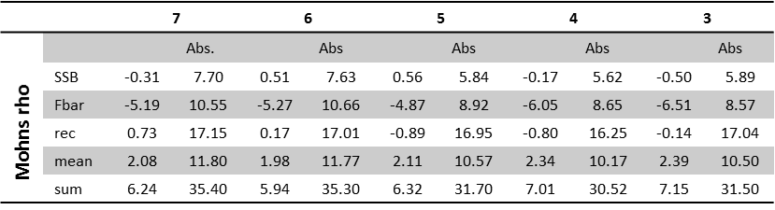
IBP 2018 – Plus group survey-at-age

Slide 11
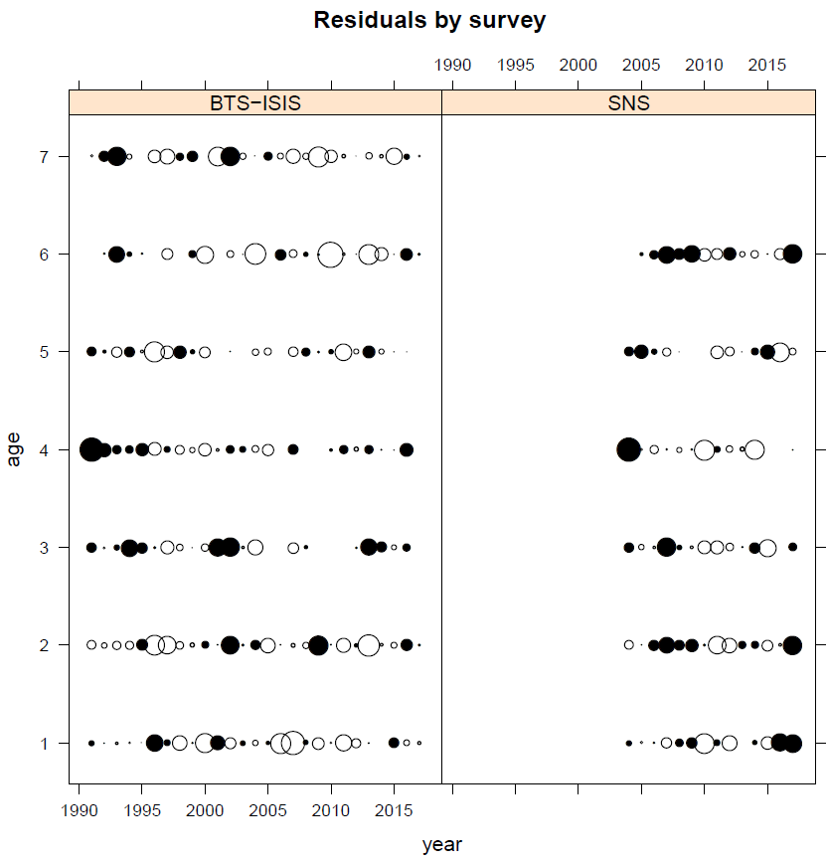
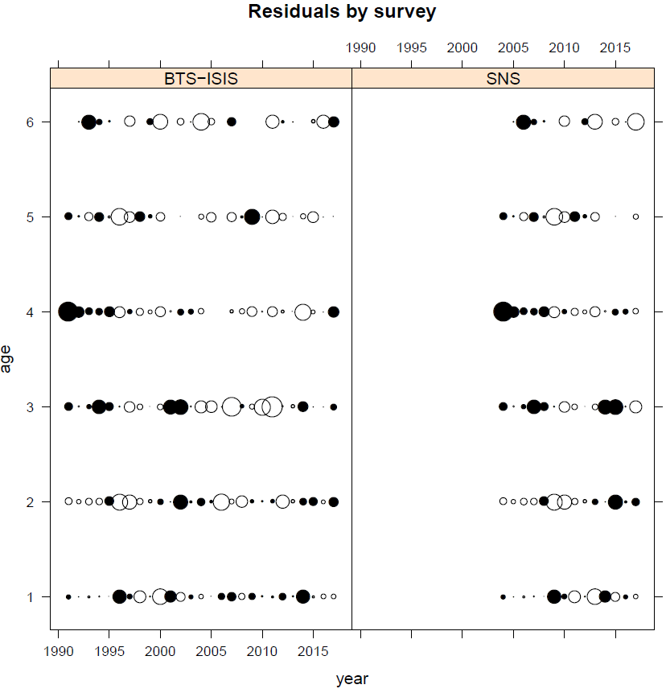
IBP 2018 – Plus group survey-at-age

Slide 12
IBP 2018 – Parameter binding configuration
Parameter categories
1. Fishing mortality states
2. correlated random walks
3. Coupling catchability parameters
SNS
BTS
NL_LPUE
4. Coupling of fishing mortality RW
5. Coupling of log N RW
6. Coupling of observation variances
Catch
SNS
BTS
NL_LPUE
7. Stock–recruitment model
8. Coupling of survey correlation correction by age
SNS

Slide 13
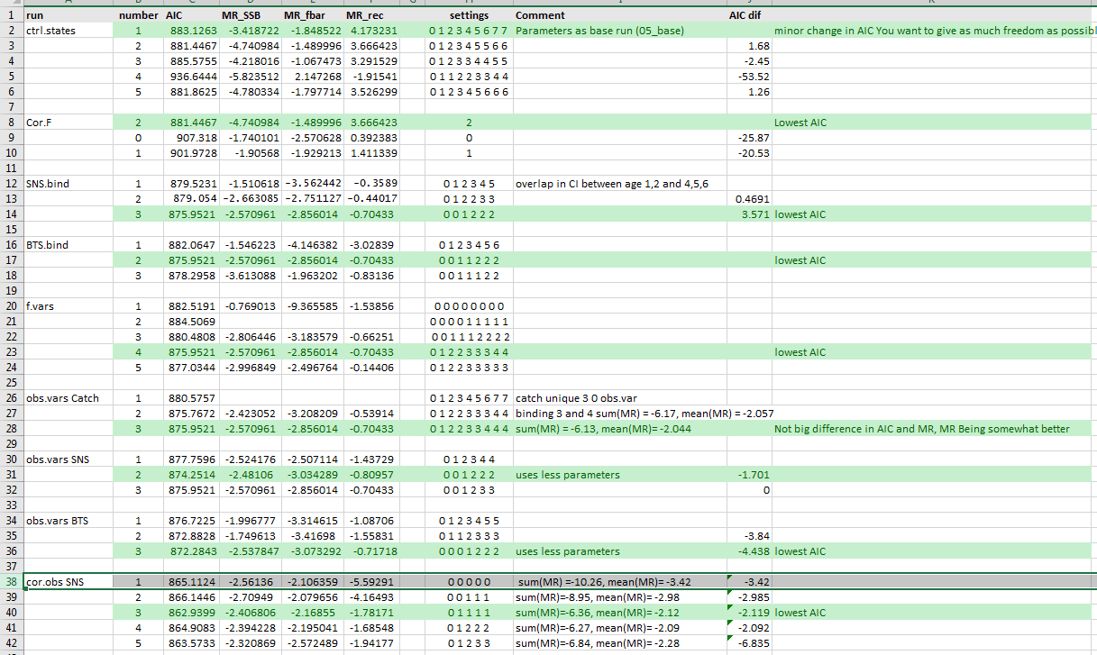

Slide 14
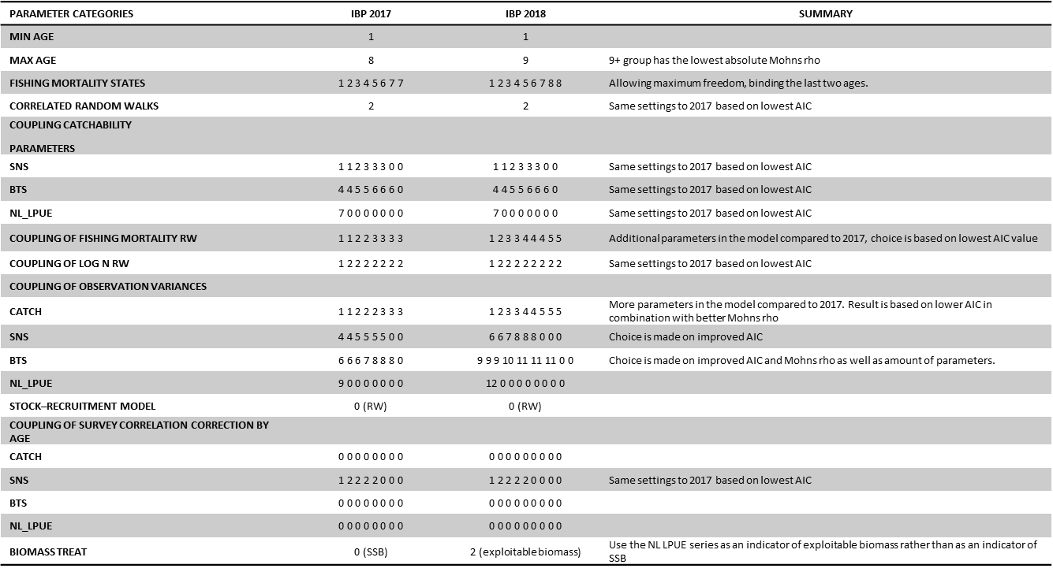
IBP 2018 – Final assessment

Slide 15
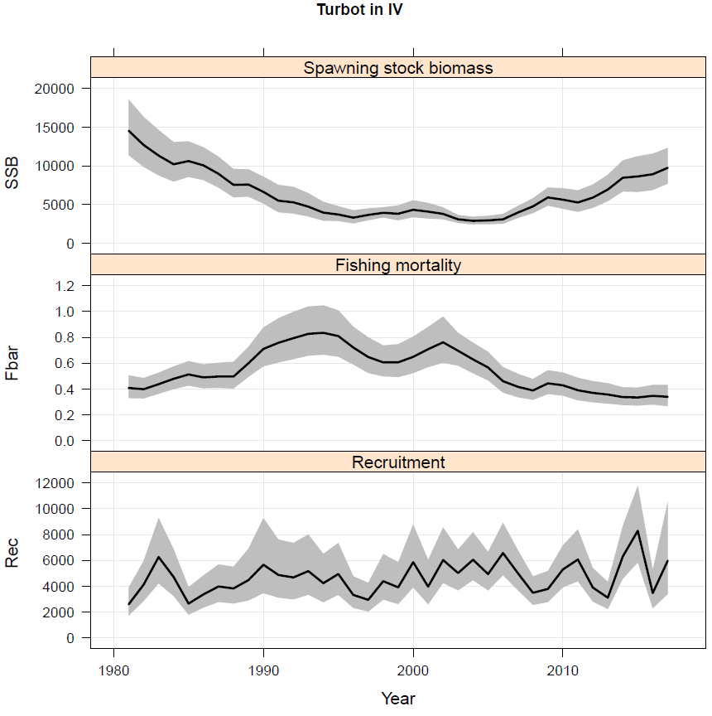
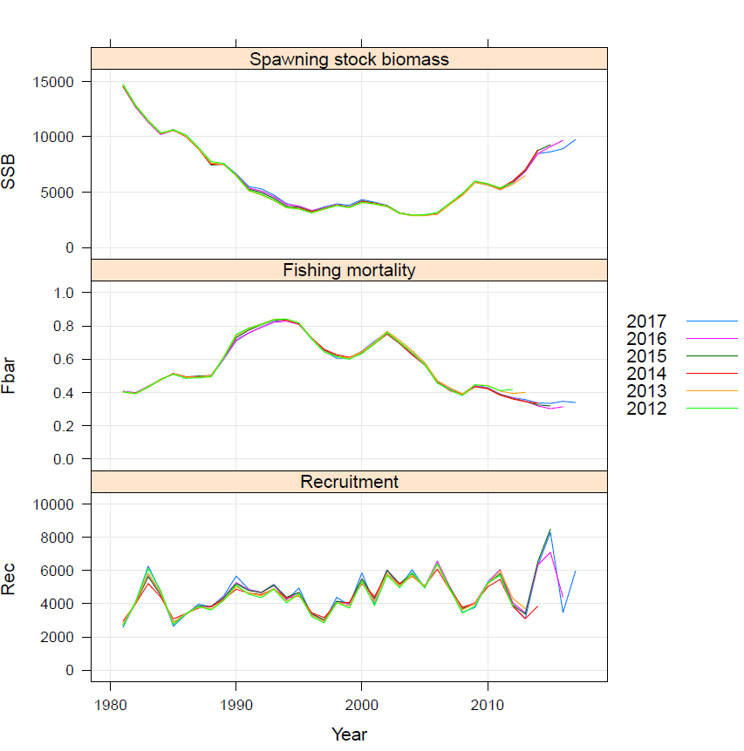
IBP 2018 – Final assessment

Slide 16
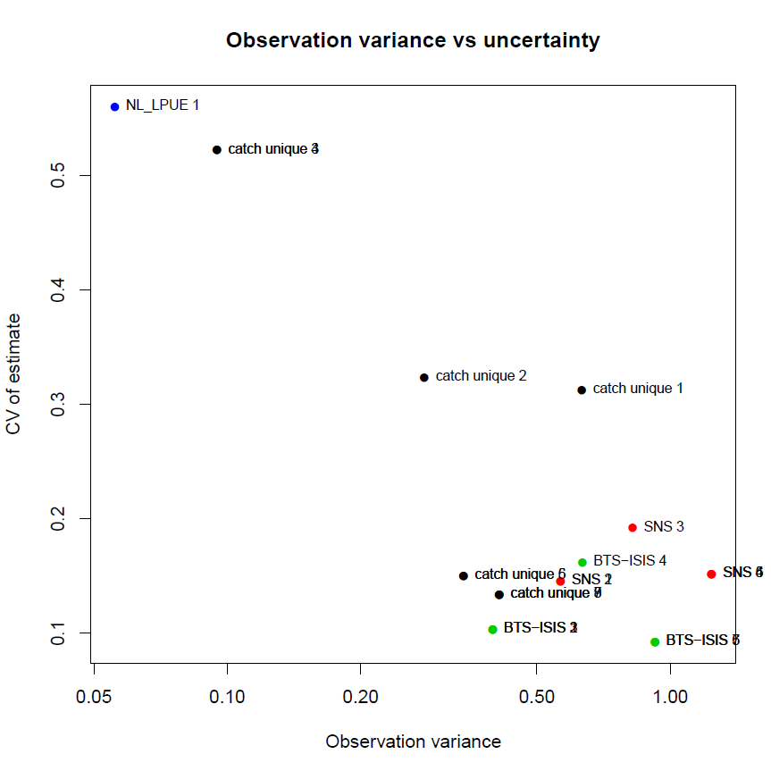
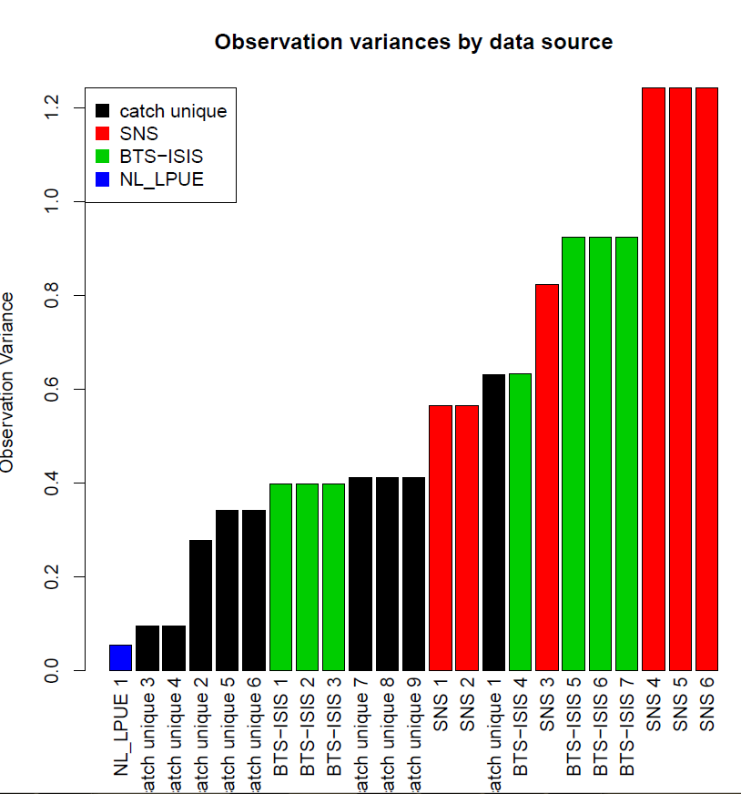
IBP 2018 – Final assessment

Slide 17
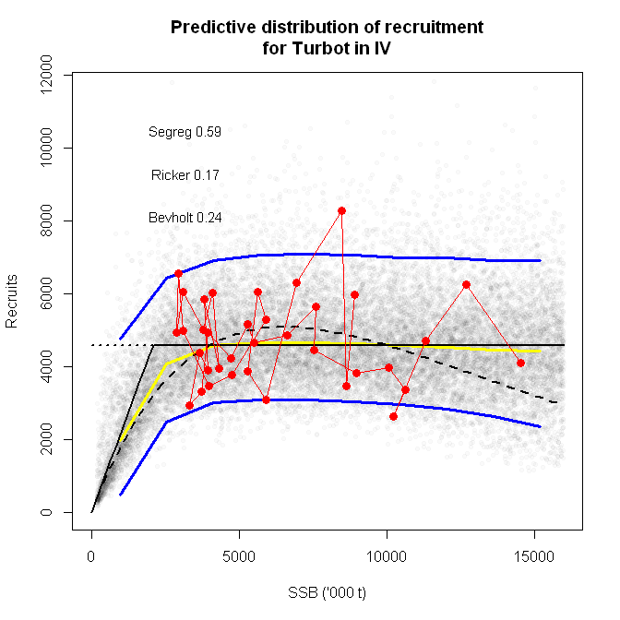
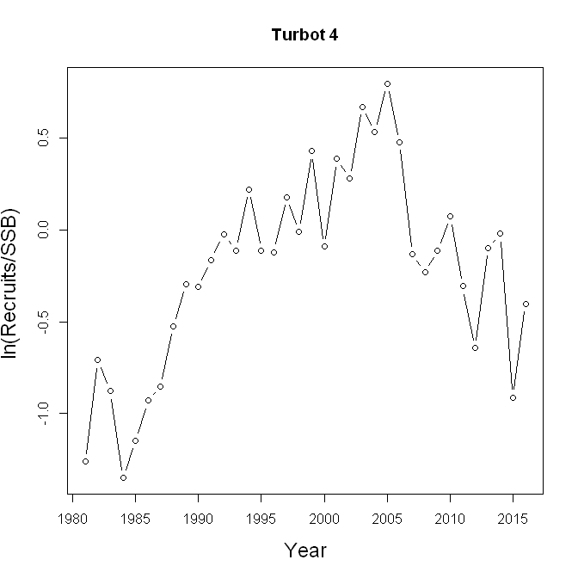
IBP 2018 – Reference points

Slide 18
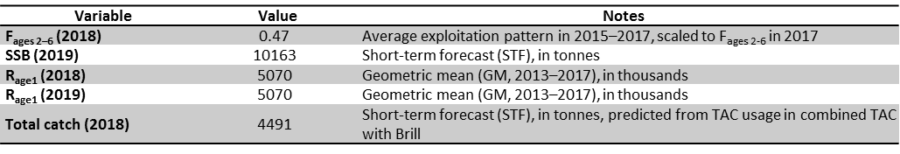
IBP 2018 – Short-term forecast
Assumptions made for the interim year and in the forecast

Slide 19
IBP 2018 – Short-term forecast

Slide 20
Tuesday 31-07-2018

Slide 22
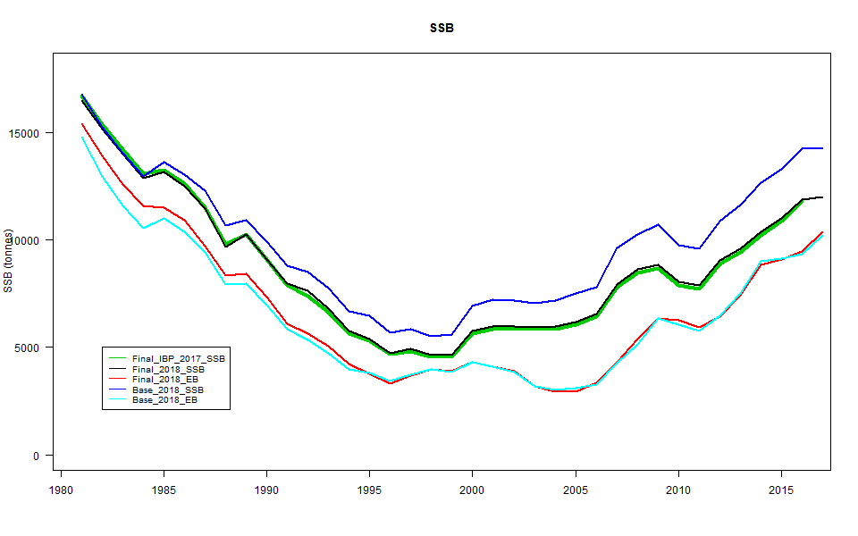
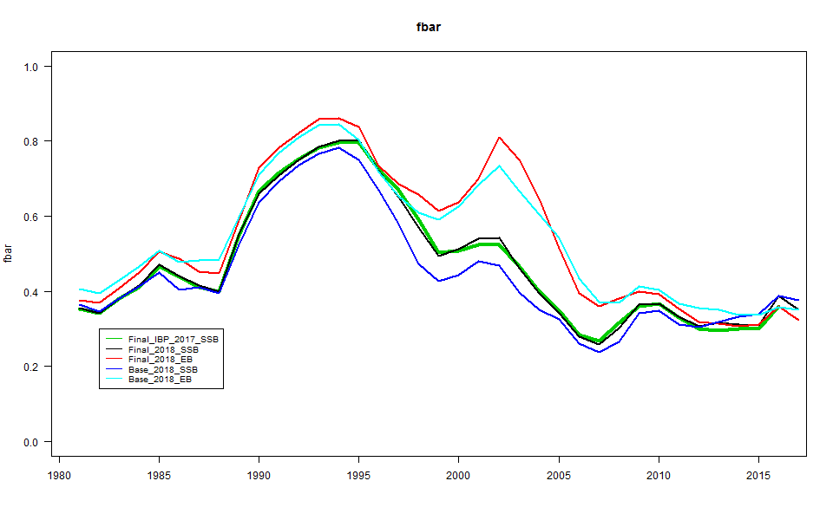
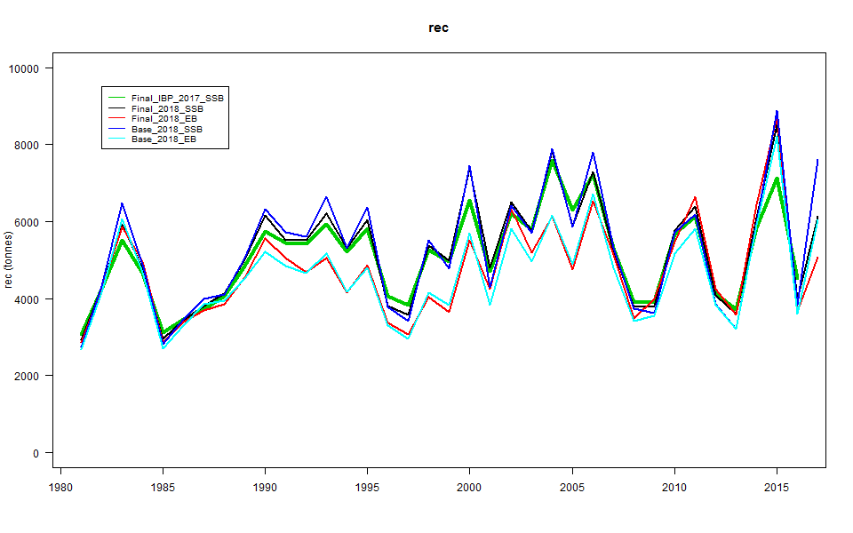

Slide 23
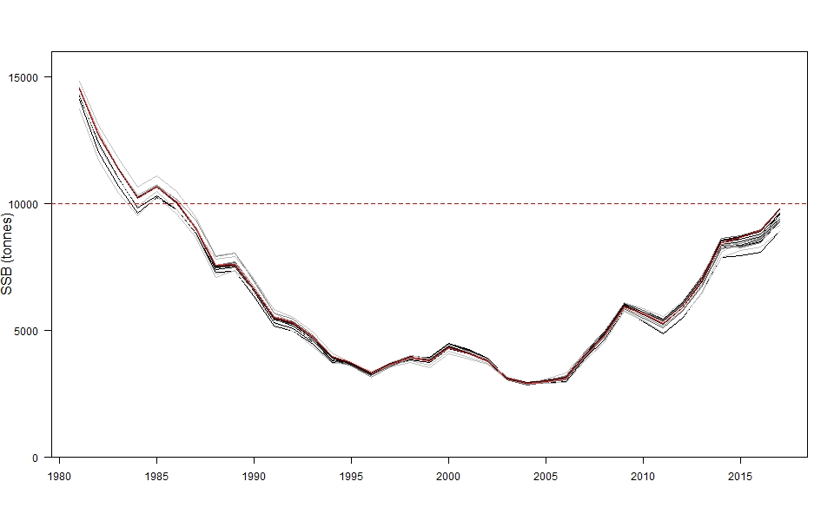
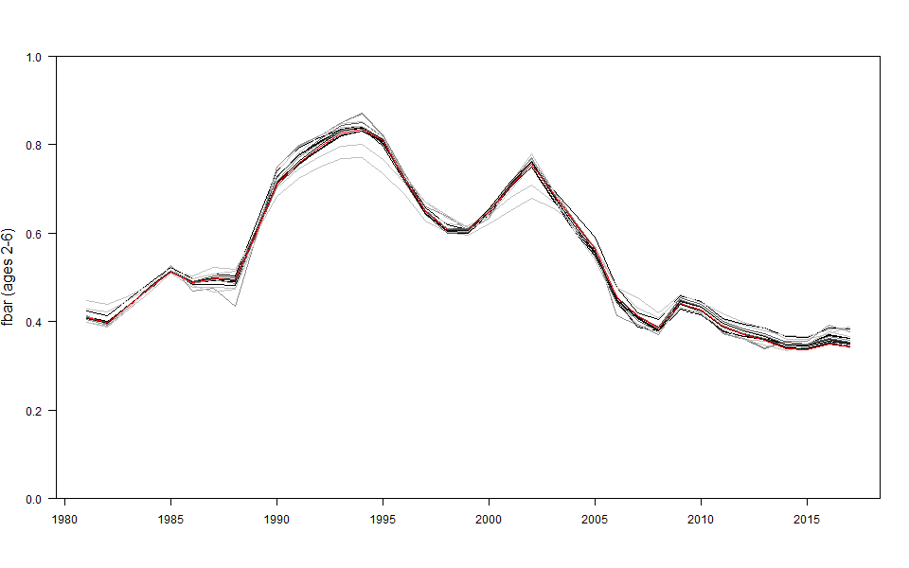
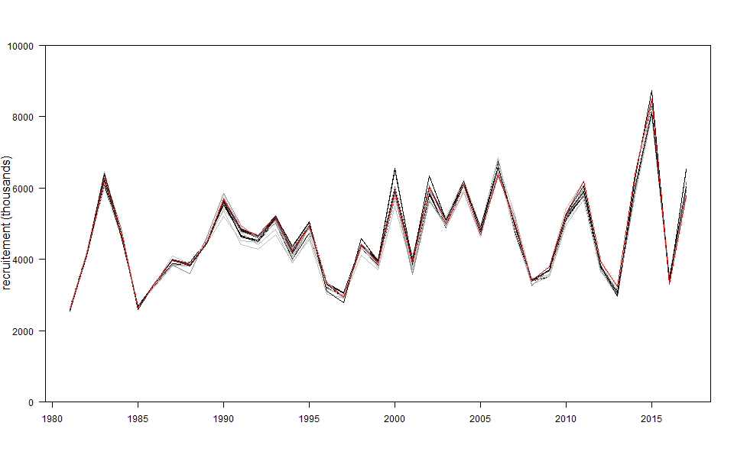
IBP 2018 – All runs

Slide 24
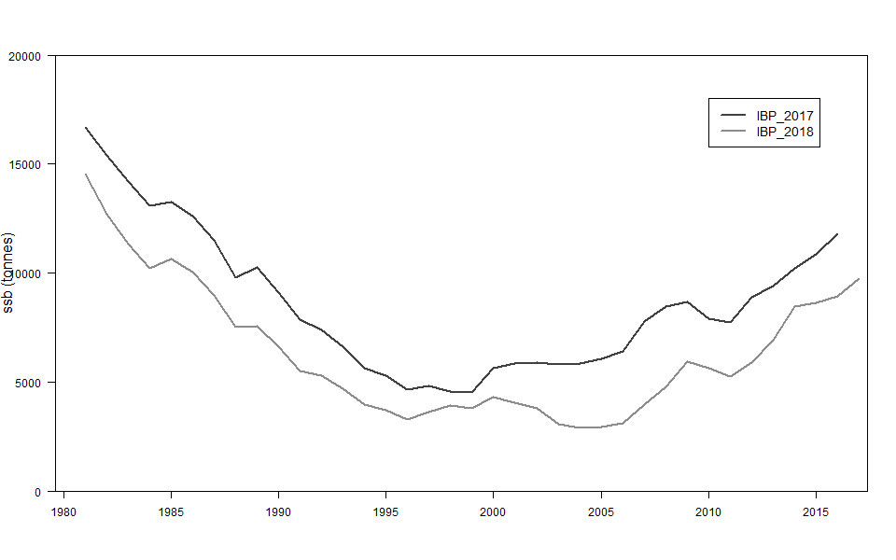
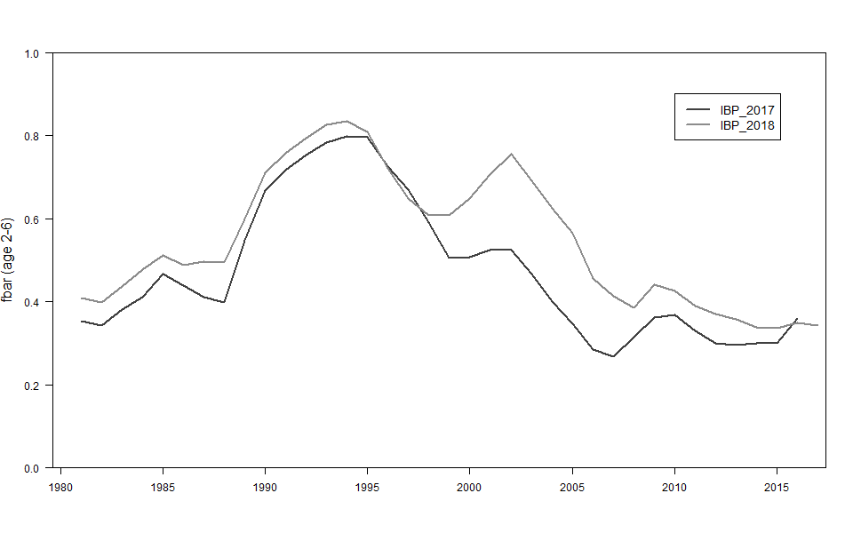
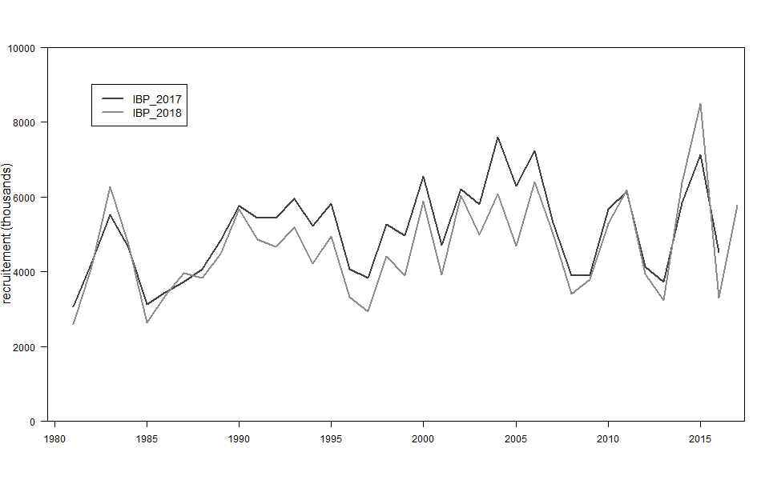
IBP 2018 – Comparison 2017 - 2018

Slide 25
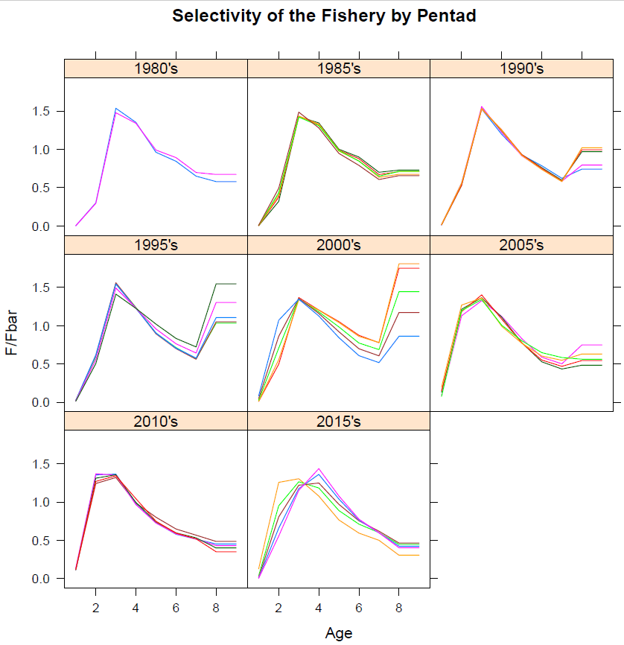
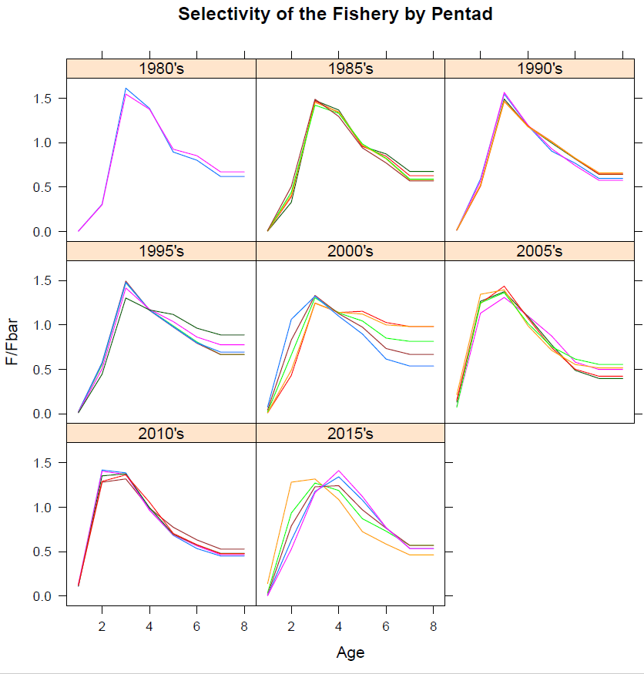
IBP 2018 – Comparison Plusgroups CAA
PG9
PG8

