Slide 1



ple27.420: SAM assessment runs
Chun Chen
WKNSCS

Slide 2
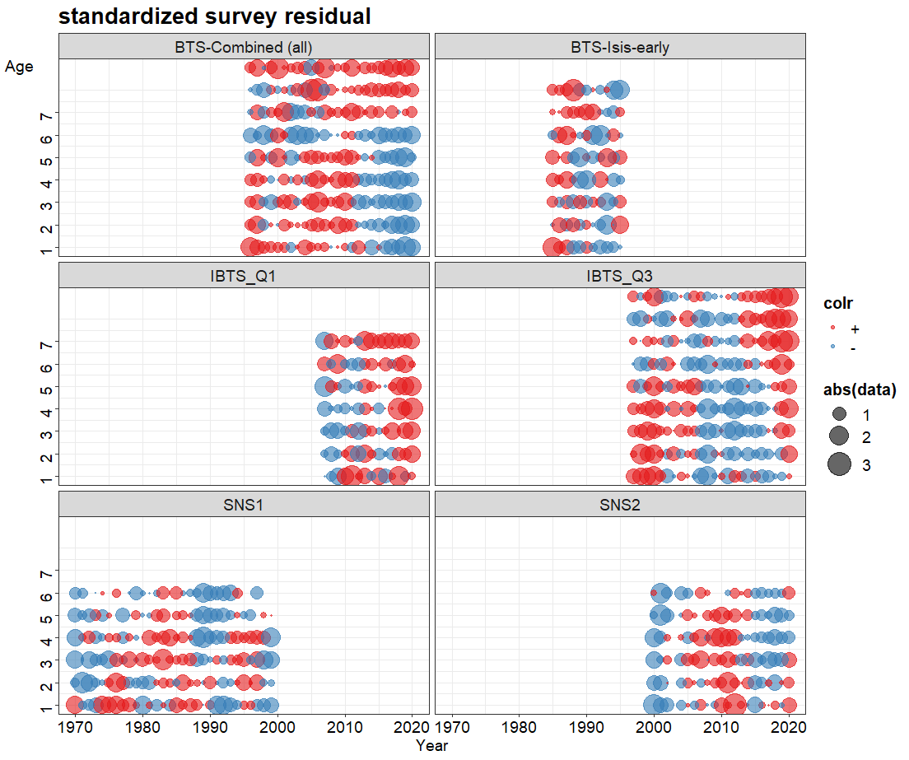
Problem in assessment, WGNSSK2021, AAP model: log(est/obs)/SD: survey residuals

Slide 3
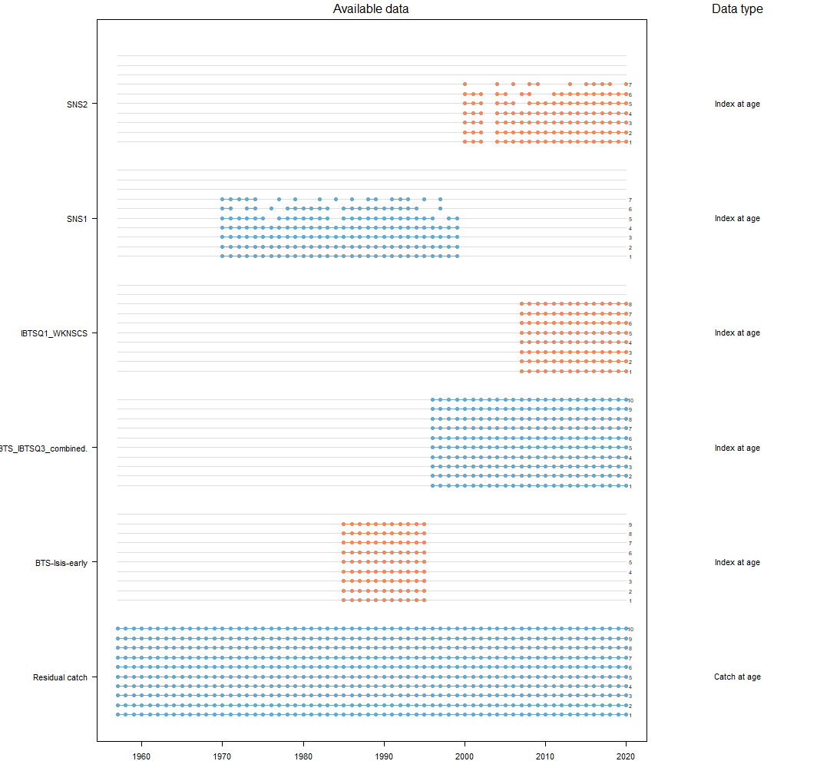

Slide 4
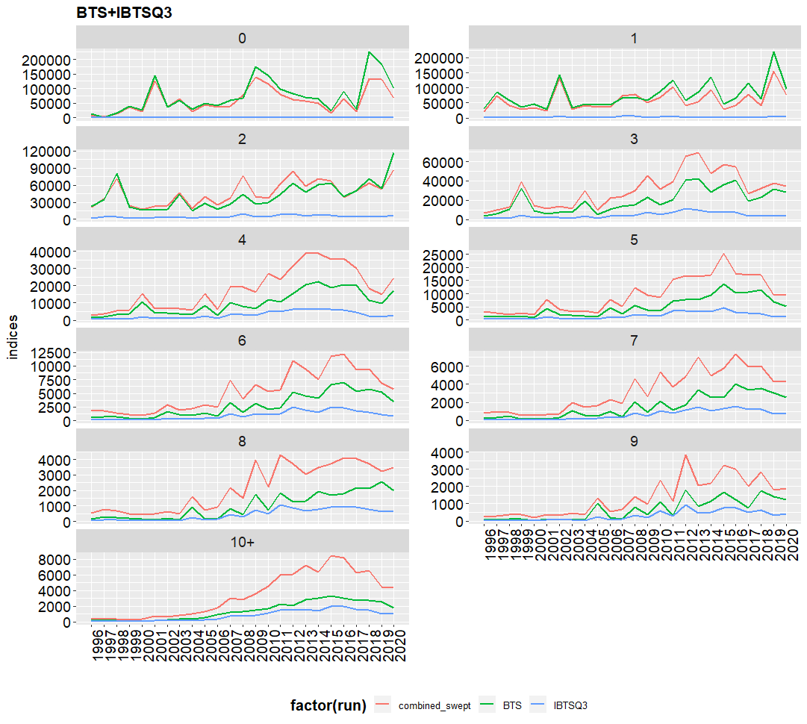

Slide 5
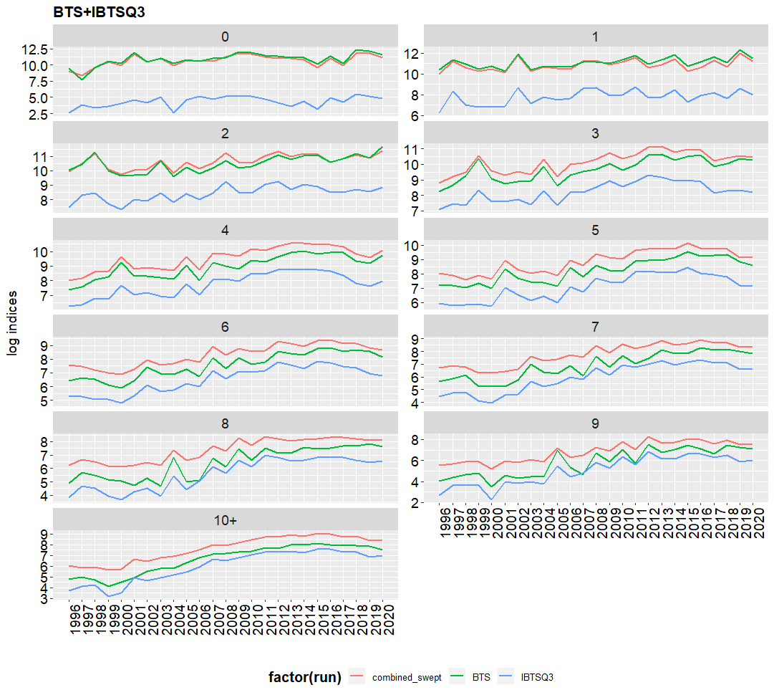

Slide 6
Model diagnosis
AIC
Ob residual and process residual
Leave-one-out
Retrospective (5 year peel)
Forecast uncertainty

Slide 7
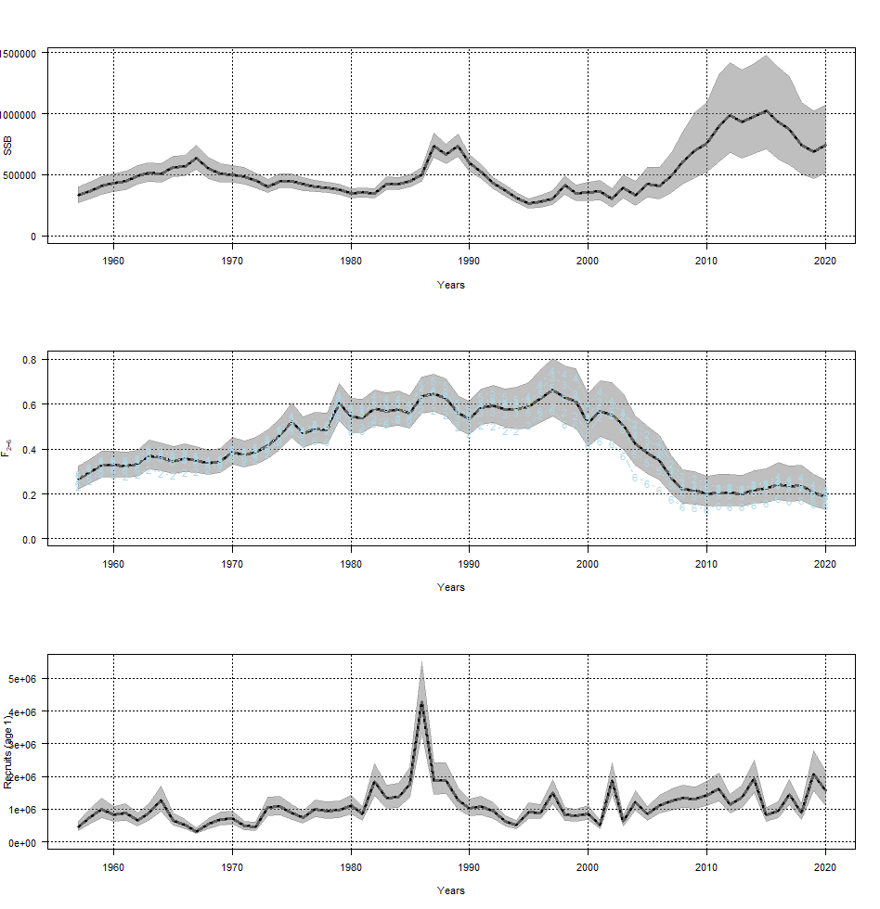
Run1: default confg

Slide 8
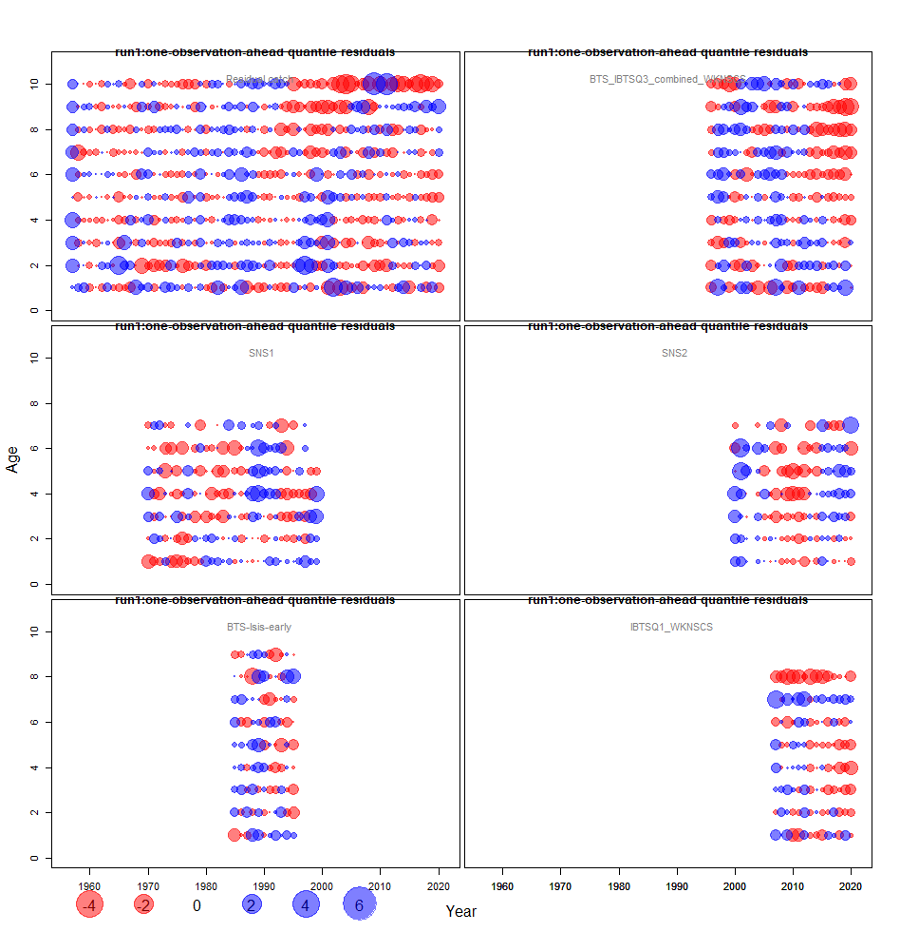
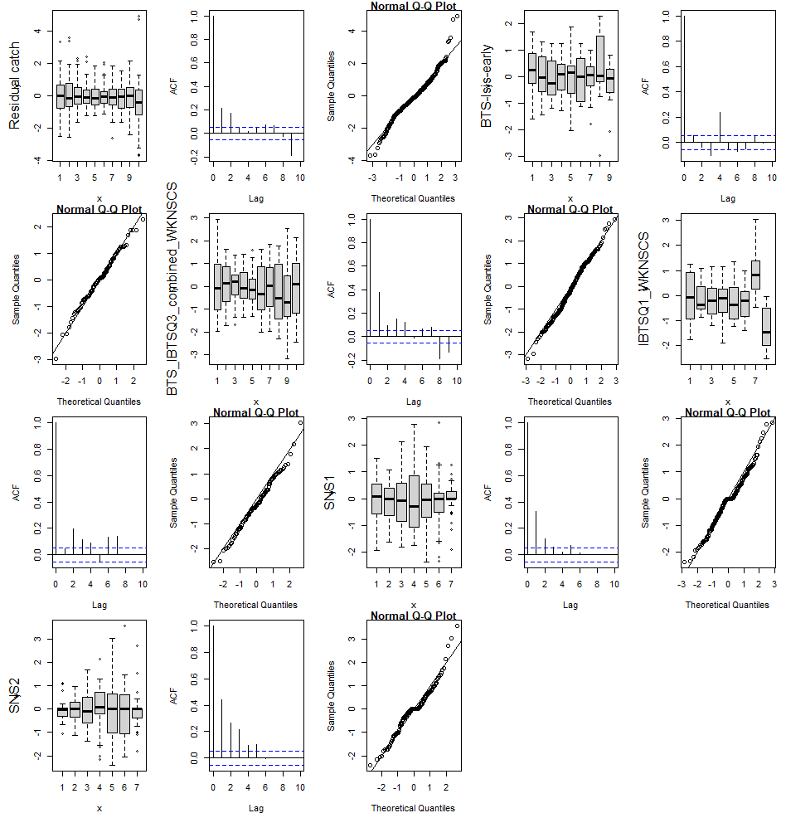
Run1: observation residual

Slide 9
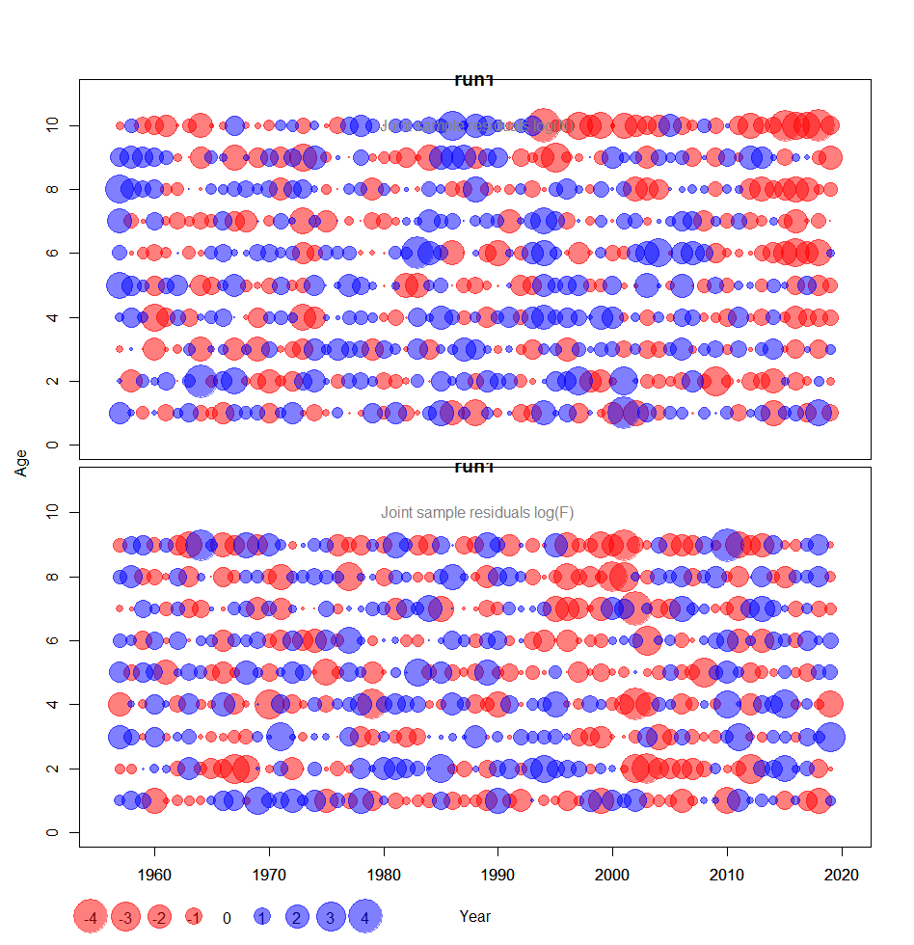

Slide 10
run2
2 | F@age | Parameters per age | keyLogFsta: 0 1 2 3 4 5 6 7 8 9
4 | observation | Survey catchability parameters per age | keyLogFpar: [,1] [,2] [,3] [,4] [,5] [,6] [,7] [,8] [,9] [,10] [1,] -1 -1 -1 -1 -1 -1 -1 -1 -1 -1 [2,] 0 1 2 3 4 5 6 7 8 -1 [3,] 9 10 11 12 13 14 15 16 17 18 [4,] 19 20 21 22 23 24 25 26 -1 -1 [5,] 27 28 29 30 31 32 33 -1 -1 -1 [6,] 34 35 36 37 38 39 40 -1 -1 -1
8 |  | Coupling variance parameters per age | keyVarObs: [,1] [,2] [,3] [,4] [,5] [,6] [,7] [,8] [,9] [,10][1,] 0 1 2 2 2 2 3 3 4 5[2,] 6 7 8 8 8 8 9 9 9 -1[3,] 10 11 12 12 12 12 13 13 14 15[4,] 16 17 17 17 17 17 18 18 -1 -1[5,] 19 20 21 21 21 21 21 -1 -1 -1[6,] 22 23 24 24 24 24 24 -1 -1 -1
10

Slide 11

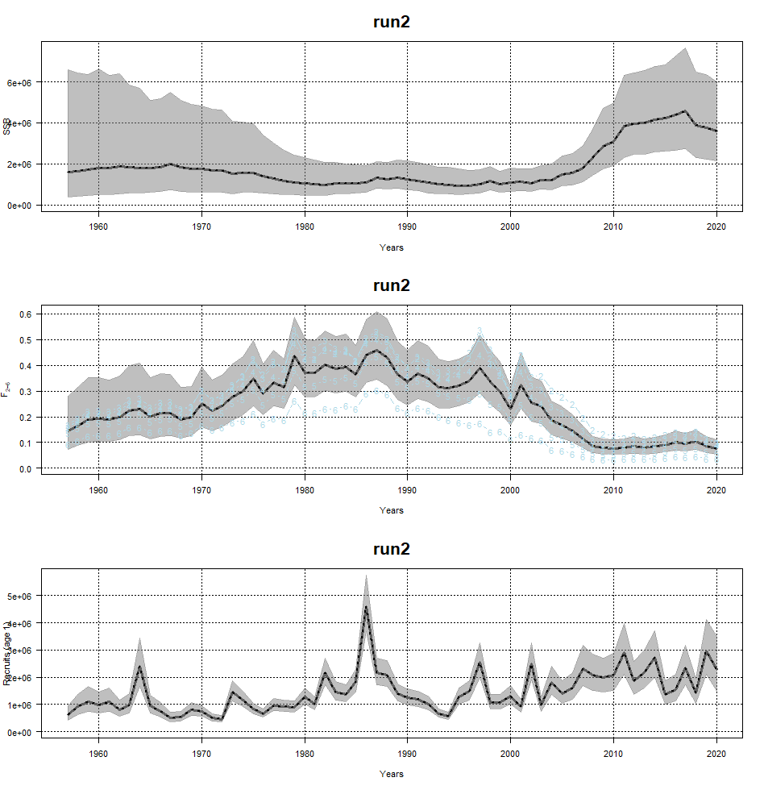
run2
Notes:
Increased uncertainty of early years, no age 10 survey indices before 1996
Increased uncertainty of all 3 variables also in later years
More flucturations in recruitment?

Slide 12
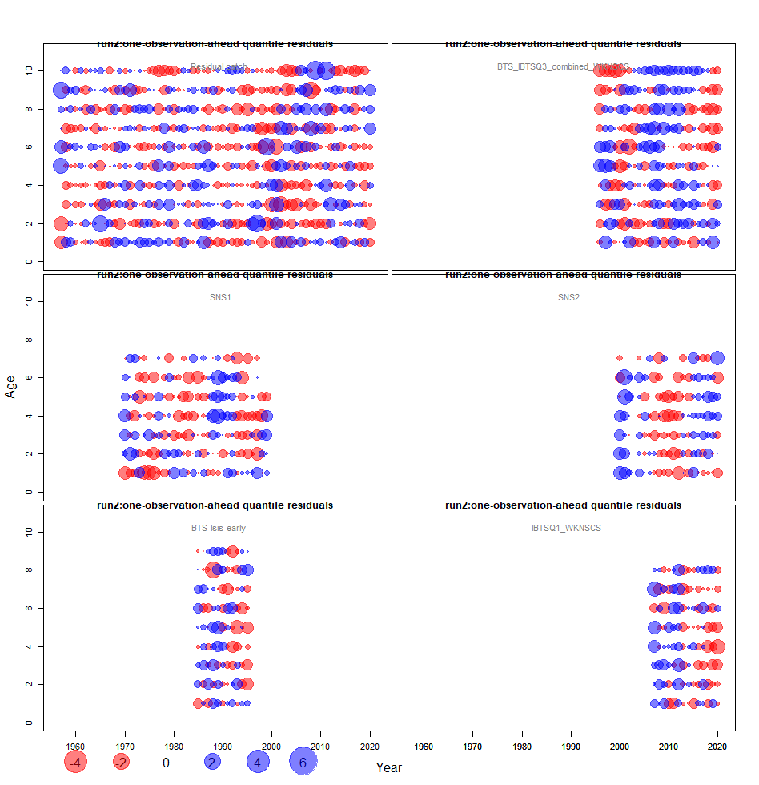
Notes:
Re-setting the catchability parameters has little impact on SNS residuals, SNS residuals still have year/cohort pattern
Improved residual for age 8 in IBTSQ1
Decoupling F age 9 and 10 does not improve the catch residuals for age 9 and 10, only brings larger uncertainty, so we keep age 9 and 10 coupled

Slide 13
Seperate survey catchability and their variance
Separate last 2 ages in keyLogFsta brings larger uncertainty and does not improve the catch residual pattern for age 9 and 10.

Slide 14
run3
4 | observation | Survey catchability parameters per age | keyLogFpar: [,1] [,2] [,3] [,4] [,5] [,6] [,7] [,8] [,9] [,10] [1,] -1 -1 -1 -1 -1 -1 -1 -1 -1 -1 [2,] 0 1 2 3 4 5 6 7 8 -1 [3,] 9 10 11 12 13 14 15 16 17 18 [4,] 19 20 21 22 23 24 25 26 -1 -1 [5,] 27 28 29 30 31 32 33 -1 -1 -1 [6,] 34 35 36 37 38 39 40 -1 -1 -1
8 |  | Coupling variance parameters per age | keyVarObs: [,1] [,2] [,3] [,4] [,5] [,6] [,7] [,8] [,9] [,10][1,] 0 1 2 2 2 2 3 3 4 5[2,] 6 7 8 8 8 8 9 9 9 -1[3,] 10 11 12 12 12 12 13 13 14 15[4,] 16 17 17 17 17 17 18 18 -1 -1[5,] 19 20 21 21 21 21 21 -1 -1 -1[6,] 22 23 24 24 24 24 24 -1 -1 -1
10

Slide 15
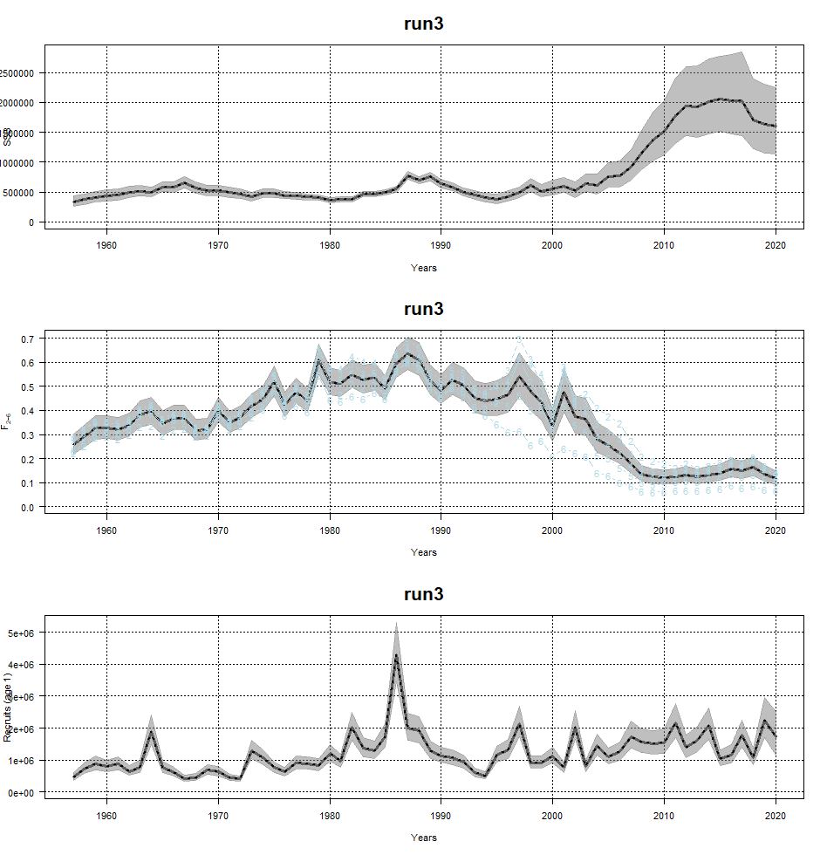
Run1 vs run3

Slide 16
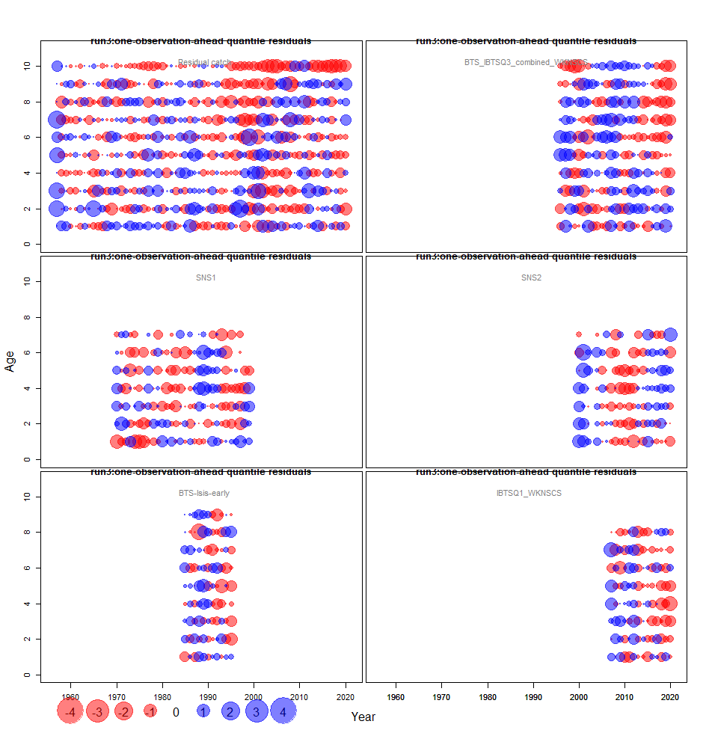
Obs-est
Notes:
Run3: coupling variance parameters in catches has made some changes in catch/F estimates and large changes in catch residual pattern, but the age 9,10 pattern still exist
Coupling survey catchability and their variance does not make large difference to survey ob residual

Slide 17
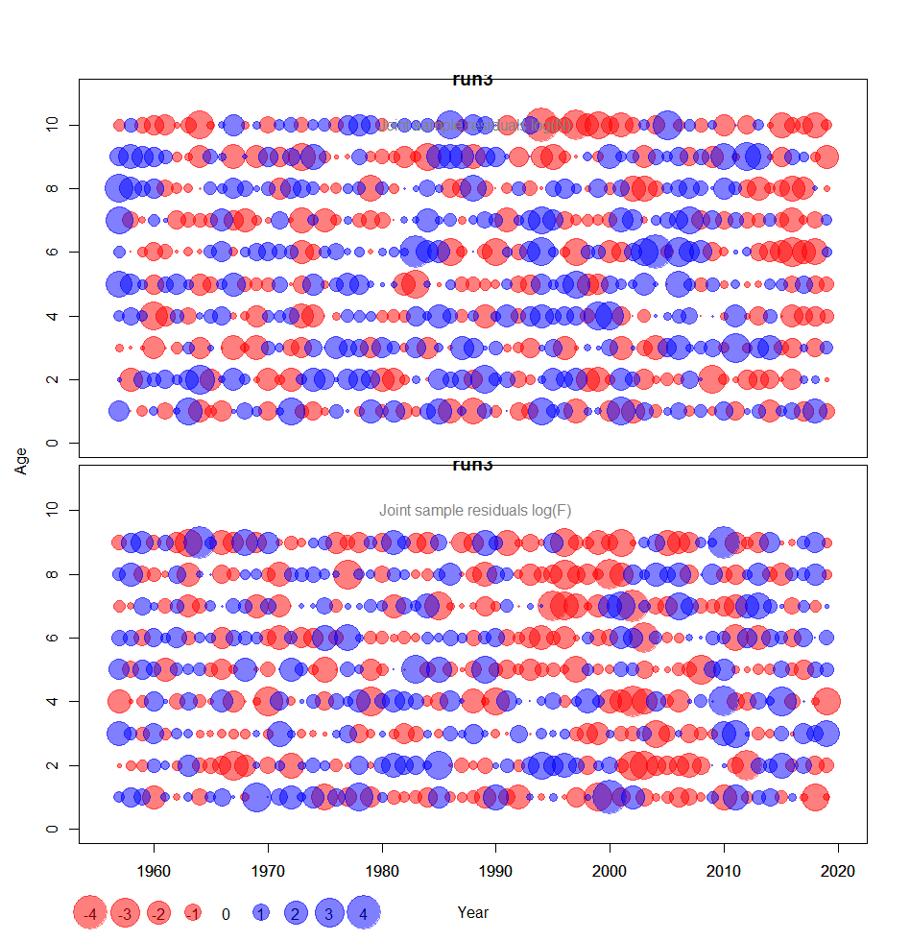
Obs-est

Slide 18
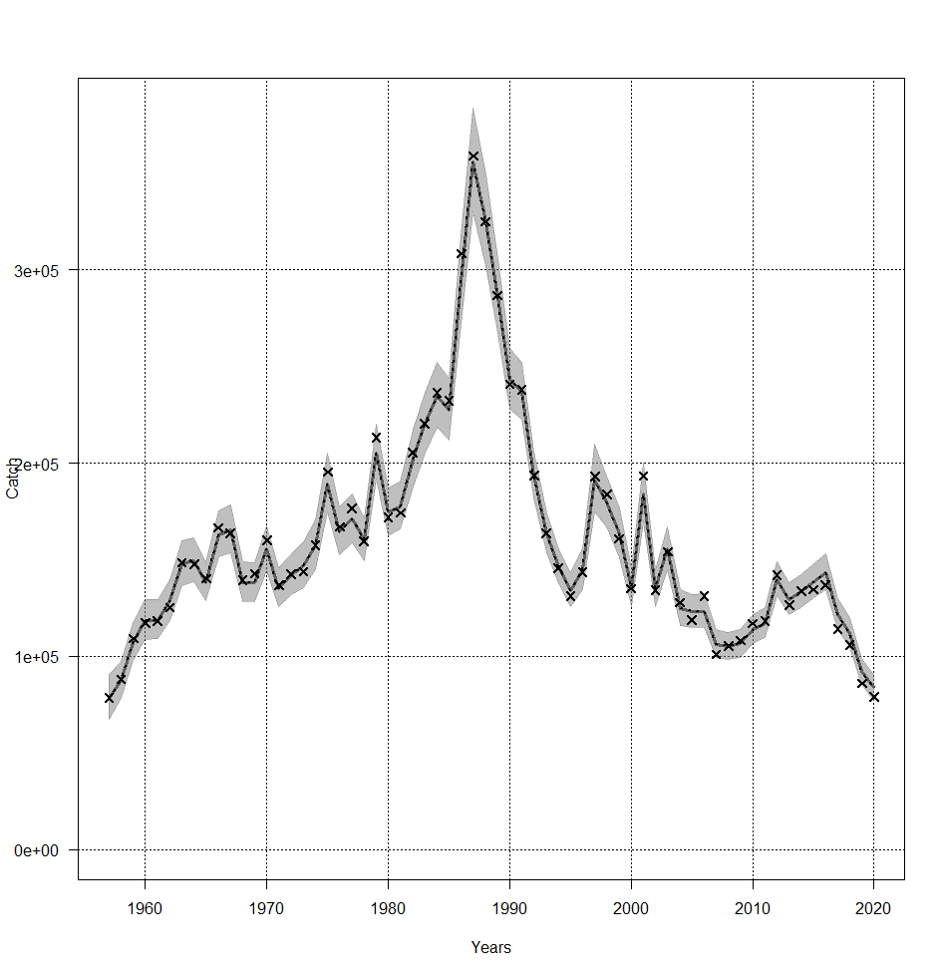

Slide 19
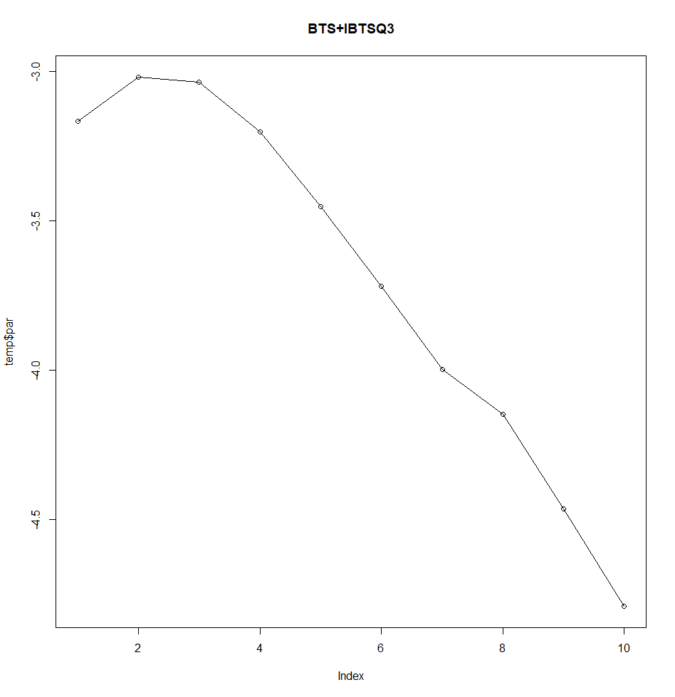
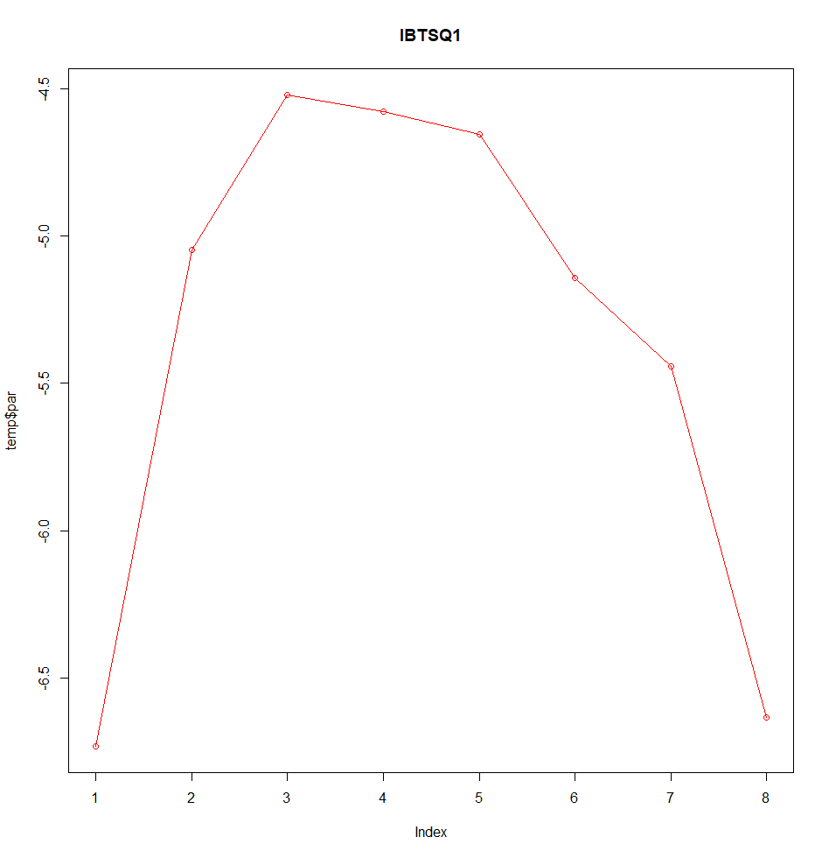
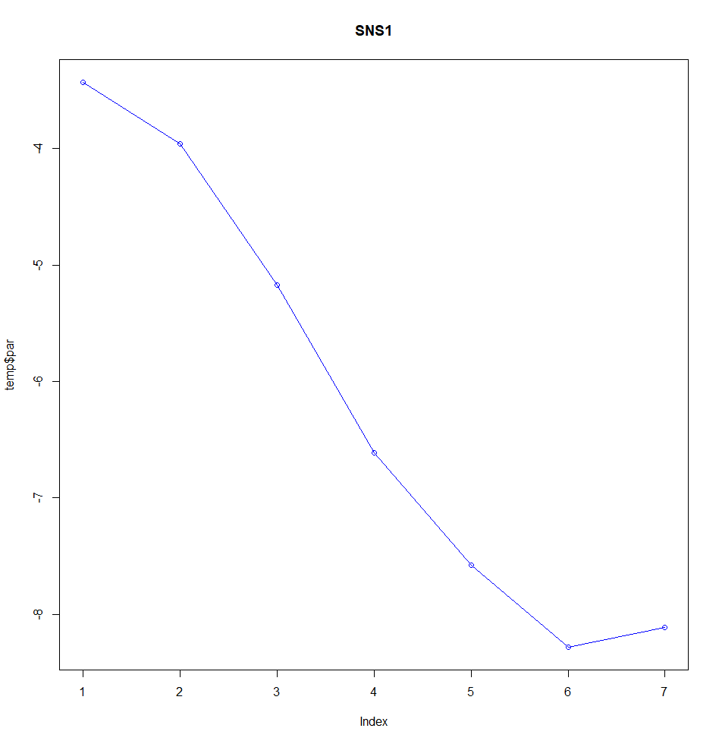
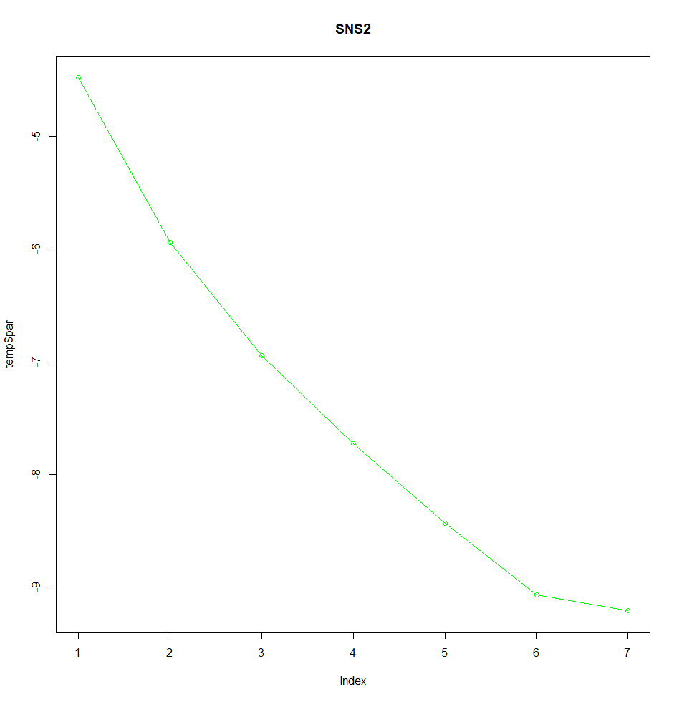
Estimated survey catchability

Slide 21
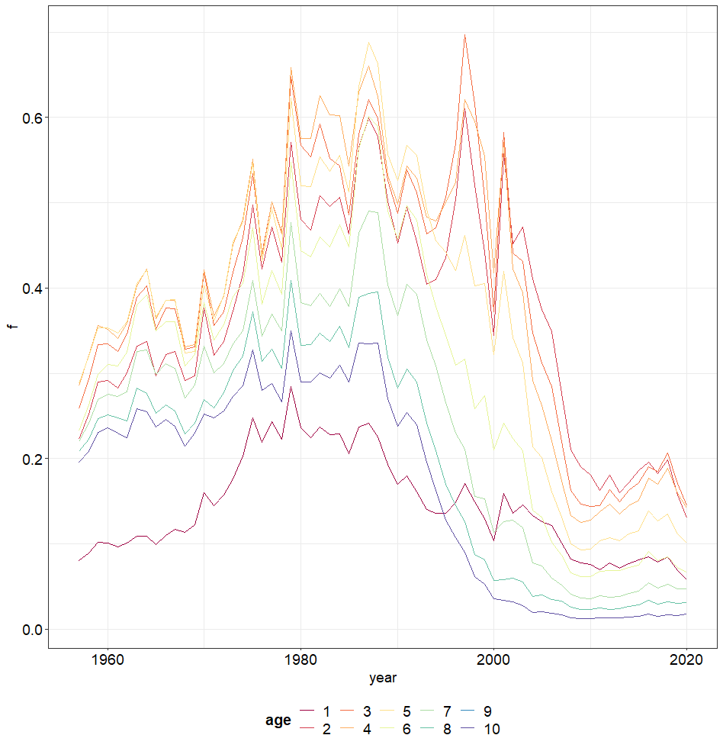
Notes:
Age 9-10 is the same curve

Slide 22
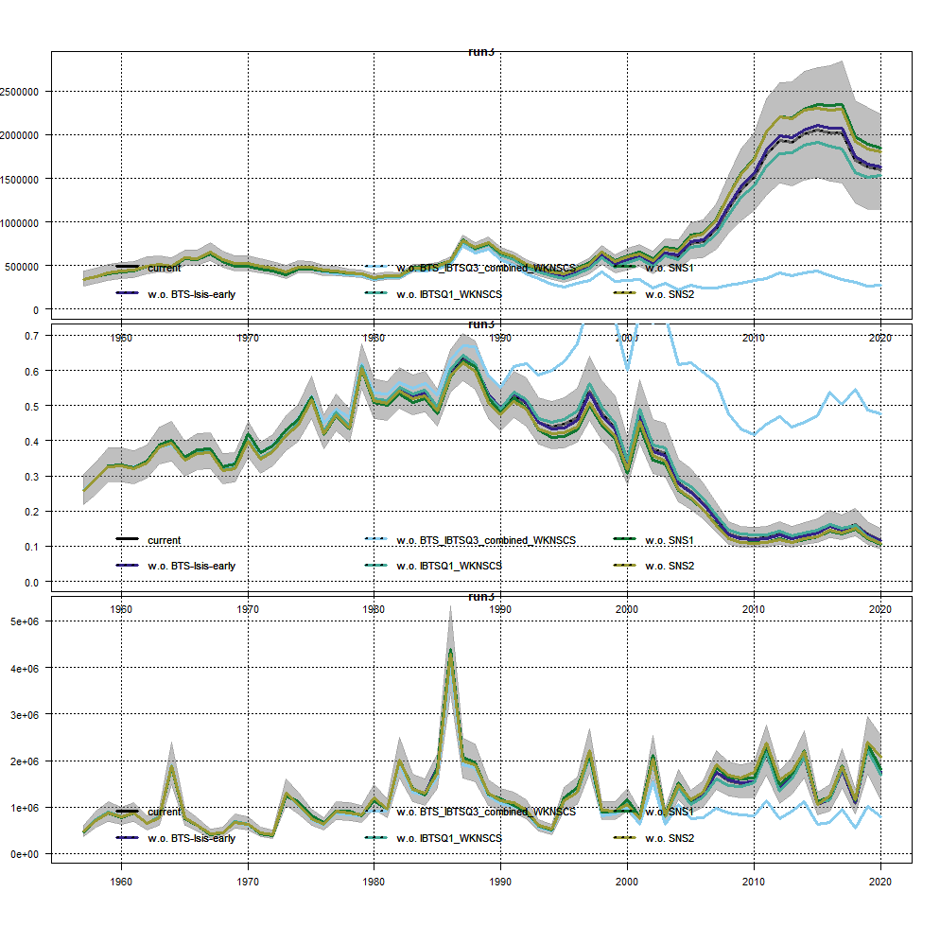
LOO

Slide 23
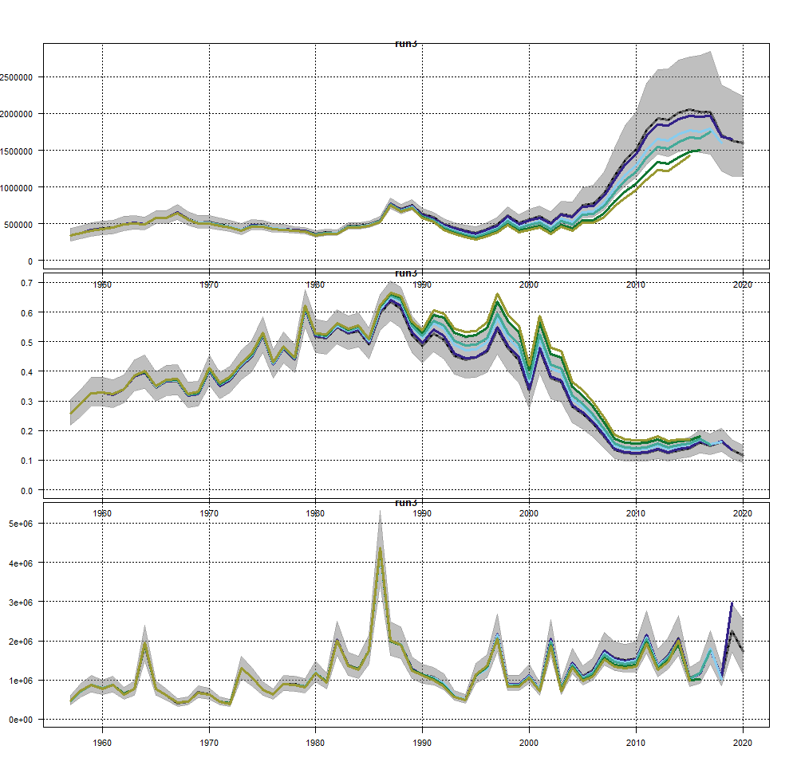
retro

Slide 24
Run3 compared to run1
Reduced AIC
Made changes to catch/F estimates, and changes in catch residuals, but does not improve the age 9-10 residual pattern
Coupling survey catchability and variance parameters seems does not change the survey residuals
Improved residual age 8 for IBTSQ1
Age pattern in catch residual
Residual pattern in BTS+IBTSQ3, and SNS2
Cohort pattern in SNS2
Almost no changes in process residuals

Slide 25
Run4= run3+
 |  | Covariance structure for each fleet | obsCorStruct: AR AR AR AR AR AR
No difference as compared to run3?

Slide 26
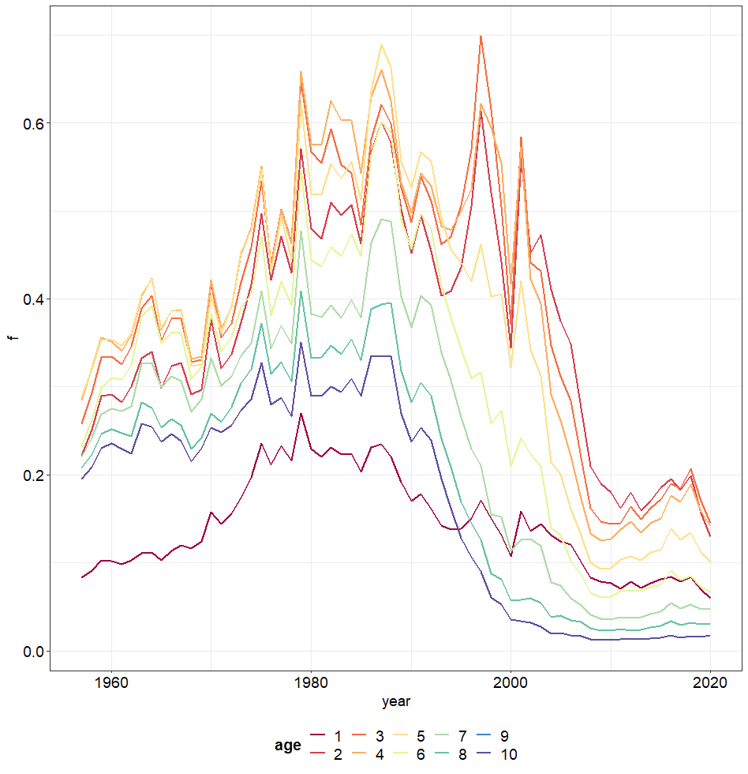
Run5= run4+
2 | F@age | Coupling process variance across age | conf$keyVarF[1,]: 0,1,1,1,1,2,2,2,2,2
run4
run5

Slide 27
Run5 compared to run4
AIC increased from 1283 to 1287
No difference in estimated F

Slide 28
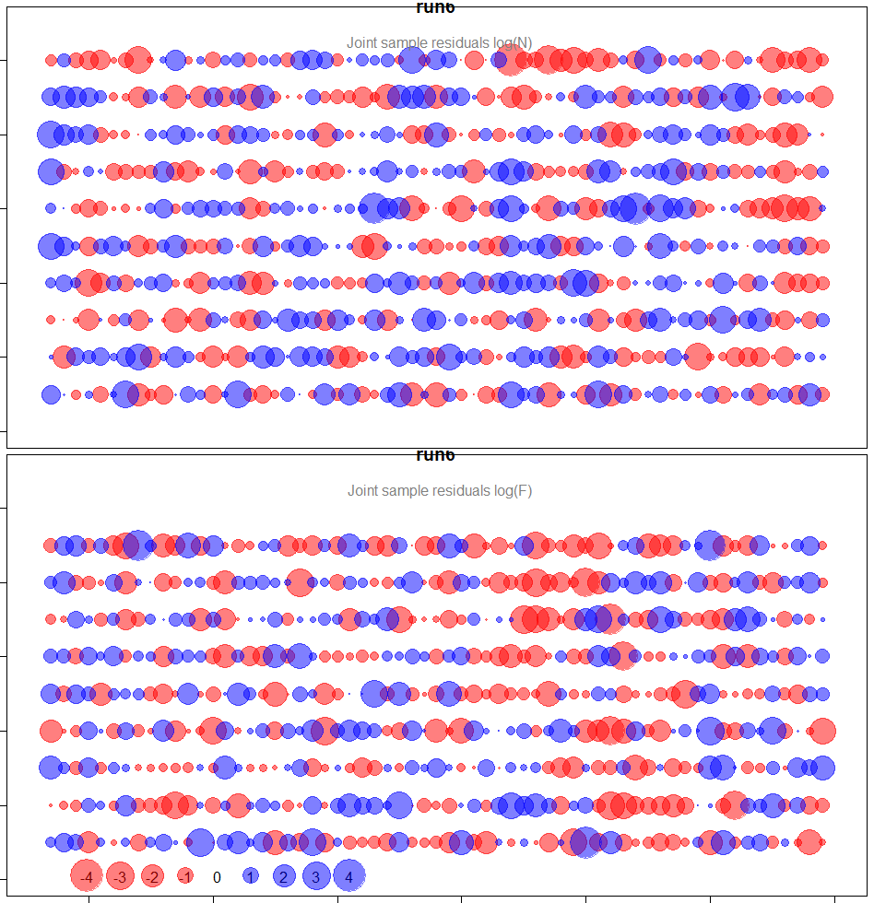
Run6= run4+
 | N@age | Coupling process variance parameters per age | keyVarLogN: 0,1,1,1,1,2,2,2,2,2
run6
run3

Slide 29
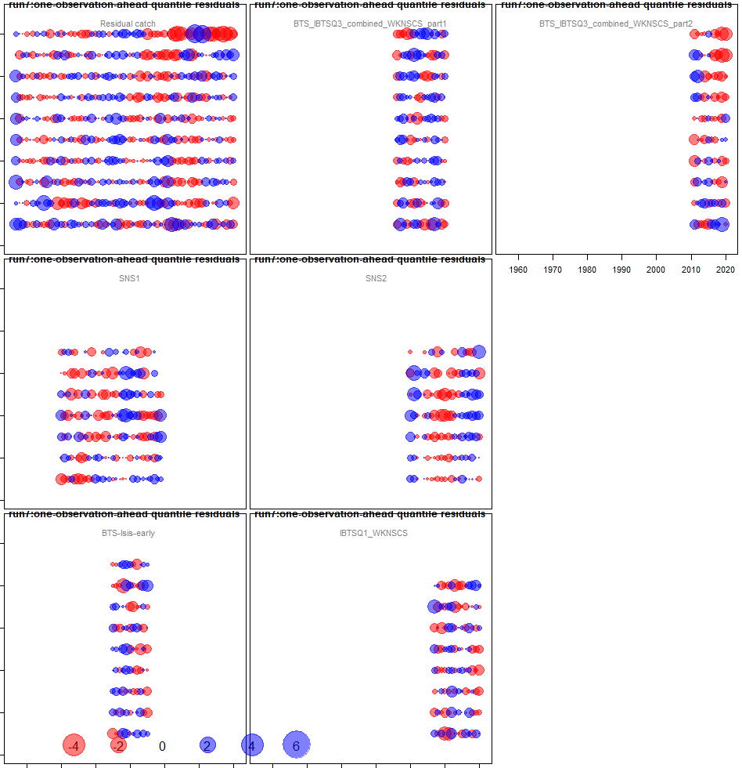
run7-=run3+ separate BTS+IBTSQ3 before and after 2010

Slide 30
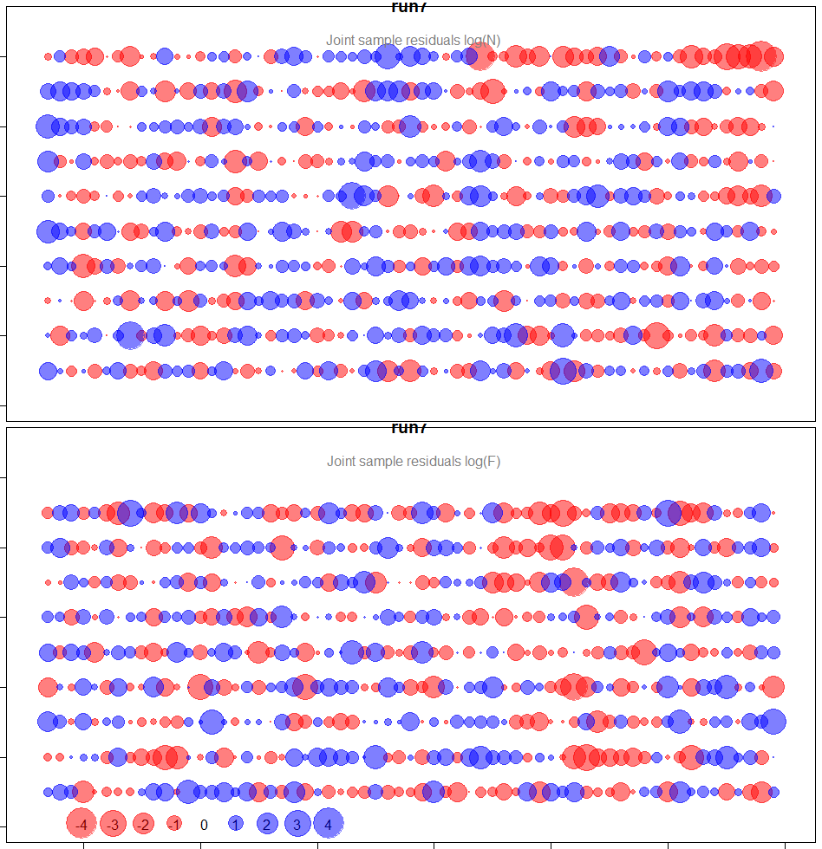

Slide 31
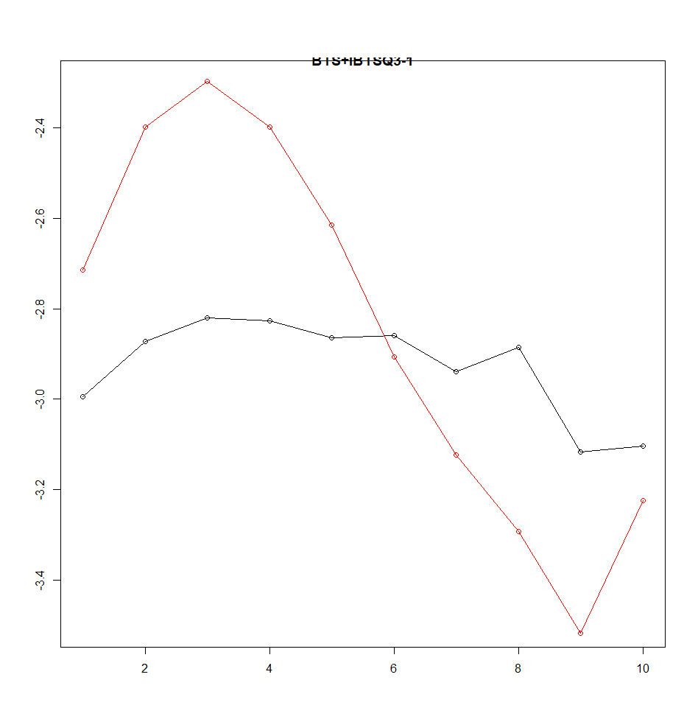
catchability
Catchability BTS+IBTSQ3
<2011(black)
>=2011(red)

Slide 32
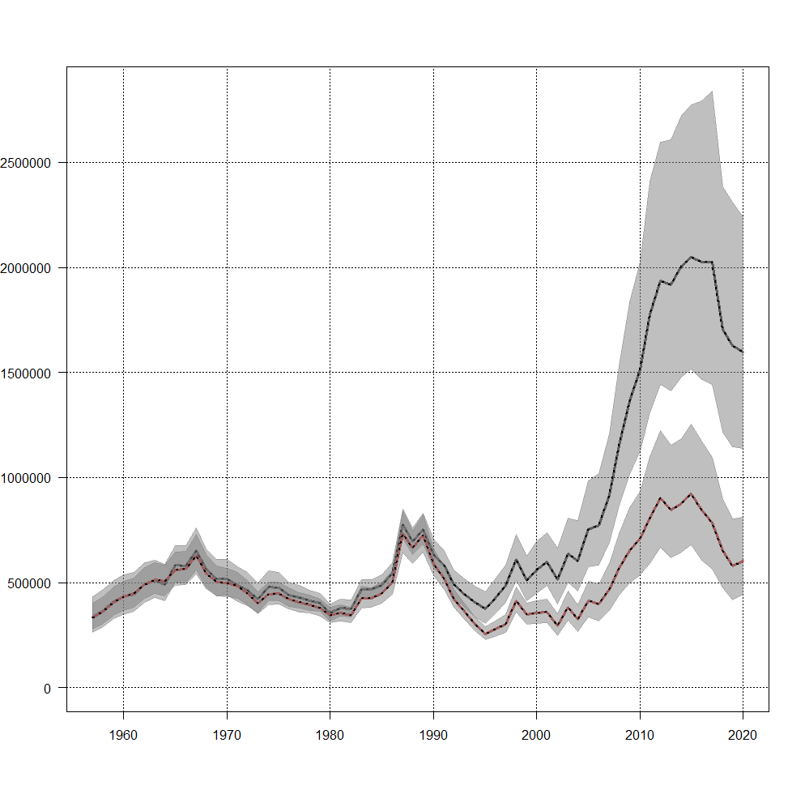
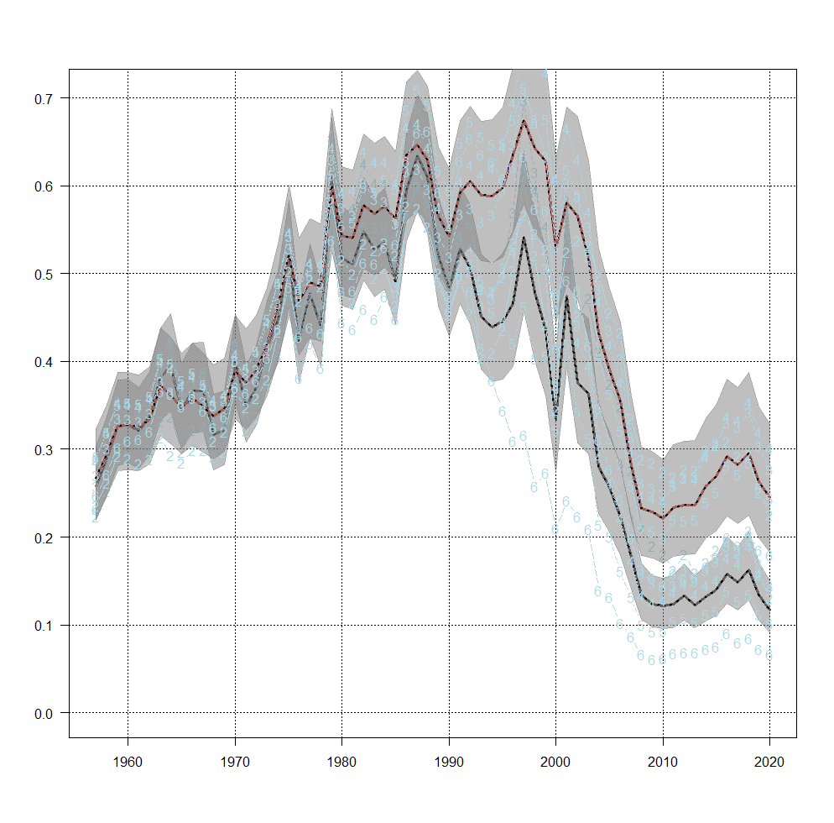
SSB: run3 (black), run7(red)

Slide 33
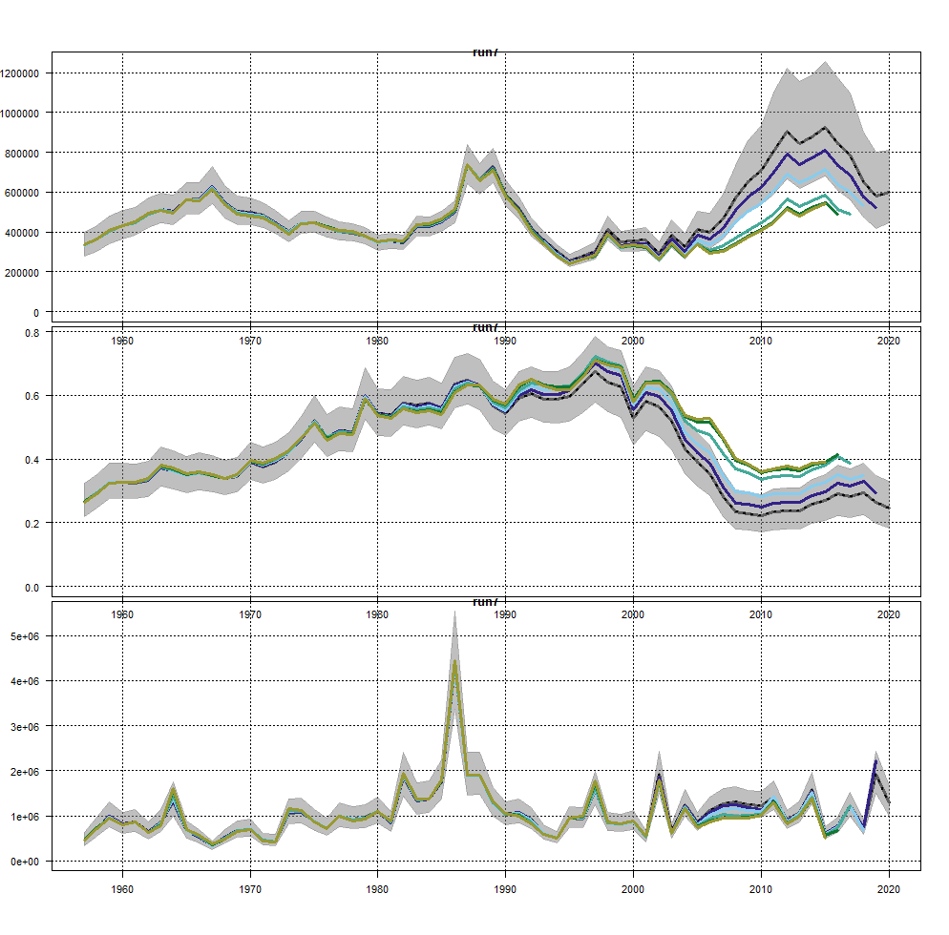
retro
run3
run7

Slide 34
Run 7
By separating BTS+IBTSQ3 indices,
Seems that residual gets better for BTS+IBTSQ3?
Reduced magnitude of process error
The estimated catchability of these 2 periods are quite different
Impling change of M?

Slide 35
fselectivityplot(myrun)
Age 0 DYFS, use in forecast, or age 0 BTS+IBTSQ3
AIC, does not include process error
Age reading error
obsCorStruct=AR does not change results
Recruitment process error
Patterns in F process error is ok?
Plot survey catchability@age and uncertainty per year, maybe couple come ages together

Slide 36
AR structure in corFlag and obsCorStruct are all referring the age, not time?
Weights of surveyes

