Slide 1
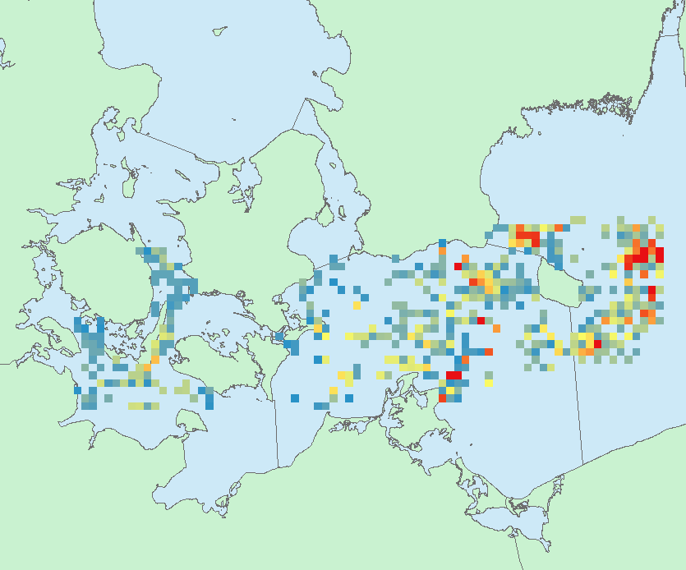
R scripts on https://github.com/ices-eg/wk_WKTRADE2
SPATIAL LONG TERM DYNAMIC MODELLING (DISPLACE/SMART/FishRent)
AUGMENTED WGSFD Shape files
STATIC SNAPSHOOT VARIABLES
ObtainProbabilityFieldForEffortDisplacement.R
SelectPolygonsToRestrictFromAugmentedShape.R
WGFBIT
Impact evaluation with SPATIAL LONG TERM DYNAMICS MODELLING (RBS, Catch, Profit etc.)

Slide 2
R scripts on https://github.com/ices-eg/wk_WKTRADE2
SPATIAL LONG TERM DYNAMIC MODELLING (DISPLACE/SMART/FishRent)
AUGMENTED WGSFD Shape files
STATIC SNAPSHOOT VARIABLES
ObtainProbabilityFieldForEffortDisplacement.R
SelectPolygonsToRestrictFromAugmentedShape.R
WGFBIT
Impact evaluation with SPATIAL LONG TERM DYNAMICS MODELLING (RBS, Catch, Profit etc.)

Slide 3
R scripts on https://github.com/ices-eg/wk_WKTRADE2
SPATIAL LONG TERM DYNAMIC MODELLING (DISPLACE/SMART/FishRent)
AUGMENTED WGSFD Shape files
ToR (a,d) Practical steps:
prioritisation, data availability,
Feasability, future data collation
ToR (b) –Case studies
for disaggregation to the right spatial scale
AddAttributeToShpFromRasterExtractorFromShpOverlay.R
Raster dist2Coast
ObtainRasterDistanceToCoast.R
W_1 *
JRC
ObtainRasterJRCOceanProd.R
Raster OP/LPUE
SelectPolygonsToRestrictFromAugmentedShape.R
ObtainProbabilityFieldForEffortDisplacement.R
ObtainRasterFleetSpatialDependencies.R e.g. ISLA
W_2 *
Logbooks
Or SECFISH routines
Raster SpatialDepend
ObtainRasterGVA.R
W_3 *
WGFBIT
Raster GVA
ObtainExpectedProfit
W_4 *
ObtainWindmillsFarms
Raster Profit
W_5 *
Impact evaluation with SPATIAL LONG TERM DYNAMICS MODELLING (RBS, Catch, Profit etc.)
Etc.
Raster Windmills
W_6 *

Slide 4
R scripts on https://github.com/ices-eg/wk_WKTRADE2
SPATIAL LONG TERM DYNAMIC MODELLING (DISPLACE/SMART/FishRent)
ObtainEffortForecastFromDynamicView.R
Raster effortForecast
AUGMENTED WGSFD Shape files
ToR (a,d) Practical steps:
prioritisation, data availability,
Feasability, future data collation
ToR (b) –Case studies
for disaggregation to the right spatial scale
AddAttributeToShpFromRasterExtractorFromShpOverlay.R
Raster dist2Coast
ObtainRasterDistanceToCoast.R
JRC
ObtainRasterJRCOceanProd.R
Raster OP/LPUE
SelectPolygonsToRestrictFromAugmentedShape.R
ObtainProbabilityFieldForEffortDisplacement.R
ObtainRasterFleetSpatialDependencies.R e.g. ISLA
Logbooks
Or SECFISH routines
Raster SpatialDepend
ObtainRasterGVA.R
WGFBIT
Raster GVA
ObtainExpectedProfit
ObtainWindmillsFarms
Raster Profit
Etc.
Impact evaluation with SPATIAL LONG TERM DYNAMICS MODELLING
Raster Windmills

Slide 5
R scripts on https://github.com/ices-eg/wk_WKTRADE2
Extra analysis e.g. effort allocation variability?
SPATIAL LONG TERM DYNAMIC MODELLING (DISPLACE/SMART/FishRent)
ObtainEffortForecastFromDynamicView.R
Raster effortForecast
AUGMENTED WGSFD Shape files
ToR (a,d) Practical steps:
prioritisation, data availability,
Feasability, future data collation
ToR (b) –Case studies
for disaggregation to the right spatial scale
AddAttributeToShpFromRasterExtractorFromShpOverlay.R
Raster dist2Coast
ObtainRasterDistanceToCoast.R
JRC
ObtainRasterJRCOceanProd.R
Raster OP/LPUE
SelectPolygonsToRestrictFromAugmentedShape.R
ObtainProbabilityFieldForEffortDisplacement.R
ObtainRasterFleetSpatialDependencies.R e.g. ISLA
Logbooks
Or SECFISH routines
Raster SpatialDepend
ObtainRasterGVA.R
WGFBIT
Raster GVA
ObtainExpectedProfit
ObtainWindmillsFarms
Raster Profit
Etc.
Impact evaluation with SPATIAL LONG TERM DYNAMICS MODELLING
Raster Windmills

Slide 6
R scripts on https://github.com/ices-eg/wk_WKTRADE2
ToR (c) – Obtain
probability fields for displacement in reaction to effort cut
SelectPolygonsToRestrictFromAugmentedShape.R
Proposed spatial cut
WGFBIT scenario for cut and effort reallocation
CompareStaticVsDynamicDisplacement.R
Future effort allocation forecasted with spatial dynamic modelling

Slide 7
R scripts on https://github.com/ices-eg/wk_WKTRADE2
To contribute to the scripts, either do it on your own computer side then share with us later,
…or a little bit more tricky: use github (first of all: ‘fork’ online, then get a local copy with ‘clone’, modify on a branch you create locally, ‘push’ on local, and finally create a ‘pull request’ online for the main developer to accept)
…or more simple: be accepted as a github collaborator to the repository with access and writing rights
ICES have some guidelines here:
https://github.com/ices-tools-dev/doc
and if you want to develop a package some guidelines here:
https://github.com/ices-tools-prod/doc

