Slide 1
WGRDBES-GOV ISSG Quality
Rmarkdown guidelines
22/10/2024

Slide 2
General information
This Rmarkdown script was developed under the WGRDBES-GOV ISSG Quality
Tool to assist the data submitters in quality checking their national data and enhancing the data quality
It’s still being developed
Only CL & CE tables are currently implemented, and the script requires testing from countries to ensure all details are captured adequately
CS tables are a future development considering their complexity
Long term plan: Report automatically generated during the upload in the RDBES database
Subject to funding
Priority after the full transition from InterCatch to RDBES

Slide 3
What we need
Main data
The RDBES CL and CE tables downloaded from the RDBES database
https://rdbes.ices.dk/#/
The script is working with multiple years of data for both tables
2. Auxiliary data
Eurostat: If enabled, it pulls the Eurostat data directly from the Eurostat database.
ICES preliminary catch statistics: https://data.ices.dk/rec12/login.aspx
Fleet register: Not yet implemented
Please note: You do not have to modify the downloaded files!

Slide 4
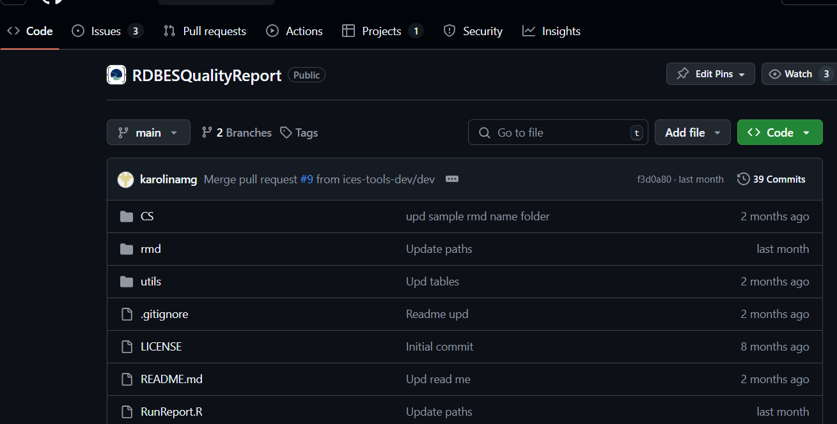
How to run the script
Go to the GitHub page
ices-tools-dev/RDBESQualityReport: Quality report script for RDBES
Make sure that you’re downloading the “Main” branch.
The other branch called “Dev” is for the developers. You can use It but at your own risk, as It could potentially be unstable during the development phase

Slide 5
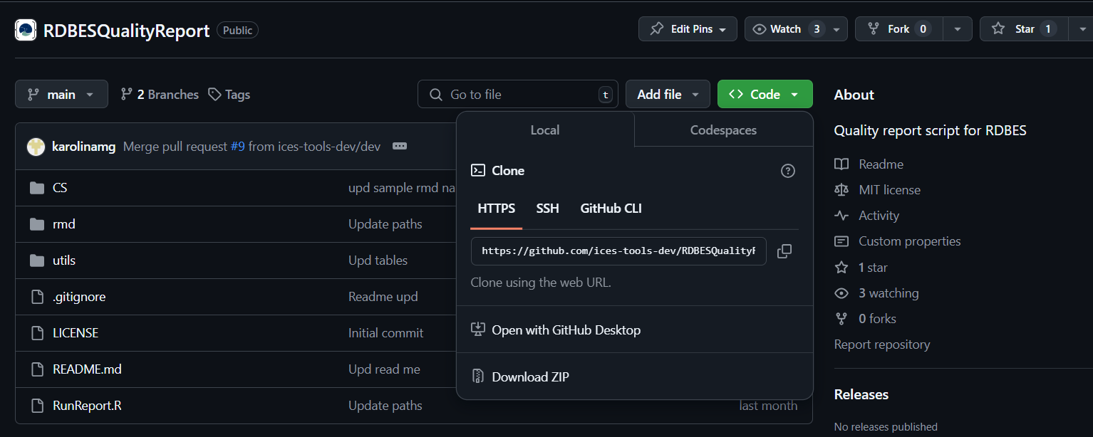
How to run the script
Are you familiar with Git?
Then clone it directly from the repository.
Are you not familiar with Git? Click on Code and Download ZIP. Save the ZIP in a dedicated folder and extract it.

Slide 6
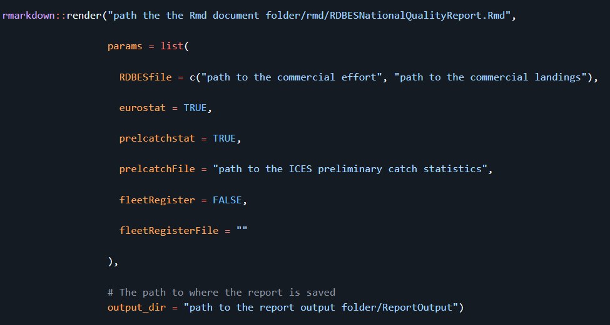
How to run the script (almost there ☺ )
Click on the RunReport.R script
1. Set the path to the main script
2. Set the path the CL & CE tables
3. TRUE if you want to see this
4. TRUE if you want to see this
5. AND set the path
Leave as it is
6. Set the path to where you want to save the report
7. Select all and Ctrl + Enter

Slide 7
Troubleshooting
This session:
Does it run as intended?

Slide 8
Feedback
Afternoon session:
Issues with running the script (technical)
Specific issues related to the output
E.g., you don’t see important information for your country’s data
Plot dimensions all wrong
Suggestions for additional features
Other?

Slide 9
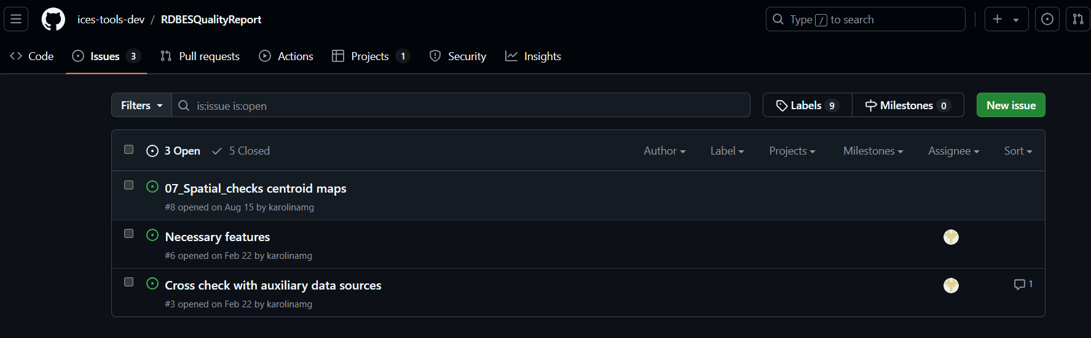
Future developments
Contribute if you can
Keep using it
Future feedback

