Slide 1
A newbie’s guide to the development of a new function for icesRDBES (and editing existing ones) (with details for more experienced contributors at the end)

Slide 2
Contents
Slide 3: Time table of development
Slide 4: Overview of routine work-flow
Slide 5-14: Building of new functions
[slide 5-12]: If you have little experience in contributing functions to R packages
[slide 13-14]: If you have some previous experience in contributing functions to R packages
Slide 15: Contributing to already existing functions

Slide 3
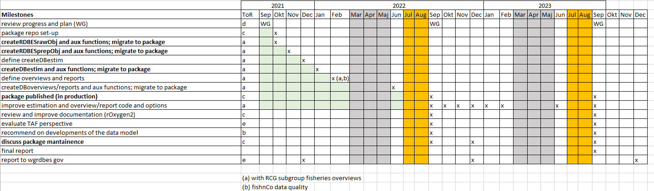
Time table of development (as of 25/11/2021)

Slide 4
Overview of routine work-flow
Bold: Main decision points; MC = Main Contributor; TG = test group; PG = supporting package group
Meet: identify what functions needs produced [issues are open in GitHub and main contributor MC identified]
Meeting
Development
MC: setup up your workspace and develop your function
Meet: Present&Discuss with other contributors; identify group for testing and further development TG; set a test period;
Meeting
Testing
MC,TG: Place issues in github, help solve them; further development
Meeting
Meet: is function ready for “safe” routine use? -> function can go to package
Packaging
MC (with PG support): Incorporate function in package [issue put in GitHub]
More tests are developed; remaining complexity issues solved; optimization; etc. [note: function may drastically change after re-coding]

Slide 5
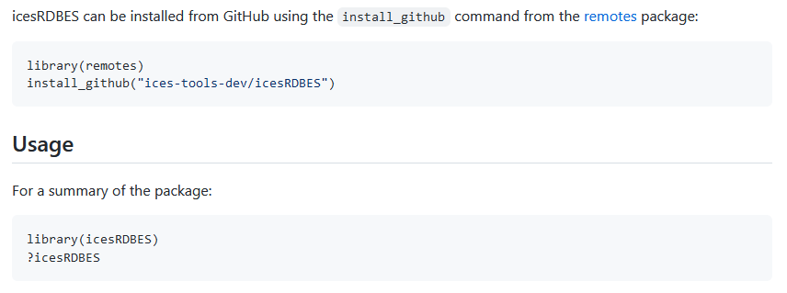
First steps: set-up your workspace
Install latest version of R, roxygen and any dependencies; R-studio also comes handy
installr::check.for.updates.R(notify_user = TRUE, GUI = TRUE,
page_with_download_url = "https://cran.rstudio.com/bin/windows/base/", pat = "R-[0-9.]+.+-win\\.exe")
Install “remotes”
Install latest version of icesRDBES

Slide 6
First steps: set-up your workspace
If not already done: Request writing access to icesRDBES repo [email to chairs];
Open an issue that details on what you will be working on.
This will signal to others what you are doing and avoid duplication; also allow you to make your contributions more visible.
Check out the “dev” branch and work on it
The dev branch is used for all development work – contributors can commit directly to it
Choose the options below you are more comfortable with:
Work directly on the core repo [preferable]
This means your functions and changes will be readily available to those (including you) interested in building a local “dev version” of the icesRDBES package.
If you are not experienced with building packages and the checks and procedures involved, some changes you make may lead code to break
Work on folder WGRDBES\personal [less advised]
This means your functions will not be readily available local “dev version” of the icesRDBES package [because WGRDBES directory is in buildignore]
Since its personal there are less risks of breaking others code; But also less interaction with other contributors; and it will take more time for your functions to integrate the package

Slide 7
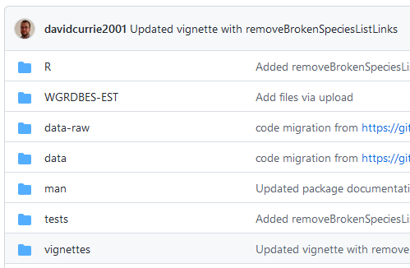
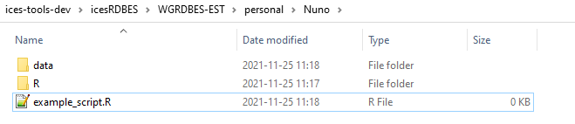
First steps: set-up your workspace
If you decide to Work directly on the core repo
Commit your functions in \R dir
Commit your data to \data dir
Commit your vignettes to \vignettes dir
Commit your tests to \tests dir
If you decide to work on WGRDBES-EST\personal
Open a folder with your name
Create a \R directory and \data to put your functions and data
Vignettes/Examples that details use of your functions:
If you can Rmd: Create a \vignettes to put your .Rmd vignettes there
If you cannot Rmd: Create “example_script.R” in normal R and place it in the root of your personal folder
In any case:
Do not forget to check out “dev” branch before you start
Do not forget to open an issue

Slide 8
First steps: set-up your workspace
Take a look styleguide developed during WKRDB-EST 1-2 https://github.com/ices-eg/WK_RDBES/blob/master/WKRDB-EST2/styleGuideCodeRDBES.pdf
prefer nouns when naming your objects; use concise and meaningful names; avoid using names of existing objects
use camelCase for variable names; use verbs as start of function names (e.g., import…; generate…)
It is preferable to use base R but the following packages (and their dependencies) are also allowed: data.table, and dplyr (not the whole tidyverse). If contributors wish/need to use other packages this must be discussed beforehand.
Start developing your code
Do not forget to check out “dev” branch before you start
and open an issue!

Slide 9
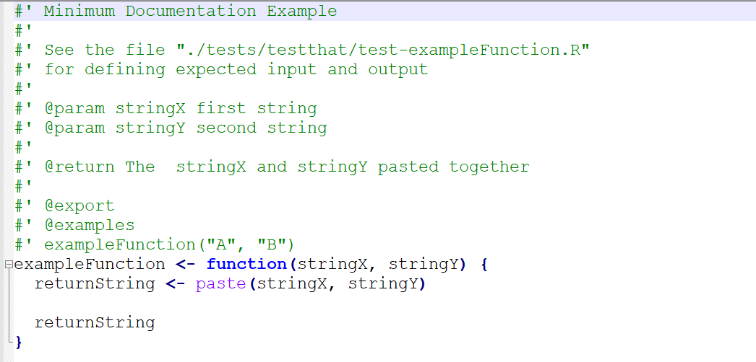
When you are done with your function
Add the “Minimum standard documentation” preamble
Some more info e.g., https://riptutorial.com/r/example/18279/documenting-a-package-with-roxygen2

Slide 10
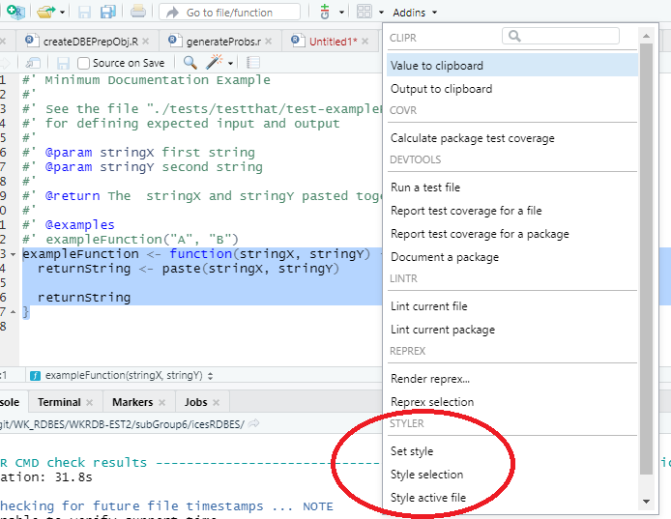
When you are done with your function
Install and run styler package in e.g., default mode (tidyverse)
If you are using RStudio then when you install styler an RStudio add-in is created – this allows you to easily style sections of text, or the active file.
Just select the text, and then choose “Style selection” from Addins:

Slide 11
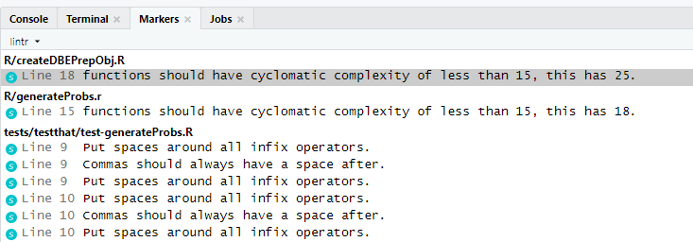
When you are done with your function
Install and run lintr package, solving the main issues flagged
This is a tool to help identify and remove problems in your code – in particular we are using it to identify any remaining style problems.
Run the following command to identify problems in a file called myFunction.R:
lintr::lint("myFunction.R",linters=lintr::with_defaults(object_name_linter=lintr::object_name_linter(styles = "camelCase")))
If you run the lintr command in RStudio you will see a “Markers” pane open to show any problems
If you have a warning about cyclomatic complexity: consider splitting up the function into smaller parts, (but don't worry too much if that looks difficult – can be done later)

Slide 12
When you are done with your function
Commit your code, data and example/vignettes
Inform WGRDBES-EST chairs so your example_script&function are highlighted for discussion at next meeting;
Leave a comment in your issue detailing where the code is (and other developments you consider important to flag), and label it as “in test” so others know they can test it.
After your code is tested you will receive support from maintainers in the final preparation of your code for inclusion in the package

Slide 13
If you are a more experienced contributor
Contributors need to be given commit access to the dev and prod repos – ICES have a work-flow for this [contact the chairs for info]
There are two branches within the repo: master and dev
The master branch is protected so that only the maintainers can commit to it
The dev branch is used for all development work – contributors can commit directly to it
A pull request needs to be created when we want to merge the development branch into the master branch – the maintainers will need to approve the pull request
Release labels will be applied to the master branch to keep track of releases
Before any development is started an “issue” should be raised on the GitHub repo – this can be to point out a bug in existing code, improve existing functions, or describe new functions that are required. The proposed changes can then be discussed and agreed with the maintainers and other relevant people (there are regular online meetings) – this should also act as peer-review system for the statistical content of the proposed development
All contributed developments should be linked to an issue – they will not be included in a future pull request if they are not.
Periodically the maintainers will update the package in CRAN. If people want/need the latest version of the package it can always be installed directly from GitHub.
A small group of maintainers will need to volunteer. The group includes someone from the ICES Secretariat. We are actively looking for maintainers. You are welcome to flag your interest.
A “lint” tool is configured that will compare committed code to a defined style and warn if there any problems. For now it is not activated – just run styler (default: tidyverse) and lintr::lint("myFunction.R",linters=lintr::with_defaults(object_name_linter=lintr::object_name_linter(styles = "camelCase")))

Slide 14
If you are a more experienced contributor
The fastest way for contributors to get code included in the package is to provide code that fully meets our package standards. These are:
The contributor is using the latest version of R, roxygen and any dependencies
Work is done in the “dev” branch directly in the icesRDBES core directories after issue is open
Contributors should pull the “dev” branch, make and commit changes on their local machine, and only push changes back to GitHub once their work is consistent (e.g. a new function is created and documented). For each function an R file exists in the \R directory, example data exists in \data, and vignettes in .Rmd code exist in \vignettes.
Consider the style guide developed during WKRDB-EST 1-2 https://github.com/ices-eg/WK_RDBES/blob/master/WKRDB-EST2/styleGuideCodeRDBES.pdf. It is preferable for contributors to only use base R but the following packages (and their dependencies) are also allowed: data.table, and dplyr (not the whole tidyverse). If contributors wish/need to use other packages this must be discussed beforehand.
Full roxygen2 documentation has been generated for that function and any data included. A good example of comprehensive documentation can be provided by the “gam” function (https://www.rdocumentation.org/packages/mgcv/versions/1.8-33/topics/gam ). This level of documentation might not be appropriate or feasible in all cases but does show some important features to bear in mind.
The contributor has defined tests for all new functionality (committed to \tests)
Devtools::check has been run successfully on their local machine
The code passes the automatic lint checks (when these are included in the package)
A pull request needs to be created when we want to merge the development branch into the master branch – the maintainers will need to approve the pull request

Slide 15
Contributing to already existing functions
Are you contributing to a function you are the main contributor of?
Yes
Open an issue, label it and assign it to yourself [so others know you are working on it]
Code your changes, test them, and commit your changes including the text “Closes #n” (where n is the issue number) in the commit message
No
Open an issue, label it and assign it to the main contributor
Check with him/her if it is needed to address it [he/she might already be working on it] and get ideas on solutions [there may be solutions already thought of]
Code your changes, test them, and commit your changes including the text “Closes #n” (where n is the issue number) in the commit message

