Slide 1
WGRDBES-StockCoord Regional Catch Estimates Format(RCEF)
Kirsten Birch Håkansson, DTU Aqua, Denmark
Sofie Nimmegeers, ILVO, Belgium
Presented at WGRDBES-StockCoord 3th intersessional meeting, 23-24 of September 2025

Slide 2
Tuesday sessions
09:30 – 12:00 Presentation of RCEF (Regional Catch Estimates Format)
Overview of the current structure of the RCEF (version 15)
https://github.com/ices-tools-dev/RDBESstockCoord/tree/main/WGRDBESstockCoord/format
12:00 – 13:00 Lunch Break
13:00 – 16:00 Hands-on Session - Opportunity to explore the format (try applying it to your own data as a test case)

Slide 3
Wednesday sessions
09:30 – 12:00
Review and discuss the feedback from yesterday's hands-on session
12:00 – 13:00 Lunch Break
13:00 – 16:00 Continuation of Discussions

Slide 4
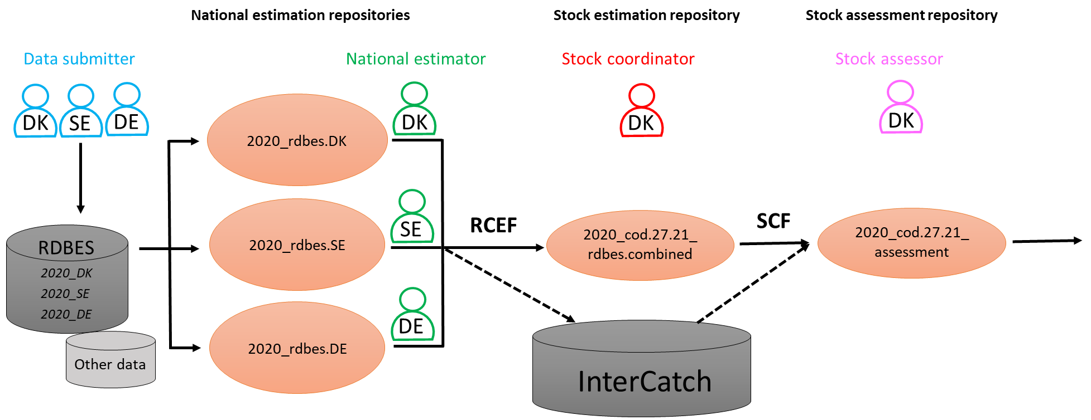
What is the Regional Catch Estimates Format (RCEF)
The RCEF format as the standard exchange format within RDBES for sharing estimates between national/regional estimators and stock coordinators-replacing InterCatch input files in the future.

Slide 5
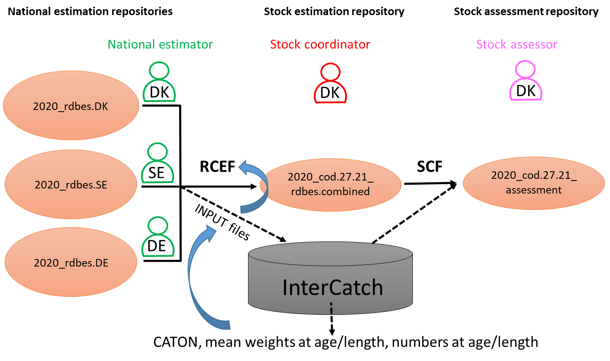
What is the Regional Catch Estimates Format (RCEF)
The RCEF is designed to be compatible with InterCatch.
A conversion function developed by WGRDBES-StockCoord enables transformation between InterCatch and RCEF, primarily to support historical data submissions and ease the transition from InterCatch to RDBES.

Slide 6
Other requirements
Present focus
Data presently submitted to InterCatch
Landings per statistical rectangle
WGBAST and other WG’s using Number of fish and not weight
Future focus
Standard request from WG’s, like e.g., MIXFISH
Other inputs to the main stock assessment models used in ICES AWGs?
Will not be supported
Mortality indices
Recruitment indices

Slide 7
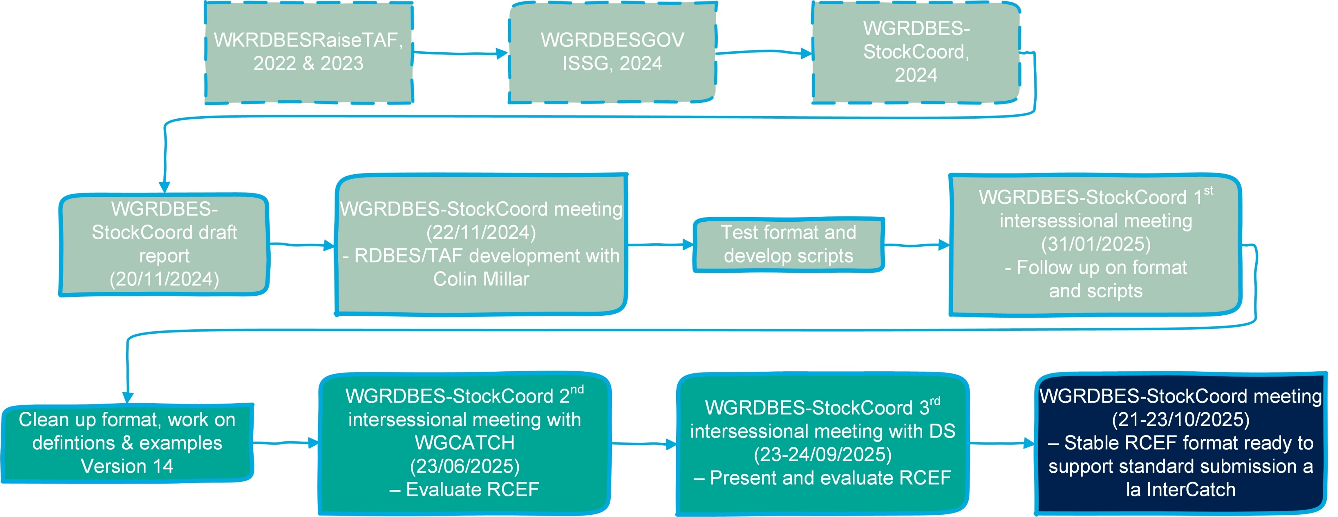
Development of the exchange format (RCEF)

Slide 8
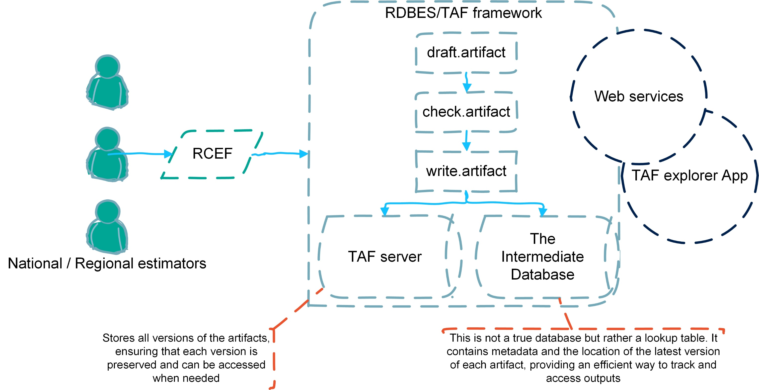
Integration in TAF

Slide 9
Current RCEF format- version 15

Slide 10
RCEF
Version 15
Spatial landings details
vesselFlagCountry
year
workingGroup
stock
speciesCode
catchCategory
SeasonType
seasonValue
areaType
areaValue
fisheriesManagementUnit
statisticalRectangle
dataSourceOfStatisticalRectangle
metier6
fleetType
fleetValue
variableType
variableTypeUnit
total
Catch
vesselFlagCountry
year
workingGroup
stock
speciesCode
catchCategory
SeasonType
seasonValue
areaType
areaValue
fisheriesManagementUnit
metier6
fleetType
fleetValue
domainCatchDis
domainCatchBMS
domainBiology
variableType
variableTypeUnit
total
variance
PSUtype
numPSUs
numTrips
comment
Age/Length/Width Distribution
vesselFlagCountry
year
workingGroup
stock
speciesCode
catchCategory
domainBiology
fishDomain
bvType
bvTypeUnit
bvValue
AgeGroupPlus
variableType
variableTypeUnit
valueType
value
variance
PSUtype
numPSUs
numTrips
numMeasurements
Fish Domain
vesselFlagCountry
year
workingGroup
stock
speciesCode
catchCategory
fishDomain
bvType
bvTypeUnit
bvValue
AgeGroupPlus
Detailed
Census catches
Effort
vesselFlagCountry
year
workingGroup
SeasonType
seasonValue
areaType
areaValue
fisheriesManagementUnit
metier6
fleetType
fleetValue
variableType
total
Effort
~ HI record
in InterCatch
Estimated
age/length/width distributions
~ SD record in InterCatch
Census catches +
Estimated catches
~ SI record in InterCatch

Slide 11
catchCategory
4 fractions:
Lan = Landings above minimum size
Dis = Discards is the part of the catch, which is thrown overboard into the sea
BMS = Landings below minimum size
DisBMS = Mixed fraction of discard and BMS, if it’s not possible to separate discard and BMS fractions

Slide 12
seasonType - seasonValue
Month
Quarter
Year
1-12
1-4
e.g. 2025

Slide 13
areaType – areaValue
ICESArea
ICESAreaList
StockArea
e.g. 27.4.a
e.g. 27.4.a;27.4.b;27.4.c
All
Major Area (e.g. 27 - NE Atlantic)
└── Subarea (e.g. 27.4 - North Sea)
└── Division (e.g. 27.4.a - Northern North Sea)
└── Subdivision (e.g. 27.4.a.1 - [if needed])
fisheriesManagementUnit
e.g. Fu32

Slide 14
fleetType - fleetValue
WGFleet
WGFleetList
Metier4
Metier5
Metier6
Metier4List
Metier5List
Metier6List
e.g. GNS_DEF_100-119_0_0_all
e.g. GNS_DEF_>=220_0_0_all; GNS_DEF_120-219_0_0_all
e.g. GNS
e.g. GNS_DEF
e.g. GNS_DEF_>=220_0_0
e.g. GNS; GTR
e.g. GNS_DEF; GTR_DEF
e.g. GNS_DEF_>=220_0_0; GNS_DEF_120-219_0_0

Slide 15
Examples

Slide 16
domainCatchDis - domainCatchBMS
Link the Dis, BMS or DisBMS fractions with the landings
Mandatory if an estimate exists
Free tekst
Naming convention: season_area_fleet
Estimation domains — may differ from the stock coordination domain of interest

Slide 17
Examples

Slide 18
variableType - variableTypeUnit
Wgweight
OfficialWeight
Number
kg or ton
kg or ton
pcs or 1000_pcs
 | Wgweight | OfficialWeight
Lan | M | O
Dis | O | O
BMS | O | O
DisBMS | O | O

Slide 19
Examples

Slide 20
PSUtype – numPSUs - numTrips
fishing trip
fishing operation
landing event
= numTrips
≠ numTrips
≠ numTrips

Slide 21
Examples

Slide 22
RCEF
Version 15
Spatial landings details
vesselFlagCountry
year
workingGroup
stock
speciesCode
catchCategory
SeasonType
seasonValue
areaType
areaValue
fisheriesManagementUnit
statisticalRectangle
dataSourceOfStatisticalRectangle
metier6
fleetType
fleetValue
variableType
variableTypeUnit
total
Catch
vesselFlagCountry
year
workingGroup
stock
speciesCode
catchCategory
SeasonType
seasonValue
areaType
areaValue
fisheriesManagementUnit
metier6
fleetType
fleetValue
domainCatchDis
domainCatchBMS
domainBiology
variableType
variableTypeUnit
total
variance
PSUtype
numPSUs
numTrips
comment
Age/Length/Width Distribution
vesselFlagCountry
year
workingGroup
stock
speciesCode
catchCategory
domainBiology
fishDomain
bvType
bvTypeUnit
bvValue
AgeGroupPlus
variableType
variableTypeUnit
valueType
value
variance
PSUtype
numPSUs
numTrips
numMeasurements
Fish Domain
vesselFlagCountry
year
workingGroup
stock
speciesCode
catchCategory
fishDomain
bvType
bvTypeUnit
bvValue
AgeGroupPlus
Detailed
Census catches
Effort
vesselFlagCountry
year
workingGroup
SeasonType
seasonValue
areaType
areaValue
fisheriesManagementUnit
metier6
fleetType
fleetValue
variableType
total
Effort
~ HI record
in InterCatch
Estimated
age/length/width distributions
~ SD record in InterCatch
Census catches +
Estimated catches
~ SI record in InterCatch

Slide 23
domainBiology
Link the Dis, BMS, DisBMS or lan fractions with the corresponding age/length/width distributions
Mandatory if an estimate exists
Free tekst
Naming convention: season_area_fleet
Estimation domains — may differ from the stock coordination domain of interest

Slide 24
RCEF
Version 15
Spatial landings details
vesselFlagCountry
year
workingGroup
stock
speciesCode
catchCategory
SeasonType
seasonValue
areaType
areaValue
fisheriesManagementUnit
statisticalRectangle
dataSourceOfStatisticalRectangle
metier6
fleetType
fleetValue
variableType
variableTypeUnit
total
Catch
vesselFlagCountry
year
workingGroup
stock
speciesCode
catchCategory
SeasonType
seasonValue
areaType
areaValue
fisheriesManagementUnit
metier6
fleetType
fleetValue
domainCatchDis
domainCatchBMS
domainBiology
variableType
variableTypeUnit
total
variance
PSUtype
numPSUs
numTrips
comment
Age/Length/Width Distribution
vesselFlagCountry
year
workingGroup
stock
speciesCode
catchCategory
domainBiology
fishDomain
bvType
bvTypeUnit
bvValue
AgeGroupPlus
variableType
variableTypeUnit
valueType
value
variance
PSUtype
numPSUs
numTrips
numMeasurements
Fish Domain
vesselFlagCountry
year
workingGroup
stock
speciesCode
catchCategory
fishDomain
bvType
bvTypeUnit
bvValue
AgeGroupPlus
Detailed
Census catches
Effort
vesselFlagCountry
year
workingGroup
SeasonType
seasonValue
areaType
areaValue
fisheriesManagementUnit
metier6
fleetType
fleetValue
variableType
total
Effort
~ HI record
in InterCatch
Estimated
age/length/width distributions
~ SD record in InterCatch
Census catches +
Estimated catches
~ SI record in InterCatch

Slide 25
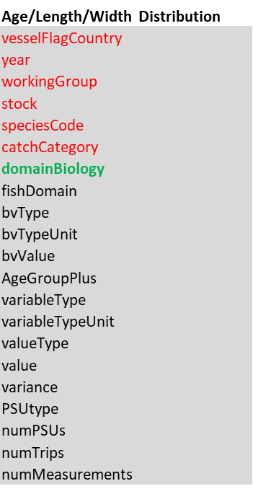
Age/Length/Width Distribution
Quite similar to the InterCatch SD record
The table links to the catches through domainBiology in Census Cathes

Slide 26
bvType, variableType & valueType
bvType – what kind of distribution?
variableType & valueType –
Number, WeightLive, LengthStandard
Mean | Total
Age
LengthCarapace
LengthLowerJawFork
LengthMantle
LengthMaximumShell
LengthPinchedTail
LengthPreAnal
LengthPreCaudal
LengthStandard
LengthTail
LengthTotal
LengthWingSpan
WidthCarapace
WidthMaximumShell

Slide 27
FishDomain - Do we need it?
This table enables the inclusion of one or more biological domains
Was included in to enable a very flexible reporting of combination of variables and support future needs
We don’t know the future needs, so maybe it is easier to look at these when relevant and then make room for them
We can only come up with sex as a needed domain
If so, then sex could maybe be included in the distribution tables and the fishDomain table could be deleted

Slide 28
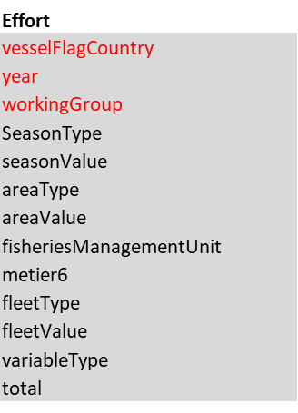
Effort
Quite similar to the InterCatch HI record
variableType: all the scientific effort measuments reported in RDBES CE e.g., ScientificDaysAtSea, scientifickWDaysAtSea.
It is possible to add a new type of effort measurement
It is possible to report more than one effort type per WG

Slide 29
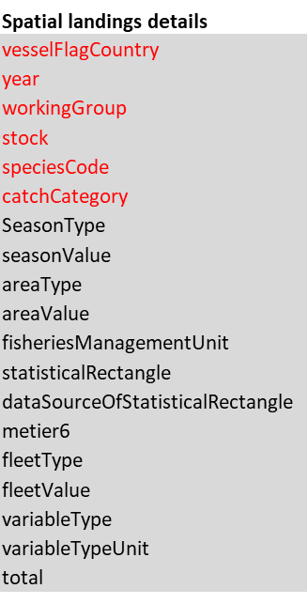
Spatial landings details
Supports request for landings per rectangles
Not presently in InterCatch

